Slide 1
Hybrid Risk-Aware Health Insurance Recommendation System
ML System Deployment – Version 1
Hybrid Retrieval + Structured Risk Modeling + Explainable LLM

Slide 2
Problem Statement
Health insurance policy documents are complex, lengthy, and written in legal language, making it difficult for individuals with chronic conditions to identify suitable plans under budget constraints.
Traditional comparison methods:
Rely on manual PDF review
Ignore condition-specific coverage logic
Fail to handle exclusions and waiting periods reliably
Lack interpretability and systematic evaluation

Slide 3
Use Case
Design a hybrid risk-aware health insurance recommendation system that:
Uses curated policy PDFs (Tables of Cover + Terms & Conditions)
Applies deterministic medical risk scoring
Combines BM25 and dense retrieval (FAISS)
Produces globally ranked plans
Generates clause-grounded explanations
Supports evaluation via precision, recall, and latency metrics

Slide 4
Why This Is Challenging
Unstructured PDF policy documents (legal language)
Numeric precision requirements (€ limits, day caps)
Pre-existing condition exclusions
Need to avoid hallucination in healthcare setting
Must track latency & system metrics (TTFT, TPOT)

Slide 5
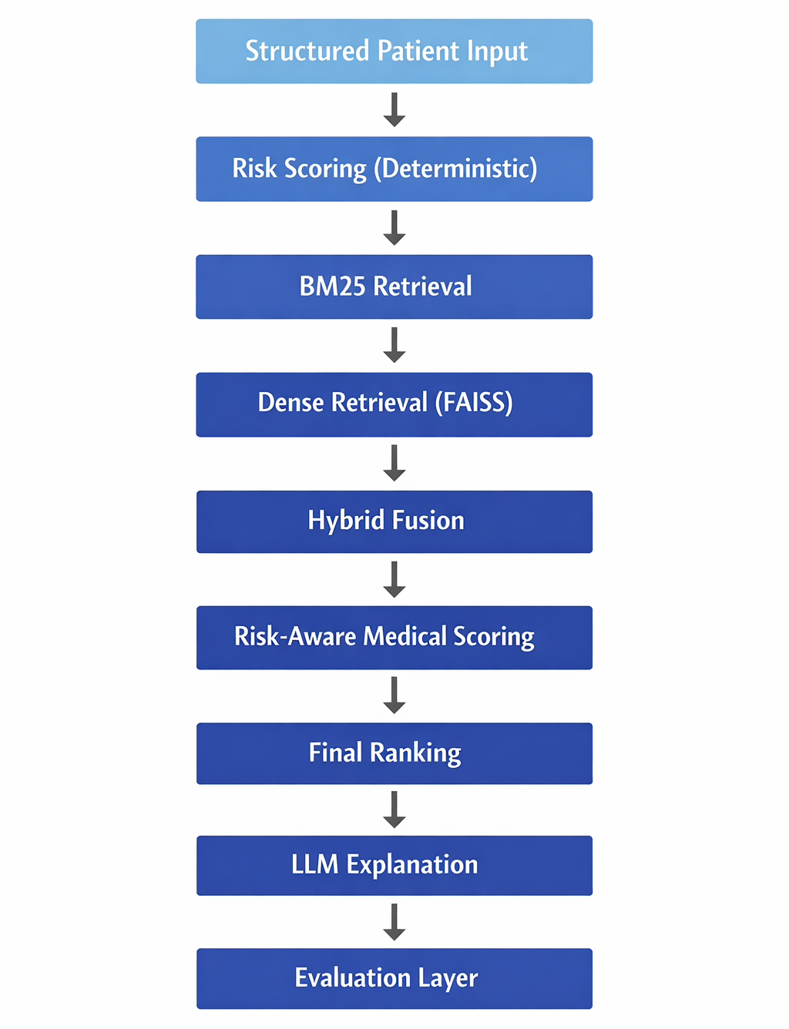
Workflow

Slide 6
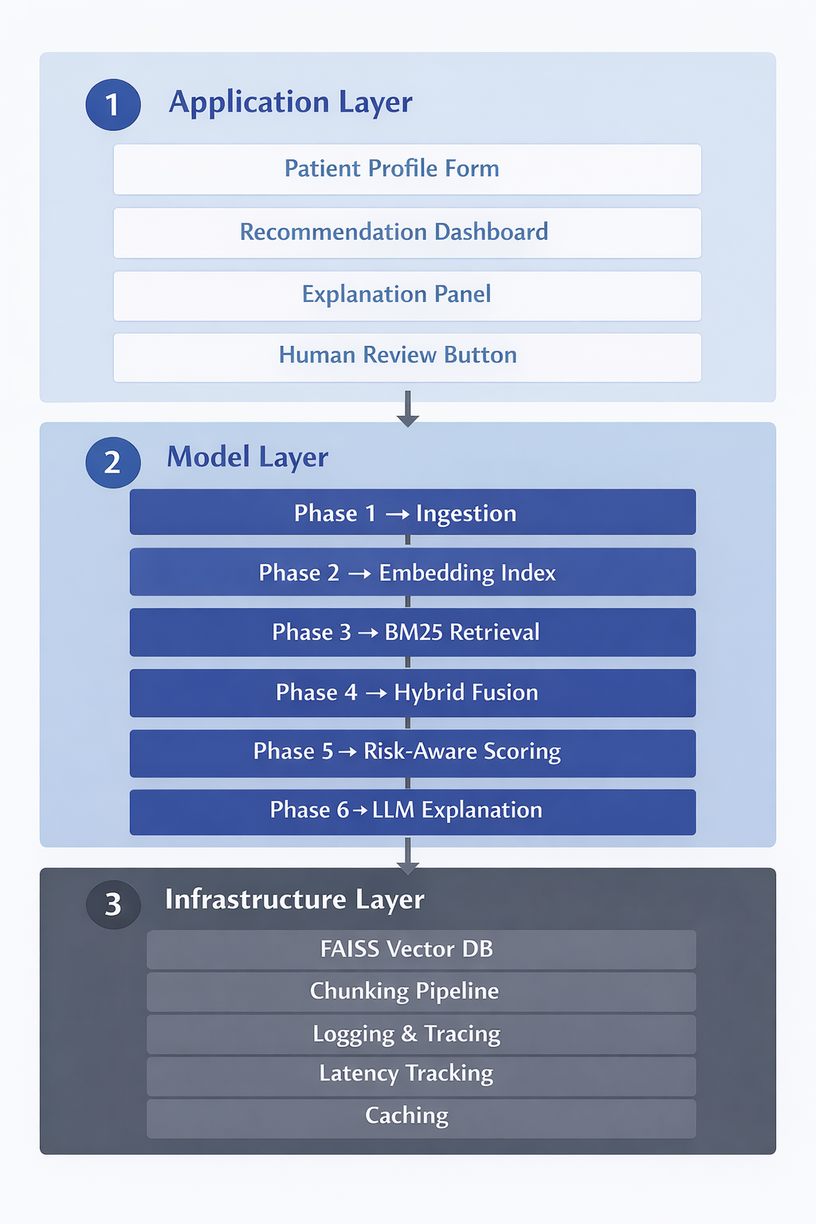
Architecture

Slide 7
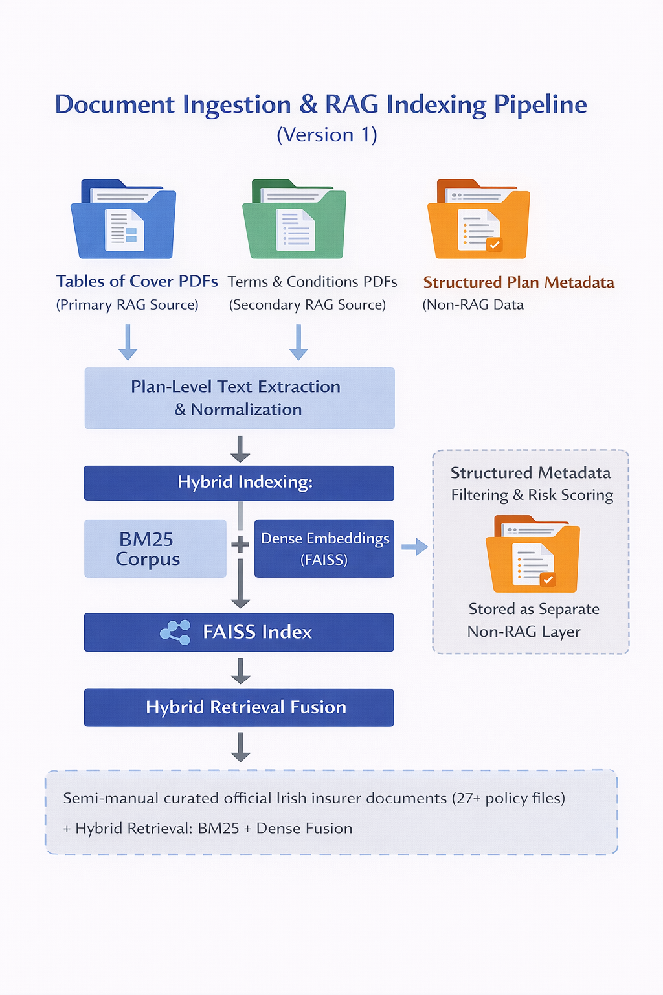
Data Strategy

Slide 8
MVP
Phase 1: Ingestion & Normalization
Phase 2: Dense Embedding Index (FAISS)
Phase 3: BM25 Retrieval
Phase 4: Hybrid Fusion
Phase 5: Risk-Aware Medical Scoring
Phase 6: Decision-Aware LLM Explanation

Slide 9
Results

