Slide 1

Bank CRM Analytics
By Kiranjeet Kaur
05-05-2025

Slide 2

The Hidden Cost of Losing Customers​
Every customer who leaves silently costs more than we realize.​ Banks often focus on acquisition, but poor service and lack of personalization are the top reasons customers churn.​ Without CRM analytics, we’re flying blind—reacting too late instead of predicting and preventing churn.

Slide 3

✅ Objectives:​
To analyze customer demographics, transactions, and churn patterns using Power BI.​
To identify key factors influencing customer churn and dissatisfaction.​
To provide actionable insights for improving customer retention and service quality.​
🎯 Goals:​
Reduce customer churn by identifying at-risk customers early.​
Enhance customer satisfaction through personalized service insights.​

Slide 4
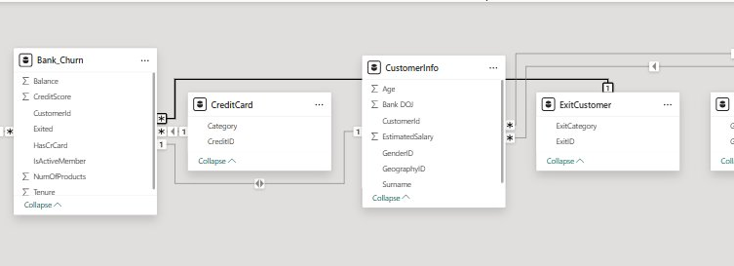
Data Overview

Slide 5


🌍 Geography Customer location data to analyze regional churn trends.
🚻 Gender Gender distribution for churn and satisfaction analysis.
🚪 Exit Customer Records of customers who left—key for churn insights.
🧍‍♂️ Customer Info Personal/account details (age, salary) for profiling.
📉 Bank Churn Churn-related metrics (tenure, credit score, products) for modeling.
💳 Credit Card Credit card ownership data to assess engagement.
✅ Active Customer Data on current customers—used for loyalty comparison.

Slide 6

Why This Data Is Critical
This data helps us understand customer behavior, identify churn risks, and improve retention:
Geography: Shows regional churn trends.
Gender: Highlights churn patterns by gender.
Exit Customer: Key to analyzing who and why customers leave.
Customer Info: Useful for profiling and segmentation.
Bank Churn: Helps predict churn using tenure, credit score, etc.
Credit Card: Reveals engagement and product usage.
Active Customer: Compares loyal vs. churned customers.

Slide 7




Tools Used
I have used a combination of tools to manage, analyze, and visualize the data:
Excel: Used for quick data checks and summary statistics.
SQL: Applied to extract and query data from databases efficiently.
Power BI: Used for data cleaning, transformation, and building interactive dashboards for insight generation.
These tools streamlined the analysis process and enabled clear, actionable insights for CRM strategy.

Slide 8
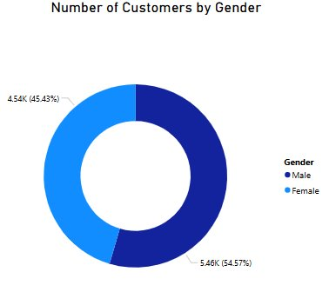

Customer Demographics Overview
INSIGHTS
Customer Distribution by Gender
The majority of customers are male (54.57%), while females make up 45.43%.
This slight gender imbalance provides a good basis to explore differences in churn behavior.
Gender-based analysis can help tailor engagement and retention strategies.

Slide 9
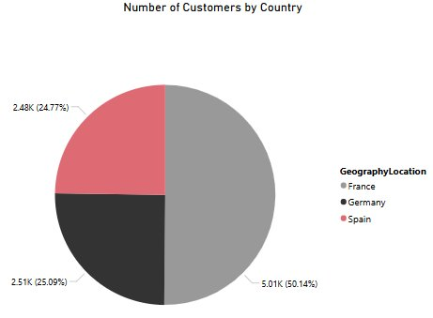
COUNTRY WISE DISTRIBUTION OF CUSTOMERS
INSIGHTS
France has the largest customer base with 50.14% (5.01K customers).
Germany and Spain contribute 25.09% and 24.77%, respectively.
This geographic spread helps in identifying region-wise churn and engagement trends.

Slide 10
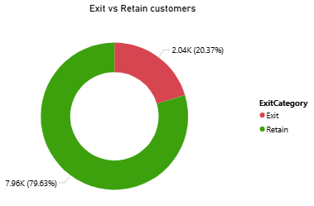
EXITED VS RETAINED CUSTOMERS
INSIGHTS
Churn Rate is 20.37% – This is a significant portion, indicating a need to strengthen retention strategies.
Majority Retained (79.63%) – Most customers are still engaged, providing a solid base for loyalty programs.
Action Required:
Identify key churn drivers (e.g., low engagement, poor service).
Compare behaviors between churned vs. active customers.
Target high-risk segments with personalized retention campaigns.

Slide 11
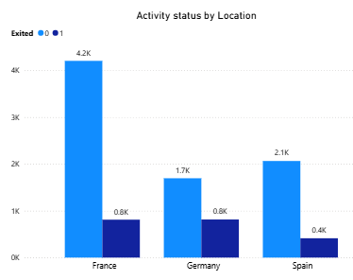
COUNTRY WISE CHURNED VS ACTIVE CUSTOMERS
INSIGHTS
France has the highest churn (0.8K) but also the largest customer base (4.2K retained).
Germany shows a balanced churn pattern (0.8K exited vs. 1.7K retained), indicating moderate risk.
Spain has the lowest churn (0.4K) and a relatively smaller customer base (2.1K retained), suggesting better retention.

Slide 12
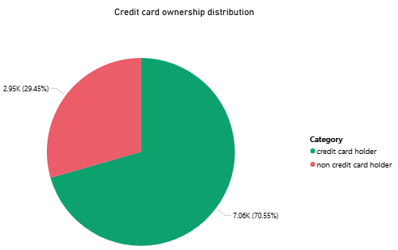
DISTRIBUTION OF CUSTOMERS BY CREDIT CARD OWNERSHIP
INSIGHTS
70.55% of customers are credit card holders (7.06K).
29.45% are non-credit card holders (2.95K).
Majority of the bank's customers are engaged with credit card products, indicating strong product adoption.
Opportunity exists to target non-holders with relevant offers to increase product penetration.

Slide 13
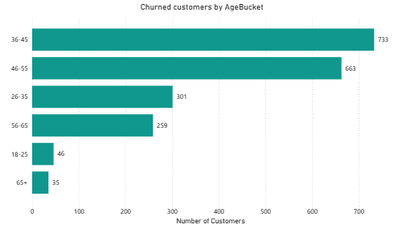
CHURNED CUSTOMERS BY AGE
INSIGHTS
The 36-45 age group has the highest churn, with 733 customers, indicating a key segment at risk.
The 46-55 age group follows closely with 663 churned customers.
Younger (18-25) and older (65+) age groups show minimal churn, suggesting less volatility in these segments.

Slide 14
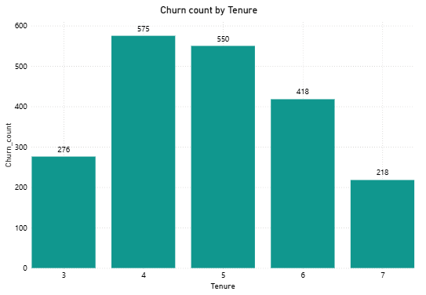
CHURN COUNT BY TENURE
INSIGHTS
Highest churn occurs at tenure of 4 and 5 years, with 575 and 550 customers respectively.
Churn declines gradually after 5 years, suggesting that longer-tenured customers are more loyal.
The lowest churn is seen at 7 years, indicating improved customer retention over time.

Slide 15
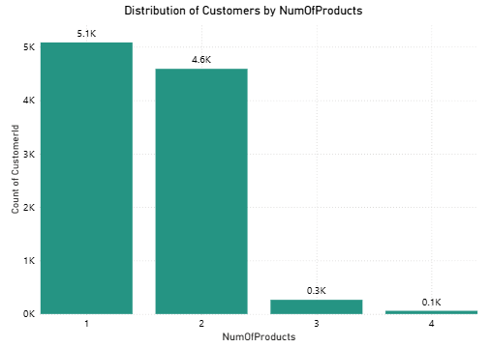
DISTRIBUTION OF CUSTOMERS BY NUMBER OF PRODUCTS
INSIGHTS
Majority of customers hold only 1 or 2 products, with 5.1K and 4.6K customers respectively.
Very few customers hold 3 or more products, indicating low product penetration.
This presents a cross-selling opportunity to encourage customers to adopt additional products.

Slide 16
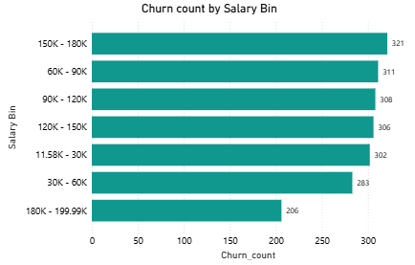
CHURNED CUSTOMERS BY SALARY
INSIGHTS
Highest churn is seen in the 150K–180K salary bin (321 customers), followed by 60K–150K ranges with similar churn levels (~300 each).
Lowest churn occurs in the 180K–199.99K segment (206 customers), suggesting better retention among higher earners.
Churn is fairly distributed across most income ranges, but slightly higher in the middle to upper-middle income groups.

Slide 17
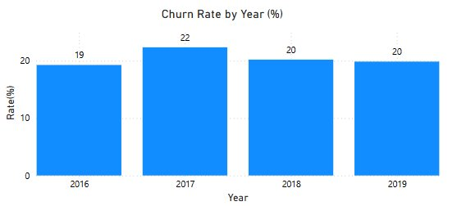
Churned customer percentage by every year
INSIGHTS
Most customers were churned in the year 2017(i.e. 22%)
Year 2016 has least churn rate(i.e. 19%)
No changes were found in the churn rate in Year 2018 and 2019.

Slide 18
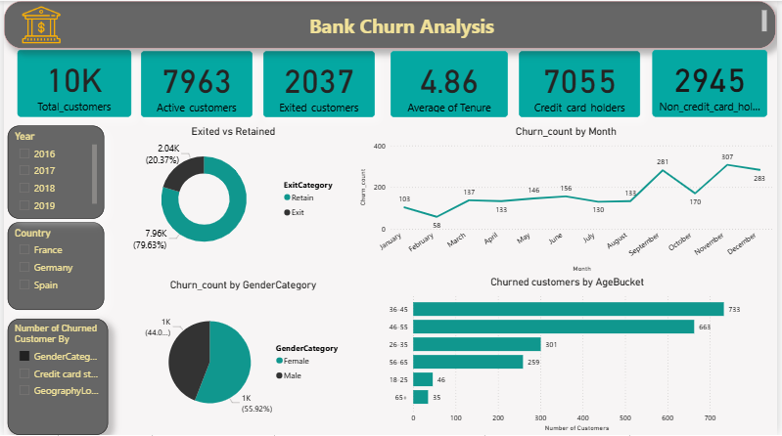
DASHBOARD

Slide 19
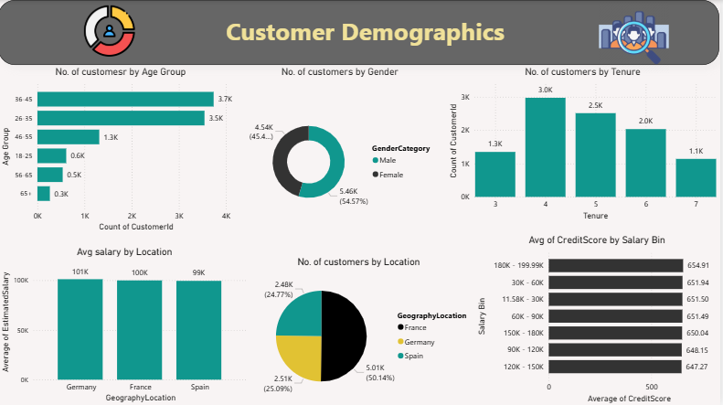
CUSTOMER DEMOGRAPHICS REPORT

Slide 20
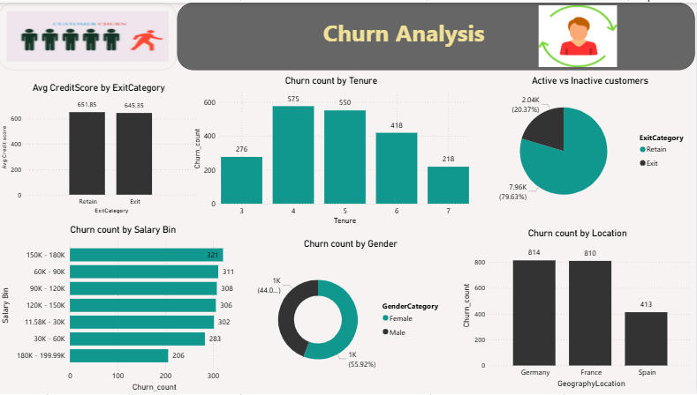
CHURN ANALYSIS REPORT

Slide 21
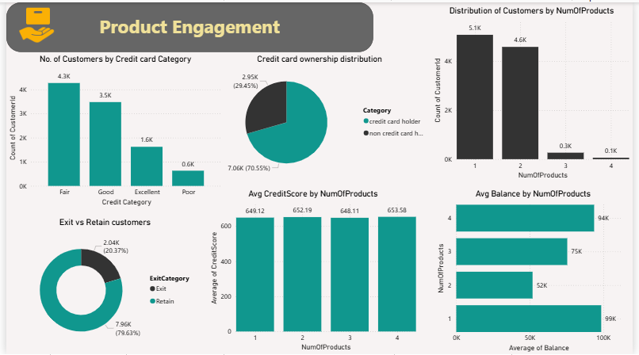
PRODUCT ENGAGEMENT REPORT

Slide 22
WHAT IT DOES?
This dashboard provides a comprehensive view of customer churn, enabling the bank to:
Monitor overall churn rate with a quick snapshot of active vs. exited customers.
Identify at-risk segments by analyzing churn across gender, age groups, and time periods.
Detect seasonal trends with monthly churn data to take timely preventive actions.
Understand product engagement through credit card ownership stats.
Filter insights by country and year, helping tailor strategies to specific regions and timeframes.

Slide 23


