Slide 1

Instagram Analysis
By Kiranjeet Kaur
02-04-2025

Slide 2


Instagram Stories Have 500 Million Daily Active Users!
More than 500 million people use Instagram Stories every day! Stories have quickly become one of the most engaging features, with users spending significant time interacting with them, making them a goldmine for brands looking to boost visibility and engagement.

Slide 3
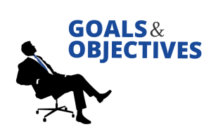


Leverage Instagram user data to uncover insights for targeted marketing strategies.
Analyze user behavior, demographics, and engagement patterns to drive personalized marketing.
Develop strategies that focus on increasing user acquisition, retention, and engagement.
Optimize Meta's marketing efforts to strengthen brand-user relationships and boost overall performance.

Slide 4
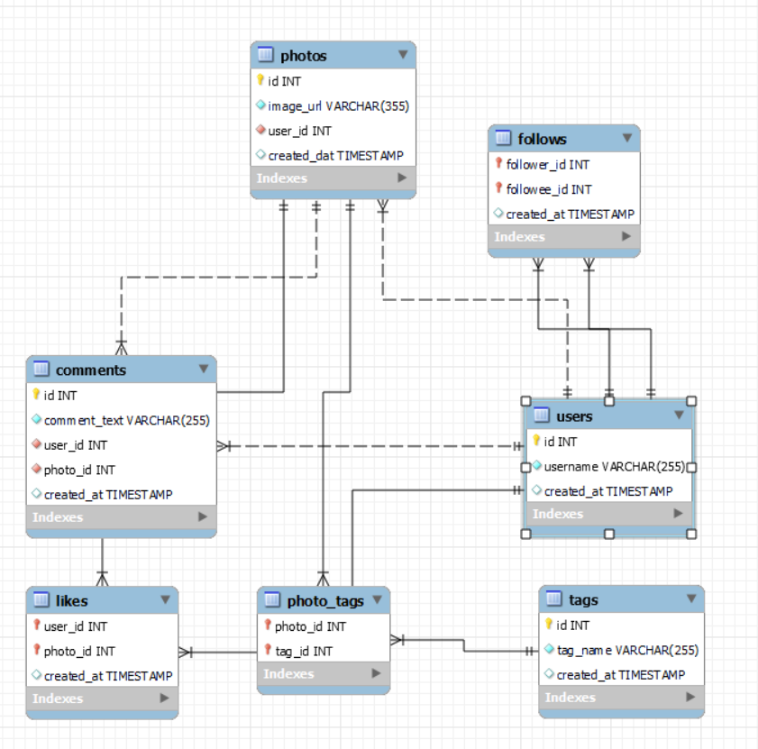
Data Overview

Slide 5

Users Table: Stores user information including unique ID, username, and account creation timestamp.
Photos Table: Captures photo details such as image URL, associated user ID, and photo upload timestamp.
Comments Table: Logs user comments on photos, along with comment text, user ID, and photo ID.
Likes Table: Records likes for photos, capturing which user liked which photo and the timestamp.
Follows Table: Tracks user follow relationships and when the follow action occurred.
Tags Table: Maintains unique tags used for categorizing photos with timestamp of tag creation.
Photo-Tags Table: Links photos with tags, enabling multiple tags per photo for better discoverability.

Slide 6

Why This Data is Critical
User Insights: The users table provides valuable demographic and behavioral data, enabling personalized marketing strategies and targeted campaigns based on user activity and preferences.
Engagement Tracking: The photos, likes, and comments tables offer direct insights into user interactions with content, helping to measure engagement and identify the most popular content and active users.
Social Network Analysis: The follows table captures user relationships, which is key for understanding social dynamics, identifying influencers, and segmenting audiences based on their social connections.
Data-Driven Decisions: This rich dataset allows for the development of data-driven marketing strategies, ensuring that Meta’s marketing efforts are aligned with user interests, ultimately enhancing ROI and user satisfaction.

Slide 7




Analytical Approach and Tools
Conducted exploratory data analysis (EDA) to understand user behavior, engagement patterns, and social interactions.
Utilized SQL queries to identify trends in photo engagement (likes, comments), user activity (follows, posts), and content categorization (tags).
Measured the correlation between user
interactions (likes, comments) and follow
relationships to identify key influencers
and high-engagement users.
Leveraged SQL queries with joins to combine data from multiple tables, allowing for in-depth analysis of user interactions and content engagement.
Utilized aggregate functions (e.g., COUNT, AVG) and filtering to derive actionable insights from large datasets.

Slide 8
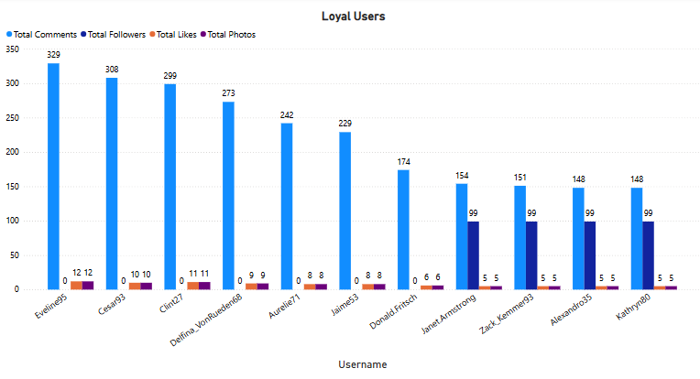
Identifying Loyal & Valuable Users

Slide 9
Key Engagement Metrics:
High photo uploads, comments, likes, and follower counts indicate valuable users.
Example: Top user "Eveline" ranks highest in all engagement metrics.
Incentives to Boost Loyalty:
🎖 Exclusive Features (premium filters, early access to new tools).
🌟 Recognition & Visibility (leaderboards, featured posts).
🎮 Gamification & Rewards (badges, points, discount offers).
Impact: Retaining high-value users strengthens community engagement.

Slide 10
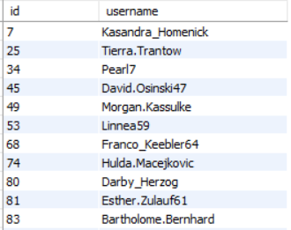
Re-Engagement Strategies for Inactive Users
Inactive Users
🔹 Challenges:
📉 30% of users are passive (no likes, comments, or posts).
Low engagement impacts retention and ad effectiveness.
🔹 Re-Engagement Strategies:
📲 Personalized Notifications – Recommend content based on past interests.
🎁 Exclusive Rewards – Give badges, discounts, or profile boosts.
📊 AI-Powered Content Suggestions – Suggest trending posts & hashtags.
🔹 Impact: Converting inactive users into engaged participants.

Slide 11
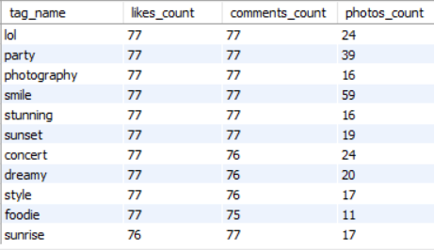
High-Engagement Hashtags & Content Topics
How This Guides Content Strategy
✅ Content Creation:
Focus on high-engagement hashtags for more relevant content.
Identify emerging trends for early adoption before saturation.
✅ User-Generated Content (UGC):
Launch hashtag campaigns (e.g., #NatureVibes Challenge).
Feature top user posts with trending hashtags to increase participation.
✅ Influencer Marketing:
Partner with niche influencers in high-engagement categories.
Leverage influencers to expand reach and credibility.
Popular hashtags: #lol, #party, #photography, #smile, etc.
These hashtags receive high user engagement in likes and comments.

Slide 12

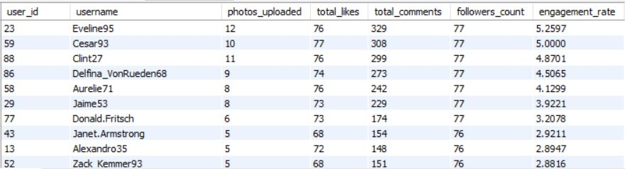
Influencer Marketing Strategy
Key Metrics for Influencer Selection:
Follower count – High reach potential
Engagement rate – Active audience interaction (likes + comments ÷ followers)
Content relevance – Alignment with brand and campaign goals
Post consistency – Regular content creation on trending topics

Slide 13

Collaboration Strategies
✅ Customized Collaboration:
Sponsored posts & product reviews – Showcase the brand naturally.
Exclusive content & giveaways – Encourage audience participation.
Co-branded campaigns – Build long-term partnerships.
✅ Value-Based Partnership:
Offer early product access, exclusive experiences, and commission incentives.
Set clear content expectations (e.g., posts per month, engagement goals).
✅ Building Long-Term Relationships:
Consistency is key! Partner with top-performing influencers over time.
Encourage them to be brand ambassadors for sustained trust and visibility.

Slide 14
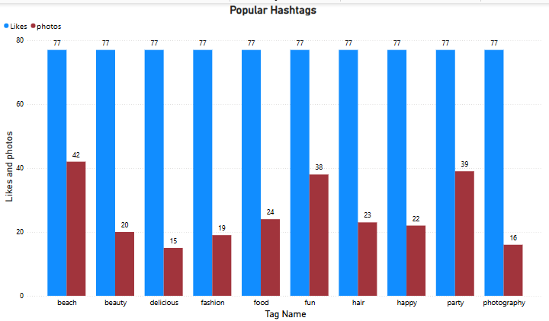
Popular Hashtags

Slide 15
How This Information Can Guide Ad Campaigns
Targeted Ads
Hashtag-Based Targeting: Use the insights from the engagement analysis to run targeted ads based on the most popular content topics.
Create Hashtag-Specific Ads: We could create ad campaigns that leverage these high-engagement tags to increase visibility. For example, a branded hashtag like #ExploreWith[BrandName] could be promoted if users are highly engaged with travel-related content.
Sponsored Content and Partnerships
Collaborate with Popular Hashtags: If certain hashtags have high engagement, we can sponsor content related to those hashtags.This can help us organically reach the engaged audience for that topic.
Promote User-Generated Content (UGC): Run paid ads that feature top-performing user-generated content tagged with high-engagement hashtags. This approach works well with organic content that resonates more with the target audience.

Slide 16


