Slide 1


V.ANMISHA 21L31A05O7
K.KIRAN GANESH 21L31A05P6
S.N.V.P.ABHINAV 21L31A05M2
M.RAVI PRANEETH 21L31A05P8
S.DURGA MADHAV 22L35A0523
PUC CERTIFICATE RENEWAL REMAINDER
TEAM MEMBERS:
PROJECT GUIDE:
Mrs. Nekkanti Renu

Slide 2
Contents
Introduction
Ideology
Our Work
Technology used
Applications

Slide 3
INTRODUCTION
Pollution is an escalating global crisis that poses significant threats to our environment, health, and future generations. It is a pressing issue that demands immediate attention and action. One of the key contributors to pollution is vehicular emissions, which release harmful pollutants into the atmosphere, deteriorating air quality and exacerbating climate change. In an effort to combat this problem, governments and regulatory bodies worldwide have mandated the Pollution Under Control (PUC) certificate to ensure that vehicles meet emission standards.
This, mini project on Pollution Under Control Certificate Reminders aligns with the urgent need to address pollution and its detrimental effects on our environment and health. By combining technology, community engagement, and the project holds the potential to create a sustainable and cleaner future for our planet. Through our collective efforts, we can make a meaningful contribution towards pollution control and pave the way for a greener and healthier world.

Slide 4
Ideology:
The rapid urbanization and escalating vehicular population have significantly contributed to the deterioration of air quality, posing serious health and environmental concerns worldwide. To address this pressing issue, the present mini-project proposes an innovative solution, the "Pollution Under Control Renewal Reminder" (PUCRR), which aims to automate the process of renewing pollution under control (PUC) certificates for vehicles.

Slide 5
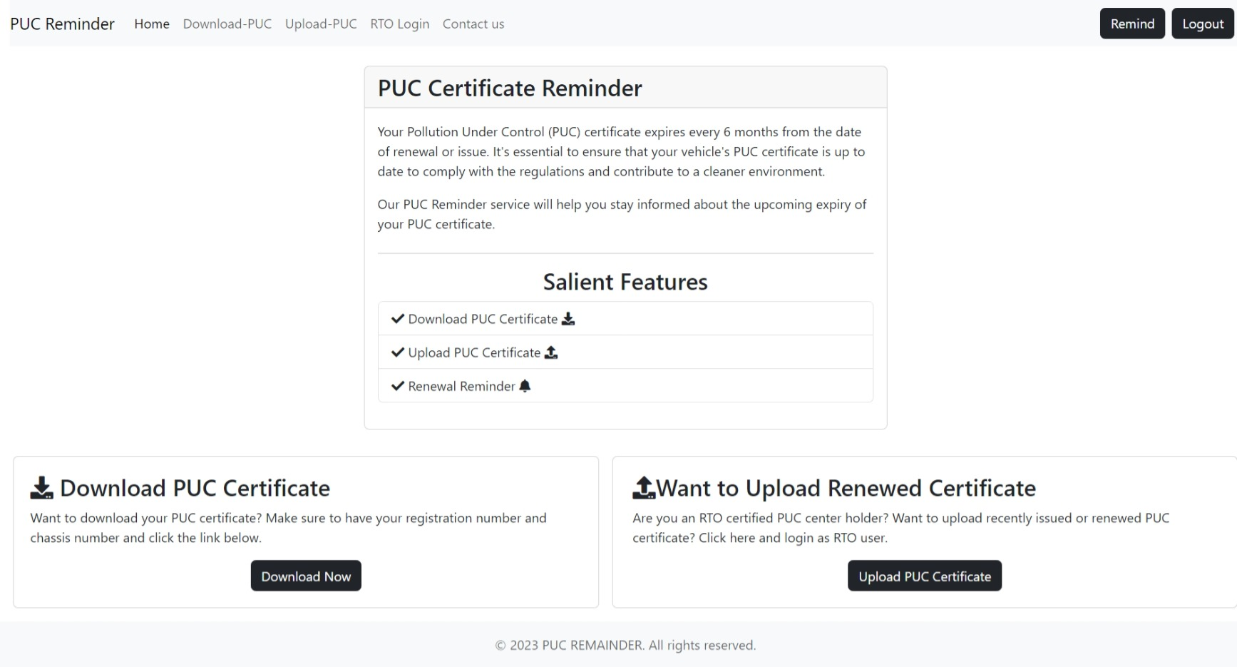
Our Work : Home Page

Slide 6
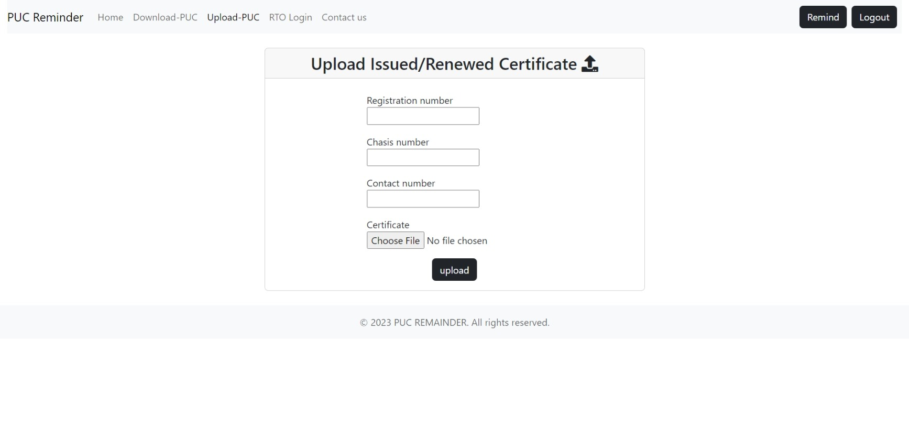

Slide 7
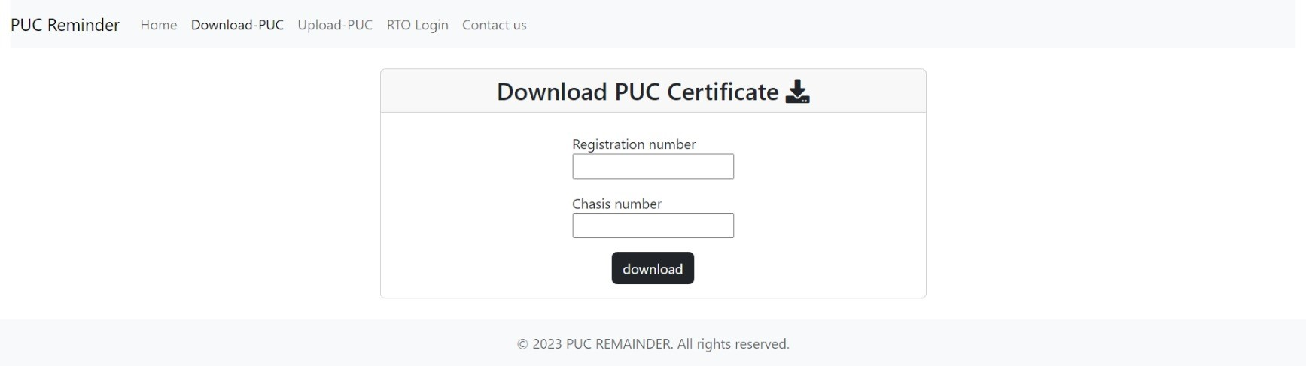

Slide 8
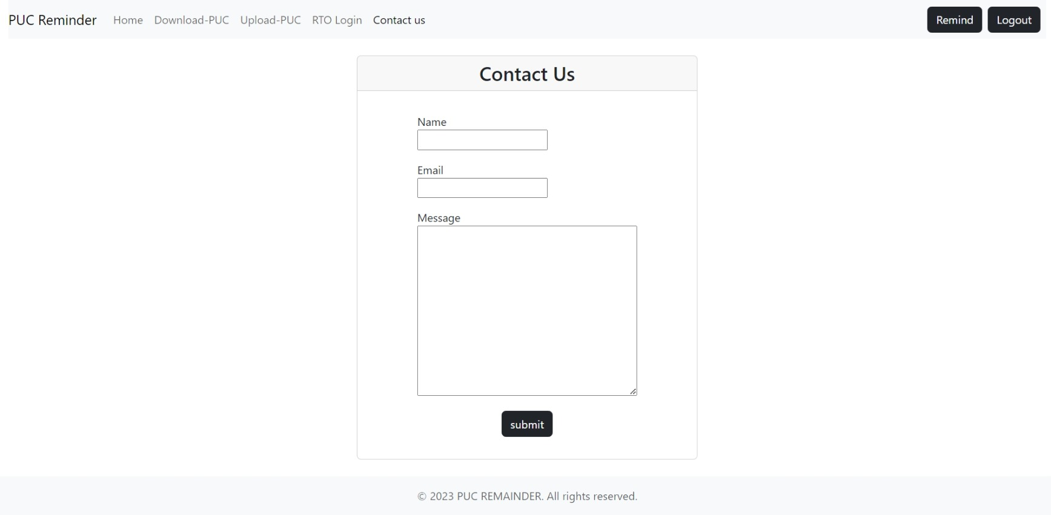
Contact Page

Slide 9
Technologies Used
Front end :
HTML
CSS
JavaScript
Bootstrap
Backend :
Django
DataBase :
Mysql

Slide 10
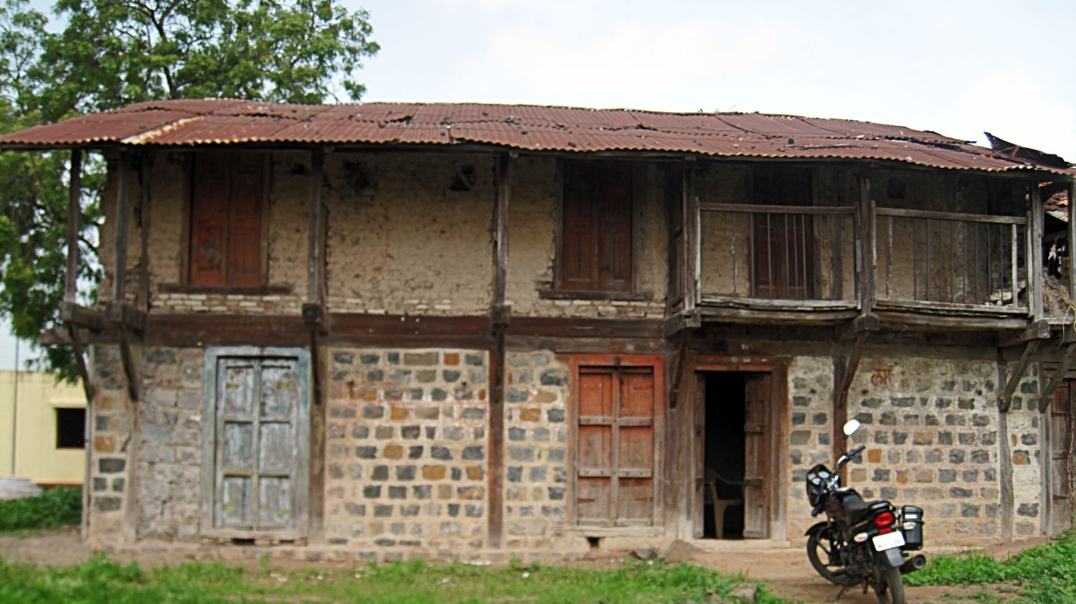
APPLICATIONS:
1. Authorization: RTO staff and PUC Center staff will be allowed to login by providing their assigned username and password.
2. Certificate Upload/Download: PUC Center staff can upload the renewed or issued certificate using their authorized username and password and general users can download their PUC certificate using their registration and chasis numbers.
3. Data Storage: The server will store the user data, including vehicle information and notification preferences, in the centralized database
4. Reminder Generation: RTO admin when logged in can click on remind button and automatically backend will send messages based upon their expiration status, the server will generate reminders for the upcoming or overdue PUC certificates.
5. Notification Delivery: The notification gateway will deliver reminders to the users.
This Photo by Unknown author is licensed under CC BY.

Slide 11


