Slide 1

CAPSTONE PROJECT PROJECT TITLE
Presented By
Student Name: K. Saikiran
College Name: VAAGDEVI COLLEGE OF ENGINEERING
Department: CSE
Email ID: 22641a05g1@vaagdevi.edu.in
AICTE Student ID: STU662f62f84ec401714381560

Slide 2
OUTLINE
Problem Statement
Proposed System/Solution
System Development Approach (Technology Used)
Algorithm & Deployment
Result (Output Image)
Conclusion
Future Scope
References

Slide 3
Problem Statement
Objective:
To accurately predict the final score of an ongoing IPL match based on live match inputs such as current runs, wickets, overs, recent performance, and team information.
Why it's important:
This prediction helps broadcasters, fans, and sports analysts gain real-time insights into the likely outcome of a match, enhancing viewer engagement and aiding strategic analysis.

Slide 4
Proposed Solution
Proposed System:
We propose a machine learning-based regression model that takes in contextual match data (team names, batsman, bowler, overs, runs, etc.) and predicts the total score for the batting team.
Key Highlights:
Takes real-time match inputs
Uses deep learning for score prediction
Interactive prediction interface using Jupyter Notebook widgets

Slide 5
System Approach
Technologies & Tools:
Python (Core language)
Pandas, NumPy (Data processing)
Matplotlib, Seaborn (Data visualization)
Scikit-learn (Preprocessing & evaluation)
Keras + TensorFlow (Deep learning framework)
Jupyter Notebook + IPyWidgets (UI for prediction)

Slide 6
Algorithm & Deployment
Model Used:
Deep Neural Network (DNN) using Keras Sequential API
Architecture:
Input Layer → 512 neurons (ReLU)
Hidden Layer → 216 neurons (ReLU)
Output Layer → 1 neuron (Linear)
Loss Function:
Huber Loss (robust to outliers)
Deployment:
Model trained and tested in Jupyter Notebook
Real-time predictions made through interactive widgets
Future scope includes web or mobile deployment via Flask or Streamlit

Slide 7
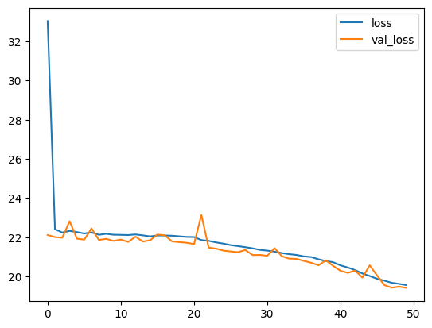
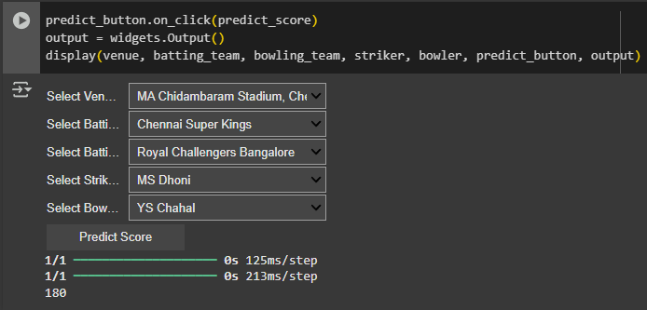
Result
Model loss graph (model_losses.plot()):
Interactive prediction UI with dropdowns and sliders:

Slide 8
Conclusion
The IPL Score Prediction model demonstrates the power of machine learning in real-time sports analytics.
It accurately forecasts the final score using critical match parameters, achieving a Mean Absolute Error (MAE) of ~13 runs.
The system is simple to use, responsive, and showcases potential for further development into full-fledged predictive analytics tools.

Slide 9
Future scope
Integrate live match feed API for real-time automation
Deploy model as a web or mobile app
Enhance model with player statistics, pitch report, weather conditions
Try other models like XGBoost, LSTM, or Transformer-based models for better temporal modeling

Slide 10
References
Kaggle - IPL Dataset
Scikit-learn Documentation - https://scikit-learn.org/
TensorFlow + Keras - https://www.tensorflow.org/
IPyWidgets – https://ipywidgets.readthedocs.io/
Matplotlib & Seaborn Docs - https://matplotlib.org/ and https://seaborn.pydata.org/
GitHub Link: https://github.com/KiranKalluri268/MS_AI_IPL-Score-Predictor

Slide 11
Thank you

