Slide 1
Combining Time Series and Sentiment Analysis for TCS Forecasting
NAME: CHAITANYA KAPOOR ROLL.NO: AM.EN,U4AIE19023
NAME: KIRAN KHANNA ROLL.NO:AM.EN.U4AIE19037
NAME: DISHITH REDDY ROLL.NO: AM.EN.U4AIE19041

Slide 2
Problems
Stock price prediction is regarded as one of most difficult task to accomplish in financial forecasting due to complex nature of stock market .
Stock price prediction has attracted many researchers in multiple disciplines. Recent studies have shown that the vast amount of online information in the public domain such as Wikipedia usage patterns, news stories from the mainstream media, and social media discussions can have an observable effect on investors’ opinions towards financial markets.

Slide 3
LITERATURE REVIEW
The stock price correlation coefficient of two separate stocks is predicted using LSTM recurrent neural networks (RNN). RNNs are capable of recognising temporal dependencies. The use of LSTM cells improves its long-term prediction abilities even further.
We use the ARIMA model to account for both linearity and nonlinearity in the model. The ARIMA model filters data for linear tendencies and sends the residual value to the LSTM model.
Other traditional predictive financial models such as the whole historical model, constant correlation model, single-index model, and multi-group model are compared to the ARIMA-LSTM hybrid model.

Slide 4
METHODOLOGY
Dataset:
Stock market prediction
We have taken the tcs dataset from yahoo finance
Sentimental Tcs News Analysics:
We have taken the dataset from FINVIZ.com

Slide 5
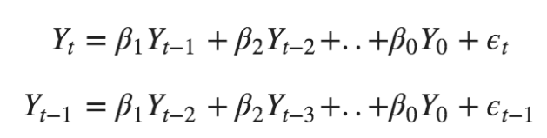
ARIMA
ARIMA is an acronym that stands for AutoRegressive Integrated Moving Average. It is a class of model that captures a suite of different standard temporal structures in time series data.
It's a model used in statistics and econometrics to measure events that happen over a period of time.
Equation:

Slide 6
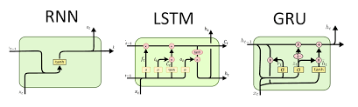
SENTIMENTAL ANALYSIS -LSTM

Slide 7
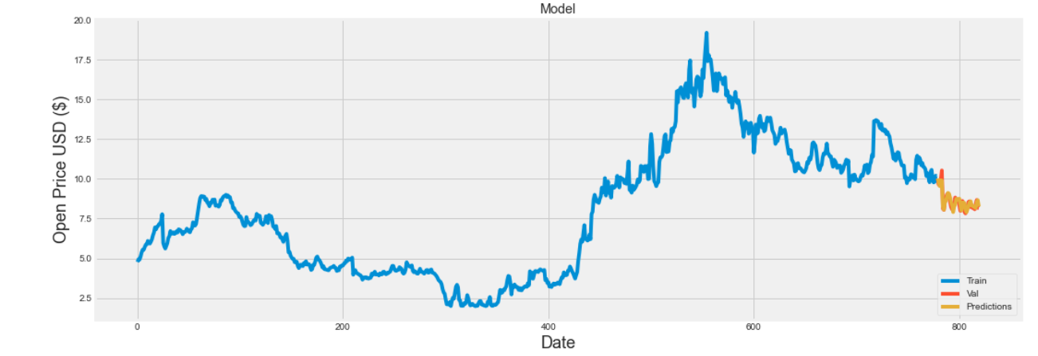
RESULTS

Slide 8
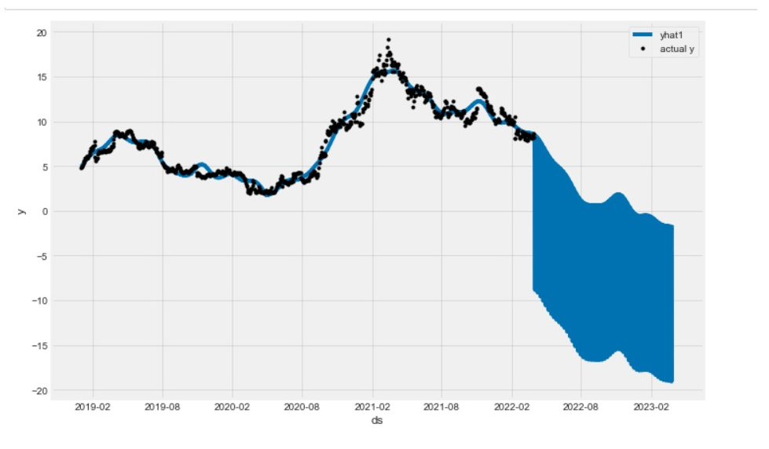
RESULTS

Slide 9
REFERENCES
https://www.researchgate.net/publication/261179224_Stock_price_prediction_using_the_ARIMA_model
https://www.sciencedirect.com/science/article/pii/S1877050920304865
https://onedrive.live.com/?authkey=%21AHrBv%5F8QFqrpiwU&cid=7E95923FF0A1FE26&id=7E95923FF0A1FE26%219581&parId=7E95923FF0A1FE26%219561&o=OneUp

Slide 10
CONCLUSION
The experimental results produced with the best ARIMA model revealed ARIMA models' ability to accurately anticipate stock prices on a short-term basis.
This could assist stock market investors in making effective investment decisions. ARIMA models can compete pretty well with developing forecasting techniques in short-term prediction based on the results obtained.
LSTM model gives us good accuracy for both stock market prediction and sentimental analysics.

