Slide 1
CLUSTERING MODELS vs TOPIC IDENTIFICATION:
BY
KIRAN KUMAR CHILLA

Slide 2
OVERVIEW
Introduction & Motivation
Implementation
Results
Conclusion

Slide 3
Introduction & Motivation
Social platforms provide new ways to express peoples opinions and ideas
Twitter has become one of the most popular platforms for users to express their opinions and communicate via tweets. Determining the topic of discussion is an important problem.
This project deals with how various clustering algorithms and number of clusters impact the determination of topics.

Slide 4
Introduction & Motivation
Data is collected from Twitter using the API and filters using some keywords
significant words were extracted as a bag for clustering analysis
The resulting bag of words is classified using different clustering algorithms.
Then, an Natural Language Tool Kit(NLTK) is used to identify the topics represented by the clusters.
main motivation for this project is to find how various clustering algorithms can impact the topic prediction

Slide 5
Implementation
Data Collection
Data cleaning
Apply clustering algorithms
Analyze results
Predict Topics

Slide 6
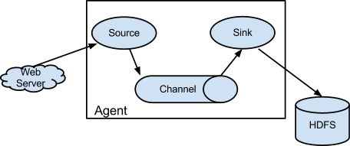
Data Collection
Data is downloaded using Apache flume
Filtering keywords/phrases used to collect tweets from the stream are Donald trump, anger, melania, impeachment, usa, America, president,washington,muslim,racism,H1-b,terrorism,radical,radical Islam, united states, Syria, army, frustrate.

Slide 7
Data Cleaning
Extract text from JSON format
unwanted URLs, stop words, non-English vocabulary, years and emoticons are removed by using regular expressions and NLTK filters.
"Retreat from Paris is retreat from reality. Stupid, dangerous, &amp; unnecessary. Another cowardly attack on our future. https://t.co/AY71VEVxbn
Data Cleaning
retreat paris retreat reality stupid dangerous unnecessary another cowardly attack future

Slide 8
Clustering Algorithms Used
Kmeans Clustering
LDA
NMF using Frobenius norm
NMF using KL norm

Slide 9
Kmeans Clustering
It is divided in to two steps
1. Cluster Assignment step
2. Updating Centroid
Convert text data in to coordinates
Feature Extraction package in python converts group of words in to coordinates.

Slide 10
LDA(Latent Dirichlet Allocation)
a generative probabilistic model which extracts topics from the text, based on co-occurrence of words with the topic in the document.
a document is a bag of words formed of topics based on some weights
For each document:
(a) randomly choose a distribution over topics (a multinomial of length K, K here corresponds to total number of clusters)
(b) for each document:
(i) Probabilistically draw one of the K topics from the distribution over topics obtained in (a), say topic βj
(ii) Probabilistically draw one of the V words from βj

Slide 11

NMF using Frobenius/KL normalization
Document Term Matrix is generated which gives the frequency of all
unique words for each tweet. Here rows present tweets, columns
represent Unique words
After running the algorithm on Document-Term Matrix (V matrix),
Its decomposed in to W(n X r) matrix and H (r X n) matrix.

Slide 12
The features matrix is represented as follows:
where n is the total number of unique words
r is the total number of clusters
Every word is grouped into one of the clusters basing on whichever cluster has a maximum weight for the given word.

Slide 13
Determining Topics
Topics are identified for each cluster by finding Similarity Index using NLTK.
Similarity Index is the statistical measure that ranges between 0, 1 which gives how closely two synsets of words are related according to wordnet database

Slide 14
Calculating Similarity Index value
Find synsets for every word
Synset or Synonym set is a group of synonyms which corresponds to words that have similar meanings.
Calculate similarity for every word with all the remaining words using synsets

Slide 15
Synset(word.POS.IndexNumber) | Lemmas(words with same meaning)
bass.n.01 | 'bass'
bass.n.02 | 'bass', 'bass_part'
bass.n.03 | 'bass', 'basso'
bass.n.04 | 'sea_bass', 'bass'
bass.n.05 | 'freshwater_bass', 'bass'
bass.n.06 | 'bass', 'bass_voice', 'basso'
bass.n.07 | 'bass'
bass.n.08 | 'bass'
bass.s.01 | 'bass', 'deep'

Slide 16
IndexNumber | Meaning
1 | lowest part of musical range
2 | lowest part in polyphonic music
3 | an adult male singer in the lowest voice
4 | lean flesh of saltwater fish of family Serranidae
5 | various north American freshwater fish with the lean fish
6 | lowest adult male singing voice
7 | member with lowest range of a family of musical instruments
8 | Nontechnical name for numerous edible, marine fresh water spiny- finned fish

Slide 17
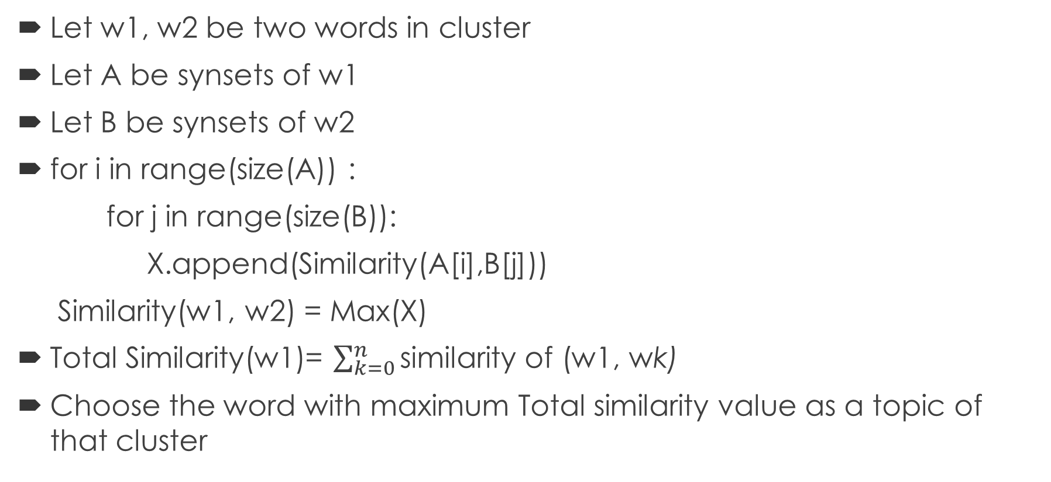
Calculating Similarity Index value
Let w1, w2 be two words in cluster
Let A be synsets of w1
Let B be synsets of w2
for i in range(size(A)) :
for j in range(size(B)):
X.append(Similarity(A[i],B[j]))
Similarity(w1, w2) = Max(X)
Total Similarity(w1)= $\sum_{k=0}^{n}{\text{similarity} \text{of}\text{ (}\text{w}\text{1, }\text{w}\text{k}\text{)}}$
Choose the word with maximum Total similarity value as a topic of that cluster

Slide 18
Topics generated for Cluster size 5
Clusters | Topics Identified
Kmeans | climate, count, country, hate, trump
LDA | answer, ground, management, voter, ways
NMF(Frobenius norm) | credibility, hear, indication, politics, trump
NMF( Kullback-Leibler divergence) | harsh, hell, liar, melania, protection

Slide 19
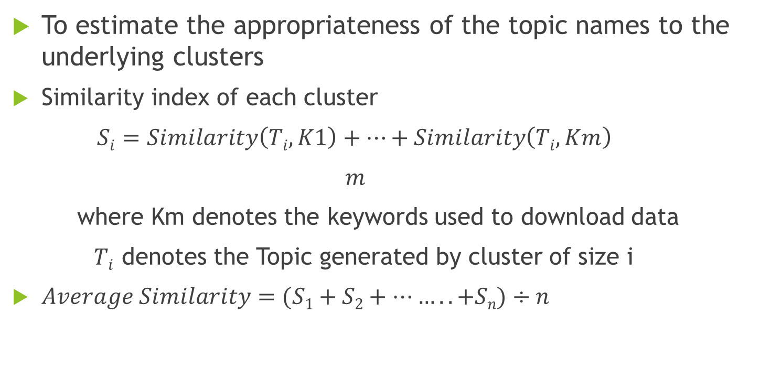
Average Similarity Calculator
To estimate the appropriateness of the topic names to the underlying clusters
Similarity index of each cluster
$Si=Similarity\left(Ti, K1\right)+…+Similarity\left(Ti, Km\right)$
$m$
where Km denotes the keywords used to download data
$Ti$ denotes the Topic generated by cluster of size i
$Average Similarity=(S1+S2+……..+Sn)÷n$

Slide 20
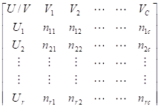
Contingency Matrix and ARI
Contingency Matrix
Where n_{ij} = Number of equal pairs that are in clusters U_{i} and V_{j} ,
c,r represents the total number of clusters generated by
respective clustering algorithms

Slide 21
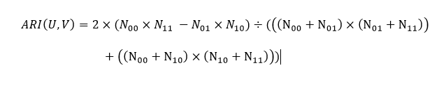
Adjusted Rand Index
Where
N₁₁: number of pairs that are in the same cluster in both U and V
N₀₀: the number of pairs that are in different clusters in both U and V
N₀₁: the number of pairs that are in same cluster in U but in different
cluster in V
N₁₀: the number of pairs that are in different clusters in U but in the same
cluster in V

Slide 22
ARI and Average ARI value for various clustering Algorithms
Clusters | Cluster 5 | Cluster10 | Cluster 15 | Cluster 20 | Cluster 50 | Average
Kmeans-LDA | 0.25 | 0.33 | 0.44 | 0.46 | 0.43 | 0.382
Kmeans- ClusterNMF | 0.15 | 0.49 | 0.34 | 0.43 | 0.46 | 0.374
Kmeans- ClusterNMFKL | 0.0625 | 0.46 | 0.34 | 0.41 | 0.46 | 0.346
LDA- ClusterNMF | 0.27 | 0.42 | 0.42 | 0.43 | 0.48 | 0.404
LDA- ClusterNMFKL | 0.33 | 0.41 | 0.46 | 0.44 | 0.47 | 0.422
NMF_FN ClusterNMFKL | 0.48 | 0.37 | 0.35 | 0.33 | 0.11 | 0.328

Slide 23
Average Similarity Index v/s Cluster size for all four algorithms

Slide 24
Conclusion
Topics generated from clusters generated by K means are better representations than other algorithms because of high Average Similarity Index.
Prediction accuracy decreases with increase in number of clusters after reaching a certain threshold
Topics generated using LDA, NMF algorithms were relatively same than any other algorithms because of Highest Average ARI(Adjusted Rand Index)

Slide 25
Thank you

