Slide 1
Handwritten Digit Recognition
using Neural Network​

Slide 2
Introduction :
The project focuses on handwritten digit recognition using the MNIST dataset and a Neural Network.
It has been extended to include a GUI where users can write digits on the screen for real-time recognition.
The GUI allows the system to capture and process the handwritten digits for accurate prediction.
The system provides instant feedback on the recognized digit after the user finishes drawing.
This extension enhances user interaction and demonstrates the practical use of neural networks in digit recognition.

Slide 3
Objectives:
To successfully implement neural networks to make a digit recognizer with high accuracy. The idea is to take a large number of handwritten digits, known as training examples, and then develop a system which can learn from those training examples.
A neural network is a model inspired by how the brain works. It consists of multiple layers having many activations, this activation resembles neurons of our brain. A neural network tries to learn a set of parameters in a set of data which could help to recognize the underlying relationships. Neural networks can adapt to changing input; so the network generates the best possible result without needing to redesign the output criteria.
In other words, the neural network uses the examples to automatically infer rules for recognizing handwritten digits.

Slide 4
Methodology :
1. Neural Network Setup:
A neural network with 1 hidden layer was implemented.
The hidden layer contains 100 neurons, excluding bias units.
2. Loading Data:
The data was loaded from a .mat file.
Features (X) and labels (y) were extracted from the file.
3. Rescaling Features:
The feature values were divided by 255 to scale them down.
This rescaling ensures the feature values are between 0 and 1, preventing overflow.
4. Data Splitting:
The dataset was split into 60,000 training examples.
An additional 10,000 examples were set aside for testing.

Slide 5
5. Feedforward:
Feedforward was done using the training set to calculate predictions (hypothesis).
This process allowed the network to make predictions based on the input features.
6. Backpropagation:
Backpropagation was used to minimize the error between the predicted and actual values.
The network’s weights were adjusted during this process to improve performance.
7. Regularization:
A regularization parameter (lambda) of 0.1 was applied to reduce overfitting.
This helps the model generalize better to unseen data.
8. Optimizer:
The optimizer was run for 100 iterations to improve the model’s accuracy.
The goal was to find the best-fit model with the least error.

Slide 6
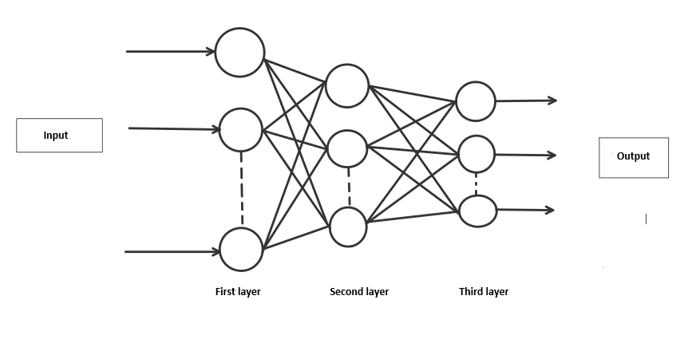

Slide 7
Progress Update:
Library Installation: We are in the process of installing and configuring the necessary libraries for running the neural network. This step is critical for ensuring smooth operation when training and testing the model. Setting up these libraries is an ongoing process as we fine-tune the environment to meet the project’s requirements.
Understanding Neural Networks: We’ve made significant progress in learning how neural networks work, particularly in the context of digit recognition. This involves studying feedforward, backpropagation, and the overall structure of the network. Understanding these concepts is helping us approach the coding aspect more effectively.

Slide 8
Coding Progress: We’ve started writing the code for different parts of the project, including data processing, model training, and the GUI. While we are still in the early stages, our coding efforts are focused on ensuring that each component works well together. We’re applying what we’ve learned from theory into practice.
Dataset Exploration: Although we are using the MNIST dataset, we are also exploring additional datasets to test the model under different conditions. We’ve referenced various Kaggle examples to gather useful insights and scenario-based examples that can improve the accuracy and robustness of our model.

Slide 9
Conclusion:
In conclusion, handwritten digit recognition using neural networks is a well-established problem with numerous practical applications. Leveraging CNNs enables high accuracy and robust performance. ​
This project outlines the steps to design, train, and deploy a neural network model for handwritten digit recognition, emphasizing the importance of model evaluation and improvement to ensure real-world applicability.​

