Slide 1
Handwritten Digit Recognition using Neural Network

Slide 2
Problem definition:
Handwritten digit recognition using MNIST dataset is a major project made with the help of Neural Network. It basically detects the scanned images of handwritten digits.
We have taken this a step further where our handwritten digit recognition system not only detects scanned images of handwritten digits but also allows writing digits on the screen with the help of an integrated GUI for recognition.

Slide 3
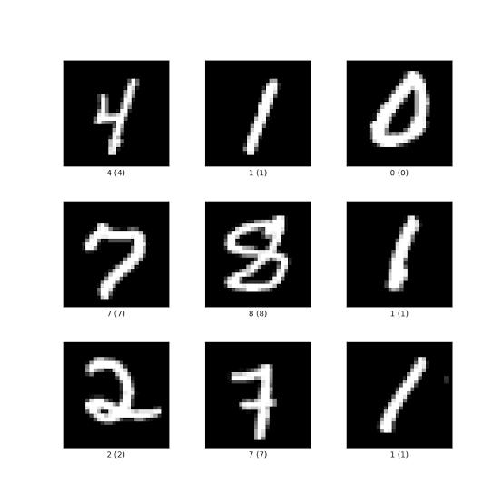
Approach:
The approach begins with data collection and preprocessing, using the MNIST dataset, a benchmark dataset comprising 60,000 training images and 10,000 test images of handwritten digits, each 28x28 pixels in size.
Preprocessing involves normalizing pixel values to the range [0, 1] to facilitate faster convergence during training. The model design focuses on selecting and constructing a CNN due to its proven effectiveness in image-related tasks.

Slide 4
Objectives:
To successfully implement neural networks and SVM to make a digit recognizer with high accuracy. The idea is to take a large number of handwritten digits, known as training examples, and then develop a system which can learn from those training examples.
In other words, the neural network uses the examples to automatically infer rules for recognizing handwritten digits.

Slide 5
Conclusion:
In conclusion, handwritten digit recognition using neural networks is a well-established problem with numerous practical applications. Leveraging CNNs enables high accuracy and robust performance.
This project outlines the steps to design, train, and deploy a neural network model for handwritten digit recognition, emphasizing the importance of model evaluation and improvement to ensure real-world applicability.

