Slide 1
22AIE115
USER INTERFACE DESIGN
Tourism in Switzerland
Presenting by
Venkata Kiran Kumar D Ketan Sairam B
CB.SC.U4AIE23122 CB.SC.U4AIE23168

Slide 2


Creating an user–friendly online tourism website on Switzerland with appealing design and images utilising HTML, CSS and JAVASCRIPT.
Showcasing different sub menus like Home, about, places etc for easy and efficient navigation.
Creating separate webpages for the available menus with back and froth navigation between the pages.
Designing Sign In box where we can Log in in the website using email and password for booking hotels.

Slide 3
Implementation:
There is a navigation bar at the top of the webpage that displays a menu. When clicked, the menu items navigate to their respective sections within the website.
When clicked on Accommodation, it navigates to a new page where it displays list of hotels with “Book Now” functionality.
Upon opening the website, we used JavaScript to create a back-and-forth movement of the main background image.
There is a “Read More” button designed at center which when clicked navigates to a new page which contains extra info on Switzerland.
On clicking the “Sign in ” button in accommodations, a sign in box will appear where we can Login using email and password.

Slide 4
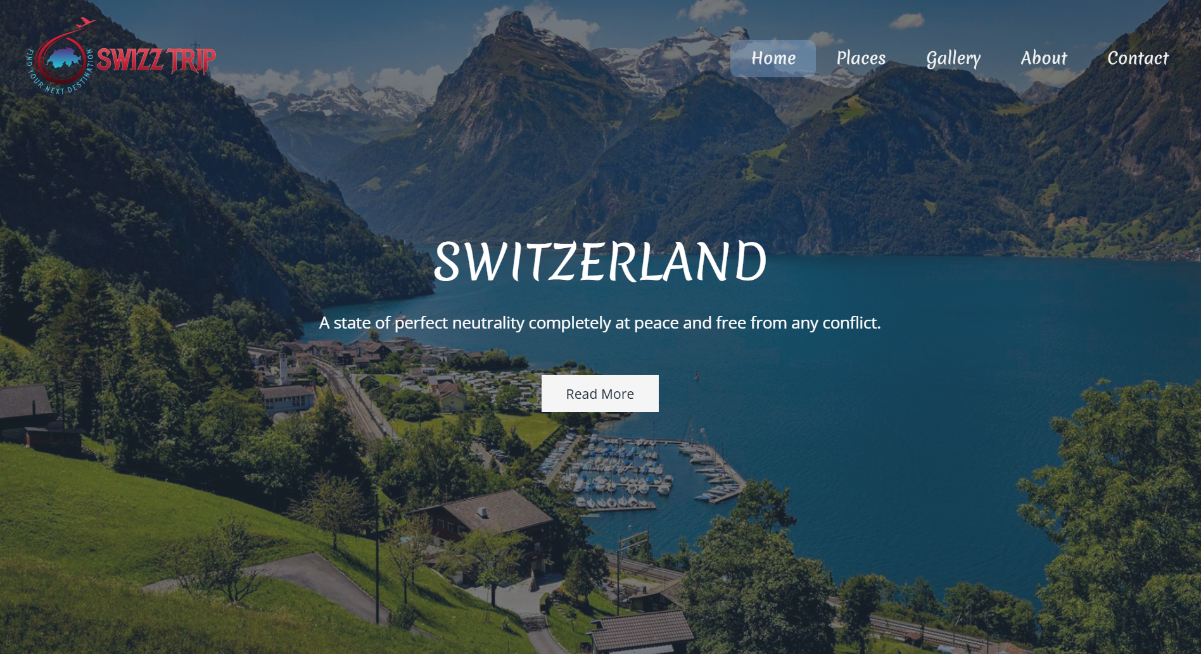
Main Webpage
This is the main index page where you can access all other navigation through buttons, such as Read more about Switzerland, and the menu.

Slide 5
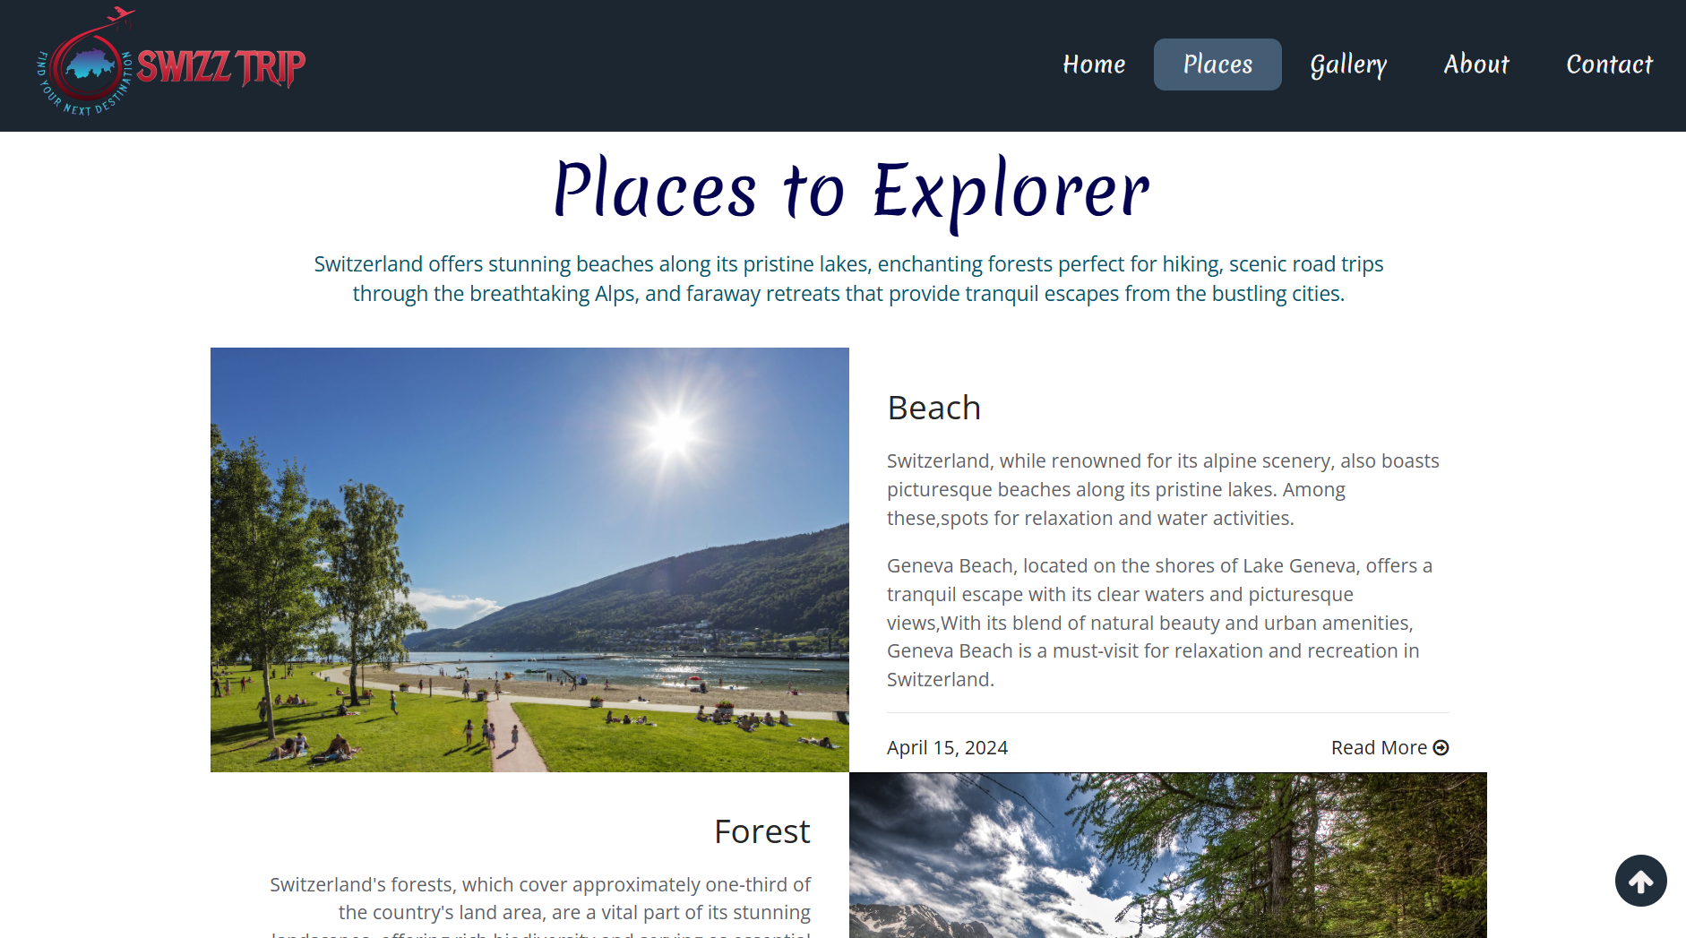
Different Kind of places
In tourism, the main attraction for every traveler is the destination, where they can enjoy and experience a heavenly escape from their busy lives by connecting with nature. Whether it's beaches, forests, or road trips.
These experiences offer the best travel moments and allow travelers to explore distant places, enhancing their enjoyment and understanding of the world.

Slide 6
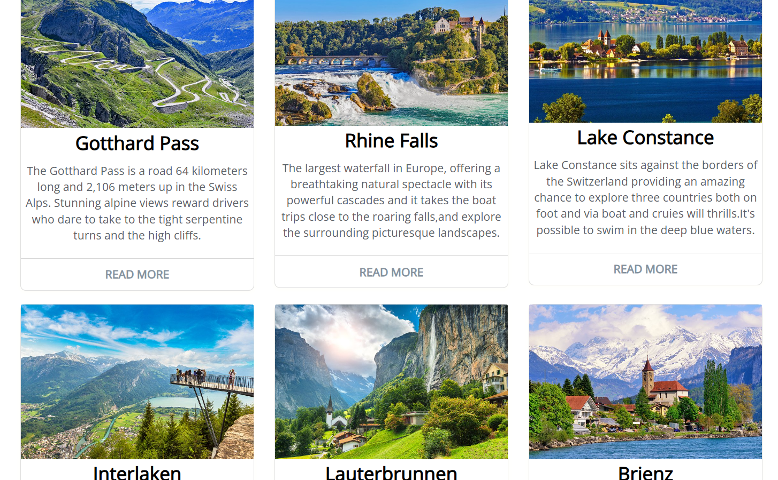
Knowing about Best places
These places are among the most visited by tourists in Switzerland, offering a perfect blend of natural beauty, cultural richness, and modern amenities.
They provide excellent content for presentations, showcasing the diverse and stunning attractions Switzerland has to offer.

Slide 7

Accomodations
People those who are planning tours in different parts of the world, checking for good accommodations like hotels, restaurants, and locations for camps is essential.
Therefore, we have included the highly rated accommodations in Switzerland.

Slide 8
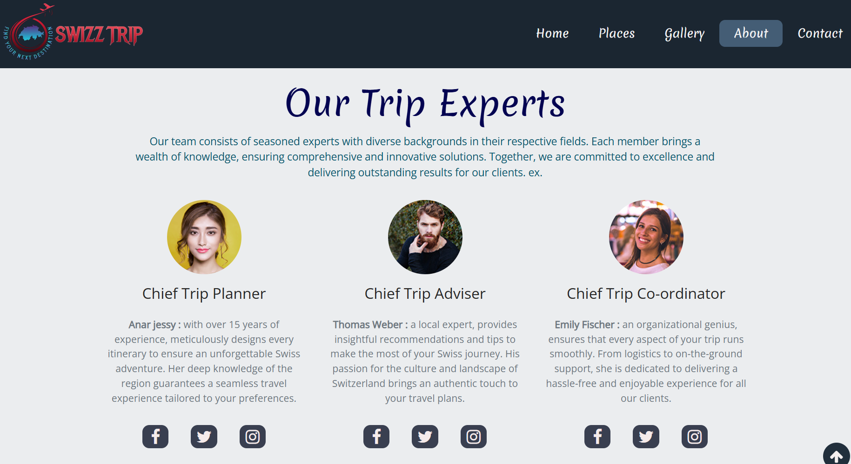
Travel Experts
When exploring unfamiliar destinations, relying on expert guidance for planning and navigating day-to-day activities becomes essential.
This page serves as a gateway to connect with trusted travel experts through various social media platforms for seamless assistance.

Slide 9
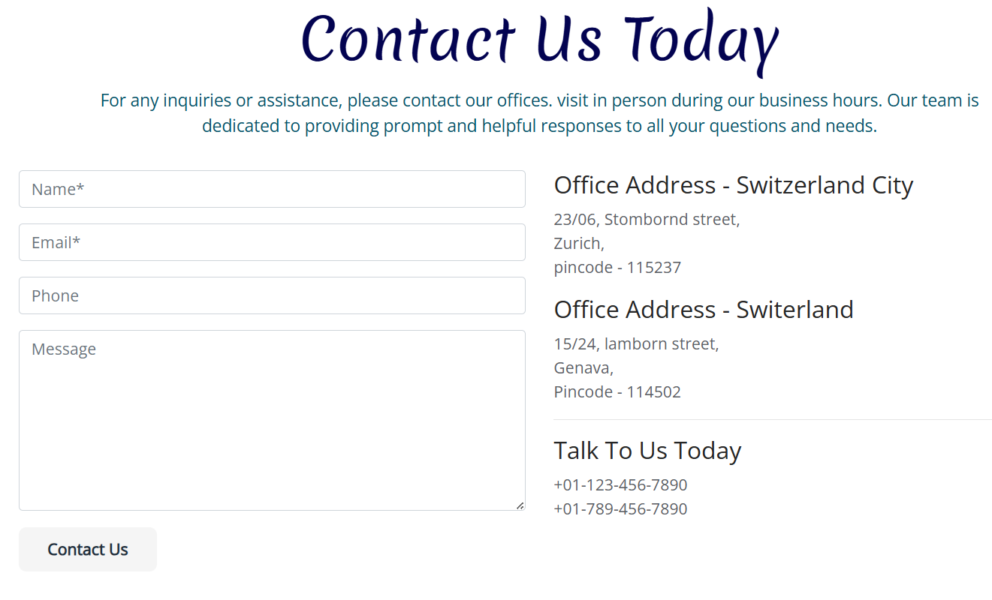
Personal Contact
For personalized information about tours, places, accommodations, travel guides, and safety, feel free to contact our guide directly. We can reach out via message or email, and our dedicated team will be happy to assist you with all your travel needs and inquiries.
Whether we are looking for detailed itineraries, insider tips, or assistance with bookings, They are here to help make your trip to Switzerland unforgettable.

Slide 10
CONCLUSION :
In conclusion, our website offers a seamless user experience with intuitive navigation and dynamic features.
From the top navigation bar to the interactive "Read More" and "Book Now" buttons, every element is designed to provide easy access to information and services.
Visitors can effortlessly explore accommodations and learn more about Switzerland, ensuring a comprehensive and engaging online experience

