Slide 1
Data Mining
Model Overfitting
Introduction to Data Mining, 2nd Edition
by
Tan, Steinbach, Karpatne, Kumar

Slide 2
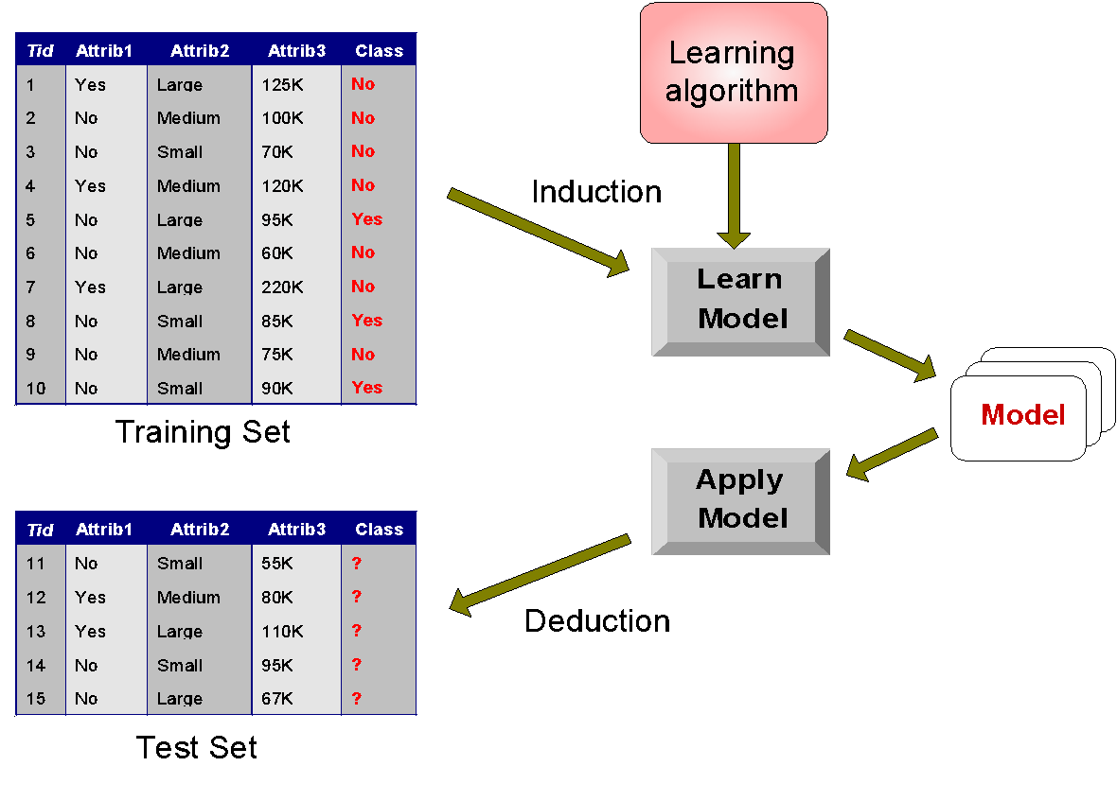
Classification Errors
Training errors: Errors committed on the training set
Test errors: Errors committed on the test set
Generalization errors: Expected error of a model over random selection of records from same distribution

Slide 3
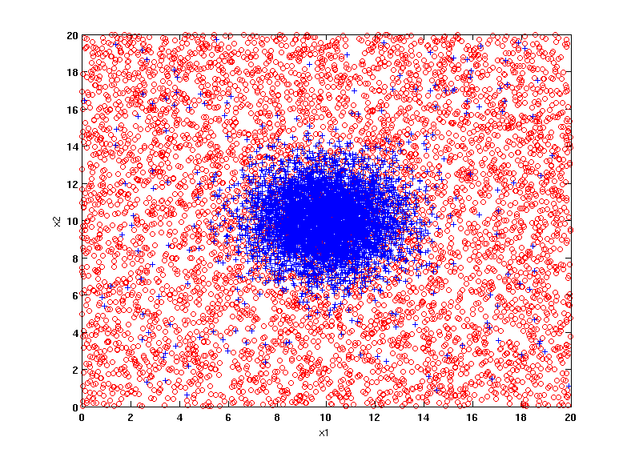
Example Data Set
Two class problem:
+ : 5400 instances
5000 instances generated from a Gaussian centered at (10,10)
400 noisy instances added
o : 5400 instances
Generated from a uniform distribution
10 % of the data used for training and 90% of the data used for testing

Slide 4
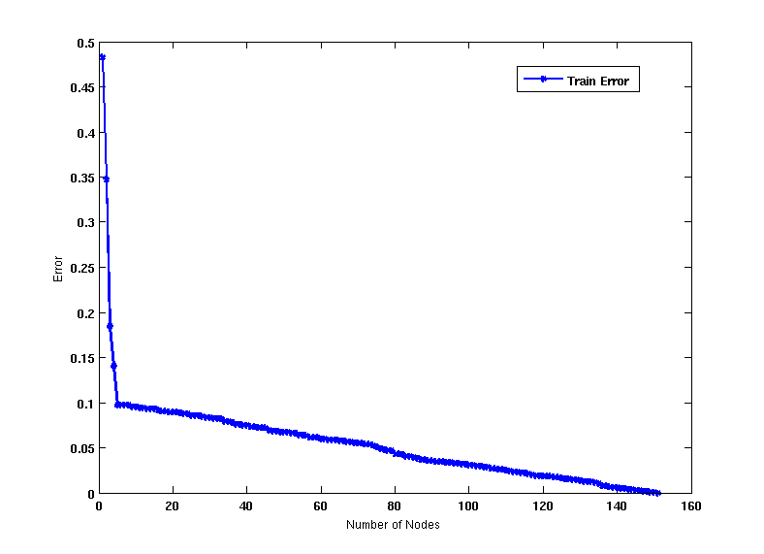
Increasing number of nodes in Decision Trees

Slide 5
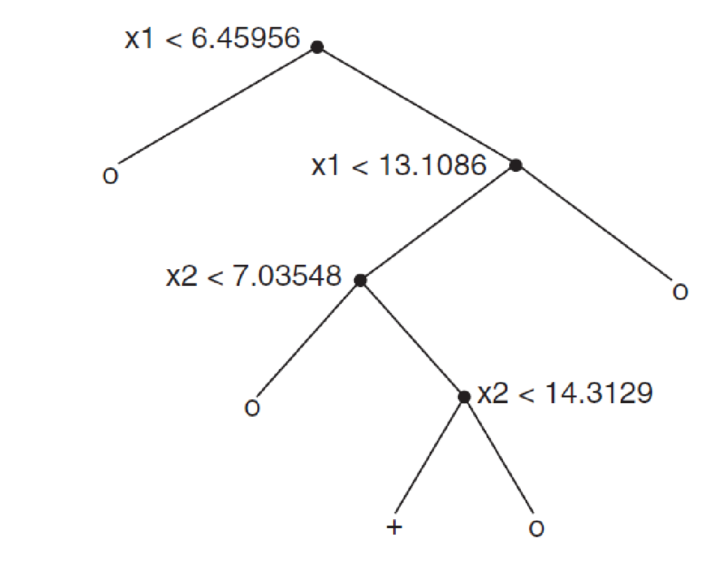
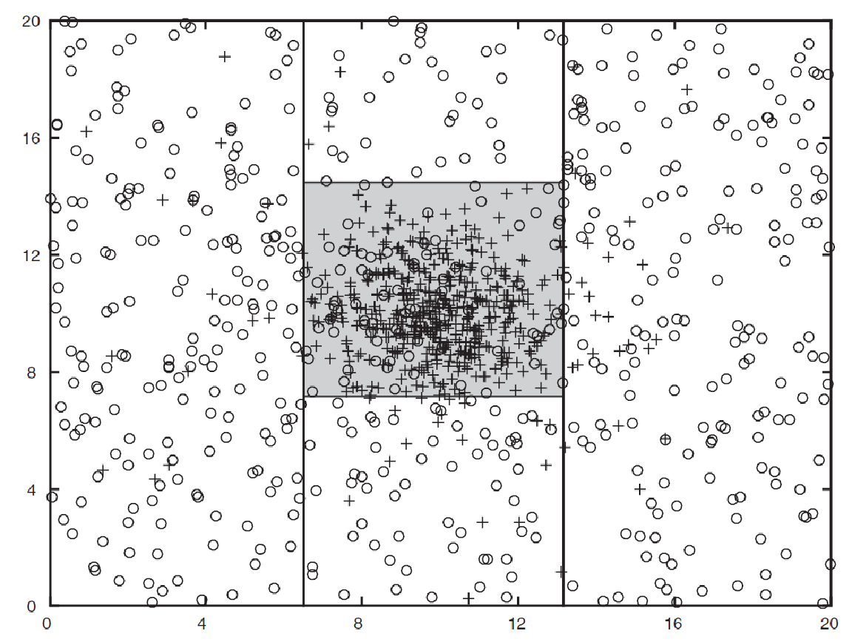
Decision Tree with 4 nodes
Decision Tree
Decision boundaries on Training data

Slide 6
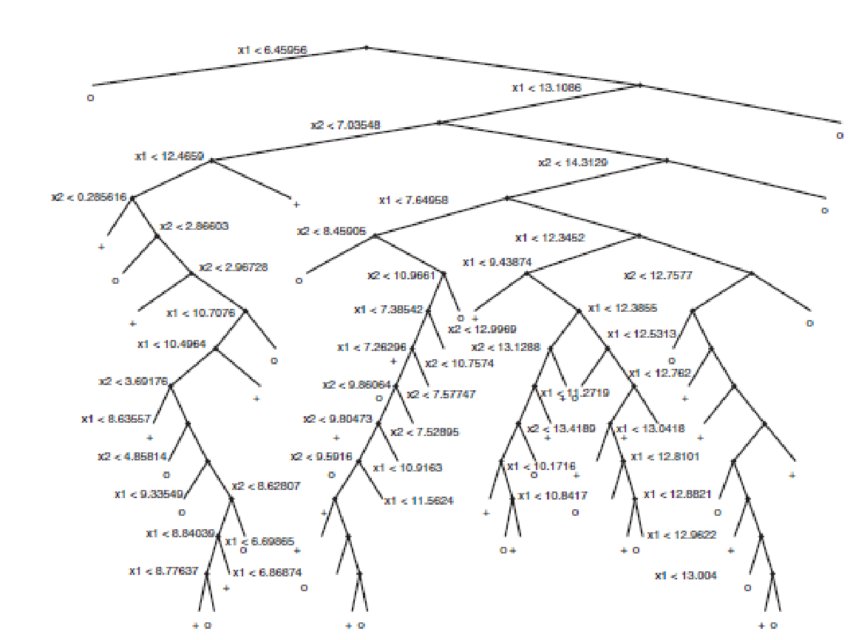
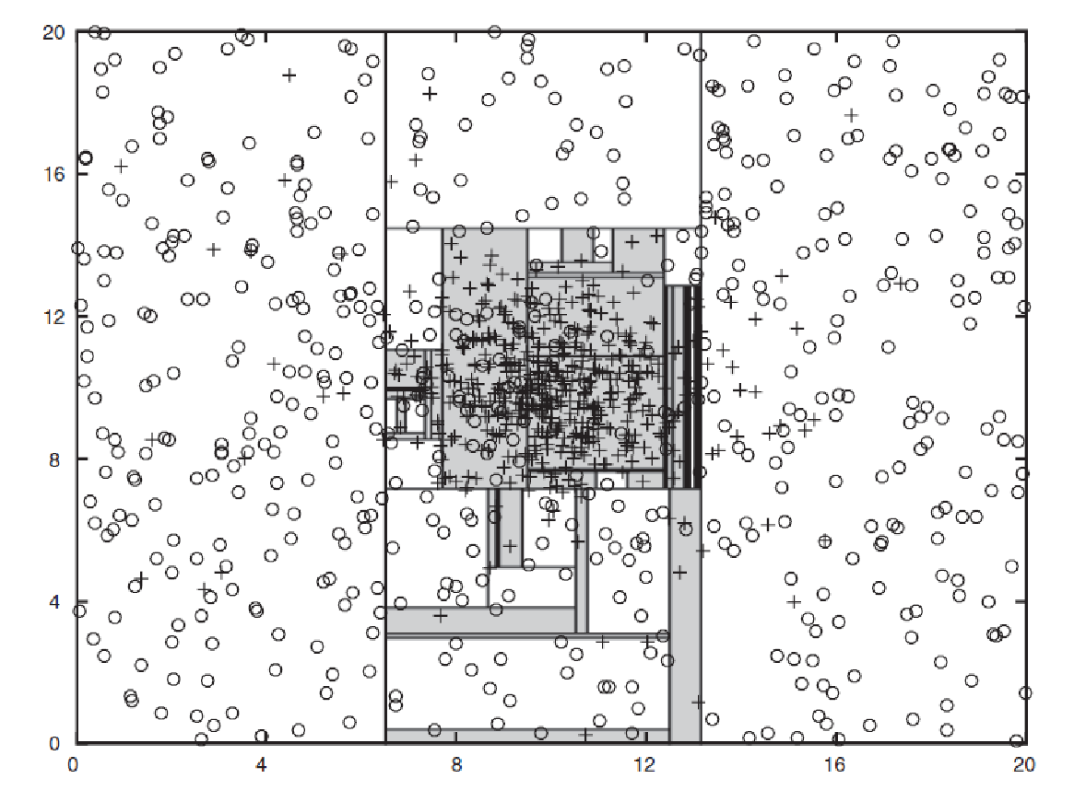
Decision Tree with 50 nodes
Decision Tree
Decision Tree
Decision boundaries on Training data

Slide 7
Which tree is better?
Decision Tree with 4 nodes
Which tree is better ?
Decision Tree with 50 nodes

Slide 8
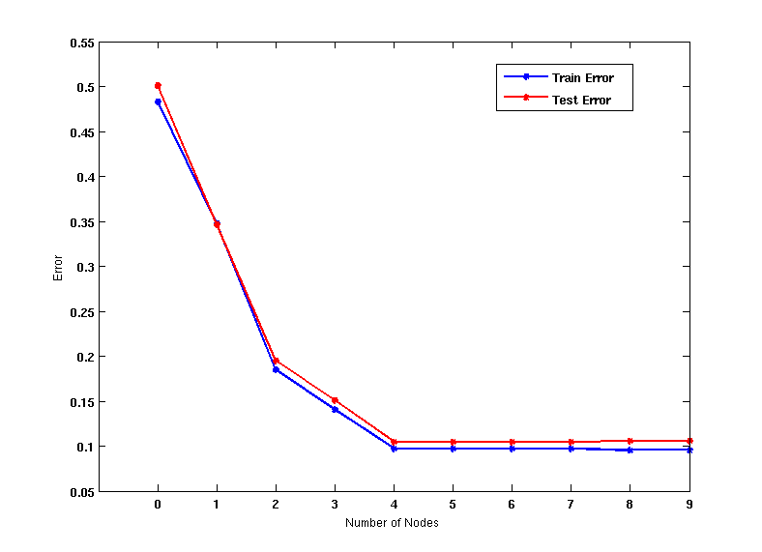
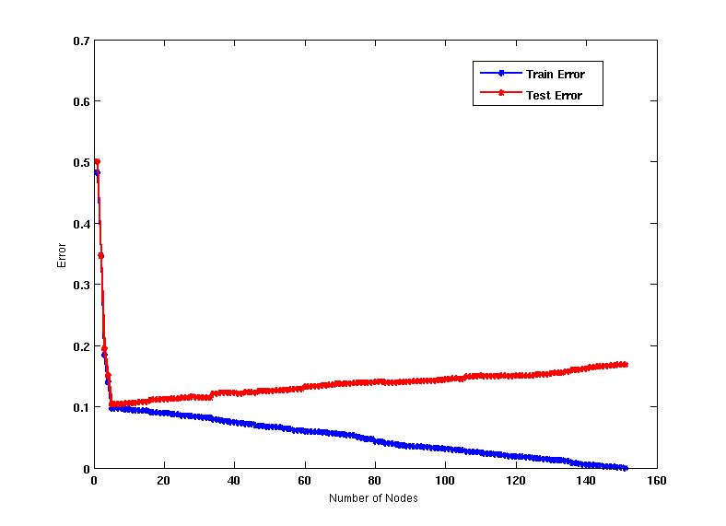
Model Underfitting and Overfitting
As the model becomes more and more complex, test errors can start increasing even though training error may be decreasing
Underfitting: when model is too simple, both training and test errors are large
Overfitting: when model is too complex, training error is small but test error is large

Slide 9
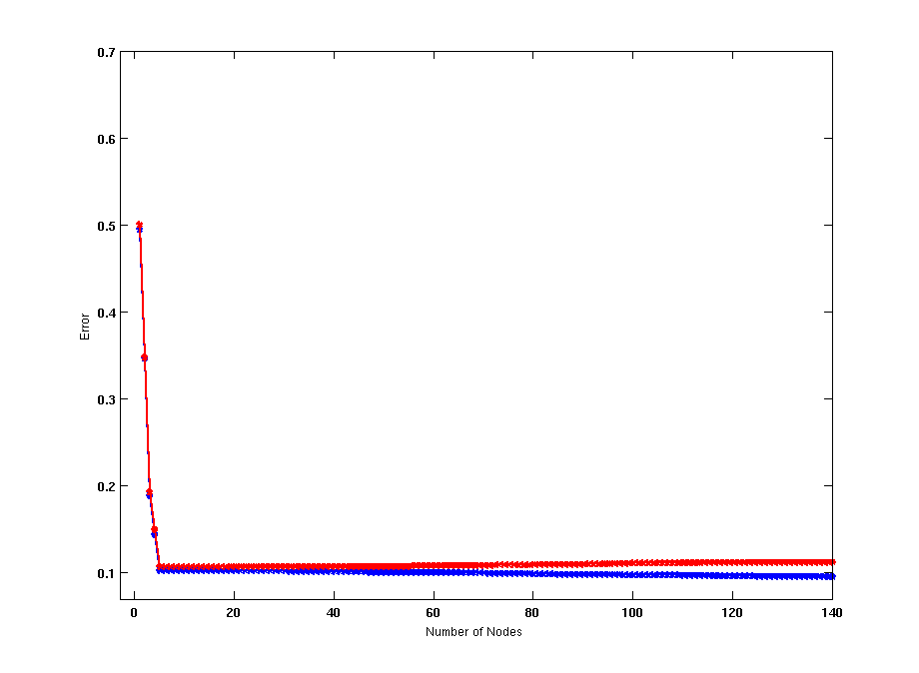
Model Overfitting – Impact of Training Data Size
Using twice the number of data instances
Increasing the size of training data reduces the difference between training and testing errors at a given size of model

Slide 10
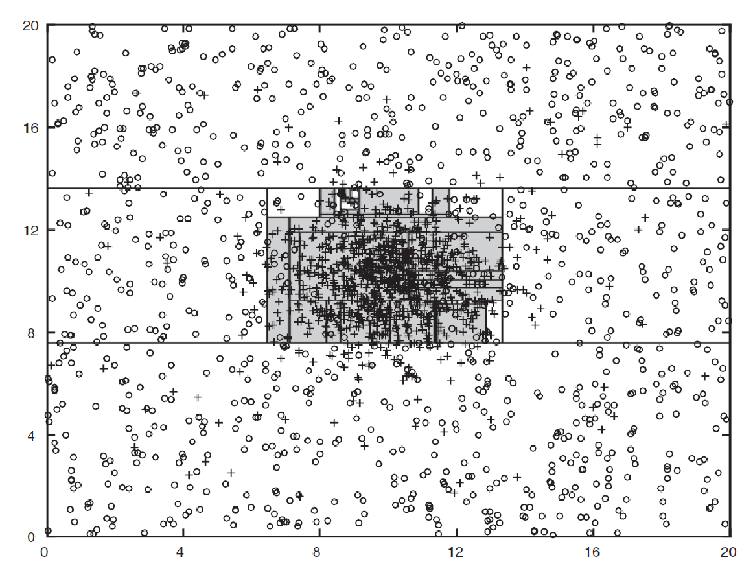
Model Overfitting – Impact of Training Data Size
Decision Tree with 50 nodes
Decision Tree with 50 nodes
Using twice the number of data instances
Increasing the size of training data reduces the difference between training and testing errors at a given size of model

Slide 11
Reasons for Model Overfitting
Not enough training data
High model complexity
Multiple Comparison Procedure

Slide 12
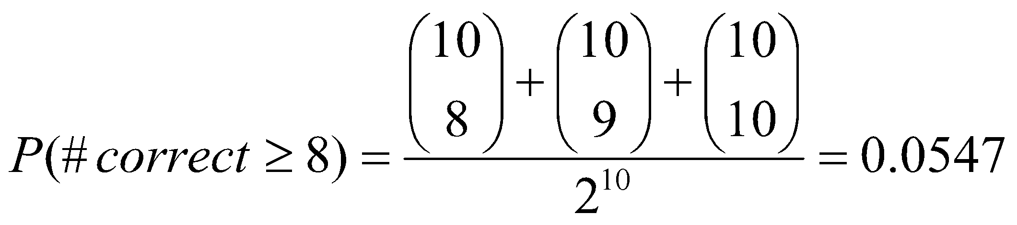
Effect of Multiple Comparison Procedure
Consider the task of predicting whether stock market will rise/fall in the next 10 trading days
Random guessing:
P(correct) = 0.5
Make 10 random guesses in a row:
Day 1 | Up
Day 2 | Down
Day 3 | Down
Day 4 | Up
Day 5 | Down
Day 6 | Down
Day 7 | Up
Day 8 | Up
Day 9 | Up
Day 10 | Down

Slide 13
Effect of Multiple Comparison Procedure
Approach:
Get 50 analysts
Each analyst makes 10 random guesses
Choose the analyst that makes the most number of correct predictions
Probability that at least one analyst makes at least 8 correct predictions

Slide 14
Effect of Multiple Comparison Procedure
Many algorithms employ the following greedy strategy:
Initial model: M
Alternative model: M’ = M ∪ γ, where γ is a component to be added to the model (e.g., a test condition of a decision tree)
Keep M’ if improvement, Δ(M,M’) > α
Often times, γ is chosen from a set of alternative components, Γ = {γ₁, γ₂, …, γ_{k}}
If many alternatives are available, one may inadvertently add irrelevant components to the model, resulting in model overfitting

Slide 15
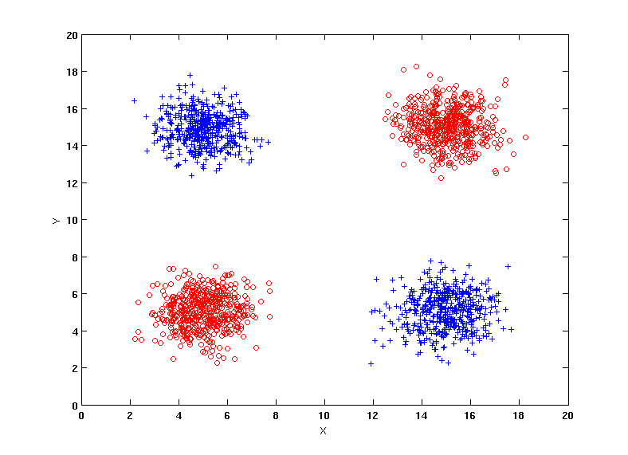
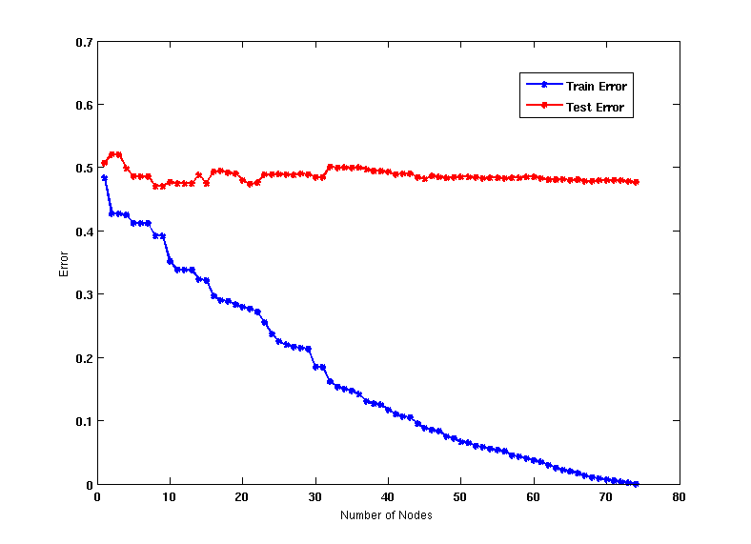
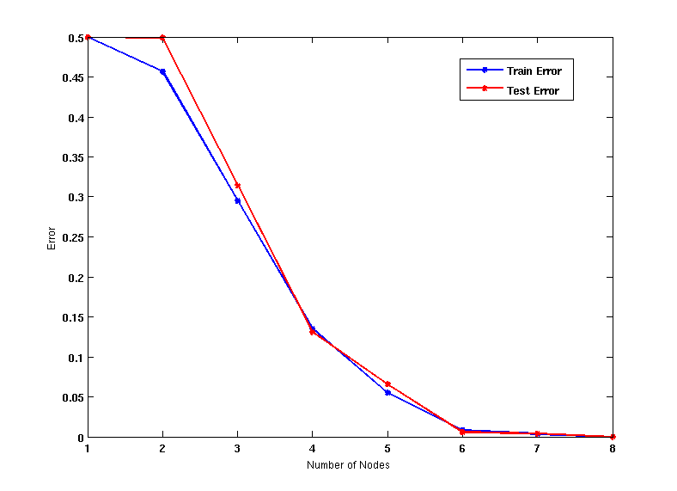
Effect of Multiple Comparison - Example
Use additional 100 noisy variables generated from a uniform distribution along with X and Y as attributes.
Use 30% of the data for training and 70% of the data for testing
Using only X and Y as attributes

Slide 16
Notes on Overfitting
Overfitting results in decision trees that are more complex than necessary
Training error does not provide a good estimate of how well the tree will perform on previously unseen records
Need ways for estimating generalization errors

Slide 17
Model Selection
Performed during model building
Purpose is to ensure that model is not overly complex (to avoid overfitting)
Need to estimate generalization error
Using Validation Set
Incorporating Model Complexity

Slide 18
Model Selection: Using Validation Set
Divide training data into two parts:
Training set:
use for model building
Validation set:
use for estimating generalization error
Note: validation set is not the same as test set
Drawback:
Less data available for training

Slide 19
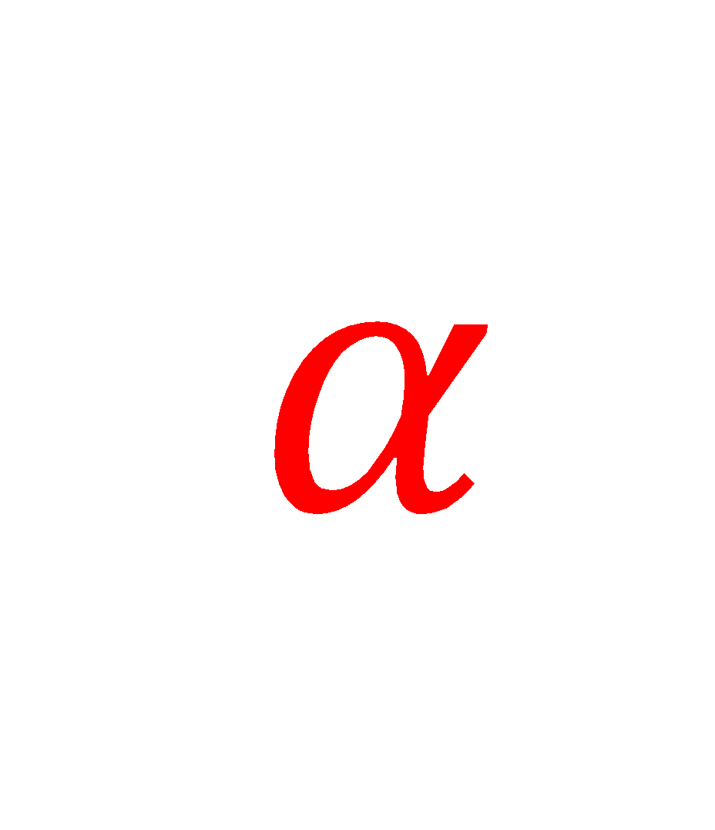
Model Selection: Incorporating Model Complexity
Rationale: Occam’s Razor
Given two models of similar generalization errors, one should prefer the simpler model over the more complex model
A complex model has a greater chance of being fitted accidentally
Therefore, one should include model complexity when evaluating a model
Gen. Error(Model) = Train. Error(Model, Train. Data) +
x Complexity(Model)

Slide 20

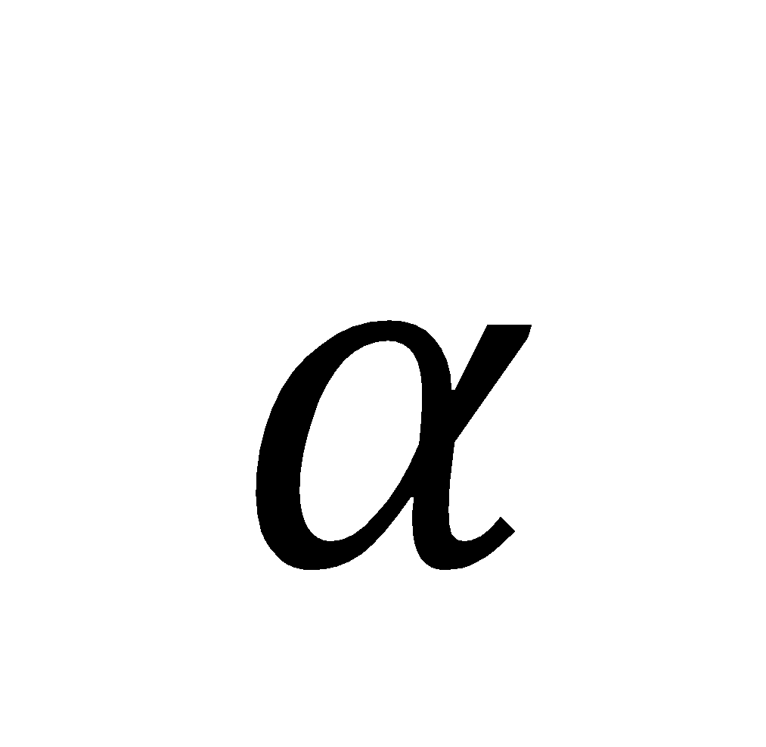
Estimating the Complexity of Decision Trees
Pessimistic Error Estimate of decision tree T with k leaf nodes:
err(T): error rate on all training records
Ω: trade-off hyper-parameter (similar to )
Relative cost of adding a leaf node
k: number of leaf nodes
N_{train}: total number of training records

Slide 21
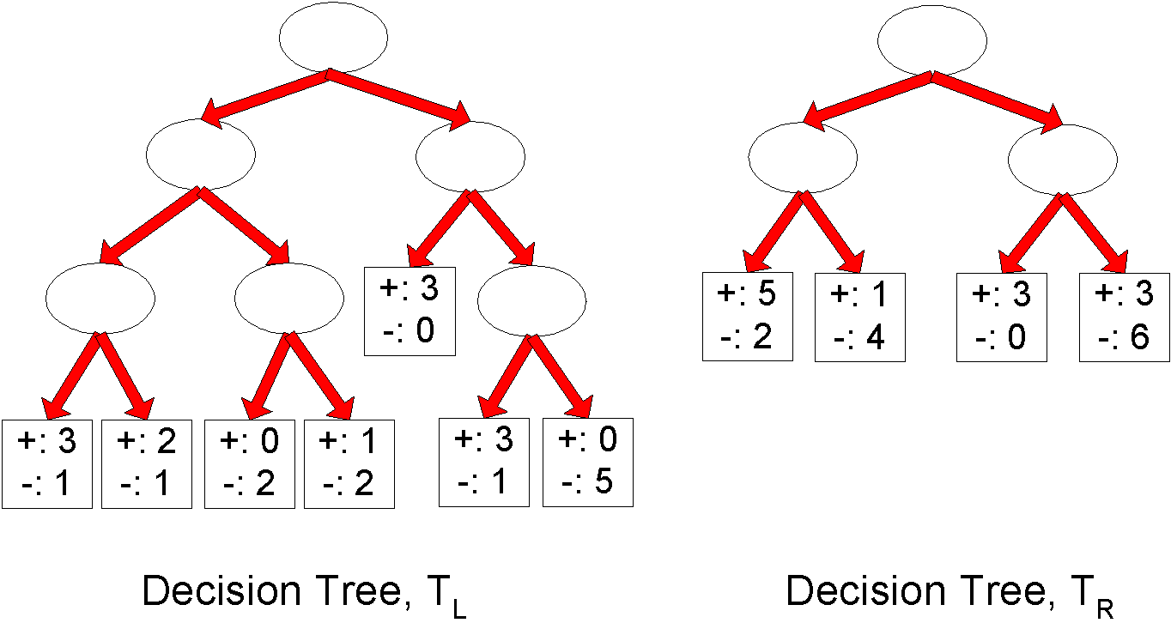
Estimating the Complexity of Decision Trees: Example
e(T_{L}) = 4/24
e(T_{R}) = 6/24
Ω = 1
e_{gen}(T_{L}) = 4/24 + 1*7/24 = 11/24 = 0.458
e_{gen}(T_{R}) = 6/24 + 1*4/24 = 10/24 = 0.417

Slide 22
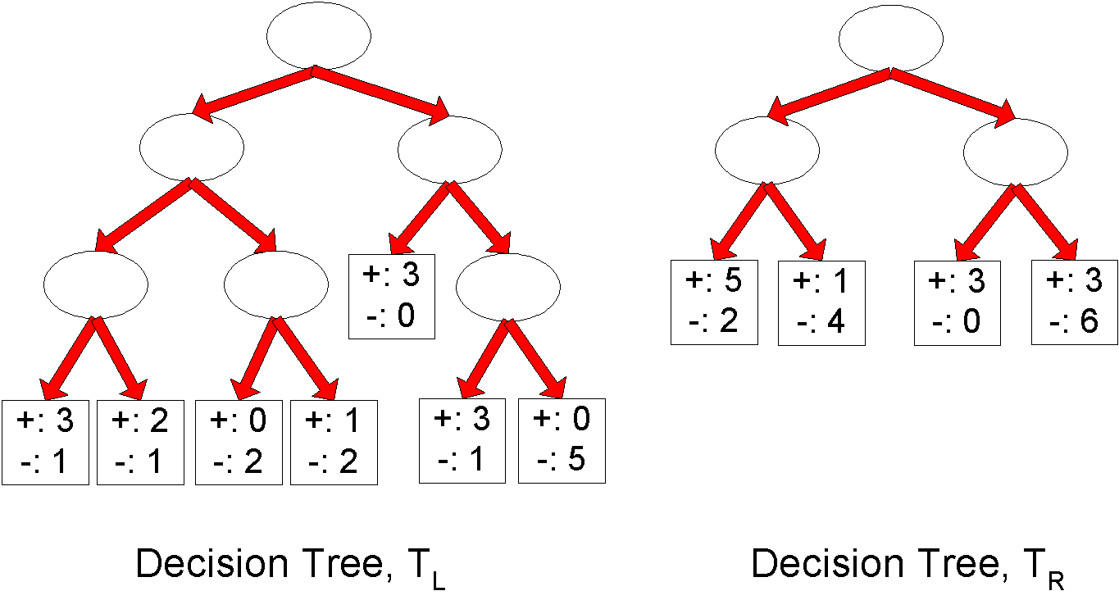
Estimating the Complexity of Decision Trees
Resubstitution Estimate:
Using training error as an optimistic estimate of generalization error
Referred to as optimistic error estimate
e(T_{L}) = 4/24
e(T_{R}) = 6/24

Slide 23
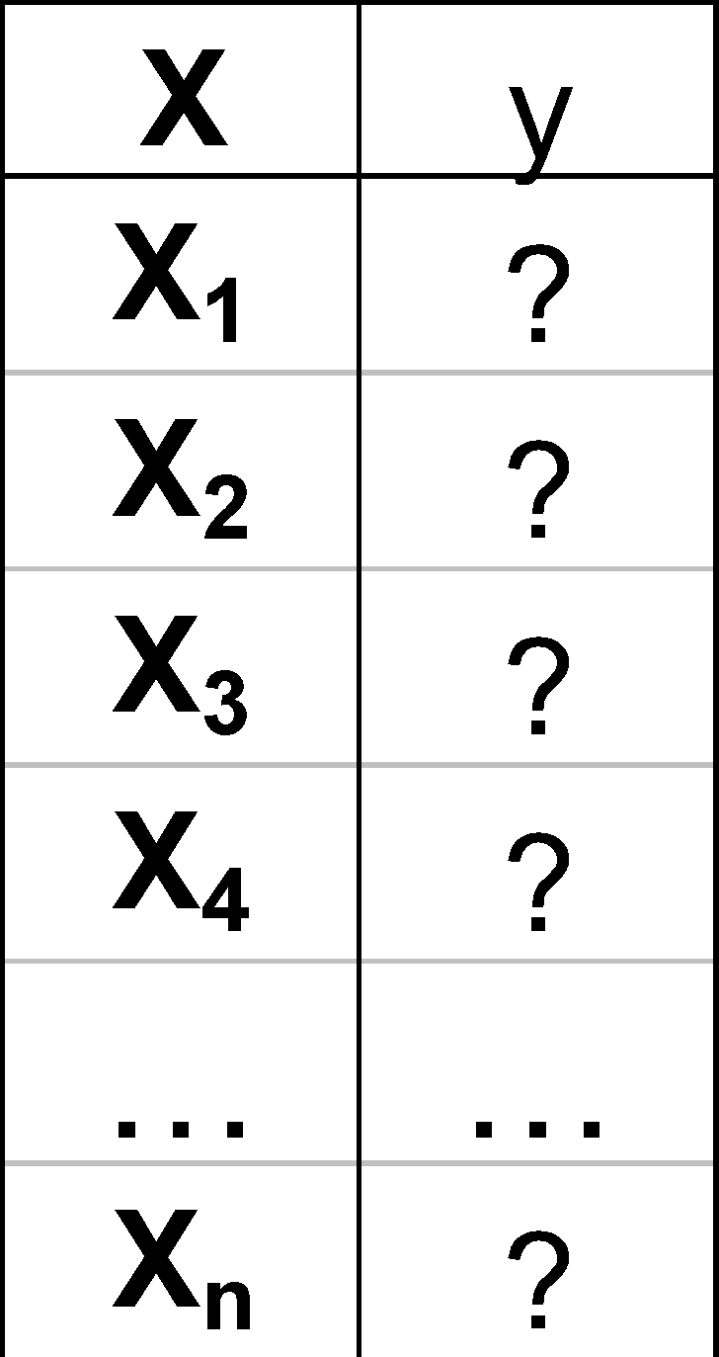
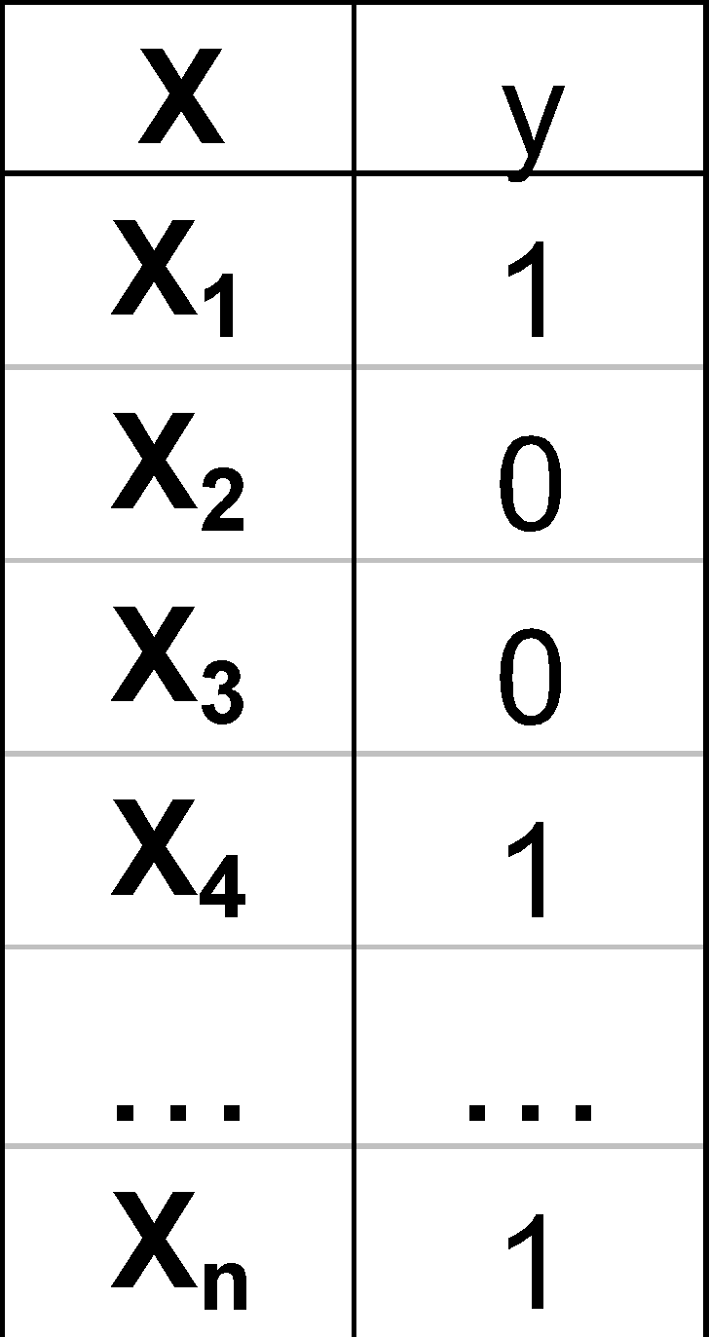
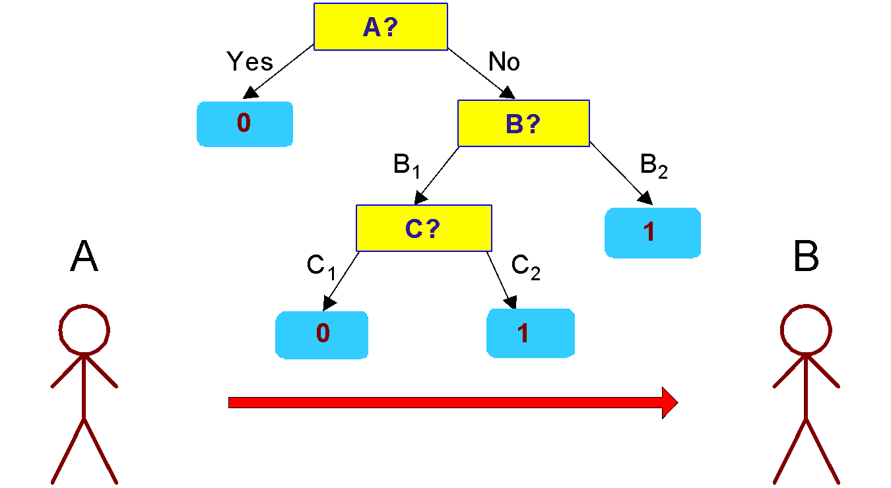
Minimum Description Length (MDL)
Cost(Model,Data) = Cost(Data|Model) + x Cost(Model)
Cost is the number of bits needed for encoding.
Search for the least costly model.
Cost(Data|Model) encodes the misclassification errors.
Cost(Model) uses node encoding (number of children) plus splitting condition encoding.

Slide 24
Model Selection for Decision Trees
Pre-Pruning (Early Stopping Rule)
Stop the algorithm before it becomes a fully-grown tree
Typical stopping conditions for a node:
Stop if all instances belong to the same class
Stop if all the attribute values are the same
More restrictive conditions:
Stop if number of instances is less than some user-specified threshold
Stop if class distribution of instances are independent of the available features (e.g., using χ ² test)
Stop if expanding the current node does not improve impurity measures (e.g., Gini or information gain).
Stop if estimated generalization error falls below certain threshold

Slide 25
Model Selection for Decision Trees
Post-pruning
Grow decision tree to its entirety
Subtree replacement
Trim the nodes of the decision tree in a bottom-up fashion
If generalization error improves after trimming, replace sub-tree by a leaf node
Class label of leaf node is determined from majority class of instances in the sub-tree

Slide 26
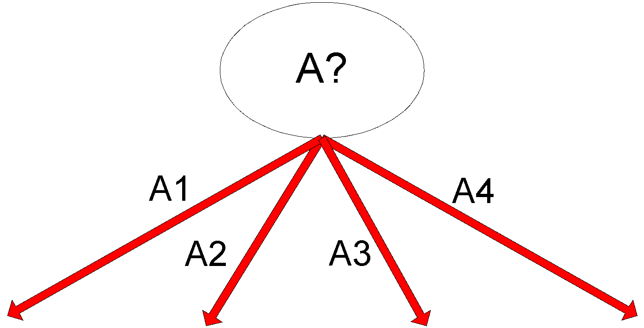
Example of Post-Pruning
Training Error (Before splitting) = 10/30
Pessimistic error = (10 + 0.5)/30 = 10.5/30
Training Error (After splitting) = 9/30
Pessimistic error (After splitting)
= (9 + 4 × 0.5)/30 = 11/30
PRUNE!
Class = Yes | 20
Class = No | 10
Error = 10/30
Class = Yes | 8
Class = No | 4
Class = Yes | 3
Class = No | 4
Class = Yes | 4
Class = No | 1
Class = Yes | 5
Class = No | 1

Slide 27
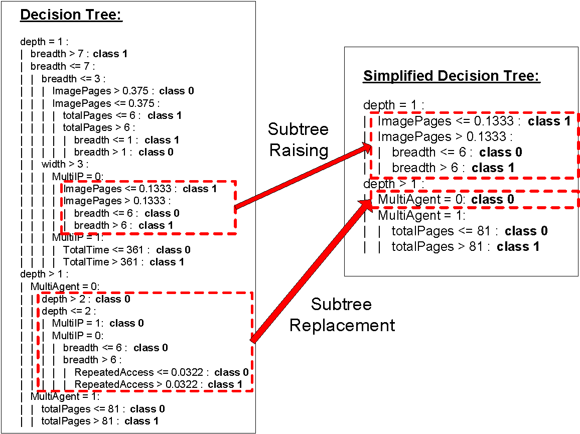
Examples of Post-pruning

Slide 28
Model Evaluation
Purpose:
To estimate performance of classifier on previously unseen data (test set)
Holdout
Reserve k% for training and (100-k)% for testing
Random subsampling: repeated holdout
Cross validation
Partition data into k disjoint subsets
k-fold: train on k-1 partitions, test on the remaining one
Leave-one-out: k=n

Slide 29
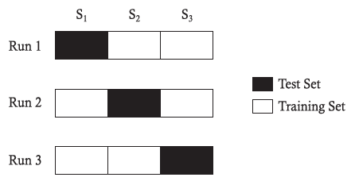
Cross-validation Example
3-fold cross-validation

Slide 30
Variations on Cross-validation
Repeated cross-validation
Perform cross-validation a number of times
Gives an estimate of the variance of the generalization error
Stratified cross-validation
Guarantee the same percentage of class labels in training and test
Important when classes are imbalanced and the sample is small
Use nested cross-validation approach for model selection and evaluation

