Slide 1
Feature Selection Techniques in Machine Learning

Slide 2
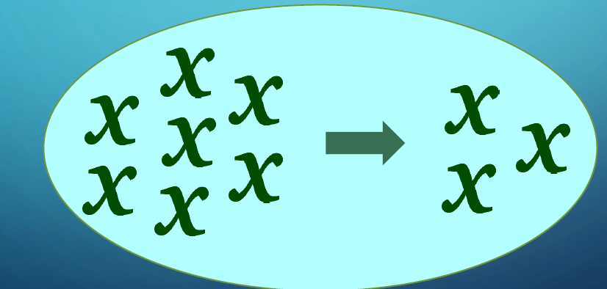
Understanding the importance of feature selection?
This problem of identifying the related features from a set of data and removing the irrelevant or less important features with do not contribute much to our target variable in order to achieve better accuracy for our model.

Slide 3
Identify Features
Feature Selection is one of the core concepts in machine learning which hugely impacts the performance of your model. The data features that you use to train your machine learning models have a huge influence on the performance you can achieve.
Irrelevant or partially relevant features can negatively impact model performance.
Feature Selection is the process where you automatically or manually select those features which contribute most to your prediction variable or output in which you are interested in.

Slide 4
Feature selection
Feature selection is the process of selecting a subset of relevant features (variables, predictors) for use in machine learning model building.
Feature selection is also known as Variable selection or Attribute selection.

Slide 5
WHY SHOULD WE SELECT FEATURES?
Simple models are easier to interpret
Shorter training times
Enhanced generalization by reducing overfitting
Easier to implement by software developers
Reduced risk of data errors during model use
Variable redundancy
Bad learning behavior in high dimensional spaces

Slide 6
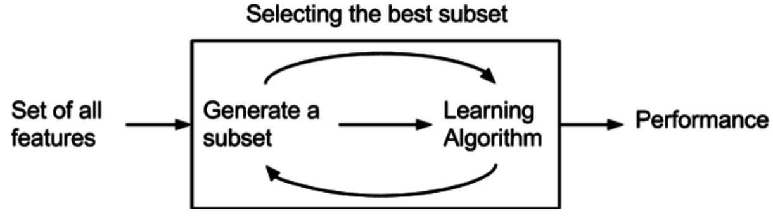
Benefits of performing feature selection
Reduces Overfitting: Less redundant data means less opportunity to make decisions based on noise.
Improves Accuracy: Less misleading data means modelling accuracy improves.
Reduces Training Time: fewer data points reduce algorithm complexity and algorithms train faster.

Slide 7
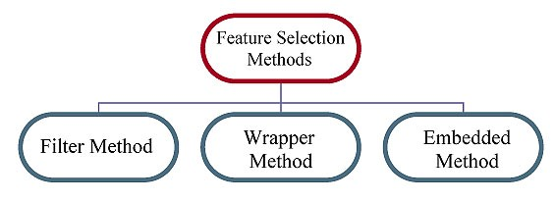
Feature Selection Methods
Filter Method.
Filter methods are also called as Single Factor Analysis.
Wrapper Method.
Wrapper methods use combinations of variables to determine predictive power.
Embedded Method
Embedded Method is inbuilt variable selection method.

Slide 8
Filter Method.
Rely on the characteristics of the data (feature characteristics)
Do not use machine learning algorithms
Model agnostic
Tend to be less computationally expensive
Usually give lower prediction performance than a wrapper methods
Are very well suited for a quick screen and removal of irrelevant features

Slide 9
Wrapper Method
Use predictive machine learning models to score the feature subset
Train a new model on each feature subset
Tend to be very computationally expensive
Usually provide the best performing feature subset for a given machine learning algorithm
They may not produce the best feature combination for a different machine learning model

Slide 10
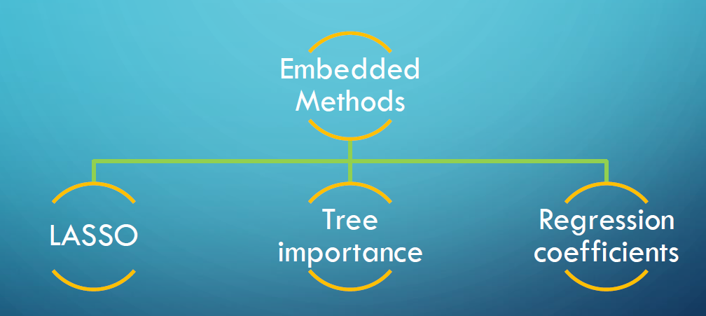
Embedded Method
Perform feature selection as part of the model construction process
Consider the interaction between features and models
They are less computationally expensive than wrapper methods, because they fit the machine learning model only once.
Find the feature subset for the algorithm being trained
Faster than wrapper methods
More accurate than filter methods

Slide 11
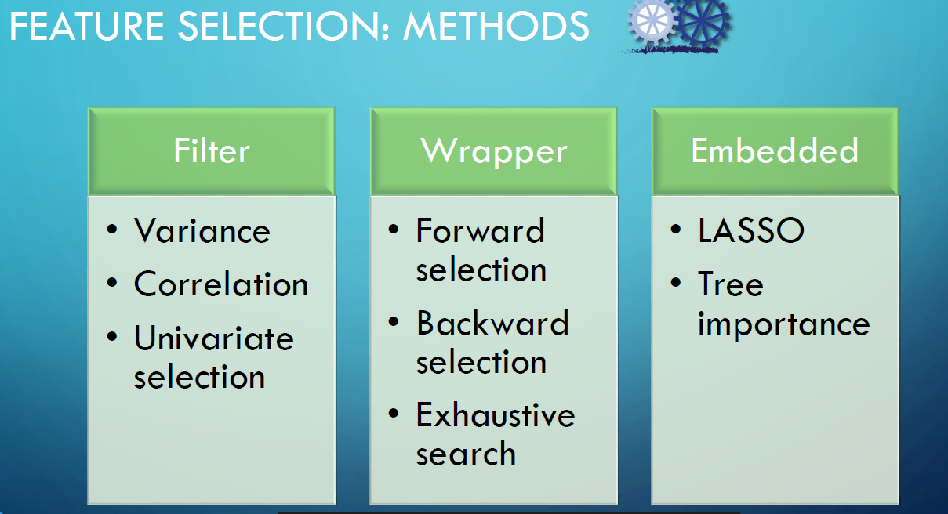
Some Methods of Feature Selection

Slide 12

Thank you

