Slide 1
Securing data hiding in image using steganography
CAPSTONE PROJECT
Presented By: Kiran Naik
Student Name : Kiran Naik
College Name & Department : AITS, ECE

Slide 2
OUTLINE
Problem Statement
Technology used
Wow factor
End users
Result
Conclusion
Git-hub Link
Future scope

Slide 3
Problem Statement
Steganography's core problem is hiding data undetectably.
Challenges involve security against detection and extraction.
Maximizing hidden data capacity without degrading the cover is key.
Resisting statistical steganalysis ensures covertness.
Adapting techniques for specific uses, like watermarking, is needed.
Ethical considerations are vital to prevent misuse.

Slide 4
Technology used
Libraries:
CV2 (OpenCV)
OS
Hashlib
Tkinter
Platforms:
This code is written in Python, which is a cross platform language. Therefore it can run on
Windows
MacOS
Linux

Slide 5
Wow factors
This Steganography project has below key features:
Secure Password Hashing: Uses SHA-256 for password protection.
Embedded Password Verification: Integrates the password hash into the image for secure decryption.
Direct Image Handling: Leverages OpenCV for straightforward image I/O.
Functional Separation: Distinguishes between encryption and decryption processes.

Slide 6
End users
Individuals who are seeking privacy
Security Conscious users
Developers and Programmers
Forensic analysts
People who wants to send a hidden message in a picture

Slide 7
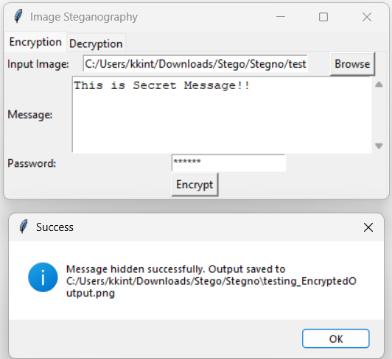
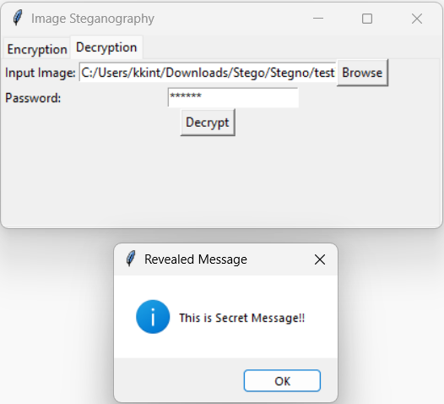
Results

Slide 8
Conclusion
This project allows users to hide text messages within images using LSB steganography. It secures messages with password hashing, making them difficult to access without authorization. Its simplified design offers a straightforward way to conceal information.

Slide 9
GitHub Link
https://github.com/KiranNaik9/Steganography

Slide 10
Future scope(optional)

Slide 11
THANK YOU

