Slide 1
Concealing secret message in an image using NUAIS and secret sharing algorithm
G.UDAY KUMAR REDDY P.KIRAN
114015038 114015052
GUIDE NAME: Prof. B.SRINIVASAN
SASTRA UNIVERSITY

Slide 2
WHY DO WE NEED THIS PROJECT?
To provide security and privacy to the text .
To increase the security by providing multiple levels of security.
To avoid unauthorized accesses.
Encryption increases the security to text.
Non Uniform Image Segmentation provides security based on the password given by user.
Secret Sharing algorithm reduced the computational complexity.

Slide 3
Literature Review
Text to be shared is encrypted and later is embedded in to image.
The image is divided in to Non uniform segments and then the cipher text is embedded into it.
The information about hiding of secret data is also stored in the same image.
Then the cover image containing the secret text and its information is sent to receiver.
Then the text is retrieved by reverse process.

Slide 4
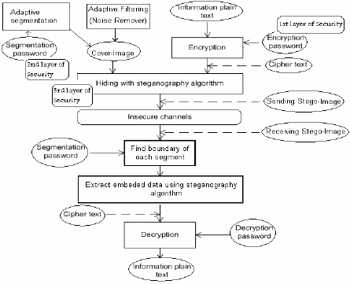
contd.

Slide 5
Problem statement
To avoid the computational complexity , secret sharing algorithm is used.
Text to be sent secretly is initially encrypted to provide more security.
To enhance character based security, segmentation is performed in non uniform way.
NUAIS and text encryption algorithms are used to improve the security.
PLATFORM: JAVA.

Slide 6
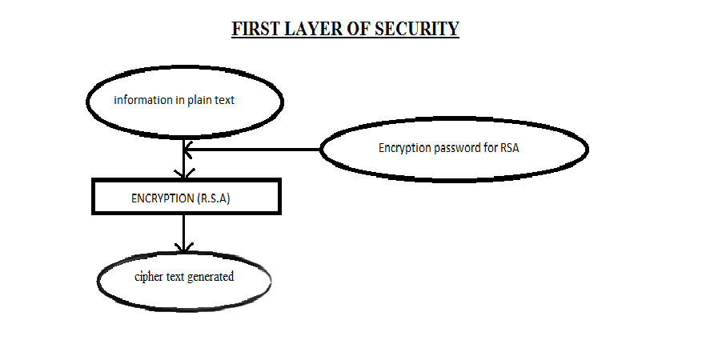
The work to be carried

Slide 7
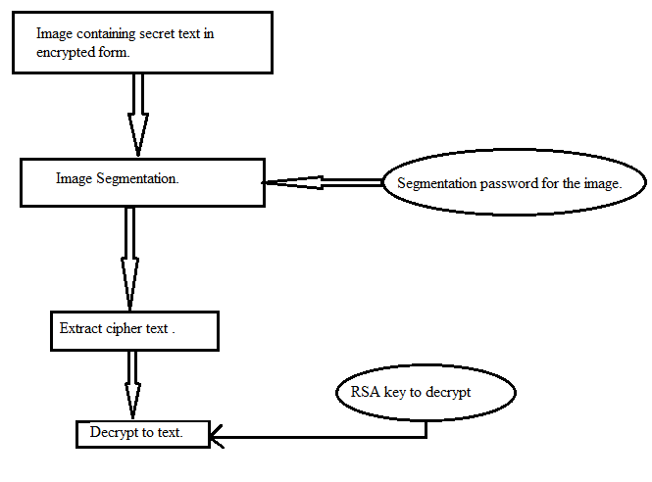
Contd..

Slide 8
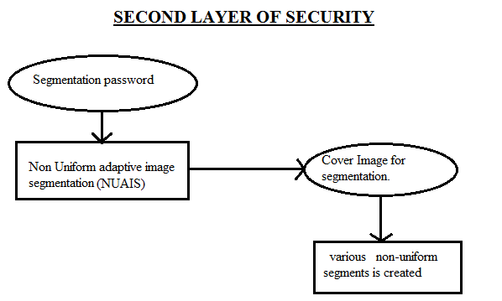
Contd..

Slide 9
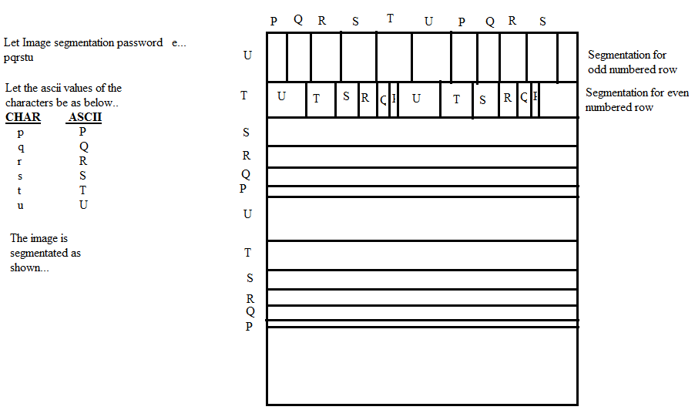
Segmentation Process

Slide 10
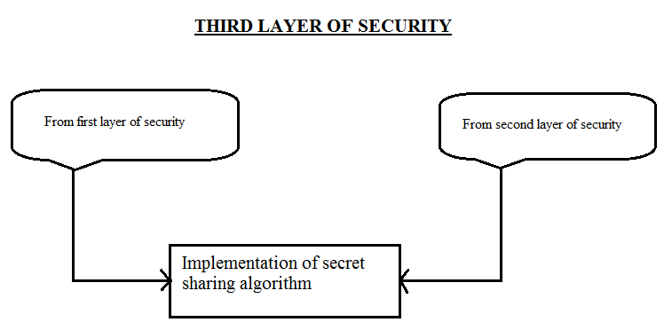
Contd..

Slide 11
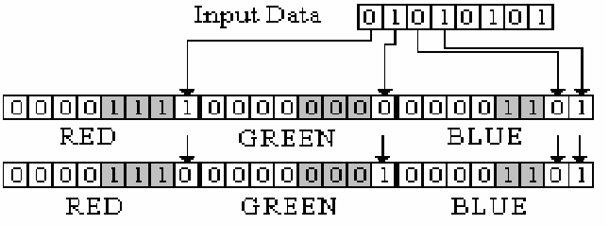
Hiding Process
Main Case -3

Slide 12
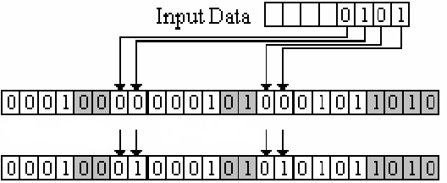
Contd..
Main case -5 and Maincase-6

Slide 13
REFERENCES
EL-Emam, N., 2007. Hiding a large amount of data with high security using steganography algorithm. Journal of Computer Science 3 (4), 223–232, doi:10.3844/jcssp.2007.223.232.
Geetha, S., Kabilan, V., Chockalingam, S., KamarajVarying, N., 2011. Radix numera system based adaptive image steganography. Information Processing Letters 111, 792–797, Elsevier. doi:10.1016/j.ipl.2011.05.013

