Slide 1
CSE 486/586 Distributed Systems Distributed File Systems
Steve Ko
Computer Sciences and Engineering
University at Buffalo

Slide 2
Local File Systems
File systems provides file management.
Name space
API for file operations (create, delete, open, close, read, write, append, truncate, etc.)
Physical storage management & allocation (e.g., block storage)
Security and protection (access control)
Name space is usually hierarchical.
Files and directories
File systems are mounted.
Different file systems can be in the same name space.

Slide 3
Traditional Distributed File Systems
Goal: emulate local file system behaviors
Files not replicated
No hard performance guarantee
But,
Files located remotely on servers
Multiple clients access the servers
Why?
Users with multiple machines
Data sharing for multiple users
Consolidated data management (e.g., in an enterprise)

Slide 4
Requirements
Transparency: a distributed file system should appear as if it were a local file system
Access transparency: it should support the same set of operations, i.e., a program that works for a local file system should work for a DFS.
(File) Location transparency: all clients should see the same name space.
Migration transparency: if files move to another server, it shouldn’t be visible to users.
Performance transparency: it should provide reasonably consistent performance.
Scaling transparency: it should be able to scale incrementally by adding more servers.

Slide 5
Requirements
Concurrent updates should be supported.
Fault tolerance: servers may crash, msgs can be lost, etc.
Consistency needs to be maintained.
Security: access-control for files & authentication of users

Slide 6
File Server Architecture
Client computer
Server computer
Application
Application
Directory service
program
program
Flat file service
Client module

Slide 7
Components
Directory service
Meta data management
Creates and updates directories (hierarchical file structures)
Provides mappings between user names of files and the unique file ids in the flat file structure.
Flat file service
Actual data management
File operations (create, delete, read, write, access control, etc.)
These can be independently distributed.
E.g., centralized directory service & distributed flat file service

Slide 8
Sun NFS
Client Computer
Server Computer
Application Program
Application Program
UNIX Kernel
Virtual File System
Virtual File System
UNIX File System
Other File System
NFS Client System
NFS Server System
UNIX File System
NFS Protocol

Slide 9
VFS
A translation layer that makes file systems pluggable & co-exist
E.g., NFS, EXT2, EXT3, ZFS, etc.
Keeps track of file systems that are available locally and remotely.
Passes requests to appropriate local or remote file systems
Distinguishes between local and remote files.

Slide 10
NFS Mount Service
/
/
/
org
usr
nfs
people
student
staff
users
mth
john
bob
...
pet
jim
bob
…
Server 1
Client
Server 2
Each server keeps a record of local files available for remote mounting. Clients use a mount command for remote mounting, providing name mappings
Remote Mount

Slide 11

NFS Basic Operations
Client
Transfers blocks of files to and from server via RPC
Server
Provides a conventional RPC interface at a well-known port on each host
Stores files and directories
Problems?
Performance
Failures

Slide 12
Improving Performance
Let’s cache!
Server-side
Typically done by OS & disks anyway
A disk usually has a cache built-in.
OS caches file pages, directories, and file attributes that have been read from the disk in a main memory buffer cache.
Client-side
On accessing data, cache it locally.
What’s a typical problem with caching?
Consistency: cached data can become stale.

Slide 13
(General) Caching Strategies
Read-ahead (prefetch)
Read strategy
Anticipates read accesses and fetches the pages following those that have most recently been read.
Delayed-write
Write strategy
New writes stored locally.
Periodically or when another client accesses, send back the updates to the server
Write-through
Write strategy
Writes go all the way to the server’s disk
This is not an exhaustive list!

Slide 14
NFS V3 Client-Side Caching
We’ll mainly look at NFS V3.
Write-through, but only at close()
Not every single write
Helps performance (reduces network activities & traffic)
Multiple writers
No guarantee
Could be any combination of (over-)writes
Leads to inconsistency

Slide 15
Validation
A client periodically checks with the server about cached blocks.
Each block has a timestamp.
If the remote block is new, then the client invalidates the local cached block.
Always invalidate after some period of time
3 seconds for files
30 seconds for directories
Written blocks are marked as “dirty.”

Slide 16
Failures
Two design choices: stateful & stateless
Stateful
The server maintains all client information (which file, which block of the file, the offset within the block, file lock, etc.)
Good for the client-side process (just send requests!)
Becomes almost like a local file system (e.g., locking is easy to implement)
Problem?
Server crash → lose the client state
Becomes complicated to deal with failures

Slide 17
Failures
Stateless
Clients maintain their own information (which file, which block of the file, the offset within the block, etc.)
The server does not know anything about what a client does.
Each request contains complete information (file name, offset, etc.)
Easier to deal with server crashes (nothing to lose!)
NFS V3’s choice
Problem?
Locking becomes difficult.

Slide 18
NFS V3
Client-side caching for improved performance
Write-through at close()
Consistency issue
Stateless server
Easier to deal with failures
Locking is not supported (later versions of NFS support locking though)
Simple design
Led to simple implementation, acceptable performance, easier maintenance, etc.
Ultimately led to its popularity

Slide 19
NFS V4
Stateful system
New APIs: open() and close()
Locking is supported through lock(), lockt(), locku(), renew()
Supports read/write locks, call backs etc.
Effective use of client side caching
Version 4.1 (pNFS)
Parallel NFS supports parallel file I/O
File is striped and stored across multiple servers
Metadata and data are separated
19

Slide 20
CSE 486/586 Administrivia
Mid-semester grades will be posted by Friday.
PA3 is due on Friday.
Academic integrity

Slide 21
Brief Intro to Data Centers
The rest of the semester deals with data centers a lot.

Slide 22
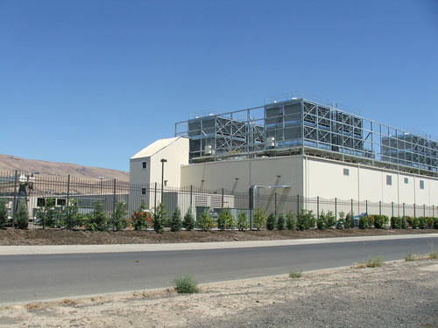
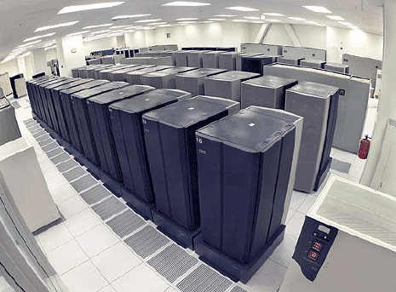
Data Centers
Buildings full of machines

Slide 23
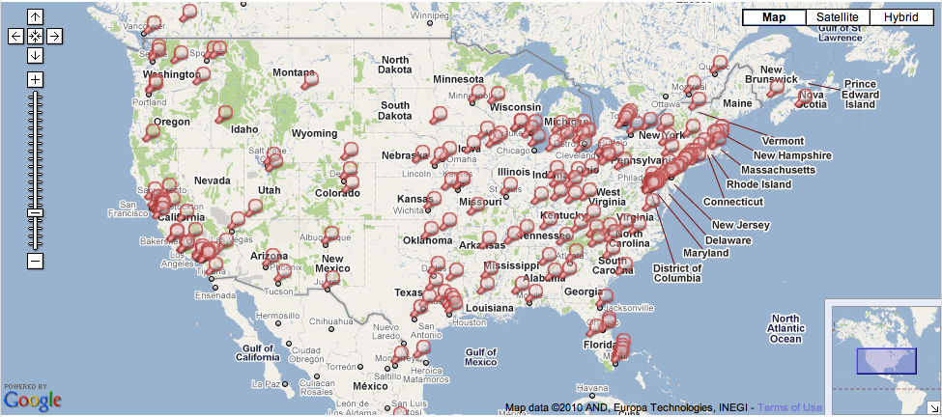
Data Centers
Hundreds of Locations in the US

Slide 24
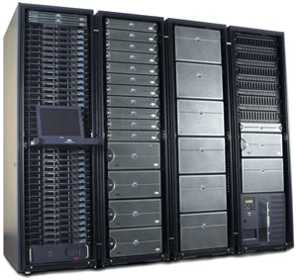
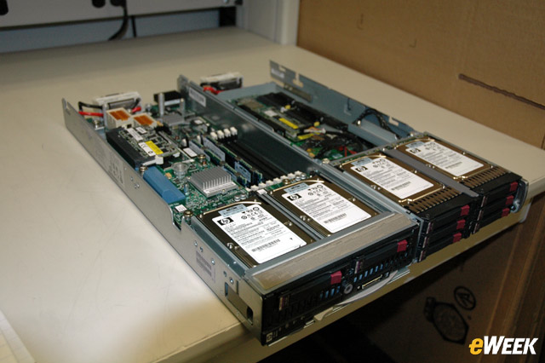
Inside
Servers in racks
Usually ~40 blades per rack
ToR (Top-of-Rack) switch
Incredible amounts of engineering efforts
Power, cooling, etc.

Slide 25
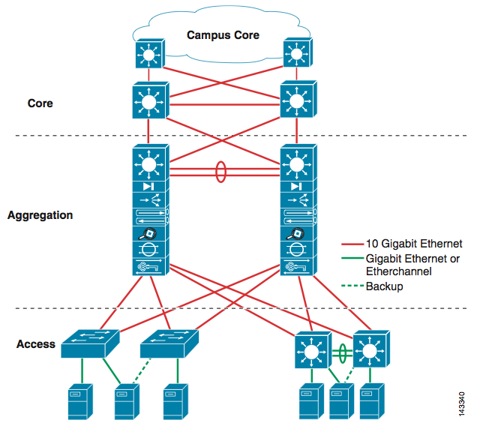
Inside
Network

Slide 26
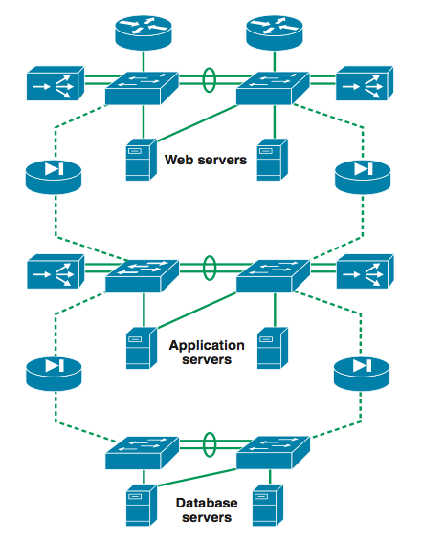
Inside
3-tier for Web services

Slide 27
Web Services
Amazon, Facebook, Google, Twitter, etc.
World-wide distribution of data centers
Load balance, fault tolerance, performance, etc.
Replicated service & data
Each data center might be a complete stand-alone web service. (It depends though.)
At the bare minimum, you’re doing read/write.
What needs to be done when you issue a read req?
Server selection
What needs to be done when you issue a write req?
Server selection
Replicated data store management

Slide 28
Server Selection Primer
Can happen at multiple places
Server resolution process: DNS -> External IP -> Internal IP
DNS
www.facebook.com
69.63.181.11
69.63.181.12
North Carolina
www.facebook.com
69.63.187.17
69.63.187.18
69.63.187.19
California

Slide 29
IP Anycast
BGP (Border Gateway Protocol) level
Hey, I know where 69.63.187.17 is…
in New York
Hey, I know where 69.63.187.17 is…
in California

Slide 30
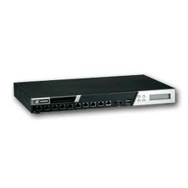
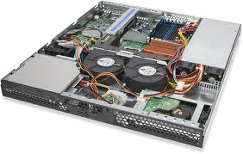
Inside
Load balancers
69.63.176.13
10.0.0.1
10.0.0.2
10.0.0.200
Web Servers

Slide 31
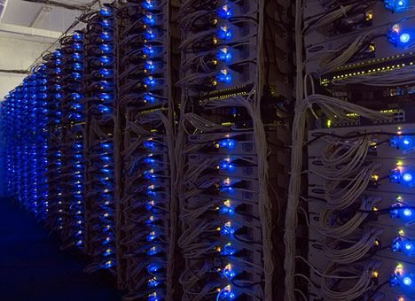
Example: Facebook
www.facebook.com
69.63.176.13
69.63.176.14
Oregon
69.63.181.11
69.63.181.12
North Carolina
69.63.187.17
69.63.187.18
69.63.187.19
California

Slide 32
Example: Facebook Geo-Replication
(At least in 2008) Lazy primary-backup replication
All writes go to California, then get propagated.
Reads can go anywhere (probably to the closest one).
Ensure (probably sequential) consistency through timestamps
Set a browser cookie when there’s a write
If within the last 20 seconds, reads go to California.
http://www.facebook.com/note.php?note_id=23844338919

Slide 33
Core Issue: Handling Replication
Replication is (almost) inevitable.
Failures, performance, load balance, etc.
We will look at this in the next few weeks.
Data replication
Read/write can go to any server.
How to provide a consistent view? (i.e., what consistency guarantee?) linearizability, sequential consistency, causal consistency, etc.
What happens when things go wrong?
State machine replication
How to agree on the instructions to execute?
How to handle failures and malicious servers?

Slide 34
Summary
NSF
Caching with write-through policy at close()
Stateless server till V3
Stateful from V4
4.1 supports parallel I/O

Slide 35
Acknowledgements
These slides contain material developed and copyrighted by Indranil Gupta (UIUC).

