Slide 1
CSE 486/586 Distributed Systems Consistency --- 3
Steve Ko
Computer Sciences and Engineering
University at Buffalo

Slide 2
Recap
Consistency
Linearizability
Sequential consistency
Chain replication
Primary-backup (passive) replication
Active replication

Slide 3
Two More Consistency Models
Even more relaxed
We don’t even care about providing an illusion of a single copy.
Causal consistency
We care about ordering causally related write operations correctly.
Eventual consistency
As long as we can say all replicas converge to the same copy eventually, we’re fine.

Slide 4
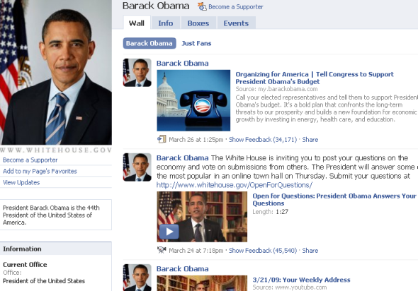

Relaxing the Guarantees
Do we need sequential consistency?
Does everyone need to see these in this particular order? What kind of ordering matters?
Causal
Notes:
E.g., my friend A posts something on my wall. Then my other friend B posts something on my wall. These are two unrelated, independent posts. Does it matter everyone sees in the exact same order?
What if on my browser, it’s A first then B, and on your browser, it’s B first then A?

Slide 5
Relaxing the Guarantees
Sequential consistency
Still single-client, single-copy semantics, it’s just that the single-client ordering does not strictly follow the physical-time order.
Every client should see the same write (update) order (every copy should apply all writes in the same order), since we need to give an illusion of a single copy.
E.g., writes are not applied in the same order:
P1: a.write(A)
P2: a.write(B)
P3: a.read()->B a.read()->A
P4: a.read()->A a.read()->B
In the previous scenario,
Sequential consistency: All clients (all users’ browsers) will see all posts in the same order.

Slide 6
Relaxing the Guarantees
For some applications, different clients (e.g., users) do not need to see the writes in the same order, but causality is still important (e.g., facebook post-like pairs).
Causal consistency
More relaxed than sequential consistency
Clients can read values out of order, i.e., it doesn’t behave as a single copy anymore.
Clients read values in-order for causally-related writes.
How do we define “causal relations” between two writes? (Hint: think about a message and a reply on a facebook wall---what events are involved?)
One client reads something that another client has written; then the client writes something.

Slide 7
Causal Consistency
If two writes are causally related, we apply those writes in the same order across all replicas.
If two writes are not causally related (concurrent), then we don’t need to apply those writes in the same order across all replicas.
The storage system doesn’t give an illusion that there is a single copy.

Slide 8
Causal Consistency
Example 1:
Causally related
Concurrent writes
P1:
W(x)1
W(x) 3
P2:
R(x)1 W(x)2
P3:
R(x)1
R(x)3 R(x)2
P4:
R(x)1
R(x)2 R(x) 3
This sequence obeys causal consistency
Notes:
1 has to be read before 2 everywhere. Likewise, 1 has to be read before 3 everywhere. But not so for 2 and 3.

Slide 9
Causal Consistency Example 2
Causally consistent?
No!
Causally related
P1:
W(x)1
P2:
R(x)1 W(x)2
P3:
R(x)2 R(x)1
P4:
R(x)1 R(x) 2

Slide 10
Causal Consistency Example 3
Causally consistent?
Yes!
P1:
W(x)1
P2:
W(x)2
P3:
R(x)2 R(x)1
P4:
R(x)1 R(x) 2

Slide 11
Implementing Causal Consistency
We drop the notion of a single copy.
Writes can be applied in different orders across copies.
Causally-related writes do need to be applied in the same order for all copies.
Need a mechanism to keep track of causally-related writes.
Due to the relaxed requirements, low latency is more tractable.

Slide 12
CSE 486/586 Administrivia

Slide 13
Relaxing Even Further
Let’s just do best effort to make things consistent.
Eventual consistency
Popularized by the CAP theorem.
The main problem is network partitions.
Client + front end
Client + front end
Network
U
withdraw(B, 4)
T
partition
deposit(B,3);
B
Replica managers
B
B
B

Slide 14
Dilemma
In the presence of a network partition:
In order to keep the replicas consistent, you need to block.
From an outside observer, the system appears to be unavailable.
If we still serve the requests from two partitions, then the replicas will diverge.
The system is available, but no consistency.
The CAP theorem explains this dilemma.

Slide 15
CAP Theorem
Consistency
Availability
Respond with a reasonable delay
Partition tolerance
Even if the network gets partitioned
In the presence of a partition, which one to choose? Consistency or availability?
Brewer conjectured in 2000, then proven by Gilbert and Lynch in 2002.

Slide 16
Coping with CAP
The main issue is the Internet.
As the system grows to span geographically distributed areas, network partitioning sometimes happens.
Then the choice is either giving up availability or consistency
A design choice: What makes more sense to your scenario?
Giving up availability and retaining consistency
E.g., use 2PC
Your system blocks until everything becomes consistent.
Giving up consistency and retaining availability
Eventual consistency

Slide 17
Dealing with Network Partitions
Basic idea: allow operations to continue in one or some of the partitions, but reconcile the differences later after partitions have healed
During a partition, pairs of conflicting transactions may have been allowed to execute in different partitions. The only choice is to take corrective action after the network has recovered
Assumption: Partitions heal eventually
Abort one of the transactions after the partition has healed

Slide 18
Quorum Approaches
Quorum approaches used to decide whether reads and writes are allowed
There are two types: pessimistic quorums and optimistic quorums
In the pessimistic quorum philosophy, updates are allowed only in a partition that has the majority of replicas
Updates are then propagated to the other replicas when the partition is repaired.

Slide 19
Static Quorums
The decision about how many replicas should be involved in an operation on replicated data is called Quorum selection
Quorum rules state that:
At least r replicas must be accessed for read
At least w replicas must be accessed for write
r + w > N, where N is the number of replicas
w > N/2
Each object has a version number or a consistent timestamp

Slide 20
Static Quorums
r = 2, w = 2, N = 3: r + w > N, w > N/2
N0
N1
N2
Client 1: Write
Client 2: Read

Slide 21
Static Quorums
What does r + w > N mean?
The only way to satisfy this condition is that there’s always an overlap between the reader set and the write set.
There’s always some replica that has the most recent write.
What does w > N/2 mean?
When there’s a network partition, only the partition with more than half of the replicas can perform write operations.
The rest will just serve reads with stale data.
R and W are tunable:
E.g., N=3, r=1, w=3: High read throughput, perhaps at the cost of write throughput.

Slide 22
Optimistic Quorum Approaches
An Optimistic Quorum selection allows writes to proceed in any partition.
“Write, but don’t commit”
Unless the partition gets healed in time.
Resolve write-write conflicts after the partition heals.
Optimistic Quorum is practical when:
Conflicting updates are rare
Conflicts are always detectable
Damage from conflicts can be easily confined
Repair of damaged data is possible or an update can be discarded without consequences
Partitions are relatively short-lived

Slide 23
Summary
Causal consistency & eventual consistency
Quorums
Static
Optimistic
View-based

Slide 24
Acknowledgements
These slides contain material developed and copyrighted by Indranil Gupta (UIUC).

