Slide 1
CSE 486/586 Distributed Systems Distributed Shared Memory
Steve Ko
Computer Sciences and Engineering
University at Buffalo

Slide 2
Overview
Today: distributed shared memory, starting from some background on memory sharing
Memory sharing for a single machine
Threads and processes
Memory sharing for different machines
Threads and processes

Slide 3
Why Shared Memory?
For sharing data
There are two strategies for data sharing.
Message passing
Shared memory
Message passing
Send/receive primitives
Explicit sharing → no synchronization (locks) necessary
Shared memory
Memory read/write primitives (in your code, you could use regular variables)
Typically requires explicit synchronization (locks)
Which is better?
Depends on your use case.
Multiple writers: perhaps message passing
(Mostly) read-only data: shared memory

Slide 4
Memory Sharing for Threads
Threads belong to a single process, so all threads share the same memory address space.
E.g., Java threads class MyThread extends Thread { HashMap hm; MyThread(HashMap _hm ) { this.hm = _hm; } public void run() { … hm.put(key, value); } } HashMap hashMap = new HashMap(); MyThread mt0 = new MyThread(hashMap); // hashMap is shared MyThread mt1 = new MyThread(hashMap); mt0.start(); mt1.start();

Slide 5
Memory: Threads vs. Processes
For threads, there’s no special mechanism necessary to share memory.
Note: Languages like Java provide constructs to create thread-specific variables because by default memory is shared across different threads.
ThreadLocal for Java: if a shared object has a ThreadLocal variable, it will be specific to each thread.
But, a process has its own address space, so by default, different processes do not share memory.
Processes (on the same machine) can share memory regions with support from their OS.

Slide 6

Shared Memory on a Single Machine
Shared memory is part of IPC (Inter-Process Communication).
What are other IPC mechanisms?
Files, (domain) sockets, pipes, etc.
Shared memory API (POSIX C)
shm_open(): create and open a new object, or open an existing object. The call returns a file descriptor.
mmap(): map the shared memory object into the virtual address space of the calling process.
…and others
Semaphore API (POSIX C)
sem_open(): initialize and open a named semaphore
sem_wait(): lock a semaphore
sem_post(): unlock a semaphore
…and others

Slide 7
Shared Memory Example* (in C)
int main() {
const char *name = “shared”; // shared with other processes
int shm_fd;
void *ptr;
/* create the shared memory segment. name is shared. */
shm_fd = shm_open(name, O_CREAT | O_RDWR, 0666);
…
/* now map the shared memory segment in the address space of the process */
ptr = mmap(0,SIZE, PROT_READ | PROT_WRITE,
MAP_SHARED, shm_fd, 0);
sprintf(ptr,"%s",message0);
return 0;
}
*Adapted from http://www.os-book.com

Slide 8
Shared Memory Implementation
VPFN: Virtual page frame number
PFN: Physical page frame number
Adapted from http://tldp.org/LDP/tlk/mm/memory.html
Process X
Process Y
VPFN7
VPFN7
Process X Page table
Process Y Page table
VPFN6
VPFN6
VPFN5
VPFN5
VPFN4
PFN4
VPFN4
VPFN3
PFN3
VPFN3
VPFN2
PFN2
VPFN2
VPFN1
PFN1
VPFN1
VPFN0
PFN0
VPFN0
Virtual memory
Physical memory
Virtual memory
Notes:
PFN4 is shared between two processes.

Slide 9
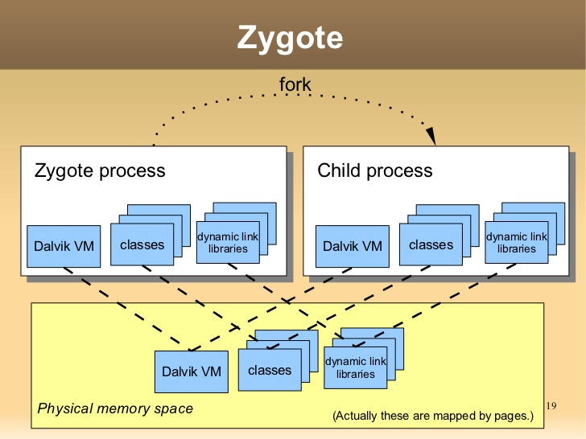
Shared Memory Use Case: Android
All apps need framework API libraries, Java VM, etc.
Too expensive if all app processes have them in their memory space individually.
Zygote: A process that starts everything else.
All app processes share memory with Zygote.
Image source: https://www.slideshare.net/tetsu.koba/android-is-not-just-java-on-linux/19-Zygote_forkZygote_process_Child_process
Notes:
Zygote has the original copy of framework libraries, Java VM, native libraries, HAL, etc. When an app starts, Zygote forks it as a new process. All other processes access this copy through shared memory.

Slide 10
CSE 486/586 Administrivia
PA3 grades will be posted today.
PA4 deadline: 5/10
Please start early. The grader takes a long, long time.
Survey & course evaluation
Survey: https://forms.gle/eg1wHN2G8S6GVz3e9
Course evaluation: https://www.smartevals.com/login.aspx?s=buffalo
If both have 80% or more participation,
For each of you, I’ll take the better one between the midterm and the final, and give the 30% weight for the better one and the 20% weight for the other one.
(Currently, it’s 20% for the midterm and 30% for the final.)
No recitation today; replaced with office hours

Slide 11
Distributed Shared Memory
We will discuss two cases.
DSM for processes
DSM for threads
DSM for processes: different processes running on different machines sharing a memory page.
The shared memory page is replicated and synchronized across different machines.
However, replication is not the goal (e.g., we’re not keeping replicas to deal with failures).
A generic way of doing this is at the OS layer.
Similar to the diagram on slide #8, but with processes on different machines

Slide 12
DSM Synchronization Options
Write-update
A process updates a memory page.
The update is multicast to other replicas.
The multicast protocol determines consistency guarantees (e.g., FIFO-total for sequential consistency).
Reads are cheap (always local), but writes are costly (always multicast).
Write-invalidate
Two states for a shared page: read-only or read & write
Read-only: the memory page is potentially replicated on two or more processes/machines
Read & write: the memory page is exclusive for the process (no other replica)
If a process intends to write to a read-only page, an invalidate request is multicast to other processes.
Later writes can take place without communication (cheap).
Writes are only propagated when there’s a read by another process (cheap for write, costly for read).
But a write can be delayed by invalidation (costly for write).
Notes:
If we’re replicating for failures, then write-update would be the choice. But that’s not the case for DSM. Write-invalidate is fine for synchronization.

Slide 13
Write Invalidate Protocol Example
Note: R fault and W fault can occur at any process
Single writer
Multiple readers
R fault
Read/write state
Read-only state
W fault
W fault (invalidation)
R fault

Slide 14
Example System: Ivy
Implements a write-invalidation protocol
Owner of a page: the process with the most up-to-date
Copyset of a page: the processes with a replica
A centralized manager maintains ownership info.
Faulting process
3. Page
Current owner
1. Req: page no (R/W)
2. Req, page no (R/W)
Manager
Page No. Owner

Slide 15
Granularity Problem
Let’s assume that we operate at the page-level.
(But other implementations also have similar problems.)
Just as a reference, a Linux memory page is 4KB.
Problem
When two processes (on two different machines) share a page, it doesn’t always mean that they share everything on the page.
E.g., one process reads from and writes to a variable X, while the other process reads from and writes to another variable Y. If they are in the same memory page, the processes are sharing the page.

Slide 16
Granularity Problem
True sharing
Two processes share the exact same data.
False sharing
Two processes do not share the exact same data, but they access different data from the same page.
False sharing problems
Write-invalidate: unnecessary invalidations
Write-update: unnecessary data transfers
P0
P1

Slide 17
Granularity Problem
Bigger page sizes
Better handling for updates of large amounts of data (good)
Less management overhead due to a smaller number of units/pages to handle (good)
More possibility for false sharing (bad)
Smaller page sizes
The opposite of the above
If there is an update of a large amount of data, it’ll be broken down to many small updates, which leads to more network overhead (bad)
A smaller page size means more pages, which leads to more management overhead, i.e., more tracking of reads and writes (bad)
Less possibility of false sharing (good)

Slide 18
Thrashing
Thrashing could happen with write-invalidate protocols.
Thrashing is said to occur when DSM spends an inordinate amount of time invalidating and transferring shared data compared with the time spent by application processes doing useful work.
This occurs when several processes compete for a data item or for falsely shared data items.

Slide 19
Thrashing
Common scenario: producer-consumer pattern
Data is produced by a process and used by another process.
The producer will keep invalidating the consumer & the consumer will keep transferring data from the producer.
Write-update is better for this pattern.
Solutions to thrashing
Manual avoidance: a programmer avoids thrashing patterns.
Timeslicing: once a process gains a write access to a page, it retains it for a period of time. Other processes’ read/write requests are buffered during that period.

Slide 20
DSM for Threads
Memory sharing among threads on different machines.
Use case: code (thread) offloading from a smartphone to a server
Low-power smartphones augmented by high-power servers (computation & energy)
It’s done already (cloud backend), but DSM allows it without any programmer effort.
Phone
Server
App
Helper Process
Notes:
E.g., a chess game that needs a lot of AI for computing the next move.

Slide 21
Example: Comet*
Comet allows thread offloading for Android apps in Java
Comet synchronizes the entire Java VM state.
Mobile app (unmodified & multi-threaded)
Offloaded threads
Phone OS
Server OS
Memory states
In-sync
Memory states
Distributed memory synchronization
Via network
Distributed memory synchronization
*https://www.usenix.org/conference/osdi12/technical-sessions/presentation/gordon

Slide 22
Java Code Execution Background
Memory: program code, stack, heap, & CPU state
Stack & heap
Generally, the program stack handles statically allocated objects & method call return addresses.
The heap is used for dynamically allocated objects. public class Ex { public void method() { int i = 0; // stack HashMap hm = new HashMap(); // heap } }
CPU state
Android Java VM uses registers for instruction execution.
The program counter (PC) points to the next instruction to execute.
For program execution, Java VM has an execution loop.
Fetches the next instruction that the PC points to.
Executes the new instruction
While executing, it uses registers, the stack, and the heap.

Slide 23
Comet Thread Migration
Comet completely synchronizes VMs on both sides (phone & server).
In Java, everything you need for program execution is stored in memory.
Program code, stack, heap, & CPU state
DSM can synchronize these.
Any side can execute a thread, since they both know everything necessary for program execution.
The PC is synchronized, so both sides know the next instruction to execute.
The registers are synchronized, so they both know the CPU state.
The stack & the heap are synchronized, so they know the memory state.

Slide 24
Summary
Memory sharing among threads
By default, they share the same address space
Memory sharing among processes
Shared memory API & semaphore API
Virtual-physical memory mapping implements this.
Memory sharing across machines
Write-update
Write-invalidate
Memory sharing across threads on different machines
Use case: code offloading

Slide 25
Acknowledgements
These slides contain material developed and copyrighted by Indranil Gupta (UIUC).

