Slide 1
CSE 486/586 Distributed Systems Case Study: Facebook Photo Stores
Steve Ko
Computer Sciences and Engineering
University at Buffalo

Slide 2
Engineering a System
Generally, when you engineer a system, you need to understand your workload.
And design your system according to the workload
(Perhaps not in the beginning since there’s no workload)
Engineering principle
Make the common case fast, and rare cases correct
(From Patterson & Hennessy books)
This principle cuts through generations of systems.
Example?
Caching
Knowing common cases == understanding your workload
E.g., read dominated? Write dominated? Mixed?
We’ll look at Facebook’s example.

Slide 3
Facebook Workload
What are the most frequent things you do on Facebook?
Read/write wall posts/comments/likes
View/upload photos
Very different in their characteristics
Read/write wall posts/comments/likes
Mix of reads and writes so more care is necessary in terms of consistency
But small in size so probably less performance sensitive
Photos
Write-once, read-many so less care is necessary in terms of consistency
But large in size so more performance sensitive

Slide 4
Facebook Photo Workload
(This is from 2010.)
260 billion images (~20 PB)
1 billion new photos per week (~60 TB)
One million image views per second at peak
Two characteristics: Facebook has analyzed their photo workload and discovered two characteristics.
The popularity distribution follows Zipf.
Popularity changes over time as photos “age.”

Slide 5
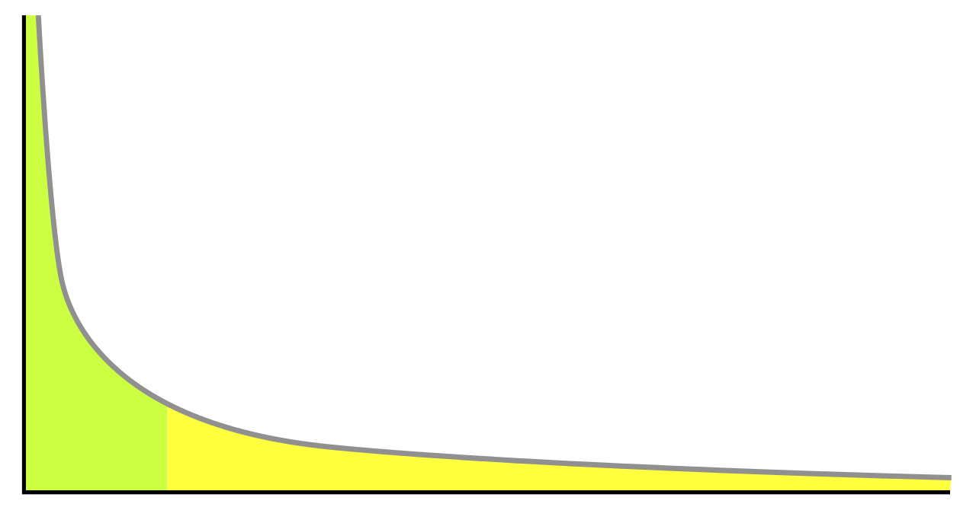
Zipf distribution
Based on the power law
Models a lot of natural phenomena
Social graphs, media popularity, wealth distribution, etc.
A lot of Web contents too.
Popularity
Items sorted by popularity

Slide 6
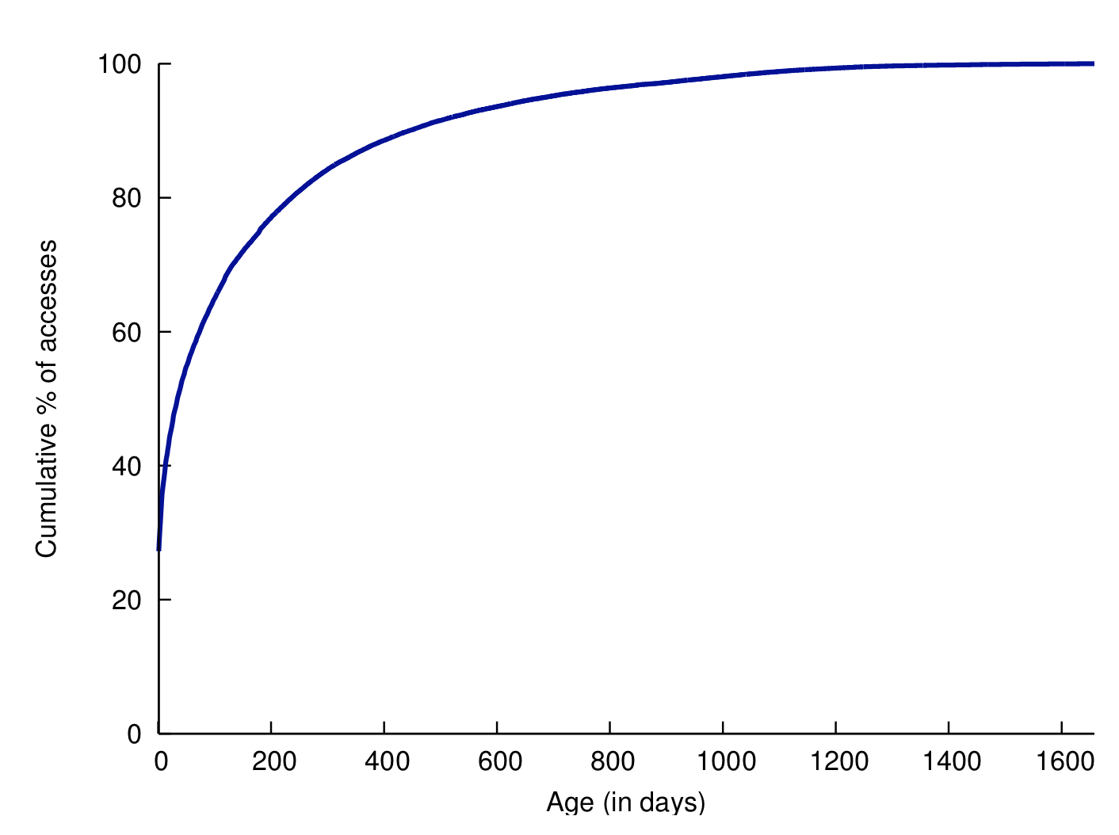
Popularity Comes with Age

Slide 7
Facebook Photo Distribution
“Hot” vs. “warm” vs. “cold” photos
Hot: Popular, a lot of views (approx. 90% of views)
Warm: Somewhat popular, but still a lot of views in aggregate
Cold: Unpopular, occasional views
Popularity
Items sorted by popularity
Notes:
Based on the observations, Facebook divided their workload into three types and designed mechanisms to handle those types differently.

Slide 8
Handling Different Types of Photos
Hot photos
Facebook uses a CDN (Content Distribution Network) for these.
Very good performance, but no reliability guarantee
CDN is a cache, not a permanent storage.
Warm photos
Facebook has designed its own storage called Haystack.
Balances performance and reliability
Cold photos
Facebook has designed an “archival” storage called f4.
Aims for storage efficiency when storing replicated photos (but not high performance)
Notes:
For each type of workload, the emphasis changes.

Slide 9
CSE 486/586 Administrivia
PA4 deadline: 5/10
Survey & course evaluation
Survey: https://forms.gle/eg1wHN2G8S6GVz3e9
Course evaluation: https://www.smartevals.com/login.aspx?s=buffalo
If both have 80% or more participation,
For each of you, I’ll take the better one between the midterm and the final, and give the 30% weight for the better one and the 20% weight for the other one.
(Currently, it’s 20% for the midterm and 30% for the final.)
No recitation this week; replaced with office hours

Slide 10
CDN for Hot Photos
10
Content providers are CDN customers
Content replication
CDN company (e.g., Akamai) installs thousands of servers throughout Internet
In large datacenters close to users
CDN replicates customers’ content
When provider updates content, CDN updates servers
origin server
in North America
CDN distribution node
CDN server
in S. America
CDN server
in Asia
CDN server
in Europe

Slide 11
Domain Name System
For a given user, how to locate a close server?
Many CDNs rely on Domain Name System (DNS)
DNS maps a DNS name to an IP address or another DNS name (alias).
E.g., www.cse.buffalo.edu
Domain: registrar for each top-level domain
Host name: local administrator assigns to each host
Properties of DNS
Hierarchical name space
Distributed over a collection of DNS servers
Hierarchy of DNS servers
Root servers
Top-level domain (TLD) servers
Authoritative DNS servers

Slide 12
Distributed Hierarchical Database
unnamed root
com
edu
org
ac
uk
zw
arpa
generic domains
country domains
bar
ac
in-
addr
west
east
cam
12
foo
my
usr
34
my.east.bar.edu
usr.cam.ac.uk
56
12.34.56.0/24

Slide 13
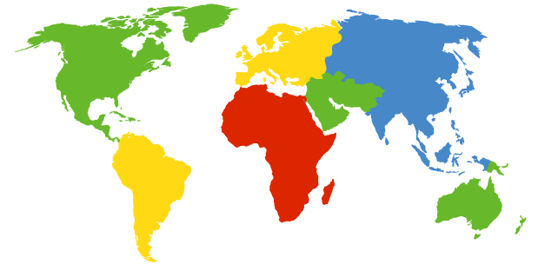
DNS Root Servers
13 root servers (see http://www.root-servers.org/)
Labeled A through M
A Verisign, Dulles, VA
C Cogent, Herndon, VA (also Los Angeles)
D U Maryland College Park, MD
G US DoD Vienna, VA
H ARL Aberdeen, MD
J Verisign, ( 11 locations)
K RIPE London (+ Amsterdam, Frankfurt)
I Autonomica, Stockholm (plus 3 other locations)
E NASA Mt View, CA
F Internet Software C. Palo Alto, CA (and 17 other locations)
m WIDE Tokyo
B USC-ISI Marina del Rey, CA
L ICANN Los Angeles, CA

Slide 14
TLD and Authoritative DNS Servers
Top-level domain (TLD) servers
Generic domains (e.g., com, org, edu)
Country domains (e.g., uk, fr, ca, jp)
Typically managed professionally
Network Solutions maintains servers for “com”
Educause maintains servers for “edu”
Authoritative DNS servers
Provide public records for hosts at an organization
For the organization’s servers (e.g., Web and mail)
Can be maintained locally or by a service provider

Slide 15
Example
root DNS server
Host at cis.poly.edu wants IP address for gaia.cs.umass.edu
2
3
TLD DNS server
4
local DNS server
dns.poly.edu
5
7
6
1
8
authoritative DNS server
dns.cs.umass.edu
requesting host
cis.poly.edu
gaia.cs.umass.edu

Slide 16
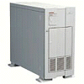

How a CDN Works
16
facebook.com (content provider)
HTTP
DNS root server
GET index.html
Akamai
cluster
http://cache.facebook.com/facebook.com/foo.jpg
Akamai global
DNS server
1
2
HTTP
Akamai regional
DNS server
Nearby Akamai
cluster
End-user
Notes:
Each Akamai DNS server runs an algorithm to narrow down close servers.

Slide 17
How a CDN Works
17
facebook.com (content provider)
HTTP
DNS root server
DNS lookup
cache.facebook.com
Akamai
cluster
Akamai global
DNS server
1
2
3
ALIAS:
g.akamai.net
4
Akamai regional
DNS server
Nearby Akamai
cluster
End-user

Slide 18
How a CDN Works
18
facebook.com (content provider)
HTTP
DNS root server
DNS lookup
g.akamai.net
Akamai
cluster
Akamai global
DNS server
5
1
2
3
Server selection algorithm
4
6
Akamai regional
DNS server
ALIAS
a73.g.akamai.net
Nearby Akamai
cluster
End-user

Slide 19
How a CDN Works
19
facebook.com (content provider)
HTTP
DNS root server
Akamai
cluster
Akamai global
DNS server
5
1
2
3
4
6
Akamai regional
DNS server
7
DNS a73.g.akamai.net
8
Server selection algorithm
Address
1.2.3.4
Nearby Akamai
cluster
End-user

Slide 20
How a CDN Works
20
facebook.com (content provider)
HTTP
DNS root server
Akamai
cluster
Akamai global
DNS server
5
1
2
3
4
6
Akamai regional
DNS server
7
8
9
Nearby Akamai
cluster
End-user
GET /foo.jpg
Host: cache.facebook.com

Slide 21
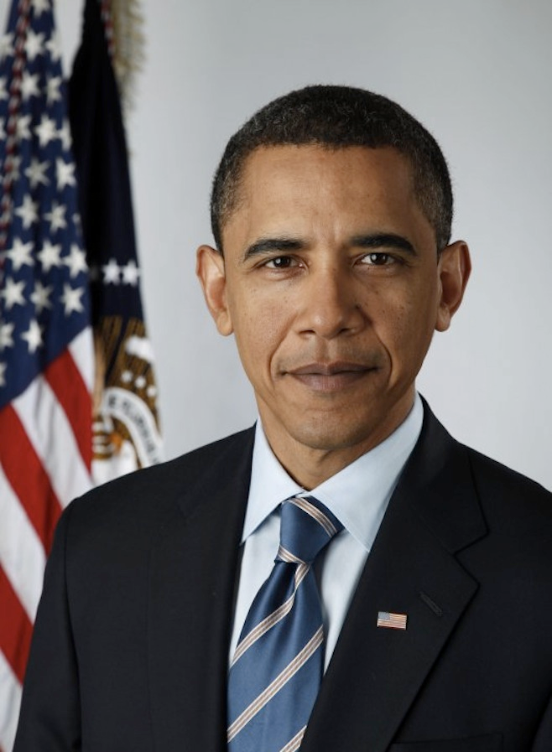
How a CDN Works
21
facebook.com (content provider)
HTTP
DNS root server
GET foo.jpg
11
12
Akamai
cluster
Akamai global
DNS server
5
1
2
3
4
6
Akamai regional
DNS server
7
8
9
Nearby Akamai
cluster
End-user
GET /foo.jpg
Host: cache.facebook.com

Slide 22
How a CDN Works
22
facebook.com (content provider)
HTTP
DNS root server
11
12
Akamai
cluster
Akamai global
DNS server
5
1
2
3
4
6
Akamai regional
DNS server
7
8
9
Nearby Akamai
cluster
End-user
10

Slide 23
Facebook Photo Distribution
“Hot” vs. “warm” vs. “cold” photos
Hot: Popular, a lot of views (approx. 90% of views)
Warm: Somewhat popular, but still a lot of views in aggregate
Cold: Unpopular, occasional views
Popularity
Items sorted by popularity

Slide 24
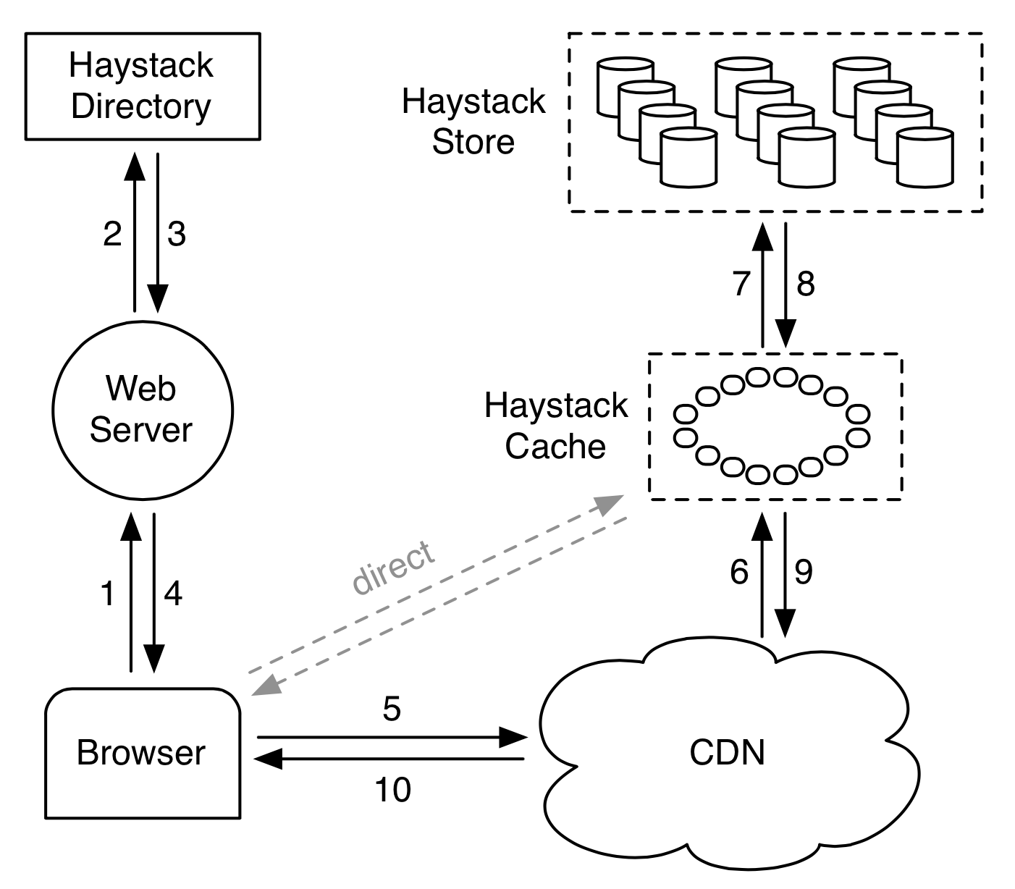
Handling Warm Photos: Haystack
Designed for performance and reliability
“Default” photo storage

Slide 25
Haystack Directory
Helps the URL construction for an image
http://⟨CDN⟩/⟨Cache⟩/⟨Machine id⟩/⟨Logical volume, Photo⟩
Staged lookup
CDN strips out its portion.
Cache strips out its portion.
Machine strips out its portion
Logical & physical volumes
A logical volume is replicated as multiple physical volumes
Physical volumes are stored.
Each volume contains multiple photos.
Notes:
Each stage uses <Logical volume, Photo> as well.

Slide 26
Haystack Cache & Store
Haystack cache
Facebook-operated second-level cache using DHT
Photo IDs as the key
Further removes traffic to Store
Haystack store
Maintains physical volumes
One volume is a single large file (100GB) with many photos (needles)
Performance-optimized: requires a single disk read for image retrieval
Notes:
(Not going into details since it’s more about how a filesystem works.)

Slide 27
Facebook Photo Distribution
“Hot” vs. “warm” vs. “cold” photos
Hot: Popular, a lot of views (approx. 90% of views)
Warm: Somewhat popular, but still a lot of views in aggregate
Cold: Unpopular, occasional views
Popularity
Items sorted by popularity
Notes:
Based on the observations, Facebook divided their workload into three types and designed mechanisms to handle those types differently.

Slide 28
CDN / Haystack / f4
CDN absorbs much traffic for hot photos.
Haystack’s tradeoff: good throughput and reliability, but somewhat inefficient storage space usage (mainly due to replication).
f4’s tradeoff: less throughput, but more storage efficient.
~ 1 month after upload, photos/videos are moved to f4.
f4 uses an error-correcting coding scheme to efficiently replicate data.

Slide 29
f4’s Replication
(n, k) Reed-Solomon code
k data blocks, f==(n-k) parity blocks, n total blocks
Upon a failure, any k blocks can reconstruct the lost block.
Can tolerate up to f block failures
Need to go through coder/decoder for read/write, which affects the throughput
Parity example: XOR
(Reed-Solomon uses something more complicated that this.)
XOR bits, e.g., (0, 1, 1, 0) → P: 0
Reconstruction after failures: (0, 1, 1, 0) → P: 0
k data blocks
f parity blocks

Slide 30
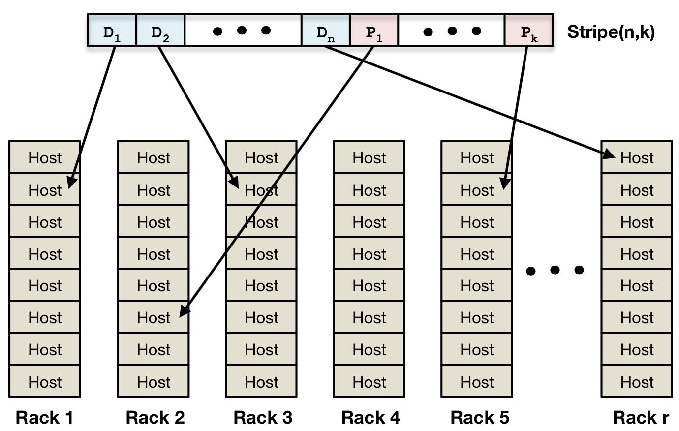
f4: Single Datacenter
Within a single data center, (14, 10) Reed-Solomon code
This tolerates up to 4 block failures
1.4X storage usage per block
Distribute blocks across different racks
This tolerates four host/rack failures

Slide 31
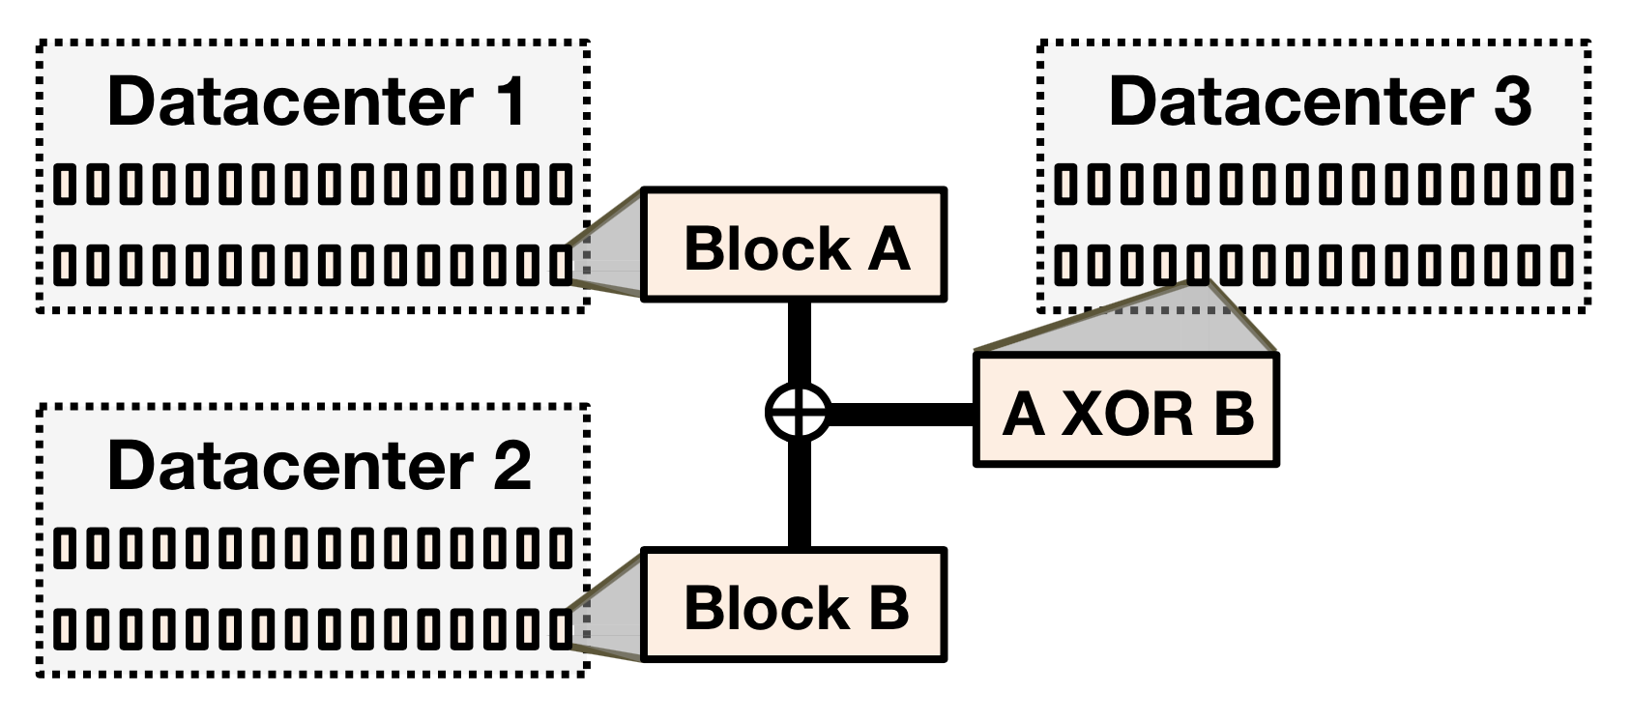
f4: Cross-Datacenter
Additional parity block
Can tolerate a single datacenter failure
Overall average space usage per block: 2.1X
E.g., average for block A & B: (1.4*2 + 1.4)/2 = 2.1
With 2.1X space usage,
4 host/rack failures tolerated
1 datacenter failure tolerated

Slide 32
Summary
Engineering a system needs workload understanding.
Facebook photo workload
Hot, warm, and cold.
CDN for hot photos
Performance
Haystack for warm photos
Performance & reliability
f4 for cold photos
Reliability and storage efficiency

Slide 33
Acknowledgements
These slides contain material developed and copyrighted by Indranil Gupta (UIUC), Michael Freedman (Princeton), and Jennifer Rexford (Princeton).

