Slide 1
CSE 486/586 Distributed Systems Security
Steve Ko
Computer Sciences and Engineering
University at Buffalo

Slide 2
Today
Secure design principles
Cryptography applications (besides encryption/decryption)

Slide 3
Security Properties
Assume a system that processes requests from agents, and a request comes in. A secure system must be able to answer the following questions before performing the required action.
Authenticity: is the agent’s claimed identity authentic?
Integrity: is the request actually coming from the agent?
Authorization: has a proper authority granted permission to this agent to perform this action?
These three combined are called the principle of complete mediation.

Slide 4
Security Threats
A secure system must be able to defend against the following threats.
Unauthorized information release
An unauthorized person accesses information.
Unauthorized information modification
An unauthorized person changes information.
Unauthorized denial of use
An adversary prevents an authorized user from reading or modifying information.

Slide 5
Designing Secure Systems
Your system is only as secure as your weakest component!
One must demonstrate that the system is protected from every possible threat.
Is the system secure?
Insecure: just needs to discover one example security hole.
Secure: must show there’s no security hole at all.
I don’t know: “We don’t know of any remaining security holes.”

Slide 6
Design Principles
Open design principle
Let anyone comment on the design. You need all the help you can get.
Closed designs have been historically proven to almost always lead to flaws.
Open vs. closed debate has been going on for ages (e.g., open vs. closed door lock design).
Minimize secrets
Because they probably won’t remain secret for long.
If secrets are minimized, when they are compromised, they’re easier to replace.
Economy of mechanism
The less there is, the more likely you will get it right.
E.g., having 10,000 lines of security critical code vs. 1,000 lines of security critical code

Slide 7
Design Principles
Minimize common mechanism
Shared mechanisms provide unwanted communication paths.
E.g., putting a new feature in the kernel (shared by all users) vs. putting it in a library (per application): choose the latter
Fail-safe defaults
Most users won’t change them, so make sure that defaults do something safe.
E.g., default Wi-Fi router passwords: a lot of users don’t change them.
Least privilege principle
Don’t store lunch in the safe with the jewels.
Give a program as fewest privileges as possible, as accidents can cause a lot of damage.
E.g., no need to run applications with sudo.

Slide 8
Safety Net Approach
Never assume the design is right.
Two principles
Be explicit
Design for iteration
Be explicit
Make all assumptions explicit so they can be reviewed.
E.g., buffer overrun using: gets(character array reference string_buffer) If the program allocates 30 bytes, and 250 bytes come in, then there’s a buffer overrun problem.
Design for iteration
Assume you will make errors and prepare to iterate the design.

Slide 9
TCB (Trusted Computing Base)
Applying the economy of mechanism principle together with the safety net approach
Organize a system design into two kinds of modules: Untrusted modules and trusted modules
The correctness of the untrusted modules should not affect the security of the whole system.
The trusted modules must work correctly to make the system secure.
The collection of trusted modules are called the trusted computing base (TCB).
It is important to minimize the size of the TCB (the economy of mechanism principle).

Slide 10
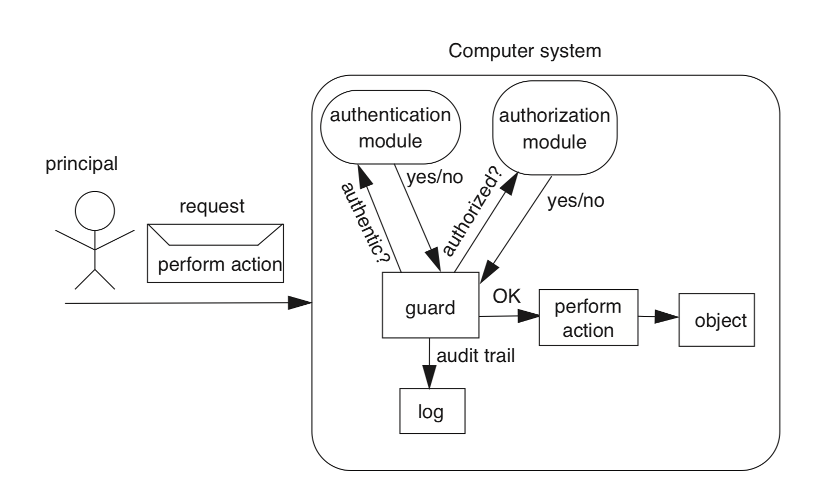
Secure System Model
A guard is commonly called a reference monitor.
Notes:
Your goal is to make the entrance (hole) as small or narrow as possible, and the guard (part of TCB; also called a reference monitor) as correct as possible.

Slide 11
CSE 486/586 Administrivia
PA4 deadline: 5/10
Survey & course evaluation
Survey: https://forms.gle/eg1wHN2G8S6GVz3e9
Course evaluation: https://www.smartevals.com/login.aspx?s=buffalo
If both have 80% or more participation,
For each of you, I’ll take the better one between the midterm and the final, and give the 30% weight for the better one and the 20% weight for the other one.
(Currently, it’s 20% for the midterm and 30% for the final.)
No recitation this week; replaced with office hours

Slide 12
Cryptography
Comes from Greek word meaning “secret”
Primitives also can provide integrity, authentication
Cryptographers invent secret codes to attempt to hide messages from unauthorized observers
Modern encryption:
Algorithm public, key secret and provides security
May be symmetric (secret) or asymmetric (public)
Cryptographic algorithms goal
Given key, relatively easy to compute
Without key, hard to compute (invert)
The strength of security often based on the length of a key (to protect against brute-force guesses)
encryption
decryption
plaintext
ciphertext
plaintext

Slide 13
Window of Validity
The minimum time to compromise a cryptographic algorithm.
Problem
It can be shorter than the lifetime of your system.
Example
SHA-0 was published in 1993.
A possible weakness was found in the algorithm and replaced in 1995 with SHA-1.
A way to compromise it was published in 2004.
A way to compromise SHA-1 was published in 2017.
A system designer needs to be prepared to update their crypto function, perhaps more than once.

Slide 14
Three Types of Functions
Cryptographic hash functions
Zero keys
Secret-key functions
One key
Public-key functions
Two keys

Slide 15
Cryptographic Hash Functions
Take message, m, of arbitrary length and produces a smaller (short) number, h(m)
Properties
Easy to compute h(m)
Pre-image resistance (strong collision): Hard to find an m, given h(m)
“One-way function”
Second pre-image resistance (weak collision): Hard to find two values that hash to the same h(m)
E.g. discover collision: h(m) == h(m’) for m != m’
Often assumed: output of hash fn’s “looks” random

Slide 16
Symmetric (Secret) Key Crypto
Also: “conventional / private-key / single-key”
Sender and recipient share a common key
All classical encryption algorithms are private-key
Was only type of encryption prior to invention of public-key in 1970’s
Most widely used
Two requirements
Strong encryption algorithm
Secret key must be known only to sender/receiver
Goal: Given key, generate 1-to-1 mapping to ciphertext that looks random if key unknown
Assume algorithm is known (no security by obscurity)
Implies secure channel to distribute key

Slide 17
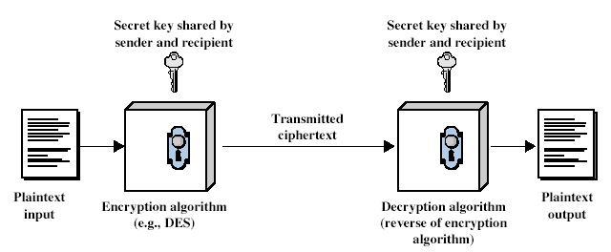
Symmetric Key Crypto

Slide 18
Public (Asymmetric) Key Crypto
Public invention Diffie & Hellman in 1976
Known earlier to classified community
Involves two keys
Public key: can be known to anybody, used to encrypt and verify signatures
Private key: should be known only to the recipient, used to decrypt and sign signatures
Avoiding key distribution: secure communication without having to trust a key distribution center with your key
Asymmetric
Can encrypt messages or verify signatures w/o ability to decrypt msgs or create signatures
If “one-way function” goes c ← F(m), then public-key encryption is a “trap-door” function:
Easy to compute c ← F(m, pub)
Hard to compute m ← F⁻¹(c) without knowing priv
Easy to compute m ← F⁻¹(c,priv) by knowing priv

Slide 19
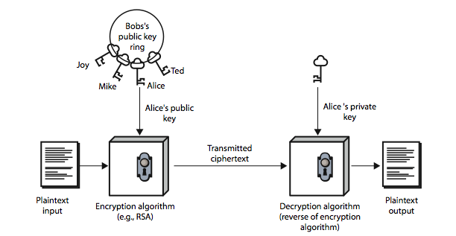
Public (Asymmetric) Key Crypto

Slide 20
Application: Storing Passwords
Password hashing
A password system don’t store plaintext passwords.
All passwords are hashed and the hashes are stored.
Concerned with insider attacks, e.g., system admins.
Must compare typed passwords to stored passwords
Does hash (typed) == hash (password)?
Actually, a salt is often used: hash (input || salt)
A salt is effectively a random number added to input.
It is stored together with the generated hash.
Avoids precomputation of all possible hashes in “rainbow tables” (available for download from file-sharing systems)
No need to be a secret: with a salt, pre-computation is not possible.

Slide 21
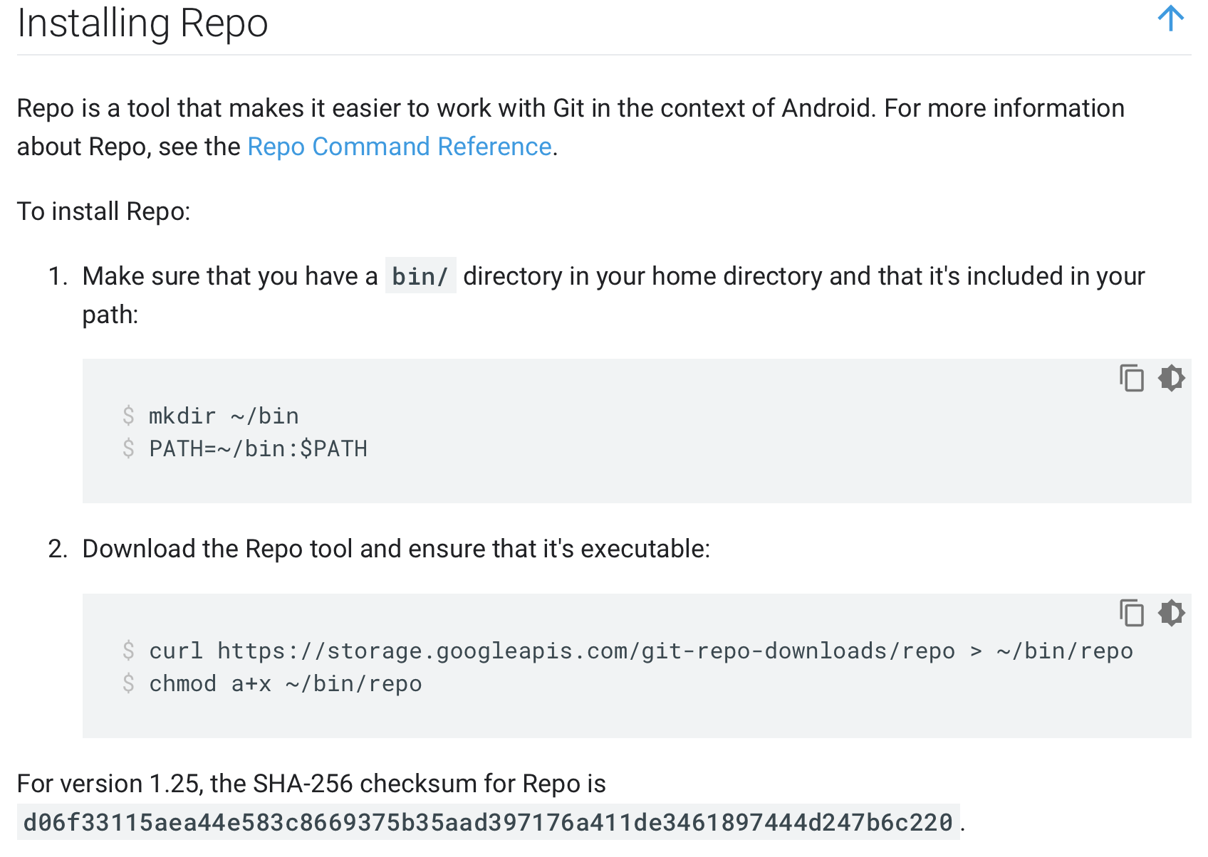
Application: Secure Digest
A secure digest is a summary of a message.
A fixed-length that characterizes an arbitrary-length message
Typically produced by a cryptographic hash function, e.g., SHA-256.
E.g., Open-source Android Repo command verification

Slide 22
Application: MAC
MAC (Message Authentication Code)
Uses symmetric crypto & hashing
Prevents sender masquerading & message tampering (but this is not about confidentiality)
Answering the following two questions
Who sent the message (authenticity)
What the sender says (integrity)
Sender (sending a message M)
Computes a message digest: SHA1 (M)
Encrypts the message digest: H = AES_{K}(SHA1 (M))
Sends <M, H>
Receiver
Receives <M, H>
Computes a message digest: SHA1 (M)
Encrypts the message digest: H’ = AES_{K}(SHA1 (M))
Checks the equality: H’ == H
Notes:
Encrypting SHA1(M) is less expensive than encrypting M.
Possession of the key K ensures sender’s authenticity.
AES(SHA1(M)) ensures integrity

Slide 23
Application: Digital Signature
Similar to MAC
Verifies a message or a document is an unaltered copy of one produced by the signer
Both integrity & authenticity
Uses asymmetric crypto & hashing
Signer (writing a document, M)
Computes a message digest: SHA1(M)
Signs the digest with the private key: H = RSA_{K}(SHA1(M))
Posts the message & the signature: <M, H>
Verifier
Obtains <M, H>
Computes a message digest: H’ = SHA1(M)
Decrypt the signature with the public key: RSA_{K’}(H)
Verifies the equality: RSA_{K’}(H) == H’
Notes:
Similar to MAC, the signer is the only one who can do the encryption with the private key (authenticity).

Slide 24
HTTPS
A use case for digital signatures
Threat model
Eavesdropper listening on conversation (confidentiality)
Man-in-the-middle modifying content (integrity)
Adversary impersonating desired website (authentication, and confidentiality)
Enter HTTP-S
HTTP sits on top of secure channels
All (HTTP) bytes written to secure channel are encrypted and authenticated

Slide 25



Encrypted Communication
What is wrong with this?
How do you know you’re actually talking to facebook and f-pub belongs to facebook?
Hey, I want to be more secure
Sure, use this public key and encrypt your traffic
Key: f-pub
(encrypted communication)

Slide 26
Digital Certificates
A digital certificate is a statement signed by a third party principal, and can be reused
A digital certificate has a public key, its organization, and a signature by a third party that attests that the public key belongs to the organization.
A third-party example: Verisign Certification Authority (CA)
Example
Facebook sends its public key to Verisign.
Verisign uses its private key to digitally sign Facebook’s public key. This says that Verisign attests that the public key belongs to Facebook.
Verisign gives the signature to Facebook.
When you ask Facebook for its public key, Facebook sends you its public key as well as the signature (from Verisign).
You verify that the signature is from Verisign. If successful, you trust that the public key belongs to Facebook.

Slide 27
Digital Certificates
Question still remains: how do you verify if the signature is from Verisign?
Verisign uses its private key to sign. What do you need to verify this signature?
You need its public key to verify the signature.
Full circle: in order to verify Facebook’s public key (which Verisign attests), you need to acquire Verisign’s public key and verify it.
Chain of trust
You don’t trust Facebook’s public key, so Facebook says “trust Verisign’s public key.”
But in order to trust Verisign’s public key, some other trusted entity needs to verify the trustworthiness of Verisign’s public key.
You can establish a chain of trust that way.
The end of the chain is called the root of trust.

Slide 28
Digital Certificates
This trust comes from your OS.
Your OS pre-stores Verisign’s public keys & certificates (self-signed by Verisign).
Use Verisign’s public key to verify Verisign’s signature for Facebook’s public key.
As long as you trust your OS, you trust Verisign’s public key as well as Facebook’s.
You can manually install other company’s certificates that you trust.
You can also self-sign your certificate, e.g., for testing HTTPS configuration.

Slide 29
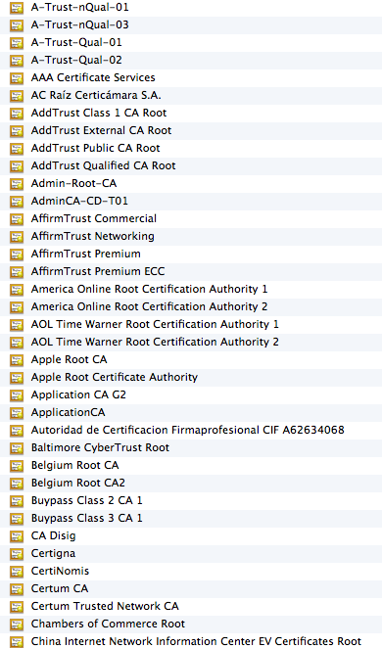
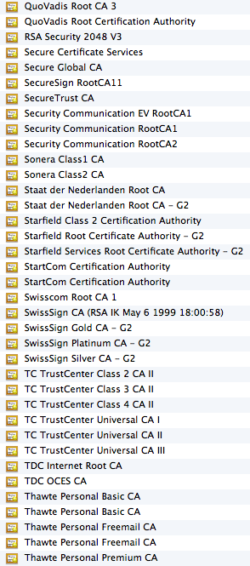
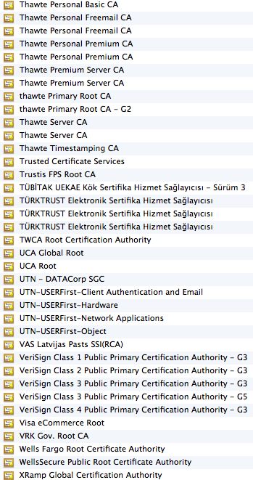
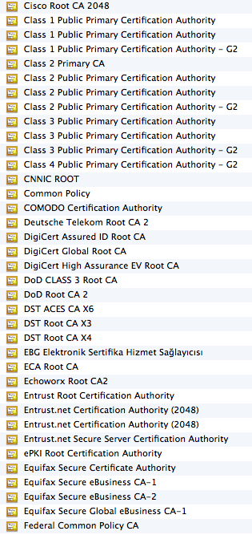
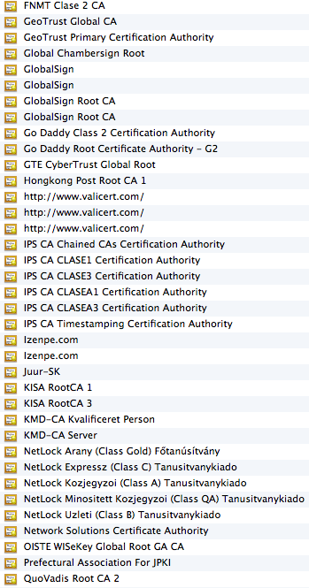
On My Mac…

Slide 30
X.509 Certificates
The most widely used standard format for certificates
Format
Subject: Distinguished Name, Public Key
Issuer: Distinguished Name, Signature
Period of validity: Not Before Date, Not After Date
Administrative information: Version, Serial Number
Extended information
Binds a public key to the subject
A subject: person, organization, etc.
The binding is in the signature issued by an issuer.
You need to either trust the issuer directly or indirectly (by establishing a root of trust).

Slide 31
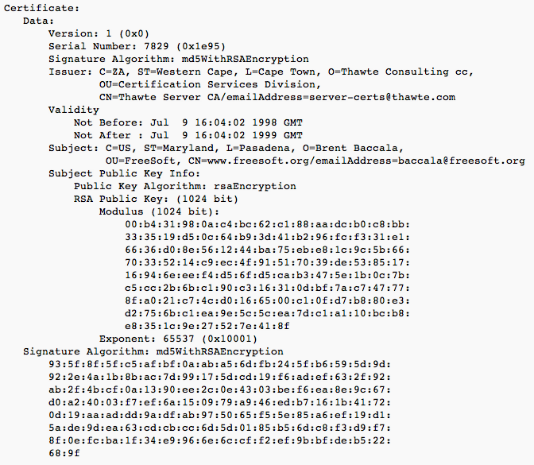
X.509 Certificates

Slide 32
Certificate Pinning
An application (e.g., a mobile app) frequently uses a back-end server.
To use HTTPS, the server typically sends a certificate which the application verifies.
Problem
A user can be tricked to install rogue certificates that verify an adversary’s server certificates.
E.g., a public Wi-Fi connection redirects you to a website and asks you to install a certificate.
The Iranian gov. is suspected to compromise a certificate authority and issued rogue certificate for Google.
Certificate pinning
An application pre-stores a few certificates that it expects to receive from its server.

Slide 33
Android App Code Signing
A use case for digital certificates
Google requires all apps to be signed by their developers before release.
A developer uses their private key to sign an app.
The public key is provided as part of the app in a (self-signed) certificate.
Installation & update
At installation time, Android verifies if it’s signed.
When updating an app, Android verifies if it’s signed by the same private key.
Sharing
Different apps from the same developer can be signed with the same private key.
Android allows those apps to share data without permission.
E.g., Facebook app, Facebook Messenger, & Instagram

Slide 34
Android Platform Key
Another use case for digital certificates
When compiling the Android OS, a vendor (Google, Samsung, etc.) includes their certificate (public key) in the platform.
A vendor, e.g., Google, signs their apps with their private key.
When installed from Google Play, Android verifies that those apps are Google apps (called platform apps, e.g., Google Play Services app).
They can have more privilege than apps from regular devs.
An OS update package is also signed by the same private key and verified before installation.

Slide 35
Authentication
Use of cryptography to have two principals verify each others’ identities.
Direct authentication: the server uses a shared secret key to authenticate the client.
Indirect authentication: a trusted authentication server (third party) authenticates the client.
The authentication server knows keys of principals and generates temporary shared key (ticket) to an authenticated client. The ticket is used for messages in this session.
E.g., Verisign servers

Slide 36
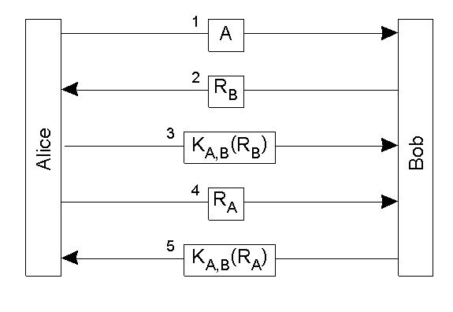
Direct Authentication
Authentication with a secret key
“Nonce” (used as a “challenge”)=random num,
Bob calculates K_{A,B} (R_{B} )
and matches with reply.
Alice is the only one
who could have
replied correctly.

Slide 37
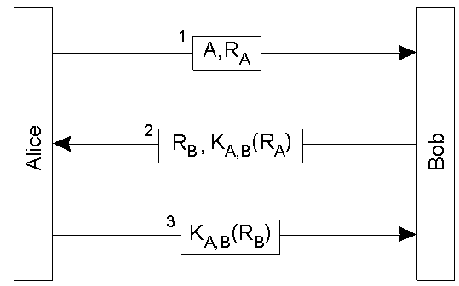
“Optimized” Direct Authentication
Authentication with a secret key with three messages
Anything wrong with this?

Slide 38
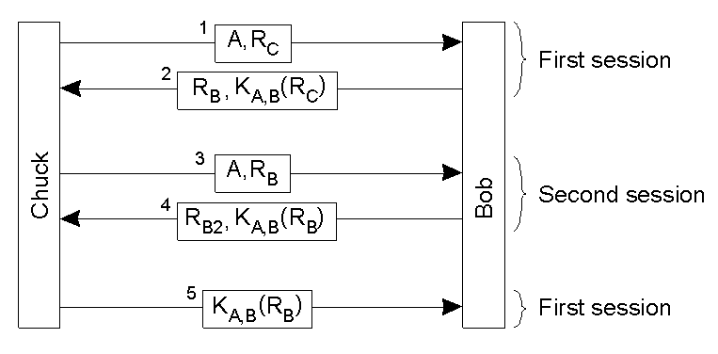
Reflection Attack

Slide 39
Needham-Schroeder Authentication
An authentication server provides secret keys.
Every client shares a secret key with the server to encrypt their channels.
If a client A wants to communicate with another client B,
The server sends a key to the client A in two forms.
First, in a plain form, so that the client A can use it to encrypt its channel to the client B.
Second, in an encrypted form (with the client B’s secret key), so that the client B can know that the key is valid.
The client A sends this encrypted key to the client B as well.
Basis for Kerberos

Slide 40
Needham-Schroeder Authentication
A asks for a key to communicate with B
“Nonce”=random num,
Authentication System
K_{A} K_{B} …
<A, B, N_{A}>
Ticket
1
2
System A
<N_{A},B,K_{AB}, {K_{AB}, A} >
K_{B}
K_{A}
K_{A}
3
< {K_{AB}, A} >
K_{B}
System B
5
< {N_{B}} >
K_{AB}
4
A demonstrates
that it is the sender
of the previous
message
< {N_{B}-1, req} >
K_{B}
K_{AB}
< {res} >
6
K_{AB}
Notes:
The authentication server has secret keys of all clients.
Response 2 is encrypted with Ka. Na prevents a reply attack (next slide). It sends a shared key between A and B (Kab). And also, Kab and A’s identity are encrypted with B’s secret key---only B can verify and get the shared key, and the communication source.

Slide 41
Nonce N_{A} in Message 1
Because we need to relate message 2 to message 1
Authentication System
1’
<A, B>
K_{A} K_{B} …
<A, B>
1
2
System A
<B, K_{AB}, {K_{AB}, A} >
K_{B}
K_{A}
K_{A}
System C
Chuck has stolen K_{B} and
intercepted message 2.
It can masquerade as the
authentication system.
<B, K_{AB}, {K_{AB}, A} >
K_{B}
K_{B}
K_{A}
2’
<B, K_{AB}, {K_{AB}, A} >
K_{B}
K_{A}

Slide 42
Kerberos
Follows Needham-Schroeder closely
Time values used for nonces
To prevent replay attacks
To enforce a lifetime for each ticket
Very popular
An Internet standard
Default in MS Windows

Slide 43
Kerberos
Kerberos Key Distribution Centre
Authentication
Step A
database
Ticket-
Authen-
granting
1. Request for
tication
service T
TGS ticket
service A
2. TGS
ticket
Step B
3. Request for
server ticket
Login
4. Server ticket
Step C
session setup
5.
Service
Server
request
Service
Client
session setup
Server
C
Request encrypted with session key
function
S
DoOperation
Reply encrypted with session key

Slide 44
Summary
Security properties
Confidentiality, authenticity, integrity, availability, non-repudiation, access control
Three types of functions
Cryptographic hash, symmetric key crypto, asymmetric key crypto
Applications
Password store, secure digest, MAC, & digital signature

Slide 45
Acknowledgements
These slides contain material from "Principles of Computer System Design: An Introduction,” Chapter 11
https://ocw.mit.edu/resources/res-6-004-principles-of-computer-system-design-an-introduction-spring-2009/online-textbook/protection_open_5_0.pdf
These slides contain material developed and copyrighted by Indranil Gupta (UIUC), Jennifer Rexford (Princeton) and Michael Freedman (Princeton).

