Slide 1
CSE 486/586 Distributed Systems Introduction
Steve Ko
Computer Sciences and Engineering
University at Buffalo

Slide 2
First Things
Instructor
Steve Ko
9th year at UB
TAs
Harishankar Vishwanathan
Archita Pathak
Yuyang Chen
Hanbin Zhang
Add/drop
Help your fellow students and make up your mind by Thursday (and drop if that’s your decision).
On Friday, if necessary, I will increase the cap
Please don’t email me for force registration until Friday night.

Slide 3
Welcome to CSE 486/586
Why do you want to take this course?
Some positive feedback of this course…
“(CSE 486/586) didn't only helped with understanding the concepts involved, but have also always given me something cool and interesting to talk about in interviews.”
“I am actually learning new things.”
“(CSE 486/586) literally got me a job.”
Some negative feedback of this course…
“Projects are a bit too much on the difficult side.”
“The midterm came almost out of nowhere.”
“Stay away at all cost!”
Are you ready? ;-)

Slide 4
Building a Distributed System
“The number of people who know how to build really solid distributed systems…is about ten”
Scott Shenker, Professor at UC Berkeley
The point: it’s hard to build a solid distributed system.
So, why is it hard?...but first of all…

Slide 5
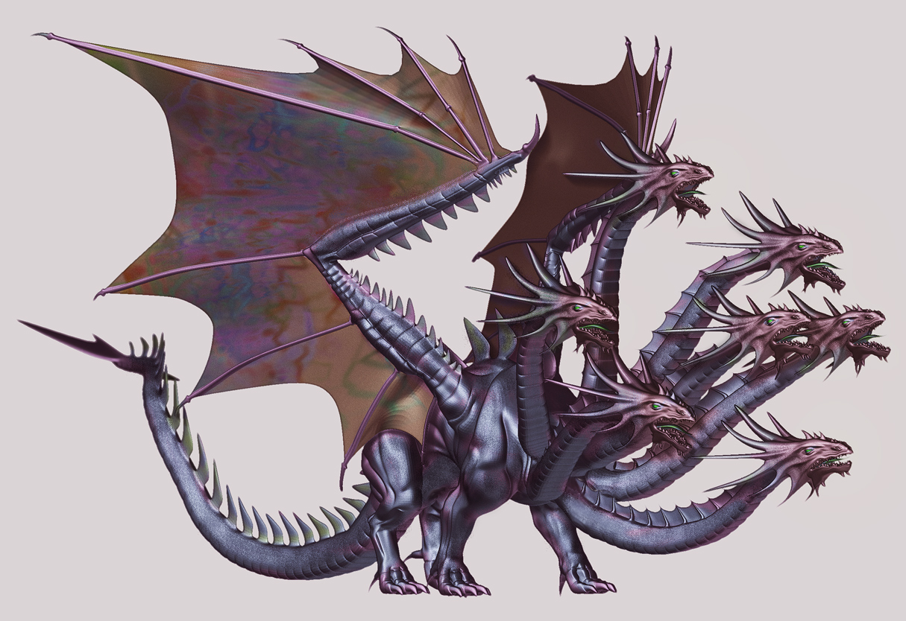
What is a Distributed System?

Slide 6
What is a Distributed System?
A distributed system is a collection of entities with a common goal, each of which is autonomous, programmable, asynchronous and failure-prone, and which communicate through an unreliable communication medium.
This will be a working definition for us.

Slide 7
Why Is It Hard to Build One?
Scale: hundreds or thousands of machines
Google: 4K-machine MapReduce cluster
Yahoo!: 4K-machine Hadoop cluster
Akamai: 70K machines distributed over the world
Facebook: 60K machines providing the service
Hard enough to program one machine!
Dynamism: machines do fail!
50 machine failures out of 20K machine cluster per day (reported by Yahoo!)
1 disk failure out of 16K disks every 6 hours (reported by Google)
As we will learn, these come with:
Concurrent execution, consistency, etc.

Slide 8
OK; But Who Cares?
This is where all the actions are!
What is the two biggest driving forces in the computing industry for the last 7-8 years?
It’s the cloud!
And smartphones!
They are distributed!
(And there’s also machine learning, robotics, etc.)
Now --- it’s all about distributed systems!
Well…with a bit of exaggeration… ;-)

Slide 9
OK, Cool; How Am I Going to Learn?
Textbook
Main: Distributed Systems: Concepts and Design, 5th Edition (Coulouris, Dollimore, Kindberg, Blair)
Optional: Distributed Systems: Principles and Paradigms, 2nd Edition, (Tanenbaum, Van Steen)
Lectures
(Non-graded) HW assignments
Programming assignments
Exams

Slide 10
What Am I Going to Build?
A “starter” project: PA1
This will be out today and due next week Friday.
A distributed key-value storage (based on Amazon Dynamo) on Android in multiple stages
Individual submission

Slide 11
Important Policies
Late submissions only allowed for one day
20% penalty
The deadlines are on Friday, and we don’t count weekends, so technically you have 3 more days.
Regrading
If requested, the entire work will be regraded
No “I”
No makeup exam
No grade negotiation

Slide 12
I Have a Confession to Make…
I have a split personality disorder.
Jekyll
Hyde
Most of you (I expect) will just see my Jekyll’s side. If you…
work with good ethics,
respect others on Piazza, during office hours, etc.,
follow class and submission rules,
and generally use common sense and are a good citizen in the class.
Some of you might see my Hyde’s side. If you…
copy other people’s code or exams,
try to negotiate your way in the class,
generally are not such a good citizen in the class.

Slide 13
Academic Integrity Policies
Academic integrity: exams, HW, and code
Copying others’ code: no
Copying from other sources (the Web, books, etc.): get permission
Exceptions: http://developer.android.com (copy freely, but mark clearly that you copied)
http://stackoverflow.com (generally OK to see how things get done; but do not copy and paste.)
If found, the incident will be reported to the university.
Will use an automatic similarity checker.
When similar submissions are found, both will get an F for the entire semester.
Please be careful when using an online code repository, e.g., GitHub, BitBucket, etc.

Slide 14
How Can I Reach the Teaching Staff?
Steve: 113F Davis
Lectures (MWF 1:00 pm-1:50 pm)
Office hours (TBD)
TAs
Office hours: Posted on Piazza
Please do not expect that the TAs will stay more than the announced office hours.
Use Piazza (http://piazza.com/class), instead of email, mailing list, blog, etc.
The teaching staff will not have any activity during weekends and holidays.
Signup link: http://piazza.com/buffalo/spring2019/cse486586
http://www.cse.buffalo.edu/~stevko/courses/cse486/spring19/

Slide 15
For Undergraduates
We do have recitations.
But it’s just like office hours, dedicated for undergraduates.

Slide 16
Background Required
You must have some background in different topics.
OS concepts
Threads, processes, synchronization (e.g., locks, semaphores), etc.
Networking concepts
IP, DNS, NAT (e.g., private IPs vs. public IPs), TCP, etc.
System programming experiences
Programming experiences with sockets, processes, threads, synchronization primitives, file I/O, etc.
Experiences with setting up environment variables, using regex, scripting (e.g., bash, python, etc.)
Programming environment
Linux or Mac

Slide 17
Background Check: PA1
Programming Assignment (PA) 1
Use this as a background check.
If you can finish this in a week all by yourself, then you are ready to take this class.
See for yourself!
Due on next Friday (2/8) 11:59:59 am.
SimpleMessenger on Android
Overall, need to implement a chatting app.
Need to set up the Android programming environment.
Need to use sockets.
Need to understand the code provided.
Need to read Android tutorials and understand them.
Need to understand and use Android APIs.

Slide 18
What Exactly Am I Going to Learn? Distributed Systems 10 Questions!
Course goal: answering 10 questions on distributed systems
At the end of the semester, if you can answer only 10 questions about distributed systems, you’ll probably get an A.
Easy enough!
What are those questions?
Organized in 6 themes
1~2 questions in each theme
A few (or several) lectures to answer each question

Slide 19

Theme 1: Hint
What’s up?
Hey!

Slide 20
Theme 1: Communications
Q1: how do you talk to another machine?
Networking basics
Q2: how do you talk to multiple machines at once?
Multicast
Q3: can you call a function/method/procedure running in another machine?
RPC

Slide 21
Theme 2: Hint
I thought I was doing it…
I’m shaking my tail.
What? I’m doing it too!

Slide 22
Theme 2: Concurrency
Q4: how do you control access to shared resources?
Distributed mutual exclusion, distributed transactions, 2-phase commit, etc.

Slide 23
Theme 3: Hint
I want to shake my tail.
OK
No, I don’t want to.
No way!

Slide 24
Theme 3: Consensus
Q5: how do multiple machines reach an agreement?
Time & synchronization, global states, snapshots, mutual exclusion, leader election, paxos
Bad news: it’s impossible!
The impossibility of consensus

Slide 25
Theme 4: Hint
Who has a brain?
I do.
I don’t.

Slide 26
Theme 4: Storage Management
Q6: how do you locate where things are and access them?
DHT, DFS

Slide 27
Theme 5: Hint
I have a feeling that something went wrong…
zzz…

Slide 28
Theme 5: Non-Byzantine Failures
Q7: how do you know if a machine has failed?
Failure detection
Q8: how do you program your system to operate continually even under failures?
Replication, gossiping

Slide 29

Theme 6: Hint
We’re under attack!

Slide 30
Theme 6: Byzantine Failures
Q9: how do you deal with attackers?
Security
Q10: what if some machines malfunction?
Byzantine fault tolerance

Slide 31
Acknowledgements
These slides heavily contain material developed and copyrighted by Indranil Gupta at UIUC.
The material was originally developed for courses CS425/CSE424/ECE428 at UIUC.

