Slide 1
CSE 486/586 Distributed Systems The Internet in 2 Hours: The First Hour
Steve Ko
Computer Sciences and Engineering
University at Buffalo

Slide 2
Recap
Please make an effort to come to every class.
Please do the work yourself and get permissions for other sources. Also, acknowledge them.
Please check if you have the background by doing PA1 all by yourself.
This course will expect:
Good work ethics
Independence
Respect for others
This course is about:
Introducing common problems that arise when building a distributed system
Discussing algorithms, architectures, and abstractions that solve those problems
Practicing how to adapt those algorithms and concepts
Notes:
This class expects you to figure a lot of things out yourself.
Most of you will start working this year, next year, etc. The easiest way to quickly earn the respect from others is showing your independence.

Slide 3
Today and Next
A brief overview of the Internet
Two things
The design philosophy of the Internet (“The Design Philosophy of the DARPA Internet Protocols” by David Clark): today
Transport & application layers: next lecture
Obviously can’t replace a networking course; this should be just a recap for you.
Why teach these?
Because I want to ;-)
If there’s no network, there’s no distributed system.
Not just that: the design of the Internet is a great example of designing a solid distributed system.

Slide 4
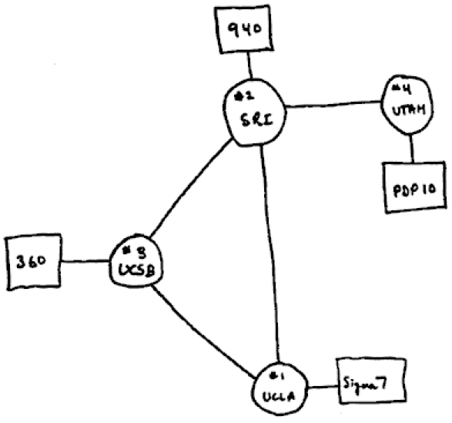
What Is the Internet?
1969

Slide 5
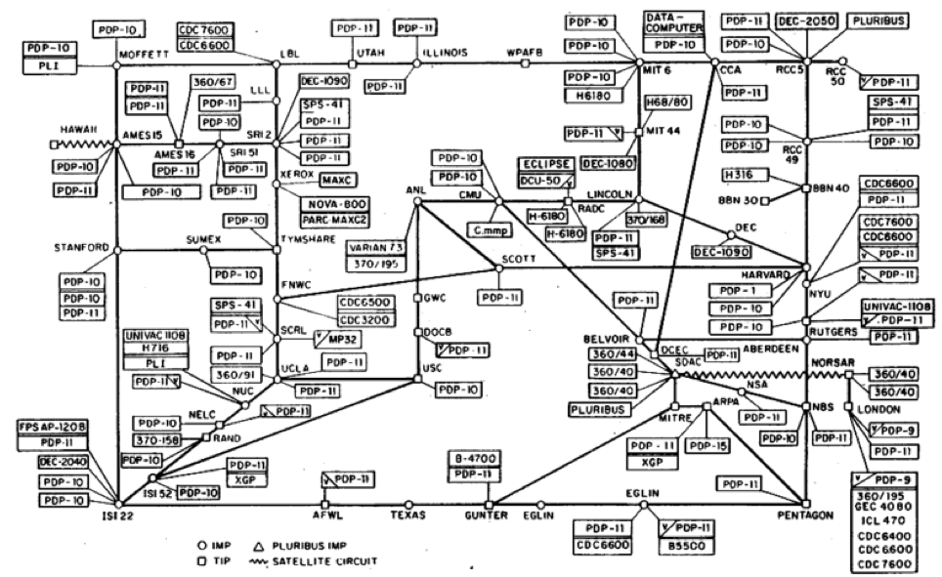
What Is the Internet?
1977

Slide 6
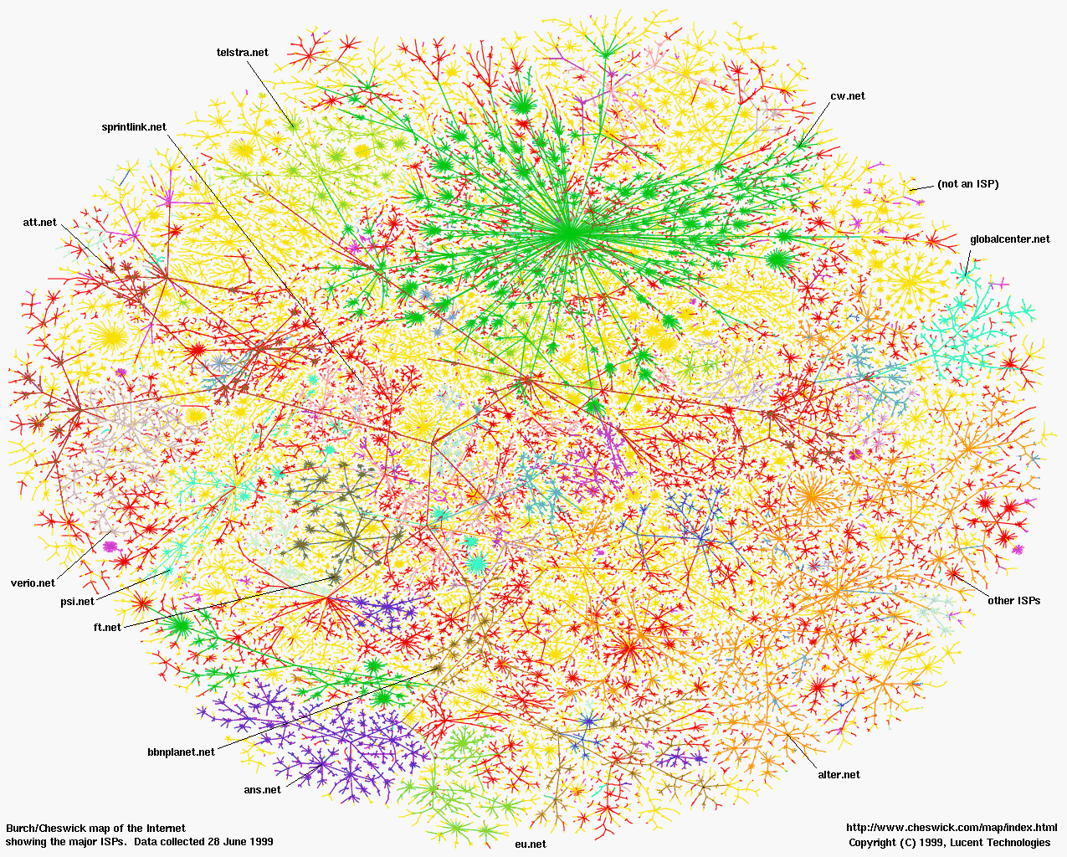
What Is the Internet?
Now
A network of networks
The fundamental goal of the original designers: interconnecting different networks by designing common protocols

Slide 7
Detour: What is a Protocol?
Example: making an appointment
Well…I think we need a better way…
Please meet with me for
1.5 hours starting at
1:30pm on February 8, 2006?
Please meet with me for
1.5 hours starting at
3:00pm on February 8, 2006?
Please meet with me for
1.5 hours starting at
4:30pm on February 8, 2006?
I can’t.
I can’t.
Yes!
Notes:
There’s no set rule, then the conversations can 1) take long, and 2) difficult to be repeated with different parties. It can go anywhere.

Slide 8
Detour: What Is a Protocol?
Bob: When are you free to meet for 1.5 hours during the next two weeks?
Alice: 10:30am on Feb 8 and 1:15pm on Feb 9.
Bob: Book me for 1.5 hours at 10:30am on Feb 8.
Alice: Yes.

Slide 9
Detour: What is a Protocol?
An agreement between entities in communication
Two things: 1) syntax, 2) semantics
Syntax
What language?
What’s the time format? Granularity?
Etc.
Semantics
If broken into pieces, how do you reassemble?
If a msg gets lost, what do you do?
If you get a msg, what do you do?
Etc.

Slide 10
Returning back: What Is the Internet?
A network of networks
The fundamental goal of the original designers: interconnecting different networks by designing common protocols

Slide 11
CSE 486/586 Administrivia
PA 1 is out. Please try it yourself.
Please use Piazza; all announcements will go there.
Signup link: http://piazza.com/buffalo/spring2016/cse486586
Anonymous/private posting: generally questions are beneficial to the whole class; please consider posting it publicly first.
All announcements will be posted there.
Please come to my office during the office hours!
Give feedback about the class, ask questions, etc.
Use good coding styles.
Use the Android code style guideline posted on Piazza.
After-class questions
Will answer them outside. There’s a class right after this one.

Slide 12
Building the Internet
Why care?
Now: you might be just doing what’s given to you.
Later: you will likely define what you want to do and do it.
Internet as a case study of a distributed system
Put a designer’s hat on for a moment.
Questions to think about:
Why? i.e., why do we want to connect computers?
What is the ideal outcome? i.e., what do we want?
How do we do that?
Notes:
Why, what, and how: E.g., planning a vacation
Talk to any kid, the first question is “why?”

Slide 13
Why and What
Why
“The whole can be greater than the sum of its parts”
What
Internet communication must continue despite loss of networks or gateways.
The Internet must support multiple types of communications service.
The Internet architecture must accommodate a variety of networks.
The Internet architecture must permit distributed management of its resources.
The Internet architecture must be cost effective.
The Internet architecture must permit host attachment with a low level of effort.
The resources used in the Internet architecture must be accountable.

Slide 14

How to Interconnect?
There were many types of networks based on various physical media.
Coax, radio, satellite, etc.
The original designers wanted to interconnect those somehow.
A potential solution
Designing a “multi-media” network (e.g., via physical signal translator for various physical media)
Solution chosen?
Hint: “All problems in computer science can be solved by another level of indirection.” --- David Wheeler
Connecting by layering with packet switching
(We will not cover packet switching vs. circuit switching)

Slide 15
Layering: A Modular Approach
Sub-divide the problem
Each layer relies on services from layer below
Each layer exports services to layer above
Interface between layers defines interaction
Hides implementation details
Layers can change without disturbing other layers
“The” computer science approach
ISA, OS, networking…
Application
Application-to-application channels
Host-to-host connectivity
Link hardware

Slide 16
Challenges in Layering
What to put on top of physical networks?
Assumption (for the sake of the discussion):
Packet switching (a conversation is divided into smaller units called packets).
Basic things for enabling a conversation between remote hosts:
Addressing (where do I send a msg?)
Routing (how do I reach that address?)
Most importantly, survivability
Protection of a conversation as long as there’s a physical path between entities communicating and they are alive.
What are some of the threats that disrupt a conversation?
Packet loss, out-of-order delivery, duplicate packets, etc.

Slide 17
We Must Ask Ourselves…
In a conversation, there are two components involved
Hosts
Network
So, one more question: where do we want to put the functionalities? More specifically, what would be a good network/host division of labor?
Addressing and routing?
Yeah, probably in the network
What about conversation protection mechanisms?
The network or hosts?

Slide 18
Summary
The Internet
A network of networks
A case study as a distributed system
Protocol
An agreement between multiple parties
Syntax & semantics
Design a system
Why, what, and how
The Internet
Connecting by layering

Slide 19
Acknowledgements
These slides contain material developed and copyrighted by
Indranil Gupta at UIUC
Mike Freedman and Jen Rexford at Princeton

