Slide 1
CSE 486/586 Distributed Systems Android Programming --- 1
Steve Ko
Computer Sciences and Engineering
University at Buffalo

Slide 2

Recap
What to put on top of physical networks?
Layers providing survivability
Where to put functionalities?
Fate-sharing & end-to-end arguments
IP layer doesn’t provide much
TCP handles most of the survivability issues
TCP & UDP: the two transport protocols of the Internet
What interface do applications see?
Socket API

Slide 3
Today
Basic Android programming interleaved with a review of PA1
Mainly programming model and components
We will look at PA1 template code alongside.
Caveats
Not really a comprehensive tutorial
Just touching on basics
Will have more of these later as more PAs come out.

Slide 4
Four Most Important Things
Tools that you need to be familiarized with:
Android APIs and constructs
Terminal (debugging, etc.)
Read the documentation.
Learn how to use the APIs and the constructs, e.g., AsyncTask, Messenger, etc.
Learn how to work within the Android’s constraints.
Learn how to use a terminal.
Setting up the environment
Using LogCat, DDMS, etc. (for debugging)
Much time is spent on debugging
Incremental development
First write the minimum possible thing to execute your app.
Iterate: write something and debug

Slide 5
Android Programming Model
Three things to keep in mind.
The responsibilities of the OS
The responsibilities of an app
How the OS knows the responsibilities of an app.
App
No main()
Event-driven (reacting to events)
OS
Deliver events by calling appropriate callbacks
AndroidManifest.xml
An app declares its capabilities (e.g., its permissions).
An app registers all the callbacks.
Notes:
Know the capabilities

Slide 6
What? No main()?
There is a main()! It’s just that it’s hidden.
Zygote starts at boot.
Launcher sends a message to start an activity.
Zygote forks a new VM instance that loads ActivityThread.
ActivityThread has the real main() for an app.
ActivityThread calls the app’s onCreate(), onStart(), etc.
What main() does is implementing an event loop.
Wait for an event to happen.
When an event happens, look up which callback handles the event.
Call the callback.
Loop
Notes:
Launcher receives the app open event from OS.
Zygote -

Slide 7
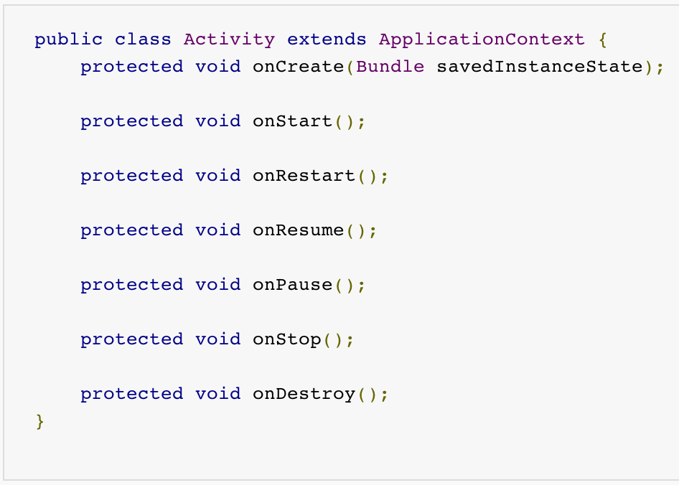
Example - Activity

Slide 8
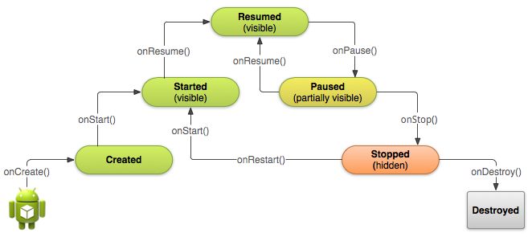
Example - Activity

Slide 9
Declare in AndroidManifest.xml
<manifest ... >
...
<application ... >
<activity android:name=".ExampleActivity" />
...
</application>
</manifest>
Notes:
Provide the capabilities in manifest

Slide 10
Define Permissions
Should define permissions (for others) in AndroidManifest.xml
<uses-permission android:name="android.permission.INTERNET"/>

Slide 11
CSE 486/586 Administrivia
Please use Piazza; all announcements will go there.
Please come to my office during the office hours!
Give feedback about the class, ask questions, etc.

Slide 12
More
Logging statements
Running a terminal window per AVD
Questions?

