Slide 1
CSE 486/586 Distributed Systems Logical Time
Steve Ko
Computer Sciences and Engineering
University at Buffalo

Slide 2
Last Time
Clock skews do happen
Cristian’s algorithm
One server
Server-side timestamp and one-way delay estimation
NTP (Network Time Protocol)
Hierarchy of time servers
Estimates the actual offset between two clocks
Designed for the Internet

Slide 3

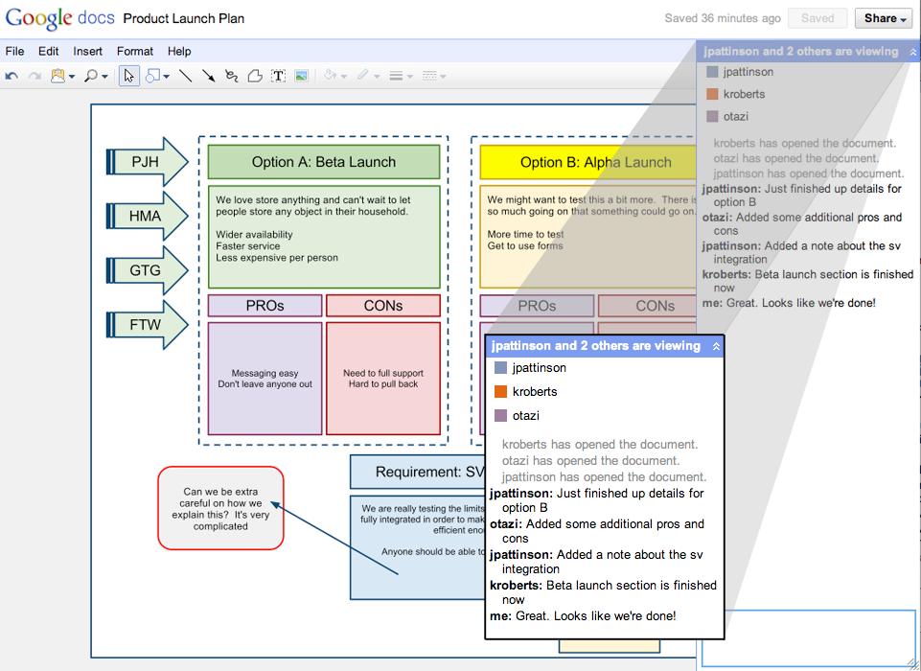
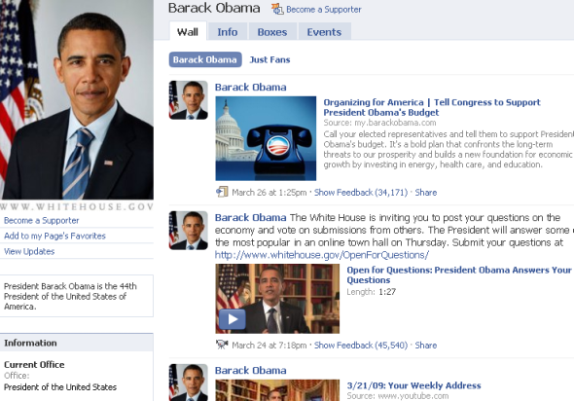
Then Came a Breakthrough…
We cannot sync multiple clocks perfectly.
But why did we want to synchronize clocks in the first place?

Slide 4
Then Came a Breakthrough…
If we just want to order events happened at different processes, we don’t need to synchronize physical clocks.
We just need to be able to determine the ordering.
So the concept of logical time:
First proposed by Leslie Lamport in the 70’s
Based on causality of events
Defined relative time, not absolute time
Critical observation: time (ordering) only matters if two or more processes interact, i.e., send/receive messages.

Slide 5
Abstract View
Background: we’ll think of a program as a collection of actions: instruction, send, and receive events.
Above is what we will deal with most of the time.
This is the execution view of a distributed system.
Ordering question: what do we ultimately want?
Taking two events and determine the ordering of the two.
Physical time

Slide 6
What Ordering?
What kind of orderings can we determine right away?
Events in the same process
Send/receive events
Physical time
Notes:
Must explain that reliably we can determine the two types of ordering

Slide 7
Lamport Timestamps
Goal: take any two events, and determine the ordering of the two.
It uses a single number to do so.
Basic idea
But each process needs to know a time value
Physical time

Slide 8
Logical Clocks
(Lamport algorithm assigns logical timestamps.)
Each process uses a counter with initial value of zero
A process increments its counter when a send or an instruction happens at it. The counter is assigned to the event as its timestamp.
A send (message) event carries its timestamp
For a receive (message) event the counter is updated by max(local clock, message timestamp) + 1

Slide 9
A Catch
Algorithm
All processes use a counter (clock) with initial value of zero
A process increments its counter when a send or an instruction happens at it. The counter is assigned to the event as its timestamp.
A send (message) event carries its timestamp
For a receive (message) event the counter is updated by max(local clock, message timestamp) + 1
Physical time

Slide 10
Happened Before
Define a logical relation happened-before (→) among events:
On the same process: a → b, if time(a) < time(b)
If p1 sends m to p2: send(m) → receive(m)
(Transitivity) If a → b and b → c then a → c
Shows causality of events

Slide 11
CSE 486/586 Administrivia
PA2A is out. Two points:
Multicast: Need to send each message to every instance including the one that sends the message. Just create 5 connections (5 sockets) and send a message 5 times through different connections.
ContentProvider: Don’t call it directly. Don’t share anything with the main activity. Consider it an almost separate app only accessible via ContentResolver.

Slide 12
Find the Mistake: Lamport Logical Time
Physical Time
p 1
0
1
2
4
3
1
p 2
3
4
0
2
2
3
6
p 3
4
0
3
5
6
8
4
7
p 4
0
5
6
7
n
Clock Value
timestamp
Message

Slide 13
Corrected Example: Lamport Logical Time
Physical Time
p 1
0
1
2
8
7
1
p 2
3
8
0
2
2
3
6
p 3
4
0
3
5
9
10
4
7
p 4
0
5
6
7
n
Clock Value
timestamp
Message

Slide 14
One Issue
Physical Time
p 1
0
1
2
8
7
1
p 2
3
8
0
2
2
3
6
p 3
4
0
3
5
9
10
4
7
p 4
0
5
6
7
n
Clock Value
3 and 7 are logically concurrent events
timestamp
Message
Notes:
Lamport clock has “true” happened-before and “false” happened-before (concurrent events).

Slide 15
Vector Timestamps
With Lamport clock
e “happened-before” f ⇒ timestamp(e) < timestamp (f), but
timestamp(e) < timestamp (f) ⇒ e “happened-before” f
Idea?
Each process keeps a separate clock & pass them around.
Each process learns about what happened in all others.
X
Physical time

Slide 16
Vector Logical Clocks
Vector Logical time addresses the issue:
All processes use a vector of counters (logical clocks), i^{th} element is the clock value for process i, initially all zero.
Each process i increments the i^{th} element of its vector upon an instruction or send event. Vector value is timestamp of the event.
A send(message) event carries its vector timestamp (counter vector)
For a receive(message) event, V_{receiver}[j] =
Max(V_{receiver}[j] , V_{message}[j]), if j is not self,
V_{receiver}[j] + 1, otherwise
Key point
You update your own clock. For all other clocks, rely on what other processes tell you and get the most up-to-date values.

Slide 17
Find a Mistake: Vector Logical Time
Physical Time
p 1
1,0,0,0
2,0,0,0
4,0,2,2
0,0,0,0
3,0,2,2
(1,0,0,0)
p 2
1,2,0,0
(4,0,2,2)
0,0,0,0
1,1,0,0
(2,0,0,0)
(1,2,0,0)
(2,0,2,2)
p 3
0,0,0,0
2,0,2,0
2,0,1,0
2,2,3,0
4,2,4,2
4,2,5,3
(2,0,2,0)
(2,0,2,3)
p 4
0,0,0,0
2,0,2,2
2,0,2,1
2,0,2,3
n,m,p,q
Vector logical clock
(vector timestamp)
Message

Slide 18
Comparing Vector Timestamps
VT₁ = VT₂,
iff VT₁[i] = VT₂[i], for all i = 1, … , n
VT₁ <= VT₂,
iff VT₁[i] <= VT₂[i], for all i = 1, … , n
VT₁ < VT₂,
iff VT₁ <= VT₂ & ∃ j (1 <= j <= n & VT₁[j] < VT₂ [j])
VT₁ is concurrent with VT₂
iff (not VT₁ <= VT₂ AND not VT₂ <= VT₁)

Slide 19
The Use of Logical Clocks
Is a design decision
NTP error bound
Local: a few ms
Wide-area: 10’s of ms
If your system doesn’t care about this inaccuracy, then NTP should be fine.
Logical clocks impose an arbitrary order over concurrent events anyway
Breaking ties: process IDs, etc.

Slide 20
Summary
Relative order of events enough for practical purposes
Lamport’s logical clocks
Vector clocks
Next: How to take a global snapshot

Slide 21
Acknowledgements
These slides contain material developed and copyrighted by Indranil Gupta at UIUC.

