Slide 1
CSE 486/586 Distributed Systems Global States
Steve Ko
Computer Sciences and Engineering
University at Buffalo

Slide 2
Last Time
Ordering of events
Many applications need it, e.g., collaborative editing, distributed storage, etc.
Logical time
Lamport clock: single counter
Vector clock: one counter per process
Happens-before relation shows causality of events
Today: An important algorithm related to the discussion of time

Slide 3
Today’s Topic
Global snapshots
For distributed programming, it’s important to be able to reason about your system’s behavior in the abstract.
Today’s topic will further increase your understanding.

Slide 4

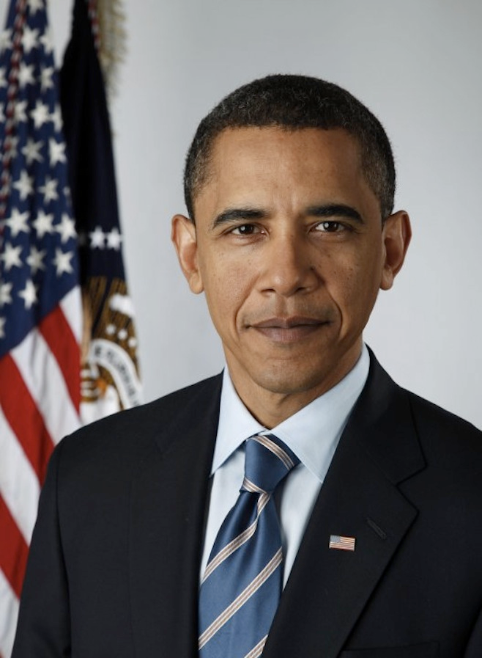
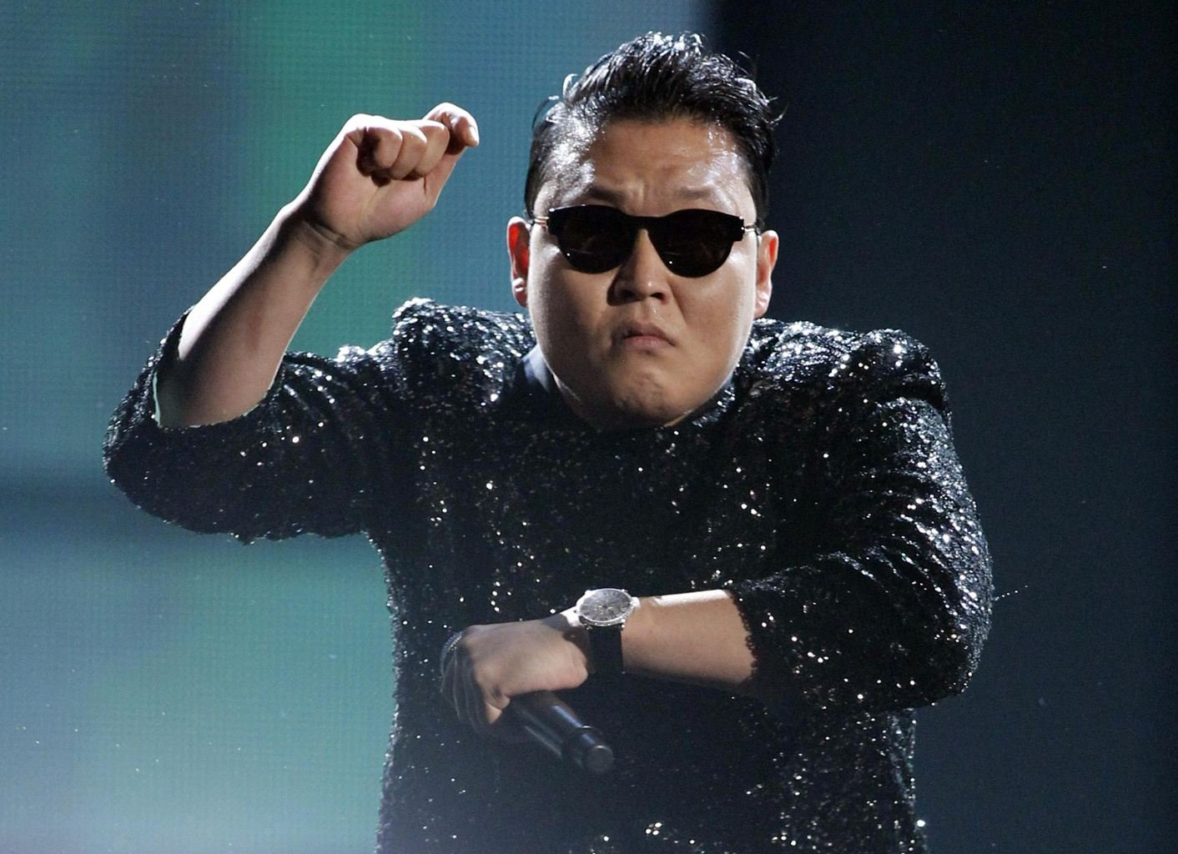
Today’s Question
Example question: who has the most friends on Facebook?
Challenges to answering this question?
It changes!
What do we need?
A snapshot of the social network graph at a particular time

Slide 5
Today’s Question
Distributed debugging
How do you debug this?
Log in to one machine and see what happens
Collect logs and see what happens
Taking a global snapshot!
P0
P1
P2
Both waiting…
Deadlock!

Slide 6
What is a Snapshot?
Single process snapshot
Just a snapshot of the local state, e.g., memory dump, stack trace, etc.
For the sake of this lecture, let’s say a log of events.
Multi-process snapshot
Two things
Process snapshots: Snapshots of all process states
Network snapshot: All messages in the network

Slide 7
What Do We Want?
A “cut”
e₁⁰
e₁¹
e₁²
e₁³
P1
e₂¹
P2
e₂⁰
e₂²
P3
e₃⁰
e₃¹
e₃²
Would you say this is a good snapshot?
“Good”: we can explain all the causality, including messages
No because e₂¹ might have been caused by e₃¹.
Three things we want.
Per-process state
Messages that are causally related to each and every local snapshot and in flight
All events that happened before each event in the snapshot

Slide 8
Obvious First Try
Synchronize clocks of all processes
Ask all processes to record their states at known time t
Problems?
Time synchronization possible only approximately
Another issue?
Does not record the state of messages in the channels
Again: synchronization not required – causality is enough!
What we need: logical global snapshot
The state of each process
Messages in transit in all communication channels
P0
P1
P2
msg

Slide 9
How to Do It? Definitions
e₁⁰
e₁¹
e₁²
e₁³
P1
e₂¹
P2
e₂⁰
e₂²
P3
e₃⁰
e₃¹
e₃²
For a process P_{i} , where events e_{i}⁰, e_{i}¹, … occur,
history(P_{i}) = h_{i} = <e_{i}⁰, e_{i}¹, … >
prefix history(P_{i}^{k}) = h_{i}^{k} = <e_{i}⁰, e_{i}¹, …,e_{i}^{k} >
S_{i}^{k} : P_{i} ’s state immediately after k^{th} event
For a set of processes P₁ , …,P_{i} , …. :
Global history: H = ∪_{i} (h_{i})
Global state: S = ∪_{i} (S_{i}^{k}i)
A cut C ⊆ H = h₁^{c1} ∪ h₂^{c2} ∪ … ∪ h_{n}^{cn}
The frontier of C = {e_{i}^{ci}, i = 1,2, … n}

Slide 10

Consistent States
A cut C is consistent if and only if
∀_{e ∈ C} (if f → e then f ∈ C)
A global state S is consistent if and only if
it corresponds to a consistent cut
e₁⁰
e₁¹
e₁²
e₁³
P1
e₂¹
P2
e₂⁰
e₂²
P3
e₃⁰
e₃¹
e₃²
Inconsistent cut
Consistent cut

Slide 11
Why Consistent States?
#1: For each event, you can trace back the causality.
#2: The state machine view of a distributed system
The execution of a distributed system as a series of transitions between global states: S0 → S1 → S2 → …
…where each transition happens with one single action from a process (i.e., local process event, send, and receive)
Each state (S0, S1, S2, …) is a consistent state.

Slide 12
CSE 486/586 Administrivia
PA2-A deadline: This Friday
PA1: Will start grading from today
Please come and ask questions during office hours.

Slide 13
The Snapshot Algorithm: Assumptions
There is a communication channel between each pair of processes (@each process: N-1 in and N-1 out)
Communication channels are unidirectional and FIFO-ordered (important point)
No failure, all messages arrive intact, exactly once
Any process may initiate the snapshot
Snapshot does not interfere with normal execution
Each process is able to record its state and the state of its incoming channels (no central collection)

Slide 14
Single Process vs. Multiple Processes
Single process snapshot
Just a snapshot of the local state, e.g., memory dump, stack trace, etc.
But for the sake of this lecture, let’s say a log of all events
Multi-process snapshot
Snapshots of all process states
Network snapshot: All messages in the network
Two questions:
#1: When to take a local snapshot at each process so that the collection of them can form a consistent global state? (Process snapshot)
#2: How to capture messages in flight? (Network snapshot)

Slide 15
Reminder: Clock-Sync’d Snapshot
Instantaneous snapshot
Process snapshots and network messages at time t
We can’t quite do it due to (i) imperfect clock sync and (ii) no help from the network.
P1
a
b
P2

Slide 16
Chandy and Lamport’s Snapshot: Basic Idea
Goal: taking a consistent (not instantaneous) global snapshot
Any process can initiate a snapshot-taking process by taking a local snapshot and sending a message called a marker.
Upon receiving a marker, a process takes a local snapshot of its own. (The proc. snapshot part done)
Still need to take a network snapshot.
How do we take a network snapshot?
Insight: messages in flight will eventually arrive.
P1
b
a
M
P2

Slide 17
Chandy and Lamport’s Snapshot: Basic Idea
Each process that has taken a snapshot also starts recording incoming messages
Since those messages were in the network when the snapshot was being taken.
If every process does this, we will capture all messages in flight, recording messages destined to each process.
Tricky part: the algorithm has a mechanism to stop recording incoming messages at some point.
P1
b
a
M
P2

Slide 18
Chandy and Lamport’s Snapshot: Basic Idea
Reminder: which messages do we want to record?
Messages that were in the network at the time of taking a snapshot
How do we record just those messages?
Insight: we can mark the end of relevant messages.
After taking a local snapshot, each process sends a message saying that it’s done sending all messages relevant to the snapshot.
In fact, we don’t need a different message type, we use the same marker message.
P1
M
b
a
M
P2

Slide 19
Chandy and Lamport’s Snapshot
Marker broadcast & recording
The initiator broadcasts a “marker” message to everyone else
If a process receives a marker for the first time, it takes a local snapshot, starts recording all incoming messages, and broadcasts a marker again to everyone else.
A process stops recording for each channel, when it receives a marker for that channel.
P1
M
M
M
M
a
P2
M
M
b
P3

Slide 20
The Snapshot Algorithm
1. Marker sending rule for initiator process P₀
After P₀ has recorded its own state
for each outgoing channel C, send a marker message on C
2. Marker receiving rule for a process P_{k}
on receipt of a marker over channel C
if P_{k} has not yet recorded its own state
record P_{k}’s own state
record the state of C as “empty”
for each outgoing channel C, send a marker on C
turn on recording of messages over other incoming channels
else
record the state of C as all the messages received over C since P_{k} saved its own state; stop recording state of C

Slide 21
Exercise
e₁⁰
e₁^{1,2}
e₁³
e₁⁴
e₁³
P1
M
M
a
M
e₂³
e₂⁴
M
P2
e₂⁰
e₂^{1,2,3}
M
M
b
P3
e₃⁰
e₃^{2,3,4}
e₃¹
1- P1 initiates snapshot: records its state (S1); sends Markers to P2 & P3; turns on recording for channels C21 and C31
2- P2 receives Marker over C12, records its state (S2), sets state(C12) = {} sends Marker to P1 & P3; turns on recording for channel C32
3- P1 receives Marker over C21, sets state(C21) = {a}
4- P3 receives Marker over C13, records its state (S3), sets state(C13) = {} sends Marker to P1 & P2; turns on recording for channel C23
5- P2 receives Marker over C32, sets state(C32) = {b}
6- P3 receives Marker over C23, sets state(C23) = {}
7- P1 receives Marker over C31, sets state(C31) = {}

Slide 22
One Provable Property
The snapshot algorithm gives a consistent cut
Meaning,
Suppose e_{i} is an event in P_{i}, and e_{j} is an event in P_{j}
If e_{i} → e_{j}, and e_{j} is in the cut, then e_{i} is also in the cut.
Proof sketch: proof by contradiction
Suppose e_{j} is in the cut, but e_{i} is not.
Since e_{i} → e_{j,} there must be a sequence M of messages that leads to the relation.
Since e_{i} is not in the cut (our assumption), a marker should’ve been sent before e_{i}, and also before all of M.
Then P_{j} must’ve recorded a state before e_{j}, meaning, e_{j} is not in the cut. (Contradiction)

Slide 23
Summary
Global states
A union of all process states
Consistent global state vs. inconsistent global state
The “snapshot” algorithm
Take a snapshot of the local state
Broadcast a “marker” msg to tell other processes to record
Start recording all msgs coming in for each channel until receiving a “marker”
Outcome: a consistent global state

Slide 24
Acknowledgements
These slides contain material developed and copyrighted by Indranil Gupta at UIUC.

