Slide 1
CSE 486/586 Distributed Systems Reliable Multicast --- 2
Steve Ko
Computer Sciences and Engineering
University at Buffalo

Slide 2
Last Time
How do a group of processes communicate?
Multicast
One-to-many: “Local” broadcast within a group g of processes
What are the issues?
Processes crash (we assume crash-stop)
Messages get delayed
B-multicast
R-Multicast
Properties: integrity, agreement, validity
Ordering
Why do we care about ordering?

Slide 3
Recap: Ordering
Totally ordered messages T₁ and T₂.
FIFO-related messages F₁ and F₂.
Causally related messages C₁ and C₃
Total ordering does not imply causal ordering.
Causal ordering implies FIFO ordering
Causal ordering does not imply total ordering.
Hybrid mode: causal-total ordering, FIFO-total ordering.

Slide 4
Example: FIFO Multicast
(do NOT be confused with vector timestamps)
“Accept” = Deliver
Physical Time
Reject: 1 < 1 + 1
Accept: 2 = 1 + 1
P1
1 0 0
2 0 0
2 1 0
2 1 0
0 0 0
1
2
2
1
1
1
P2
0 0 0
1 0 0
2 0 0
2 1 0
Accept 1 = 0 + 1
1
P3
0 0 0
0 0 0
1 0 0
2 1 0
2 0 0
Accept 1 = 0 + 1
2 0 0
Accept: 1 = 0 + 1
Buffer 2>0 +1
Accept Buffer 2 =1 + 1
0 0 0
Sequence Vector

Slide 5
Totally Ordered Multicast
Using a sequencer
One dedicated “sequencer” that orders all messages
Everyone else follows.
ISIS system
Similar to having a sequencer, but the responsibility is distributed to each sender.

Slide 6
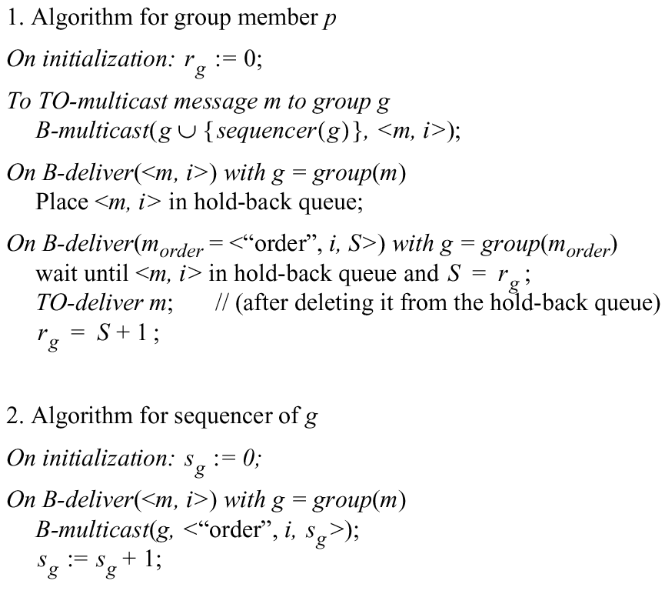
Total Ordering Using a Sequencer
Sequencer = Leader process
i: unique message id

Slide 7
ISIS algorithm for total ordering
No central sequencer
Achieves decentralization
Distributed doesn’t mean decentralized.
Every sender acts as a sequencer.
Since there is no single sequencer that determines a number, it requires agreement on sequence numbers.
Agreement is very important for decentralization.
Thus, each sender does not pick a sequence number alone.
Otherwise, two different senders can pick the same number.
Each sender receives proposals for a sequence number every time.
Among the proposals, the sender picks a number.

Slide 8
ISIS algorithm for total ordering
P
2
1 Message
3
2
P
2
2 Proposed Seq
4
1
3 Agreed Seq
1
2
P
1
3
P
3

Slide 9
ISIS algorithm for total ordering
How to propose a number?
Need a way to guarantee that a higher number is picked among all numbers assigned as sequence numbers already or potentially assigned as sequence numbers
Each message receiver pick a number that is the highest among all the numbers that it has ever seen, i.e., all previous proposals and actual message sequence numbers.
How to pick a sequence number out of all proposals?
Among all proposals, pick the highest number

Slide 10

ISIS algorithm for total ordering
Sender multicasts message to everyone
Reply with proposed priority (sequence no.)
Larger than all observed agreed priorities
Larger than any previously proposed (by self) priority
Store message in priority queue
Ordered by priority (proposed or agreed)
Mark message as undeliverable
Sender chooses agreed priority, re-multicasts message with agreed priority
Maximum of all proposed priorities
Upon receiving agreed (final) priority
Mark message as deliverable
Reorder the delivery queue based on the priorities
Deliver any deliverable messages at the front of priority queue
Notice any (small) issue?

Slide 11
CSE 486/586 Administrivia
PA2-B is due on 3/15.
Right before Spring break
Midterm is on 3/13.
Come up with a schedule that works.

Slide 12
Problematic Scenario
Two processes P1 & P2 at their initial state.
P1 sends M1 & P2 sends M2.
P1 receives M1 (its own) and proposes 1. P2 does the same for M2.
P2 receives M1 (P1’s message) and proposes 2. P1 does the same for M2.
P1 picks 2 for M1 & P2 also picks 2 for M2.
Same sequence number for two different msgs.
How do you want to solve this?
Use process numbers as a tie-breaker.
For a proposal, always use the following format: X.Y
X is the proposed number and Y is the process id.
P1 has proposed 2 for M1 → The proposal for M1 is now 2.1.

Slide 13
Example: ISIS algorithm
We don’t dictate when events are happening
P1
P2
P3
Notes:
Green arrows are message multicasts.
Dotted arrows are sequence number proposals.
A:1 in gray means message A, proposal 1

Slide 14
Example: ISIS algorithm
We don’t dictate when events are happening
A
A:1.1
P1
P2
P3
Notes:
Green arrows are message multicasts.
Dotted arrows are sequence number proposals.
A:1 in gray means message A, proposal 1

Slide 15
Example: ISIS algorithm
We don’t dictate when events are happening
A
A:1.1
P1
P2
P3
B:1.3
B
Notes:
Green arrows are message multicasts.
Dotted arrows are sequence number proposals.
A:1 in gray means message A, proposal 1

Slide 16
Example: ISIS algorithm
We don’t dictate when events are happening
A
A:1.1
P1
P2
B:1.2
P3
B:1.3
B
Notes:
Green arrows are message multicasts.
Dotted arrows are sequence number proposals.
A:1 in gray means message A, proposal 1

Slide 17
Example: ISIS algorithm
We don’t dictate when events are happening
A
A:1.1
P1
P2
B:1.2
A:2.2
P3
B:1.3
B
Notes:
Green arrows are message multicasts.
Dotted arrows are sequence number proposals.
A:1 in gray means message A, proposal 1

Slide 18
Example: ISIS algorithm
We don’t dictate when events are happening
A
A:1.1
P1
P2
B:1.2
A:2.2
P3
B:1.3
A:2.3
B
Notes:
Green arrows are message multicasts.
Dotted arrows are sequence number proposals.
A:1 in gray means message A, proposal 1

Slide 19
Example: ISIS algorithm
We don’t dictate when events are happening
A
A:1.1
P1
P2
B:1.2
A:2.2
C:3.2
C
P3
B:1.3
A:2.3
B
Notes:
Green arrows are message multicasts.
Dotted arrows are sequence number proposals.
A:1 in gray means message A, proposal 1

Slide 20
Example: ISIS algorithm
We don’t dictate when events are happening
A
A:1.1
C:2.1
P1
P2
B:1.2
A:2.2
C:3.2
C
P3
B:1.3
A:2.3
B
Notes:
Green arrows are message multicasts.
Dotted arrows are sequence number proposals.
A:1 in gray means message A, proposal 1

Slide 21
Example: ISIS algorithm
We don’t dictate when events are happening
A
A:1.1
C:2.1
P1
P2
B:1.2
A:2.2
C:3.2
C
P3
B:1.3
A:2.3
C:3.3
B
Notes:
Green arrows are message multicasts.
Dotted arrows are sequence number proposals.
A:1 in gray means message A, proposal 1

Slide 22
Example: ISIS algorithm
We don’t dictate when events are happening
A
A:1.1
C:2.1
B:3.1
P1
P2
B:1.2
A:2.2
C:3.2
C
P3
B:1.3
A:2.3
C:3.3
B
Notes:
Green arrows are message multicasts.
Dotted arrows are sequence number proposals.
A:1 in gray means message A, proposal 1

Slide 23
Example: ISIS algorithm
We don’t dictate when events are happening
A
A:1.1
C:2.1
B:3.1
P1
P2
B:1.2
A:2.2
C:3.2
C
P3
B:1.3
A:2.3
C:3.3
B
Notes:
Green arrows are message multicasts.
Dotted arrows are sequence number proposals.
A:1 in gray means message A, proposal 1

Slide 24
Example: ISIS algorithm
We don’t dictate when events are happening
A
A:2.3
C:2.1
B:3.1
P1
P2
B:1.2
A:2.2
C:3.2
C
P3
B:1.3
A:2.3
C:3.3
B
Notes:
Green arrows are message multicasts.
Dotted arrows are sequence number proposals.
A:1 in gray means message A, proposal 1

Slide 25
Example: ISIS algorithm
We don’t dictate when events are happening
A
A:2.3
C:2.1
B:3.1
P1
P2
B:1.2
A:2.2
C:3.2
C
P3
B:1.3
A:2.3
C:3.3
B
Notes:
Green arrows are message multicasts.
Dotted arrows are sequence number proposals.
A:1 in gray means message A, proposal 1

Slide 26
Example: ISIS algorithm
We don’t dictate when events are happening
A
C:2.1
A:2.3
B:3.1
P1
P2
B:1.2
A:2.2
C:3.2
C
P3
B:1.3
A:2.3
C:3.3
B
Notes:
Green arrows are message multicasts.
Dotted arrows are sequence number proposals.
A:1 in gray means message A, proposal 1

Slide 27
Example: ISIS algorithm
We don’t dictate when events are happening
A
C:2.1
A:2.3
B:3.1
P1
P2
B:1.2
A:2.2
C:3.2
C
P3
B:1.3
A:2.3
C:3.3
B
Notes:
Green arrows are message multicasts.
Dotted arrows are sequence number proposals.
A:1 in gray means message A, proposal 1

Slide 28
Example: ISIS algorithm
We don’t dictate when events are happening
A
C:2.1
A:2.3
B:3.1
P1
P2
B:1.2
A:2.3
C:3.2
C
P3
B:1.3
A:2.3
C:3.3
B
Notes:
Green arrows are message multicasts.
Dotted arrows are sequence number proposals.
A:1 in gray means message A, proposal 1

Slide 29
Example: ISIS algorithm
We don’t dictate when events are happening
A
C:2.1
A:2.3
B:3.1
P1
P2
B:1.2
A:2.3
C:3.2
C
P3
B:1.3
A:2.3
C:3.3
B
Notes:
Green arrows are message multicasts.
Dotted arrows are sequence number proposals.
A:1 in gray means message A, proposal 1

Slide 30
Example: ISIS algorithm
We don’t dictate when events are happening
A
C:2.1
A:2.3
B:3.1
P1
P2
B:1.2
A:2.3
C:3.2
C
P3
B:3.1
A:2.3
C:3.3
B
Notes:
Green arrows are message multicasts.
Dotted arrows are sequence number proposals.
A:1 in gray means message A, proposal 1

Slide 31
Example: ISIS algorithm
We don’t dictate when events are happening
A
C:2.1
A:2.3
B:3.1
P1
P2
B:1.2
A:2.3
C:3.2
C
P3
B:3.1
A:2.3
C:3.3
B
Notes:
Green arrows are message multicasts.
Dotted arrows are sequence number proposals.
A:1 in gray means message A, proposal 1

Slide 32
Example: ISIS algorithm
We don’t dictate when events are happening
A
C:2.1
A:2.3
B:3.1
P1
P2
B:1.2
A:2.3
C:3.2
C
P3
A:2.3
B:3.1
C:3.3
B
Notes:
Green arrows are message multicasts.
Dotted arrows are sequence number proposals.
A:1 in gray means message A, proposal 1

Slide 33
Example: ISIS algorithm
We don’t dictate when events are happening
A
C:2.1
A:2.3
B:3.1
P1
P2
B:1.2
A:2.3
C:3.2
C
✔
P3
A:2.3
B:3.1
C:3.3
B
Notes:
Green arrows are message multicasts.
Dotted arrows are sequence number proposals.
A:1 in gray means message A, proposal 1

Slide 34
Example: ISIS algorithm
We don’t dictate when events are happening
A
C:2.1
A:2.3
B:3.1
P1
P2
B:1.2
A:2.3
C:3.2
C
✔
✔
P3
A:2.3
B:3.1
C:3.3
B
Notes:
Green arrows are message multicasts.
Dotted arrows are sequence number proposals.
A:1 in gray means message A, proposal 1

Slide 35
Example: ISIS algorithm
We don’t dictate when events are happening
A
C:2.1
A:2.3
B:3.1
P1
P2
B:1.2
A:2.3
C:3.2
C
✔
✔
P3
A:2.3
B:3.1
C:3.3
B
Notes:
Green arrows are message multicasts.
Dotted arrows are sequence number proposals.
A:1 in gray means message A, proposal 1

Slide 36
Example: ISIS algorithm
We don’t dictate when events are happening
A
C:2.1
A:2.3
B:3.1
P1
P2
B:1.2
A:2.3
C:3.3
C
✔
✔
P3
A:2.3
B:3.1
C:3.3
B
Notes:
Green arrows are message multicasts.
Dotted arrows are sequence number proposals.
A:1 in gray means message A, proposal 1

Slide 37
Example: ISIS algorithm
We don’t dictate when events are happening
A
C:2.1
A:2.3
B:3.1
P1
P2
B:1.2
A:2.3
C:3.3
C
✔
✔
P3
A:2.3
B:3.1
C:3.3
B
Notes:
Green arrows are message multicasts.
Dotted arrows are sequence number proposals.
A:1 in gray means message A, proposal 1

Slide 38
Example: ISIS algorithm
We don’t dictate when events are happening
A
C:3.3
A:2.3
B:3.1
P1
P2
B:1.2
A:2.3
C:3.3
C
✔
✔
P3
A:2.3
B:3.1
C:3.3
B
Notes:
Green arrows are message multicasts.
Dotted arrows are sequence number proposals.
A:1 in gray means message A, proposal 1

Slide 39
Example: ISIS algorithm
We don’t dictate when events are happening
A
C:3.3
A:2.3
B:3.1
P1
P2
B:1.2
A:2.3
C:3.3
C
✔
✔
P3
A:2.3
B:3.1
C:3.3
B
Notes:
Green arrows are message multicasts.
Dotted arrows are sequence number proposals.
A:1 in gray means message A, proposal 1

Slide 40
Example: ISIS algorithm
We don’t dictate when events are happening
✔
A
A:2.3
B:3.1
C:3.3
P1
P2
B:1.2
A:2.3
C:3.3
C
✔
✔
P3
A:2.3
B:3.1
C:3.3
B
Notes:
Green arrows are message multicasts.
Dotted arrows are sequence number proposals.
A:1 in gray means message A, proposal 1

Slide 41
Example: ISIS algorithm
We don’t dictate when events are happening
✔
A
A:2.3
B:3.1
C:3.3
P1
P2
B:1.2
A:2.3
C:3.3
C
✔
✔
P3
A:2.3
B:3.1
C:3.3
B
Notes:
Green arrows are message multicasts.
Dotted arrows are sequence number proposals.
A:1 in gray means message A, proposal 1

Slide 42
Example: ISIS algorithm
We don’t dictate when events are happening
✔
A
A:2.3
B:3.1
C:3.3
P1
P2
B:1.2
A:2.3
C:3.3
C
✔
✔
✔
P3
A:2.3
B:3.1
C:3.3
B
Notes:
Green arrows are message multicasts.
Dotted arrows are sequence number proposals.
A:1 in gray means message A, proposal 1

Slide 43
Example: ISIS algorithm
We don’t dictate when events are happening
✔
A
A:2.3
B:3.1
C:3.3
P1
P2
B:1.2
A:2.3
C:3.3
C
✔
✔
✔
P3
A:2.3
B:3.1
C:3.3
B
Notes:
Green arrows are message multicasts.
Dotted arrows are sequence number proposals.
A:1 in gray means message A, proposal 1

Slide 44
Example: ISIS algorithm
We don’t dictate when events are happening
✔
A
A:2.3
B:3.1
C:3.3
P1
P2
B:3.1
A:2.3
C:3.3
C
✔
✔
✔
P3
A:2.3
B:3.1
C:3.3
B
Notes:
Green arrows are message multicasts.
Dotted arrows are sequence number proposals.
A:1 in gray means message A, proposal 1

Slide 45
Example: ISIS algorithm
We don’t dictate when events are happening
✔
A
A:2.3
B:3.1
C:3.3
P1
P2
B:3.1
A:2.3
C:3.3
C
✔
✔
✔
P3
A:2.3
B:3.1
C:3.3
B
Notes:
Green arrows are message multicasts.
Dotted arrows are sequence number proposals.
A:1 in gray means message A, proposal 1

Slide 46
Example: ISIS algorithm
We don’t dictate when events are happening
✔
A
A:2.3
B:3.1
C:3.3
P1
✔
P2
A:2.3
B:3.1
C:3.3
C
✔
✔
✔
P3
A:2.3
B:3.1
C:3.3
B
Notes:
Green arrows are message multicasts.
Dotted arrows are sequence number proposals.
A:1 in gray means message A, proposal 1

Slide 47
Example: ISIS algorithm
We don’t dictate when events are happening
✔
A
A:2.3
B:3.1
C:3.3
P1
✔
✔
P2
A:2.3
B:3.1
C:3.3
C
✔
✔
✔
P3
A:2.3
B:3.1
C:3.3
B
Notes:
Green arrows are message multicasts.
Dotted arrows are sequence number proposals.
A:1 in gray means message A, proposal 1

Slide 48
Example: ISIS algorithm
We don’t dictate when events are happening
✔
A
A:2.3
B:3.1
C:3.3
P1
✔
✔
✔
P2
A:2.3
B:3.1
C:3.3
C
✔
✔
✔
P3
A:2.3
B:3.1
C:3.3
B
Notes:
Green arrows are message multicasts.
Dotted arrows are sequence number proposals.
A:1 in gray means message A, proposal 1

Slide 49
Example: ISIS algorithm
We don’t dictate when events are happening
✔
A
A:2.3
B:3.1
C:3.3
P1
✔
✔
✔
P2
A:2.3
B:3.1
C:3.3
C
✔
✔
✔
P3
A:2.3
B:3.1
C:3.3
B
Notes:
Green arrows are message multicasts.
Dotted arrows are sequence number proposals.
A:1 in gray means message A, proposal 1

Slide 50
Example: ISIS algorithm
We don’t dictate when events are happening
✔
✔
A
A:2.3
B:3.1
C:3.3
P1
✔
✔
✔
P2
A:2.3
B:3.1
C:3.3
C
✔
✔
✔
P3
A:2.3
B:3.1
C:3.3
B
Notes:
Green arrows are message multicasts.
Dotted arrows are sequence number proposals.
A:1 in gray means message A, proposal 1

Slide 51
Example: ISIS algorithm
We don’t dictate when events are happening
✔
✔
✔
A
A:2.3
B:3.1
C:3.3
P1
✔
✔
✔
P2
A:2.3
B:3.1
C:3.3
C
✔
✔
✔
P3
A:2.3
B:3.1
C:3.3
B
Notes:
Green arrows are message multicasts.
Dotted arrows are sequence number proposals.
A:1 in gray means message A, proposal 1

Slide 52
Proof of Total Order
For a message m₁, consider the first process p that delivers m₁
At p, when message m₁ is at head of priority queue and has been marked deliverable, let m₂ be another message that has not yet been delivered (i.e., is on the same queue or has not been seen yet by p)
finalpriority(m₂) >=
proposedpriority(m₂) >
finalpriority(m₁)
Suppose there is some other process p’ that delivers m₂ before it delivers m₁. Then at p’,
finalpriority(m₁) >=
proposedpriority(m₁) >
finalpriority(m₂)
a contradiction!
Due to “max” operation at sender
Since queue ordered by increasing priority
Due to “max” operation at sender
Since queue ordered by increasing priority

Slide 53
Causally Ordered Multicast
Each process keeps a vector of message clocks.
Each counter represents the number of messages received from each of the other processes.
This works just like vector clocks, but with messages.
When multicasting a message, the sender process increments its own counter and attaches its vector clock.
Upon receiving a multicast message, the receiver process waits until it can preserve causal ordering, i.e., until it has delivered all the messages that have happened before:
It has delivered all the messages from the sender.
It has delivered all the messages that the sender had delivered before the multicast message.

Slide 54
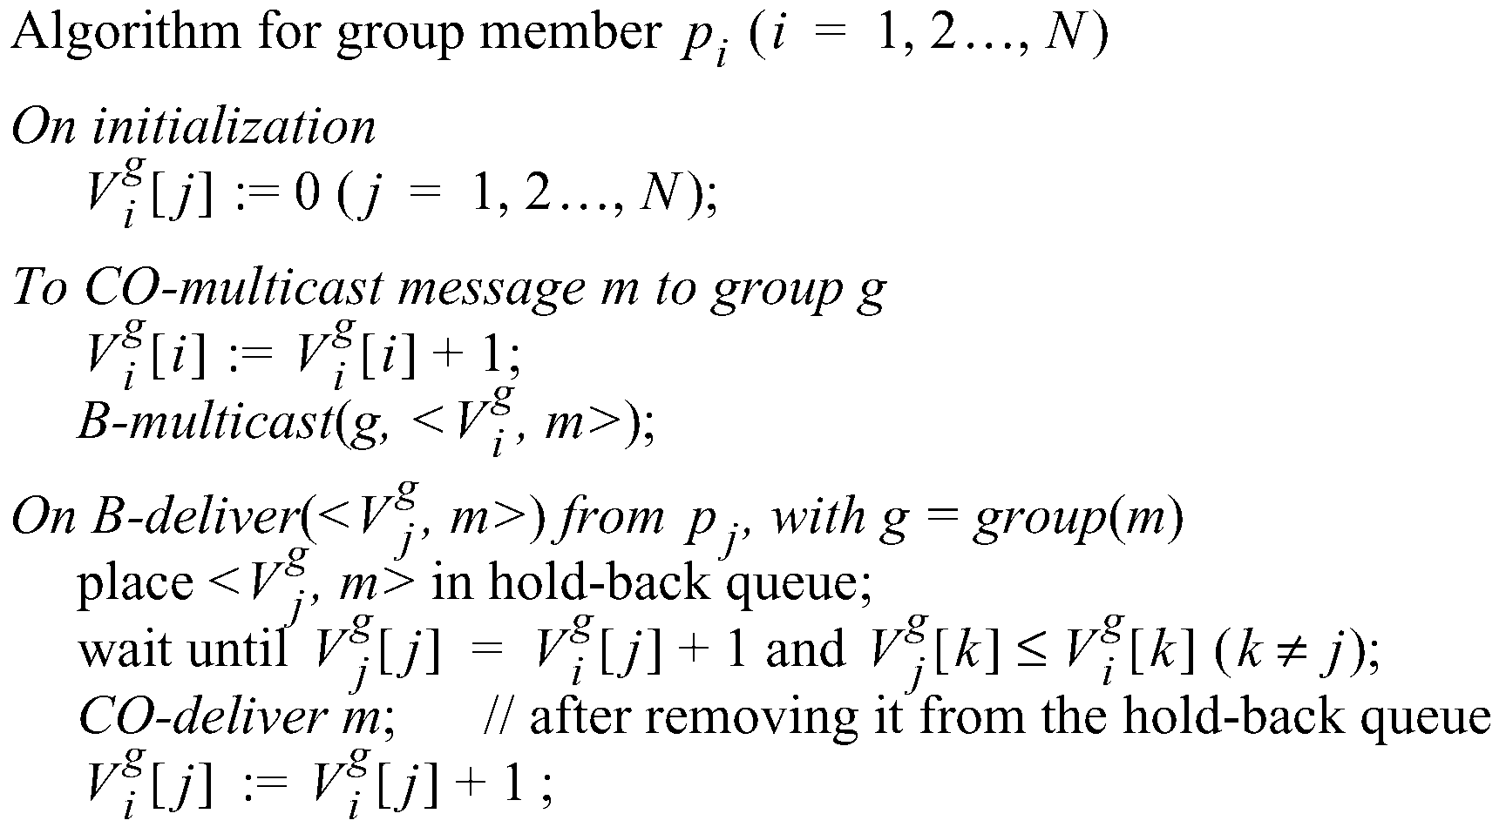
Causal Ordering
The number of group-g messages
from process j that have been seen at
process i so far

Slide 55
Example: Causal Ordering Multicast
Reject:
Accept
P1
1,0,0
1,1,0
1,1,0
0,0,0
(1,0,0)
(1,1,0)
(1,1,0)
P2
0,0,0
1,0,0
1,1,0
(1,1,0)
(1,0,0)
P3
0,0,0
1,0,0
1,1,0
1,1,0
Accept
Accept:
Accept Buffered message
Buffer, missing P1(1)
Physical Time

Slide 56
Summary
Two multicast algorithms for total ordering
Sequencer
ISIS
Multicast for causal ordering
Uses vector timestamps

Slide 57
Acknowledgements
These slides contain material developed and copyrighted by Indranil Gupta (UIUC).

