Slide 1
CSE 486/586 Distributed Systems Distributed Hash Tables
Steve Ko
Computer Sciences and Engineering
University at Buffalo

Slide 2
Last Time
Evolution of peer-to-peer
Central directory (Napster)
Query flooding (Gnutella)
Hierarchical overlay (Kazaa, modern Gnutella)
BitTorrent
Focuses on parallel download
Prevents free-riding

Slide 3
Today’s Question
How do we organize the nodes in a distributed system?
Up to the 90’s
Prevalent architecture: client-server (or master-slave)
Unequal responsibilities
Now
Emerged architecture: peer-to-peer
Equal responsibilities
Today: studying peer-to-peer as a paradigm

Slide 4
What We Want
Functionality: lookup-response
E.g., Gnutella
P
P
P
P
P
P
P

Slide 5
What We Don’t Want
Cost (scalability) & no guarantee for lookup
Napster: cost not balanced, too much for the server-side
Gnutella: cost still not balanced, just too much, no guarantee for lookup
 | Memory | Lookup Latency | #Messages for a lookup
Napster | O(1) (O(N)@server) | O(1) | O(1)
Gnutella | O(N) (worst case) | O(N) (worst case) | O(N) (worst case)
Notes:
Gnutella: cannot control how the network is formed

Slide 6

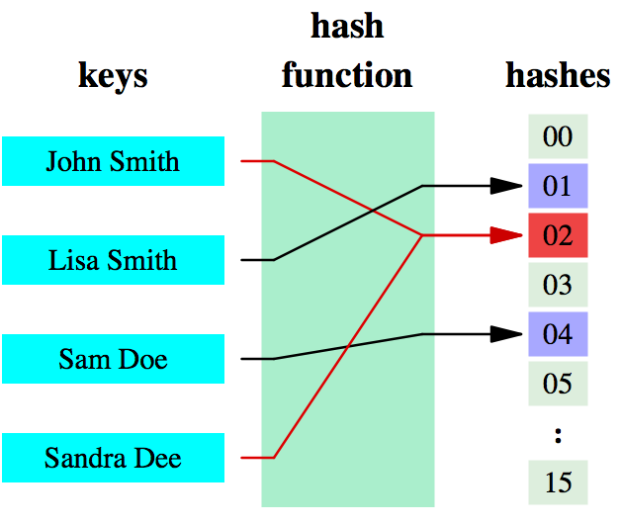
What We Want
What data structure provides lookup-response?
Hash table: data structure that associates keys with values
Name-value pairs (or key-value pairs)
E.g., “http://www.cnn.com/foo.html” and the Web page
E.g., “BritneyHitMe.mp3” and “12.78.183.2”
Table Index
Values

Slide 7
Hashing Basics
Hash function
Function that maps a large, possibly variable-sized datum into a small datum, often a single integer that serves to index an associative array
In short: maps n-bit datum into k buckets (k << 2^{n})
Provides time- & space-saving data structure for lookup
Main goals:
Low cost
Deterministic
Uniformity (load balanced)
E.g., mod
k buckets (k << 2^{n}), data d (n-bit)
b = d mod k
Distributes load uniformly only when data is distributed uniformly

Slide 8
DHT: Goal
Let’s build a distributed system with a hash table abstraction!
P
P
P
lookup(key)
key
value
value
P
P
P
P

Slide 9
Where to Keep the Hash Table
Server-side → Napster
Client-local → Gnutella
What are the requirements (think Napster and Gnutella)?
Deterministic lookup
Low lookup time (shouldn’t grow linearly with the system size)
Should balance load even with node join/leave
What we’ll do: partition the hash table and distribute them among the nodes in the system
We need to choose the right hash function
We also need to somehow partition the table and distribute the partitions with minimal relocation of partitions in the presence of join/leave

Slide 10
Where to Keep the Hash Table
Consider problem of data partition:
Given document X, choose one of k servers to use
Two-level mapping
Hashing: Map one (or more) data item(s) to a hash value (the distribution should be balanced)
Partitioning: Map a hash value to a server (each server load should be balanced even with node join/leave)
Let’s look at a simple approach and think about pros and cons.
Hashing with mod, and partitioning with buckets

Slide 11
Using Basic Hashing and Bucket Partitioning?
Hashing: Suppose we use modulo hashing
Number servers 1..k
Partitioning: Place X on server i = (X mod k)
Problem? Data may not be uniformly distributed
Mod
Table Index
Values
Server 0
Server 1
Server 15

Slide 12
Using Basic Hashing and Bucket Partitioning?
Place X on server i = uniform_hash (X) mod k
Problem?
What happens if a server fails or joins (k → k±1)?
Answer: (Almost) all entries get remapped to new nodes!
Hash + Mod
Table Index
Values
Server 0
Server 1
Server 15

Slide 13
CSE 486/586 Administrivia
PA2-B due on Friday next week, 3/15
(In class) Midterm on Wednesday (3/13)

Slide 14
Chord DHT
A distributed hash table system using consistent hashing
Organizes nodes in a ring
Maintains neighbors for correctness and shortcuts for performance
DHT in general
DHT systems are “structured” peer-to-peer as opposed to “unstructured” peer-to-peer such as Napster, Gnutella, etc.
Used as a base system for other systems, e.g., many “trackerless” BitTorrent clients, Amazon Dynamo, distributed repositories, distributed file systems, etc.
It shows an example of principled design.

Slide 15
Chord Ring: Global Hash Table
Represent the hash key space as a virtual ring
A ring representation instead of a table representation.
Use a hash function that evenly distributes items over the hash space, e.g., SHA-1
Map nodes (buckets) in the same ring
Used in DHTs, memcached, etc.
2¹²⁸-1
0
1
Id space
represented
as a ring.
Hash(name) → object_id
Hash(IP_address) → node_id

Slide 16
Chord: Consistent Hashing
Partitioning: Maps data items to its “successor” node
Advantages
Even distribution
Few changes as nodes come and go…
Hash(name) → object_id
Hash(IP_address) → node_id

Slide 17
Chord: When nodes come and go…
Small changes when nodes come and go
Only affects mapping of keys mapped to the node that comes or goes
Hash(name) → object_id
Hash(IP_address) → node_id

Slide 18
Chord: Node Organization
Maintain a circularly linked list around the ring
Every node has a predecessor and successor
Separate join and leave protocols
pred
node
succ

Slide 19
Chord: Basic Lookup
Lookup
lookup (id):
if ( id > pred.id &&
id <= my.id )
return my.id;
else
return succ.lookup(id);
Route hop by hop via successors
O(n) hops to find destination id
Object ID
node

Slide 20
Chord: Efficient Lookup --- Fingers
ith entry at peer with id n is first peer with:
id >=
Finger Table at N80
N114
i ft[i]
0 96
1 96
2 96
3 96
4 96
5 114
6 20
80 + 2⁵
80 + 2⁶
N20
N96
80 + 2⁴
80 + 2³
80 + 2²
80 + 2¹
80 + 2⁰
N80

Slide 21
Finger Table
Finding a <key, value> using fingers
N20
N102
86 + 2⁴
N86
20 + 2⁶

Slide 22
Chord: Efficient Lookup --- Fingers
lookup (id):
if ( id > pred.id &&
id <= my.id )
return my.id;
else
// fingers() by decreasing distance
for finger in fingers():
if id >= finger.id
return finger.lookup(id);
return succ.lookup(id);
Route greedily via distant “finger” nodes
O(log n) hops to find destination id

Slide 23
Chord: Node Joins and Leaves
When a node joins
Node does a lookup on its own id
And learns the node responsible for that id
This node becomes the new node’s successor
And the node can learn that node’s predecessor (which will become the new node’s predecessor)
Monitor
If doesn’t respond for some time, find new
Leave
Clean (planned) leave: notify the neighbors
Unclean leave (failure): need an extra mechanism to handle lost (key, value) pairs, e.g., as Dynamo does.

Slide 24
Summary
DHT
Gives a hash table as an abstraction
Partitions the hash table and distributes them over the nodes
“Structured” peer-to-peer
Chord DHT
Based on consistent hashing
Balances hash table partitions over the nodes
Basic lookup based on successors
Efficient lookup through fingers

Slide 25
Acknowledgements
These slides contain material developed and copyrighted by Indranil Gupta (UIUC), Michael Freedman (Princeton), and Jennifer Rexford (Princeton).

