Slide 1
Web
AI
IOT
Hybrid System

Slide 2
Ai
Image Processing
CNN
RNN
web
React
Express
Django
IOT
ARDUINO
Zigbee
LORA
Hybrid System

Slide 3
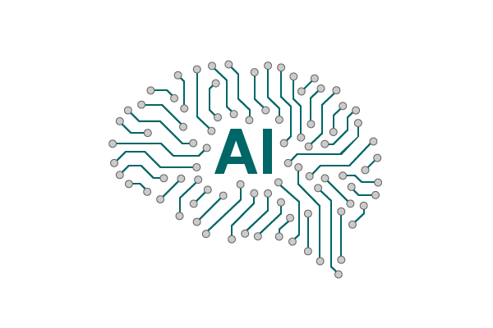



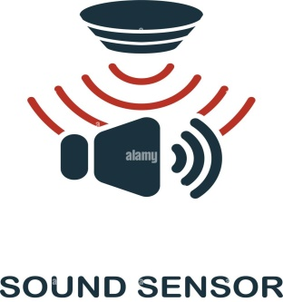
API
API
Outcome

Slide 4

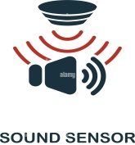
API
HYBRID SYSTEM
Saved a Life
☺

Slide 5
