Slide 1
Seizure Types

Slide 2
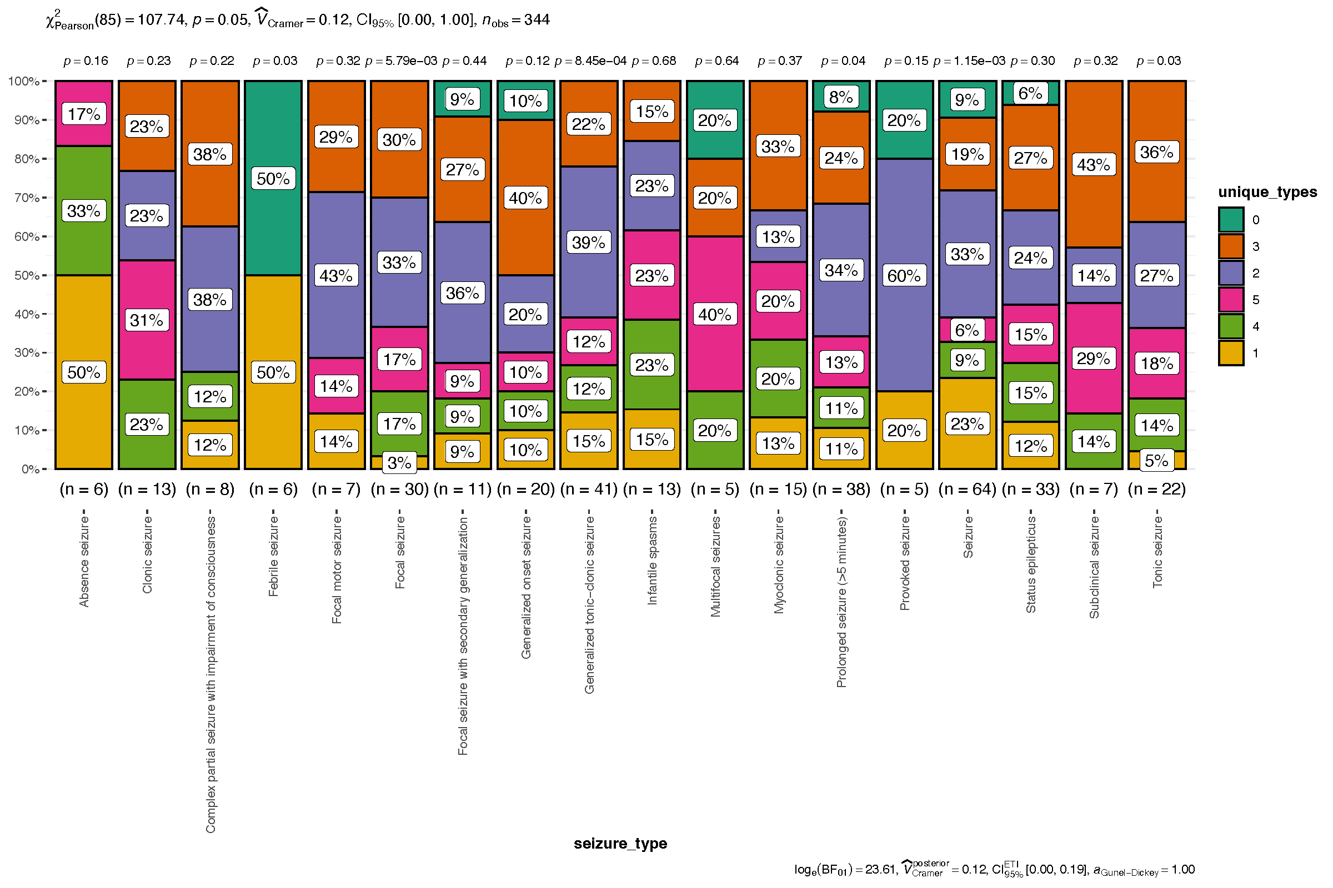

Slide 3
Hospital Events

Slide 4
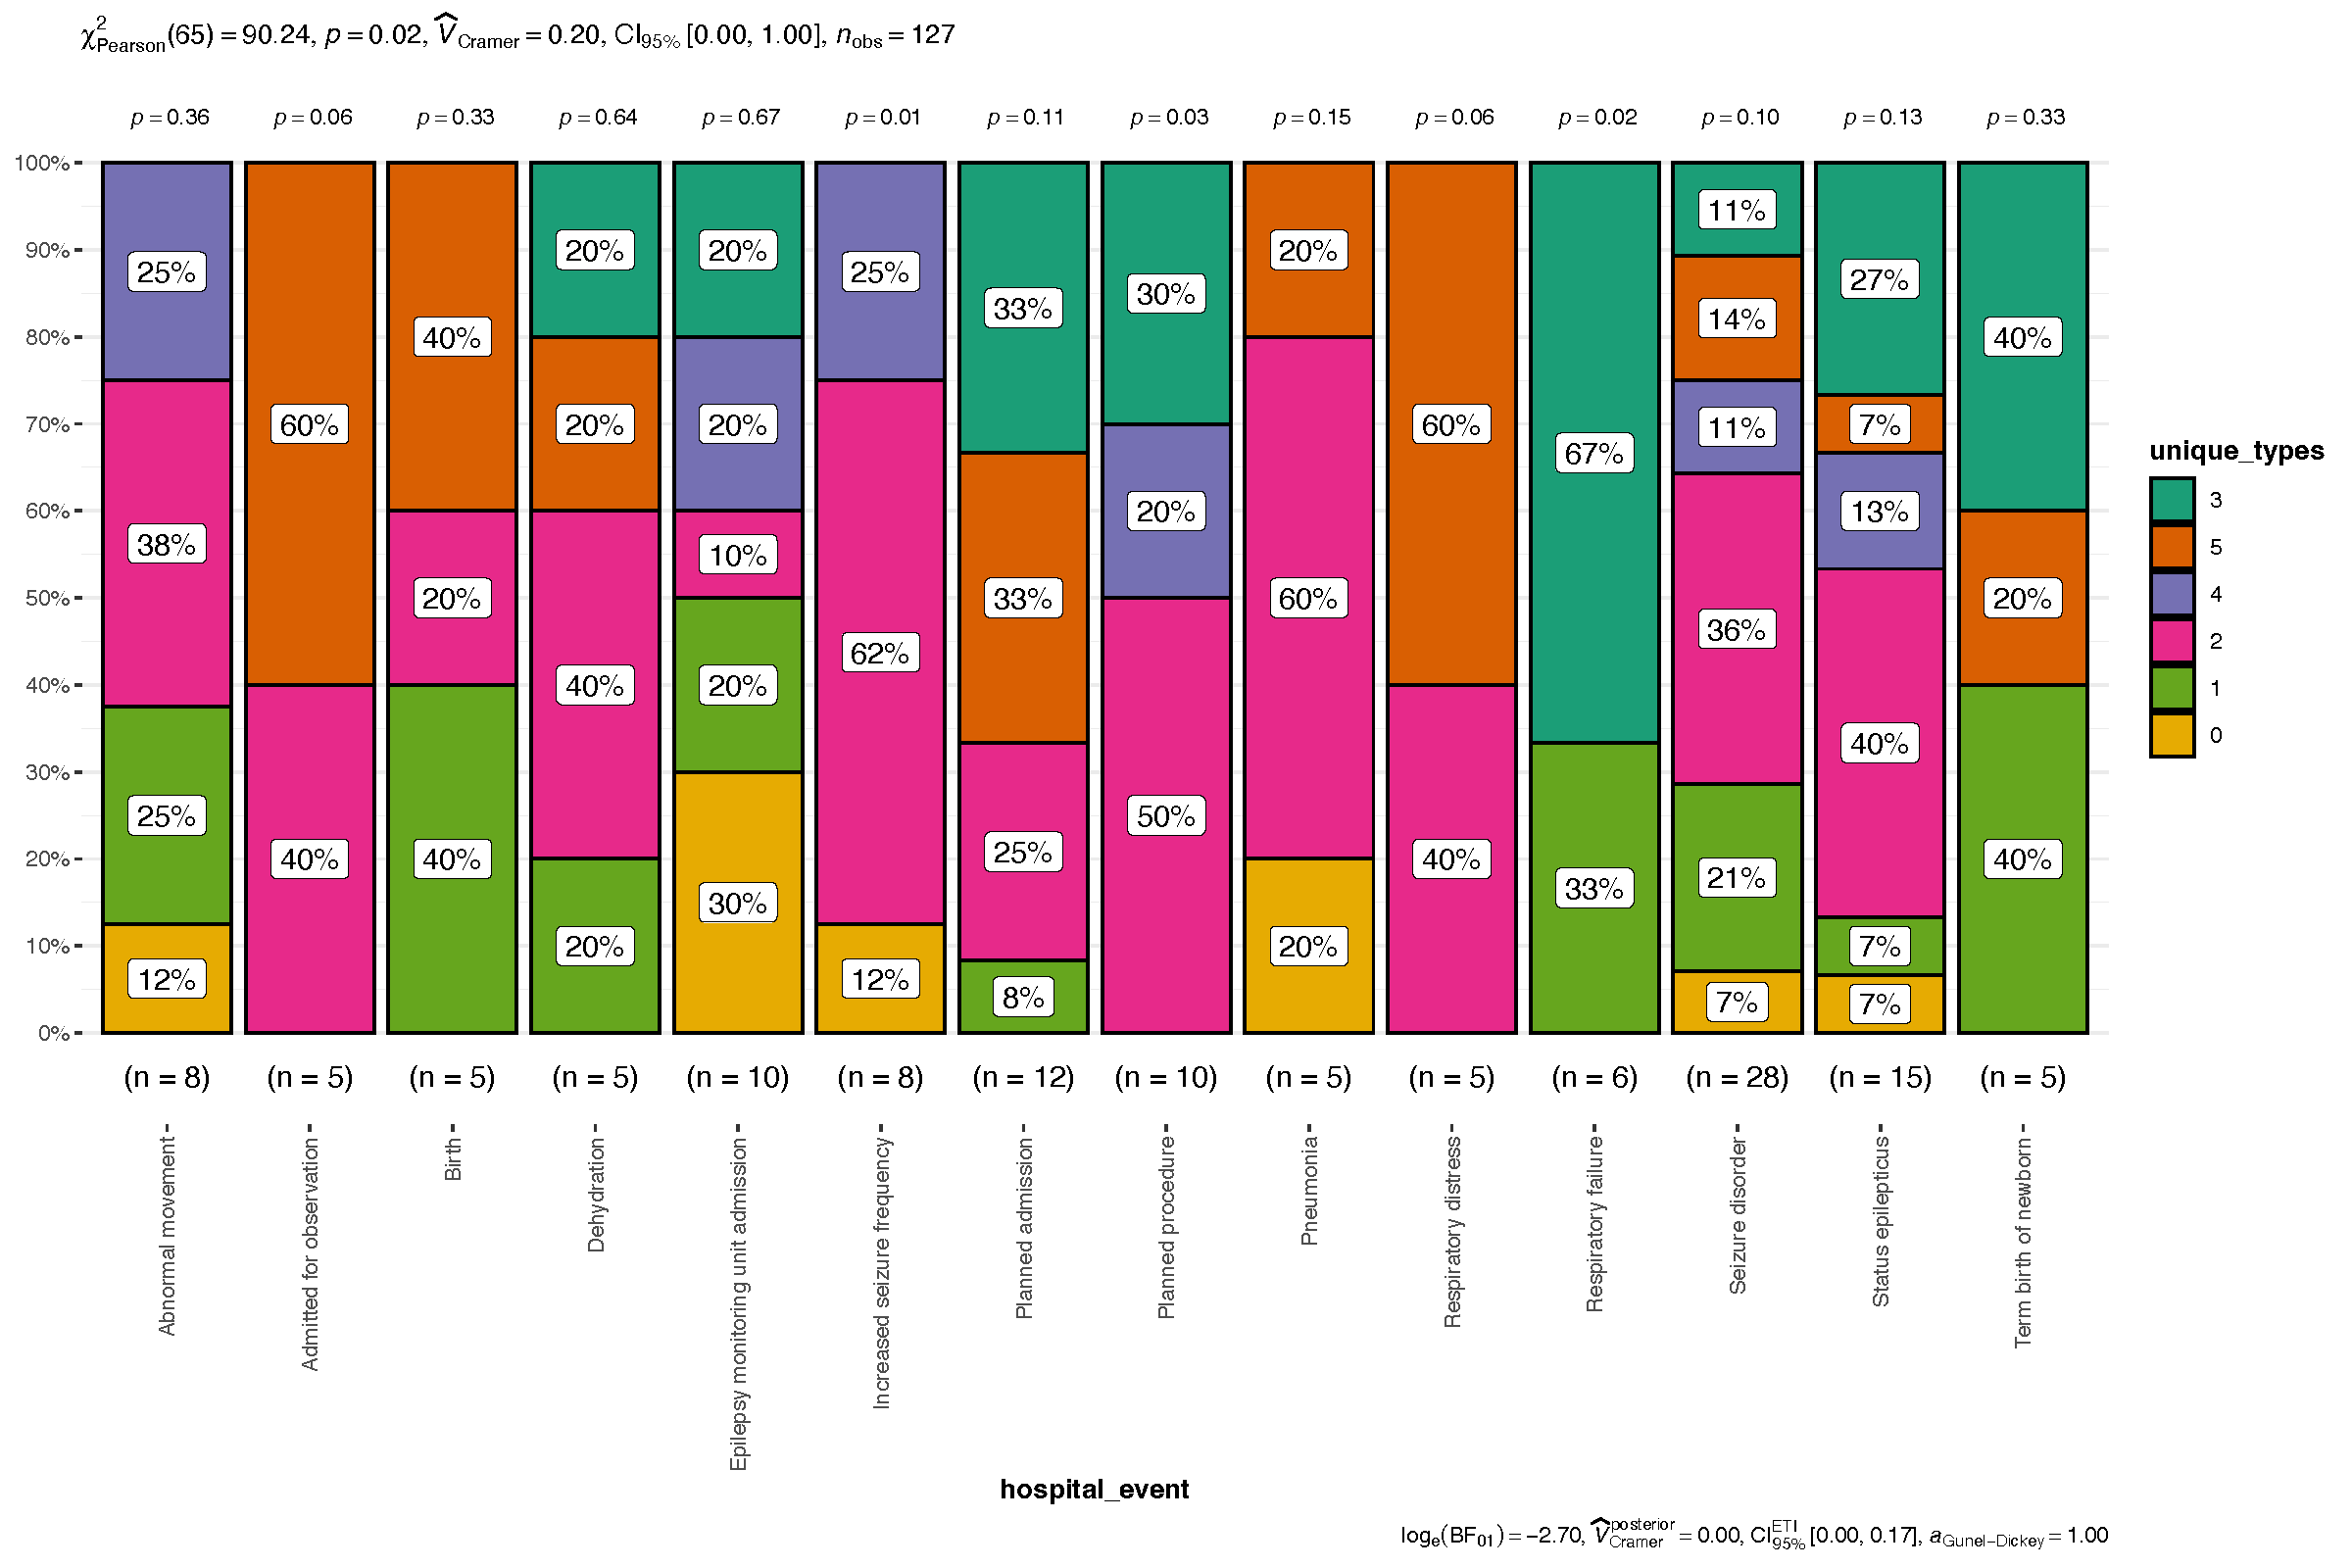

Slide 5
Clinical Diagnoses

Slide 6
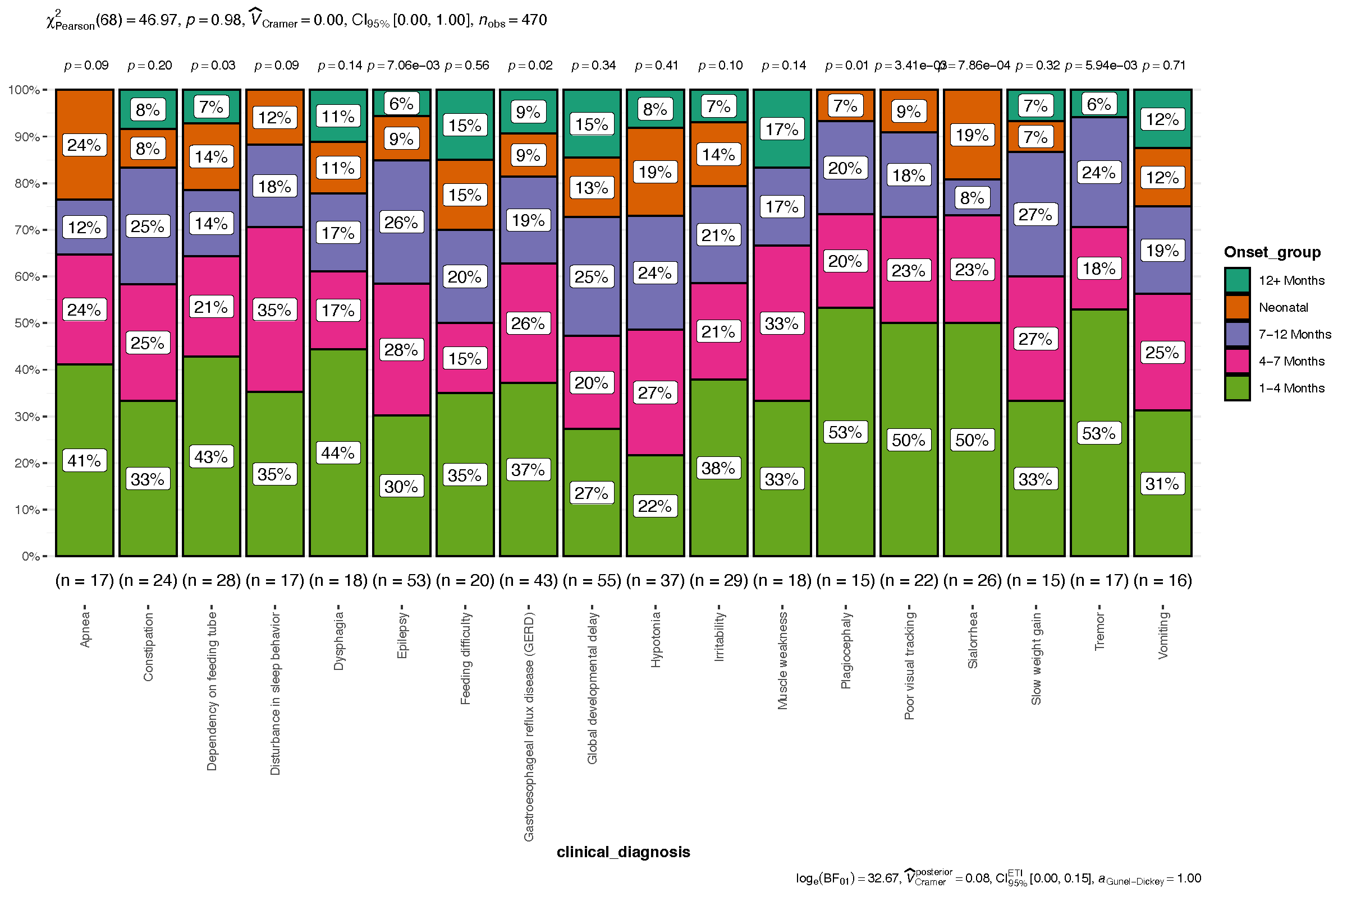

Slide 7
Procedures

Slide 8
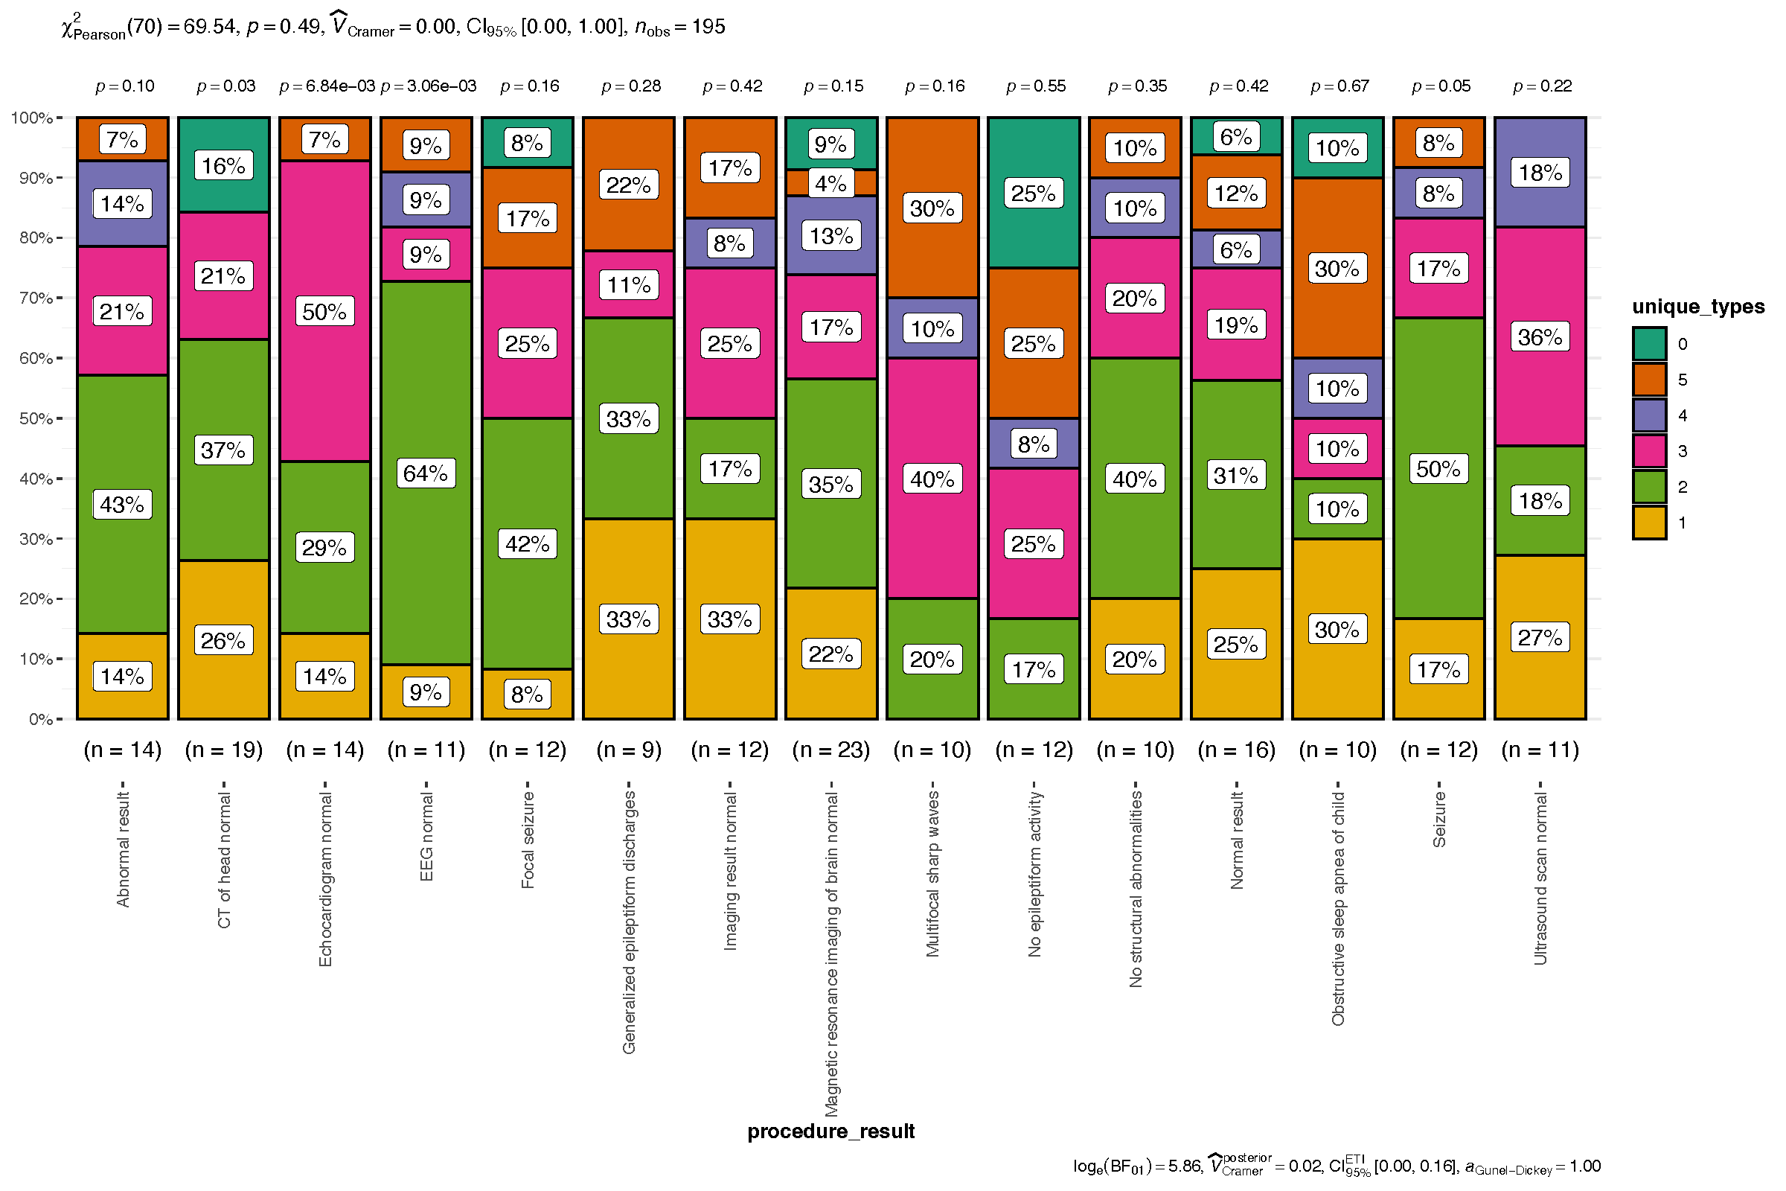

Slide 9
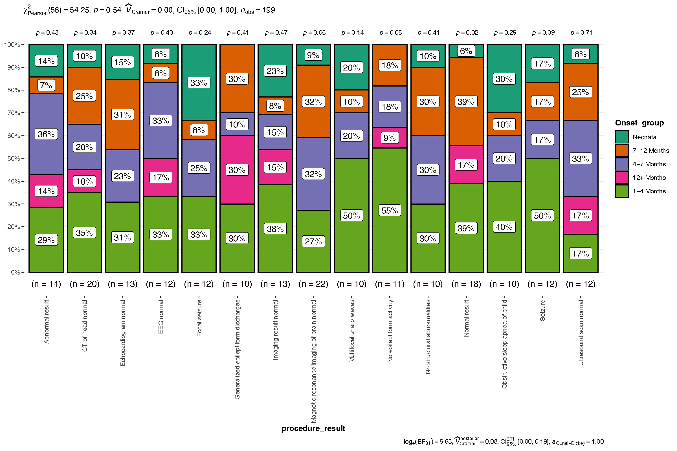

Slide 10
Stable Medications

Slide 11
