Slide 1
Given that a patient’s initial seizure type is bilateral tonic-clonic, how likely are they to develop focal seizures within the first 3 years?

Slide 2
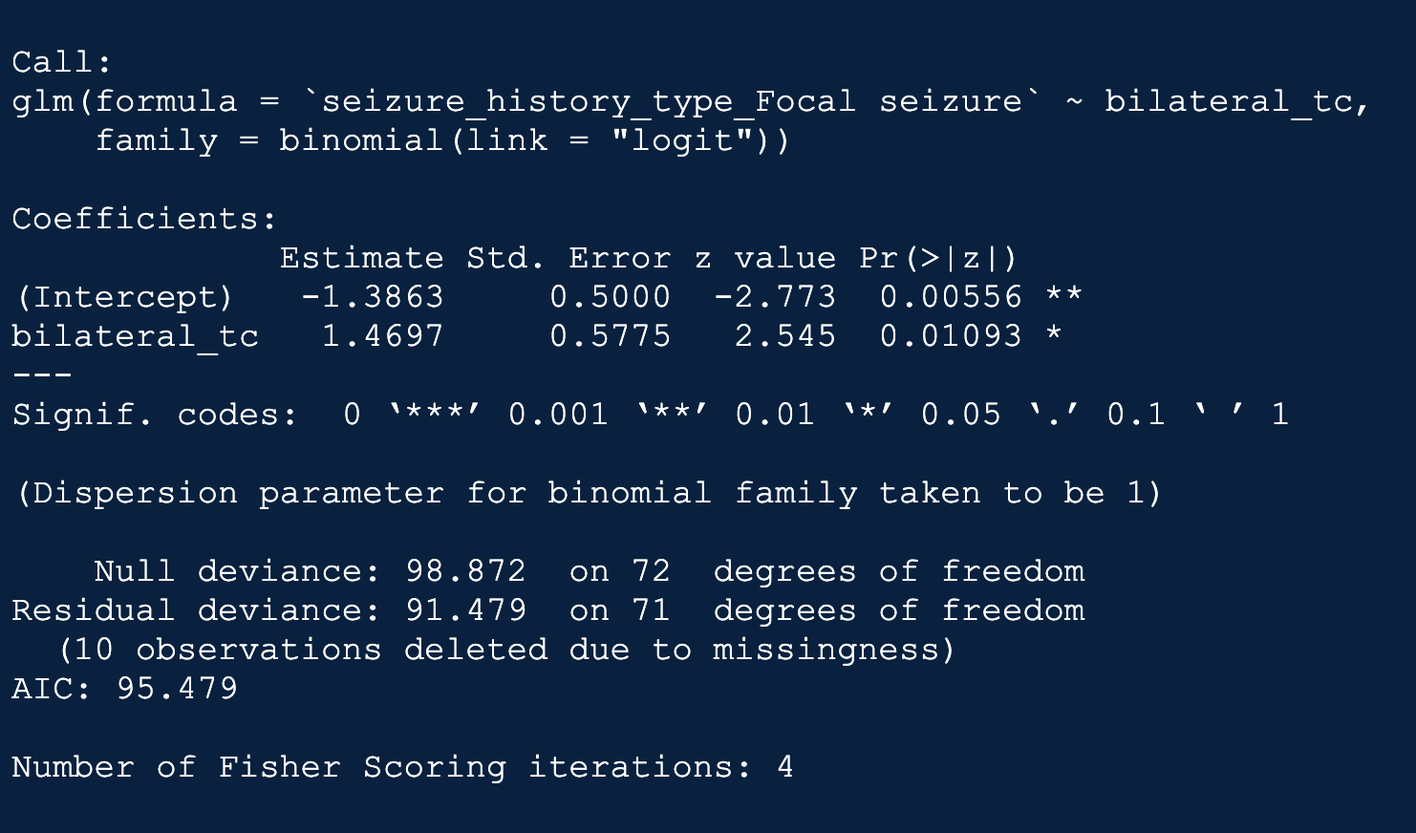
Model Summary

Slide 3
95% Confidence Interval
The lower and upper bounds of the 95% confidence interval for the odds ratio are 1.401922 and 13.48405 respectively.
Given that a patient’s initial seizure type is bilateral tonic-clonic, they are between 1.40 and 13.48 times more likely to develop focal seizures within the first 3 years compared to those whose initial seizure type is not bilateral tonic-clonic.

Slide 4
Diagnostics
AUC = 0.6492: This suggests that the model has moderate predictive power.
Accuracy = 0.6164: Correctly predicted the outcome for about 61.64% of cases.
Sensitivity (Recall) = 0.4651: Correctly identified 46.51% of true positive cases.
Specificity = 0.8333: Correctly identified 83.33% of true negative cases.
Precision = 0.8: 80% of the positive predictions made by the model were true positive.
Negative Predictive Value = 0.5208: 52.08% of the negative predictions made by the model were true negative.
Kappa = 0.2736: This suggests a fair level of agreement between the predictions and the actual outcomes, corrected for chance agreement.
Mcnemar’s Test P-Value = 0.001315: This suggests that there is a significant difference in the misclassification rates of the two classes.

Slide 5
Given that a patient’s initial seizure type is bilateral tonic-clonic, how likely are they to experience status events within the first 3 years?

Slide 6
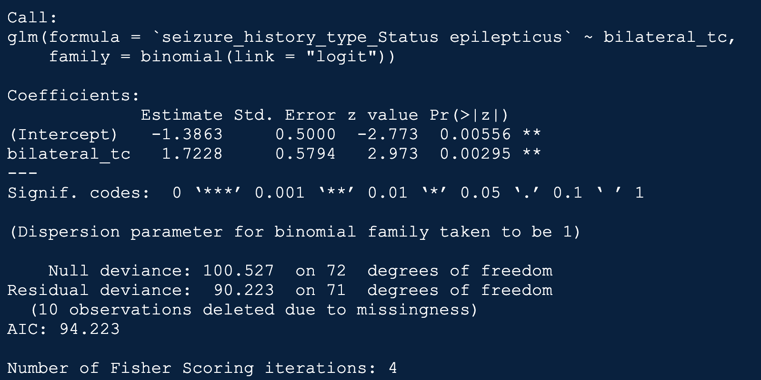
Model Summary

Slide 7
95% Confidence Interval
The lower and upper bounds of the 95% confidence interval for the odds ratio are 1.79 and 17.43 respectively.
Given that a patient’s initial seizure type is bilateral tonic-clonic, they are between 1.79 and 17.43 times more likely to experience status events within the first 3 years compared to those whose initial seizure type is not bilateral tonic-clonic.

Slide 8
Diagnostics
AUC = 0.6742: This suggests that the model has moderate predictive power.
Accuracy = 0.6575: Correctly predicted the outcome for about 65.75% of cases.
Sensitivity (Recall) = 0.5: Correctly identified 50% of true positive cases.
Specificity = 0.8485: Correctly identified 84.85% of true negative cases.
Precision = 0.8: 80% of the positive predictions made by the model were true positive.
Negative Predictive Value = 0.5833: 58.33% of the negative predictions made by the model were true negative.
Kappa = 0.3352: This suggests a fair level of agreement between the predictions and the actual outcomes, corrected for chance agreement.
Mcnemar’s Test P-Value = 0.00511: This suggests that there is a significant difference in the misclassification rates of the two classes.

Slide 9
Given that a patient’s initial seizure type is bilateral tonic-clonic, how likely are they to experience prolonged seizures within the first 3 years?

Slide 10
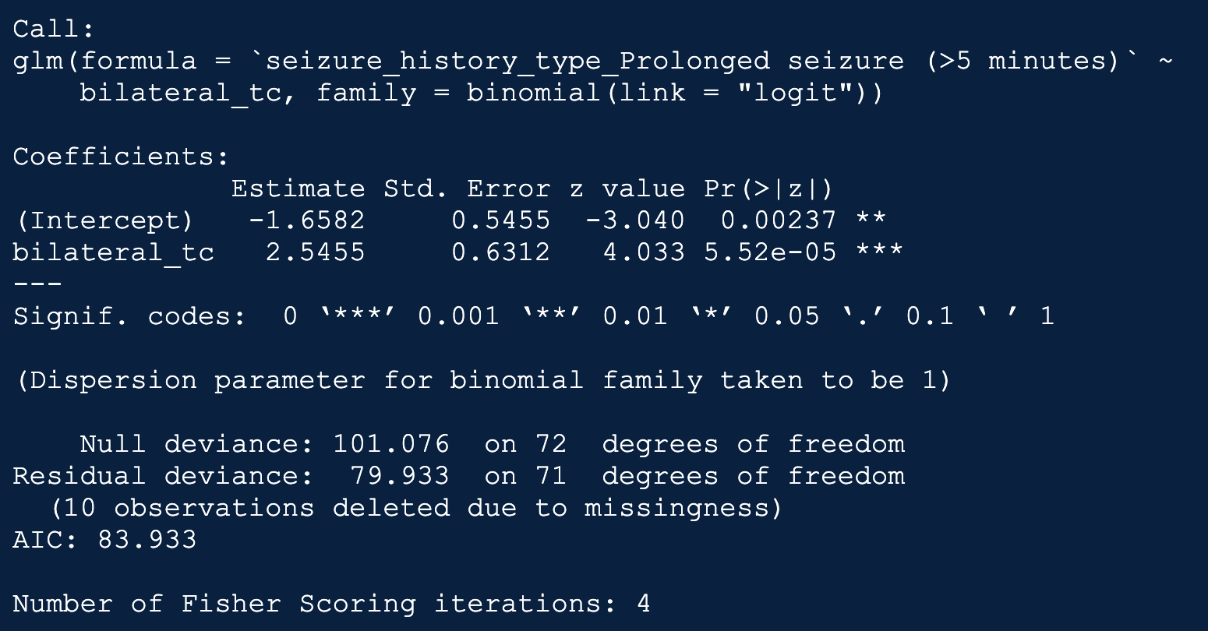
Model Summary

Slide 11
95% Confidence Interval
The lower and upper bounds of the 95% confidence interval for the odds ratio are 3.69 and 43.94 respectively.
Given that a patient’s initial seizure type is bilateral tonic-clonic, they are between 3.69 and 43.94 times more likely to experience prolonged seizures within the first 3 years compared to those whose initial seizure type is not bilateral tonic-clonic.

Slide 12
Diagnostics
AUC = 0.7474: This suggests that the model has good predictive power.
Accuracy = 0.7534: Correctly predicted the outcome for about 75.34% of cases.
Sensitivity (Recall) = 0.6: Correctly identified 60% of true positive cases.
Specificity = 0.8947: Correctly identified 89.47% of true negative cases.
Precision = 0.84: 84% of the positive predictions made by the model were true positive.
Negative Predictive Value = 0.7083: 70.83% of the negative predictions made by the model were true negative.
Kappa = 0.5004: This suggests a moderate level of agreement between the predictions and the actual outcomes, corrected for chance agreement.
Mcnemar’s Test P-Value = 0.03389: This suggests that there is a significant difference in the misclassification rates of the two classes.

