Slide 1
Sprocket Central Pty Ltd
Data Science Approach :
By Kiran Songire

Slide 2
Datasets
Customer demographic dataset
Customer address dataset
Transactions dataset
Customer New List dataset

Slide 3
Agenda
Approach for New Customer Data analysis based on:
Age distribution
Gender
Job industry
Number of cars owned statewise

Slide 4
Steps:
The approach will be implemented in three stages :
Data Cleaning
Data Exploration
Model Development
Data Analysis and Insights
Interpretation

Slide 5
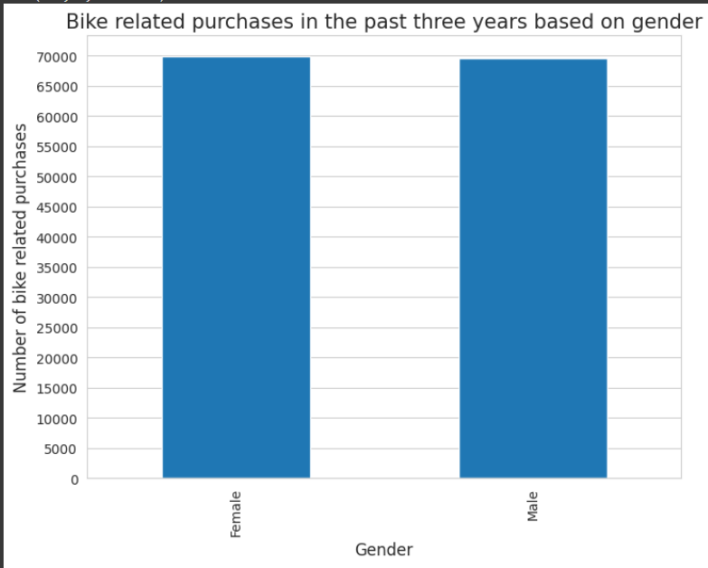
Data Exploration : Age Distribution & Bike Purchases
Data show that the age group 40-50 has a high number of bikes purchased in the last three years, with a slightly higher female ratio.
The target audience for our marketing and advertising should be oriented toward females rather than males.

Slide 6
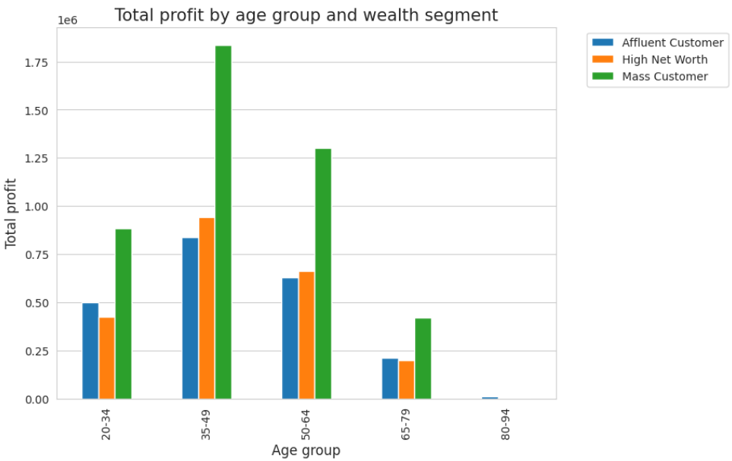
Data Exploration : Gender Distribution & Bike Purchases
New customers are more from the age group of 40-49 , followed by 50-59 & 60-69.
Fewer customer are from 10-19 & 90-99 for obvious reasons.

Slide 7
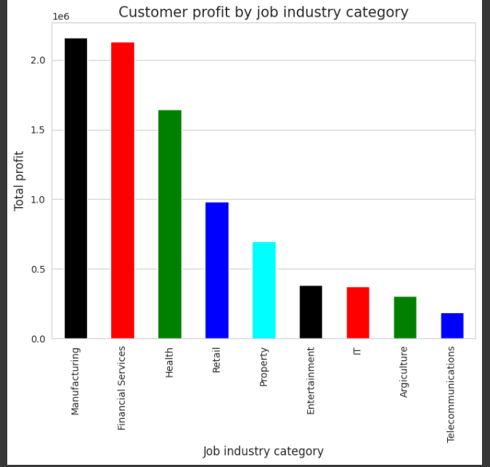
Data Exploration : Job Industry
The top three profit-generating industries are financial services, manufacturing, and health care, followed by retail and real estate.
Hence it shows that Financial Services, Manufacturing, and Health have the highest profits.

Slide 8
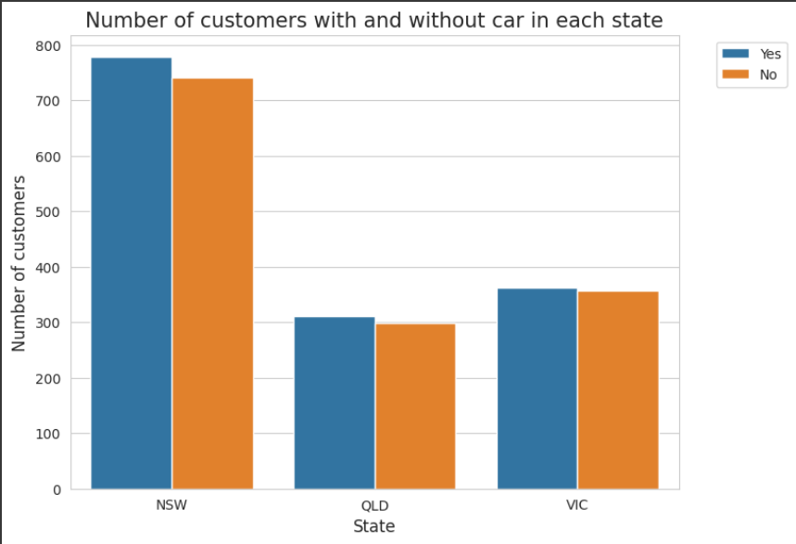
Data Exploration : Number of cars owned statewise
New South Wales, out of the three states, could be a potential market opportunity for the company.
New South Wales has the most potential because the number of people who own cars is nearly equal to the number of people who do not own cars, implying that there is room for value customers there.
Customers in VIC and QLD own cars more than those who do not, but we can try to do something to encourage those who own cars to buy bikes.

Slide 9
Model Development
CUSTOMER CLASSIFICATION – Targeting High Value Customers
Aged between 40 – 50.
Most of the high value customers are female compared to male
Working in Financial Service, Manufacturing and Health.
Who are currently living in New South Wales and Victoria.

Slide 10
Thank you

