Slide 1
Data Factory #3 – data warehouse
CAGIP

Slide 2
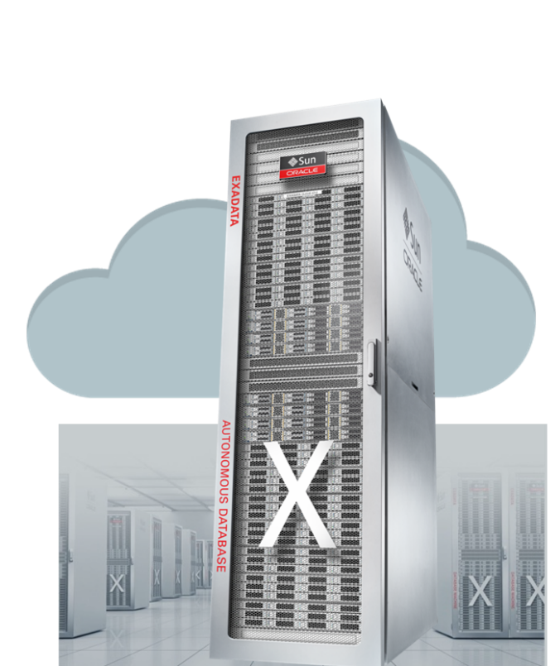
Definition:
it is high performance, open access Oracle DB Cloud without infrastructure management.
EXACC = Exadata Cloud@Customer
Simplicity of the database
Cloud Data sovereignty
Database performance
Reduced cost
Zero data loss and downtime

Slide 3
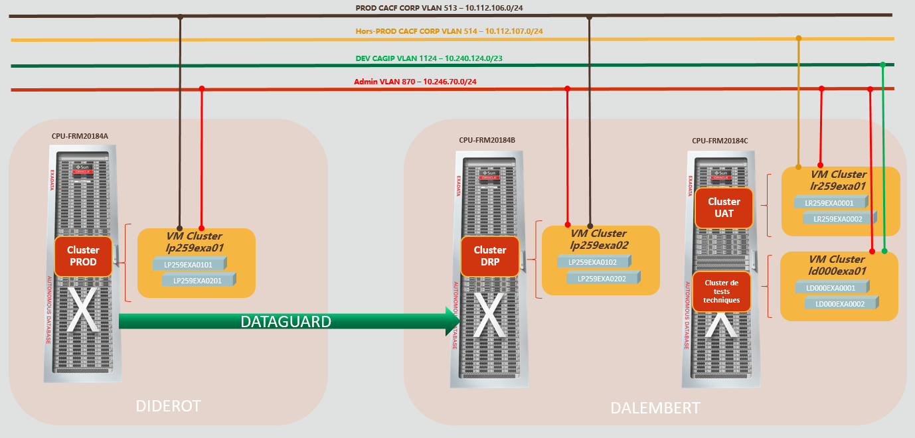
Architecture

Slide 5
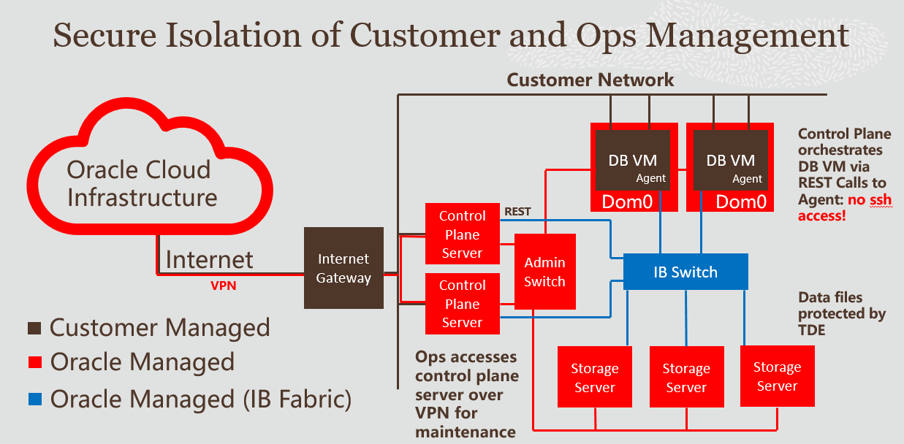

Slide 6
Administration
2 physical server per EXACC called DB node
One VM per DB node (except for Non-PROD)
Each DomU contains one or more instances
There is a local RAC between the DomU (within the same EXACC)
Active Data-Guard replication between the two production ExaCCs
Oracle manages the lower layers (hardware, storage, virtualization on DB Nodes)
CA-GIP manages databases: VM (DomU) + DB instances

Slide 7
Virtual machines
PROD
UAT (Recette)
lp259exa0101 | 10.112.106.150
lp259exa0101-admin | 10.246.70.60
lp259exa0201 | 10.112.106.152
lp259exa0201-admin | 10.246.70.61
lr259exa0001 | 10.112.107.150
lr259exa0001-admin | 10.246.70.64
lr259exa0002 | 10.112.107.152
lr259exa0002-admin | 10.246.70.65
PROD DRP
Test cluster
lp259exa0102 | 10.112.106.160
lp259exa0102-admin | 10.246.70.62
lp259exa0202 | 10.112.106.162
lp259exa0202-admin | 10.246.70.63
ld000exa0001 | 10.240.124.100
ld000exa0001-admin | 10.246.70.67
ld000exa0002 | 10.240.124.102
ld000exa0002-admin | 10.246.70.68

Slide 8
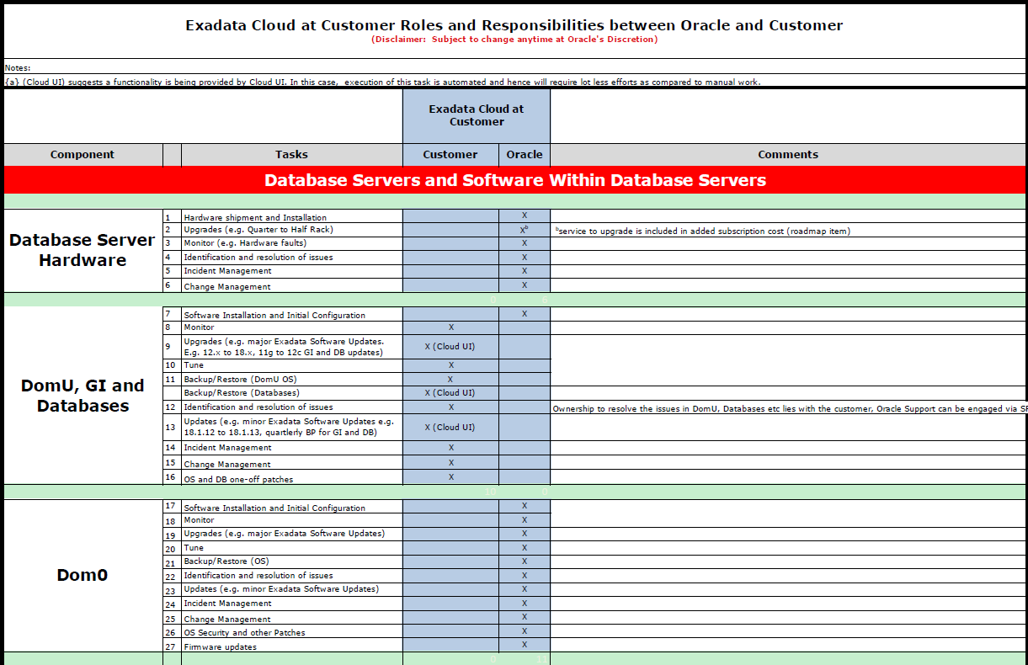

Slide 9
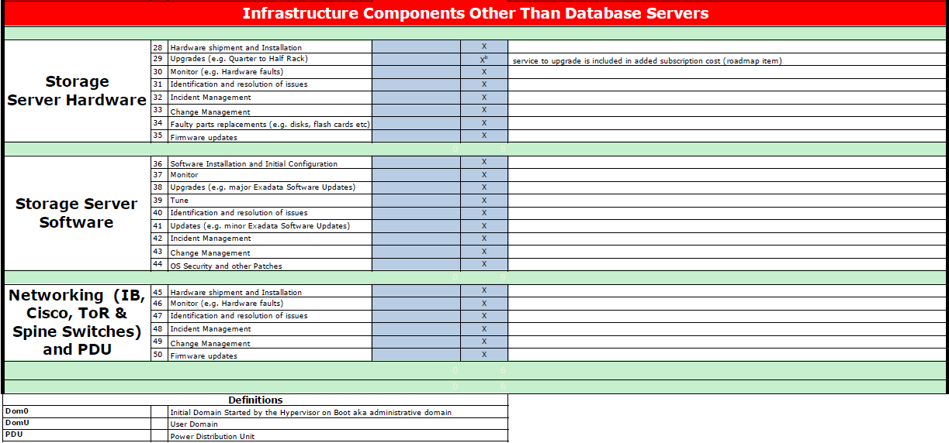

Slide 10
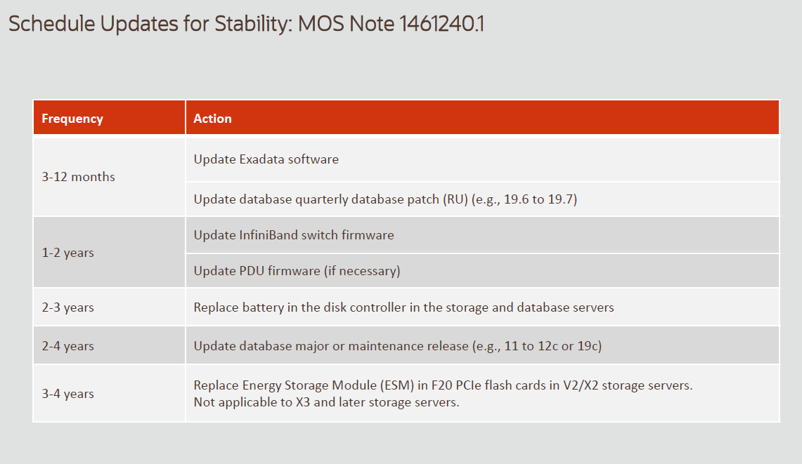
Maintenance frequency

Slide 11
Server’s Access
No direct SSH connection to root account.
SSH access with a privileged account named “opc” (a bit like our sysadm)
The "opc" account is in the SUL_ADMIN safe on Cyberark
2 VLANs on each VM: "prod" (or “client”) and "admin" (VLAN # 870)
SSH Access is done via an key exchange (no PWD)

Slide 12
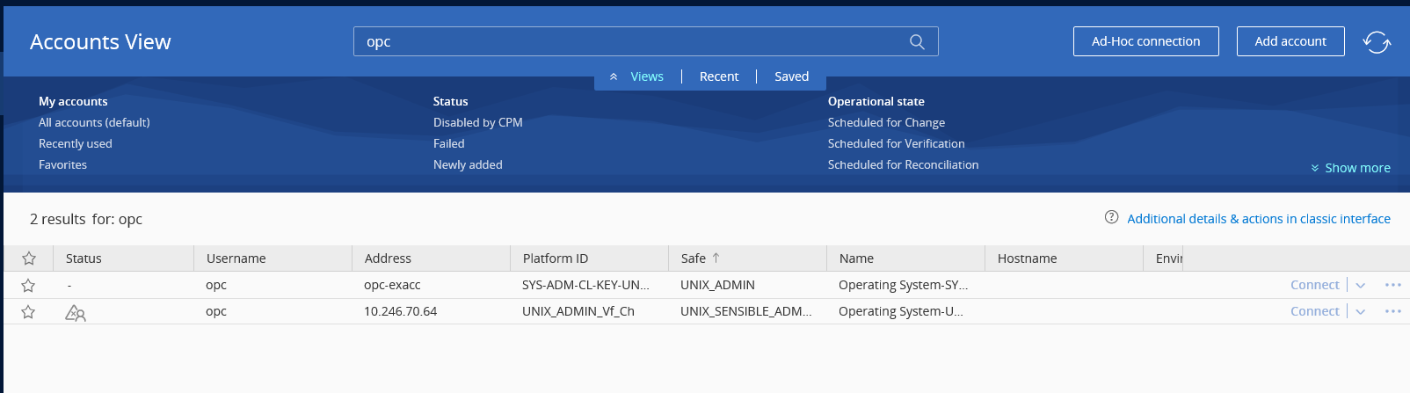
Server’s Access

Slide 13
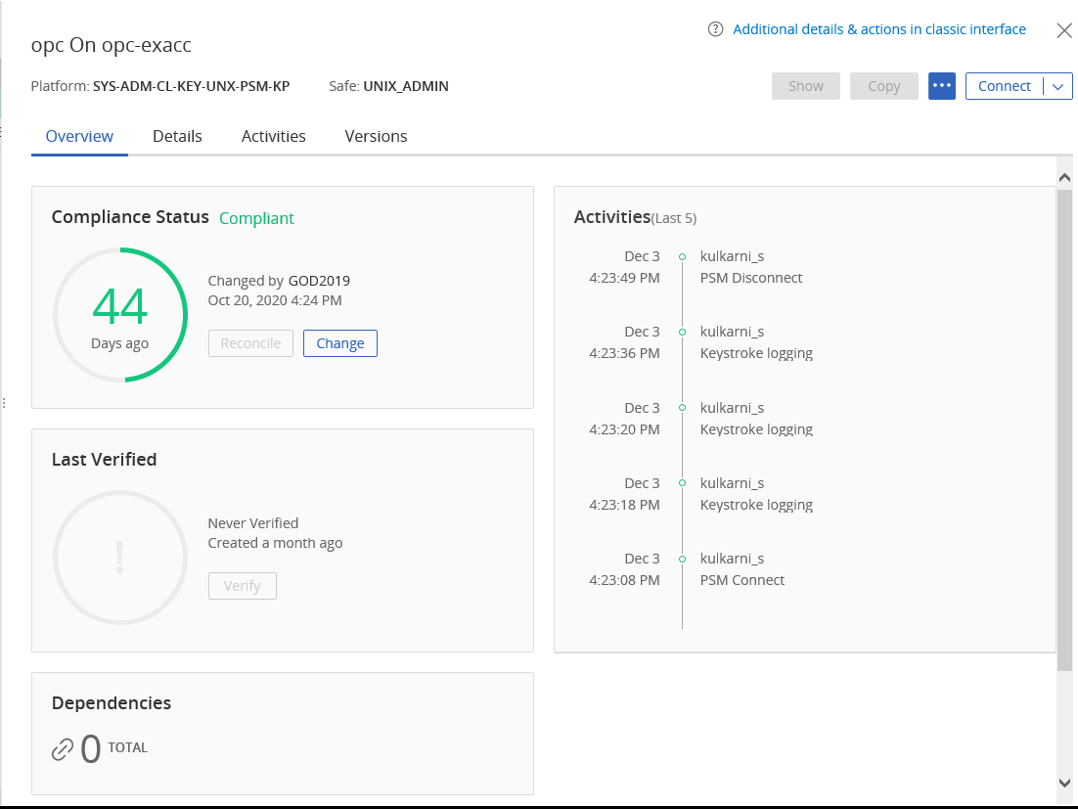
Server’s Access (opc account)

Slide 14
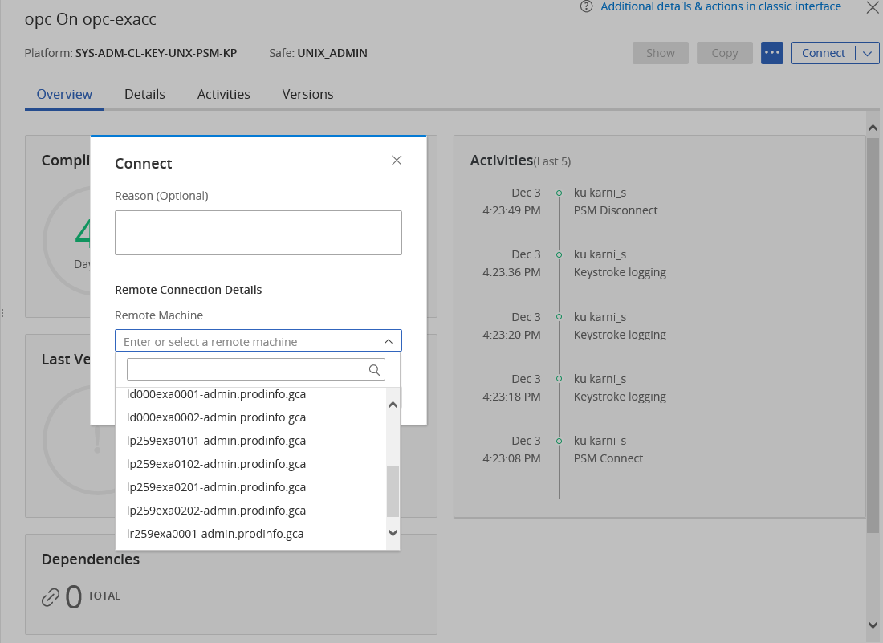
Server’s Access (opc account)

Slide 15
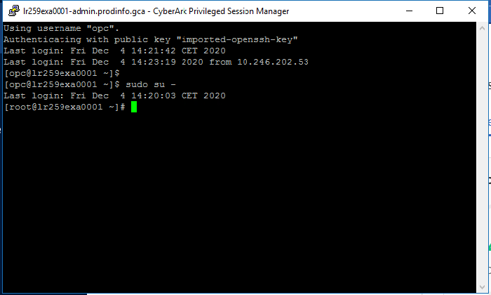
Server’s Access (opc account)

Slide 16
Backup
KVM Host (Hypervisor) → Oracle Liability
VMs:
Oracle Responsibility::
- Device level from the KVM Host (disk images and configuration of VMs)
- Once a week (Saturday evening)
CA-GIP Responsibility :
- “File” backup → provided by TSM
- "DB" backup → provided by DDBoost
- Use of admin 870 VLAN for backup
A new service account for Backup Team: uxsavexa

Slide 17
Monitoring & Incident management
Nagios + Netcool → Standard OS monitoring
OEM (Oracle Enterprise Manager) → Additional monitoring to come
A new service account for Monitoring Team : uxmonexa
No « pilotage » access.
CI owner on silcalonline : SYSTEME/UNIX/SUPPORT
Incident sources:
Monitoring
Portail Cloud Oracle through e-mails or automatic Service Request (SR)
The same account used by solaris team to access (My Oracle Support):
username: silca_ddo_ipf_pso_sul_sys2@ca-silca.fr
password: A communiquer

Slide 18
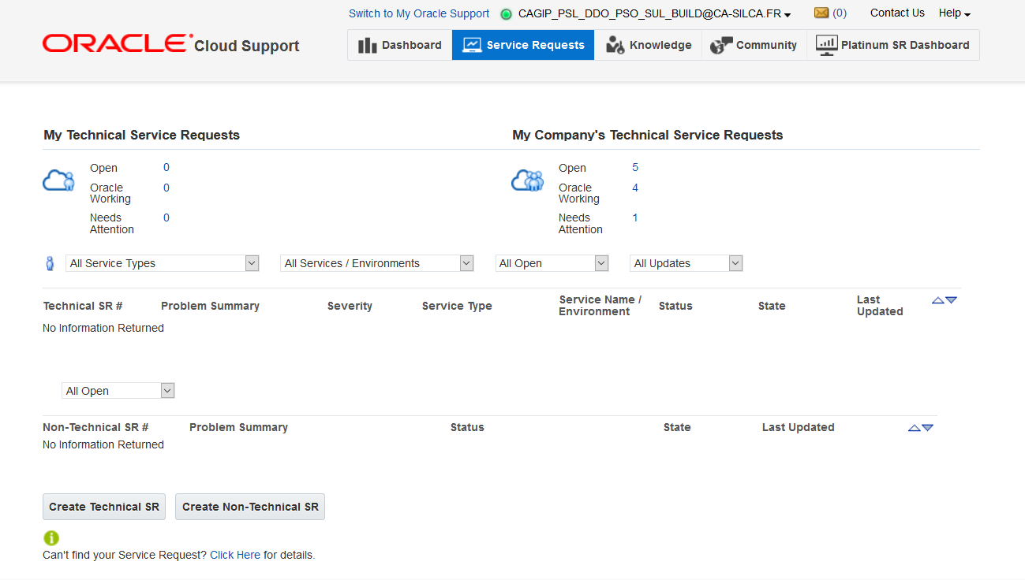
MOS Access (My Oracle Support)
Use the usual MOS account
New home page specific for cloud system

Slide 19
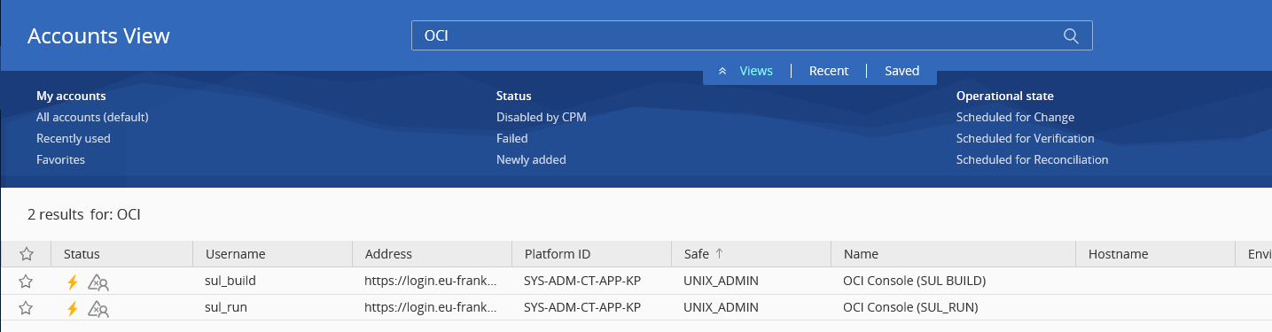
Oracle Cloud Infrastructure Access (OCI)
A new account created for OCI access
This account is locked in the Cyberark vault

Slide 20
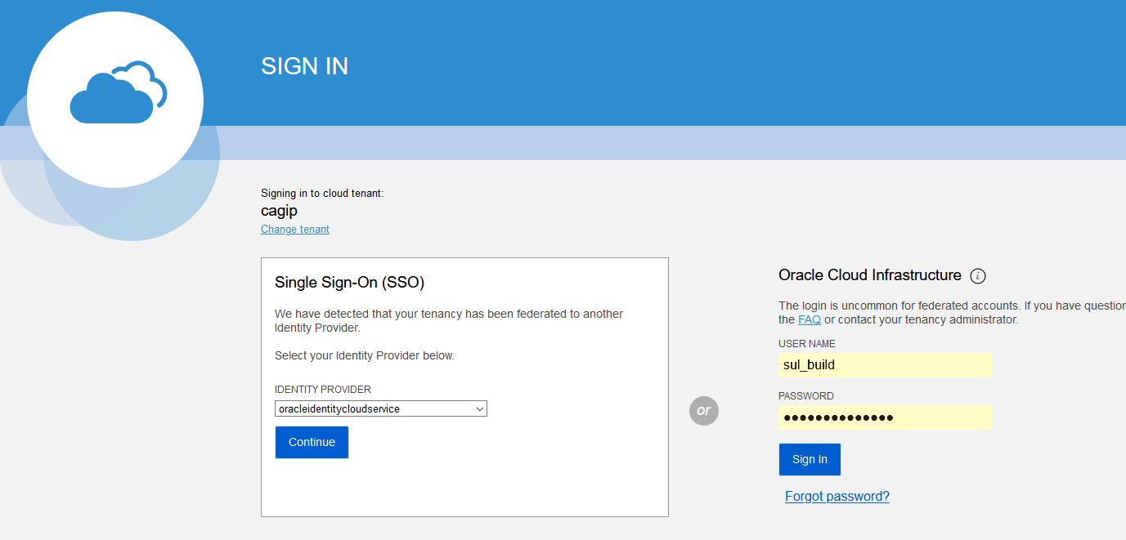
Accès à la console Oracle Cloud Infrastructure (OCI)

Slide 21
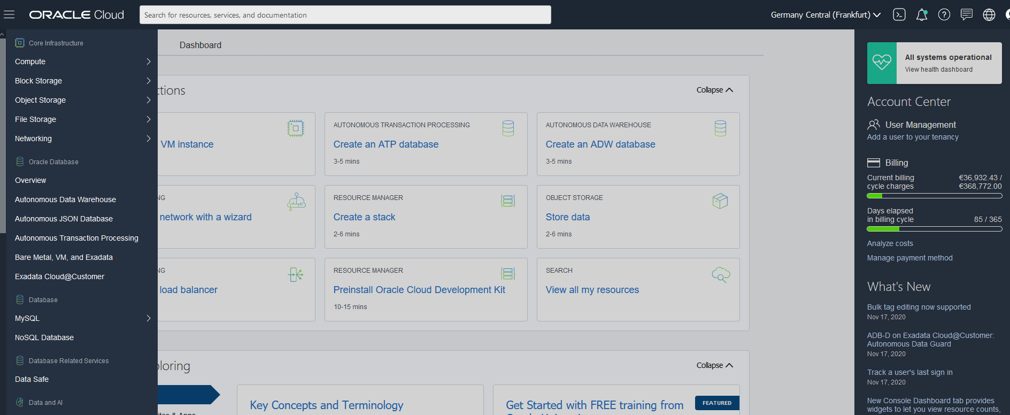
Accès à la console Oracle Cloud Infrastructure (OCI)

Slide 22
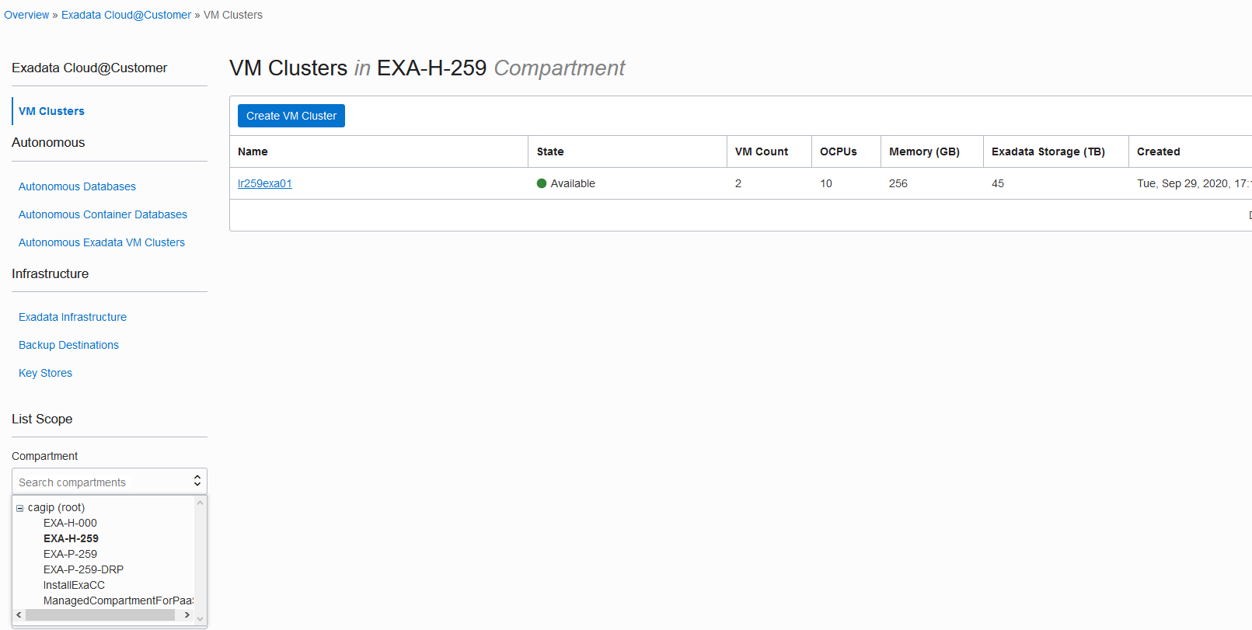
Accès à la console Oracle Cloud Infrastructure (OCI)

Slide 23
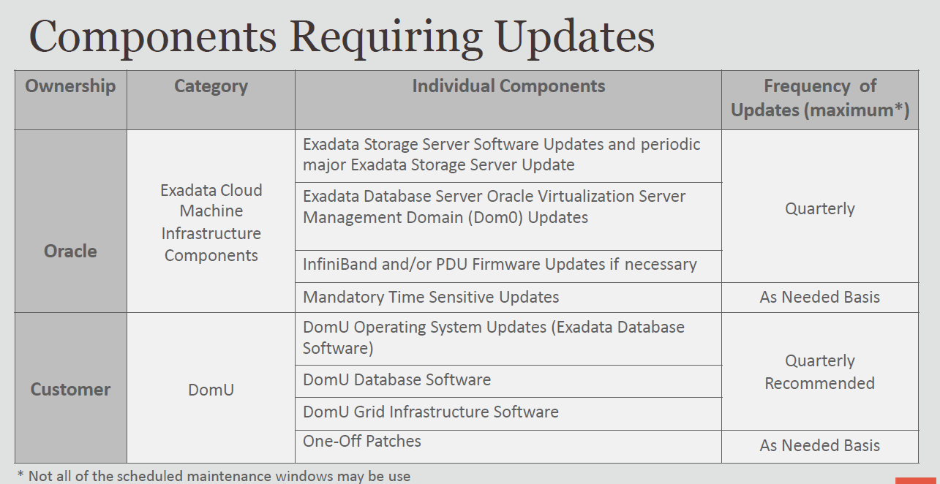

Slide 24
Patching (Oracle managed)
Components managed by Oracle:
Control Plane Servers (CPS) (OS + Software + Firmware) → transparent operation
KVM Hosts on DOM0s (OS + EFI + Firmwares) → in Rolling (no downtime with RAC)
Storage servers (OS + Software + Firmware) → no downtime
Switches RoCE + Switch Admin (Firmware) → no downtime
PDUs (firmware) → no downtime

Slide 25
Patching (Oracle managed)
Procedure:
Oracle sends and provide an initial schedule by email with the expected date.
Possibility to postpone the patch or to skip it on condition of always staying at n-1 of the very last release.
If the patch is accepted and in the case of several EXACCs, the client indicates the nature of the environments to re-establish a patch plan in order to start with the Non-PROD before.
Creation of an SR on the MOS portal (45-60 days before the scheduled date).
A first notification is sent to the predefined contacts on the portal through the created SR.
Reminder: D-40, D-7 and D-1.

Slide 26
Patching (Customer managed)
Provision of Patches (Oracle)
Oracle deploys Linux, Grid Infrastructure, and DB patches automatically to Control Plane Servers, which host a repository used byan EXACC tooling to apply them.
The deployment of these patches to all CPSs around the world is done gradually: it can take from a few days to 1 to 2 weeks before they are available locally after their announcement.

Slide 27
Patching (Customer managed)
VMs Patching (CA-GIP)
Maximum quarterly frequency
VM image version ≤ KVM Host image version
The patching of the VM OS must be planned after infrastructure
No DB downtime on RAC bases
No application downtime if compatible
For each of the clusters, 1 VM after the other (Rolling Process)
Beware of additional installed packages and customizations that could cause the update to fail due to unresolved dependencies.
Workaround → Uninstall those packages before patching and re-install them when operation is done.

Slide 28
Patching (Customer managed)
Tooling:
dbnodeupdate and patchmgr are the two ways to update the OS, sometimes referred to in Oracle docs as exadata software
However, the documentation seems to favor patchmgr and does not speak of dbnodeupdate in the context of EXACC patching
You must run these tools from an Oracle Linux (the VMs to be patched itself or another with SSH access to the VMs to be patched)

Slide 29
Patching (Customer managed)
Tooling:
The patchmgr tool allows, among other things, to:
Create the repository
Generate and store log files
Check the prerequisites (ex: presence of packages not eligible for patching and requiring their removal)
Make a backup before patching
Manage NFS mounts
Relink DB and GRID Homes
Rollback when needed

Slide 30
Patching (Customer managed)
Procedure:
3 main steps :
precheck
backup
patching
Example:
Perform a prerequisite check with the –nomodify_at_prereq option
patchmgr -dbnode -precheck -nomodify_at_prereq
Launch a “backup only” excution
patchmgr -dbnodes dbs_group –backup
Perform a second prerequisite check (optional)
patchmgr -dbnodes dbs_group –precheck
Launch the update operation
patchmgr -dbnode -dbnode_upgrade -nobackup [-rolling]

Slide 31
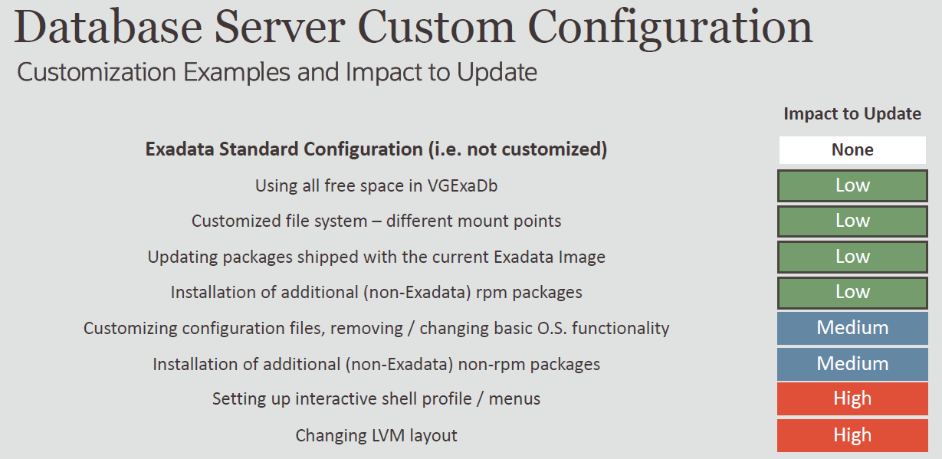

Slide 32
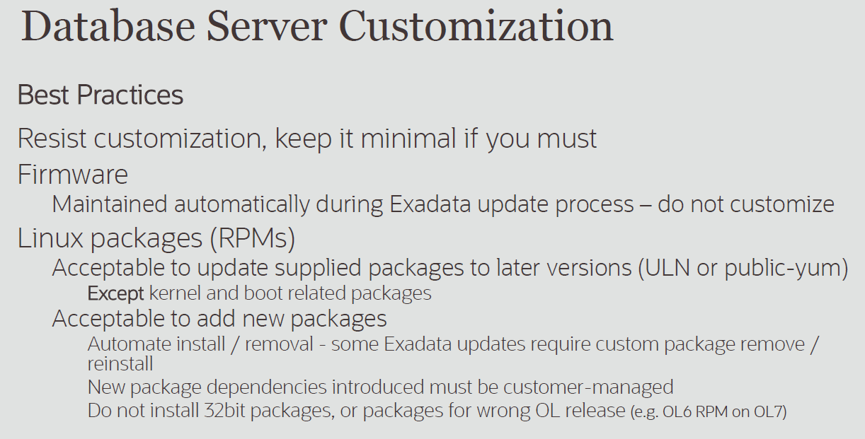

Slide 33
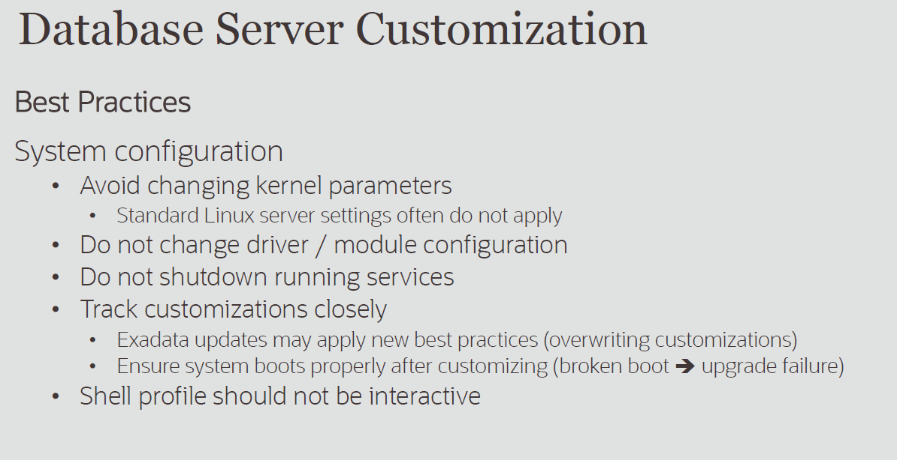

Slide 34
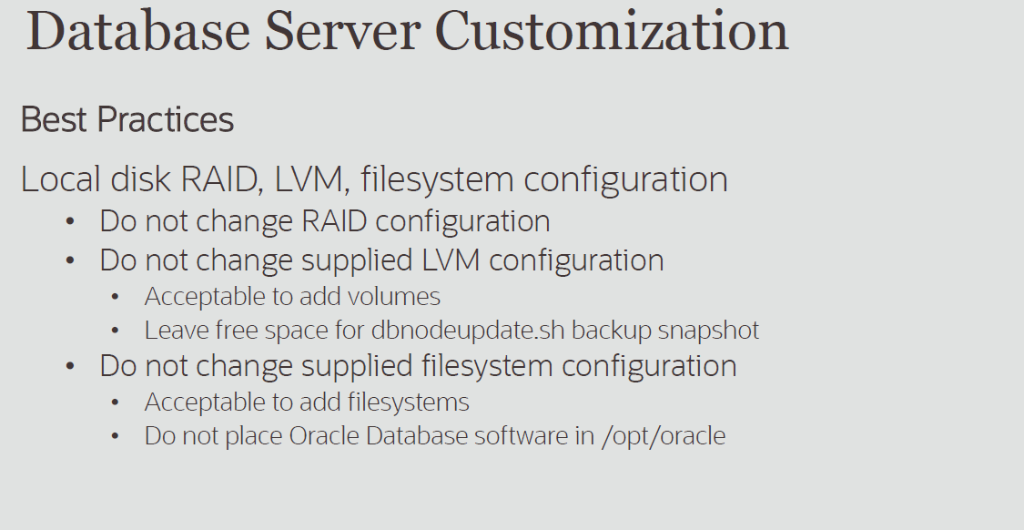

Slide 35
Feedback
good performance with conclusive benchmarks
Autonomy for DBAs to adjust hardware resources as needed
Pay-as-you-go billing
Jobs on OCI which crashes regularly and mostly related to bugs
Regular hardware problems whose resolution requires a shutdown
No access to the VMs console
"There is a SR for every problem"
SLAs not always respected

