Slide 1
Machine Learning On Specialized Hardware
Kiran Vishal Thanjavur Bhaaskar
M.S. Computer Engineering, May 2017
Advisor – Prof. Martin Herbordt

Slide 2
Why Machine Learning ?
Trustees Presentation
Machine Learning provides computers with the ability to learn without being explicitly programmed.

Slide 3
Why Accelerators - GPU and FPGA ?
Trustees Presentation
GPU
  The parallel architecture in a GPU is well adapted for vector and matrix operations.
  High Memory Bandwidth.
  Multiple software library and frameworks are available.
FPGA
  Flexible Architecture.
  Very Power Efficient.
  Faster Transfer Rates.

Slide 4
Presentation Title
Motivation
Create a Library for hardware which is easy to use and implement.
For proof of concept use Decision Tree and Random Forests.
Two Parts of the project:
Part 1 : Software Automated Dynamic Decision Tree Classifier
Part 2 : Library for Machine Learning On Specialized Hardware - FPGA

Slide 5
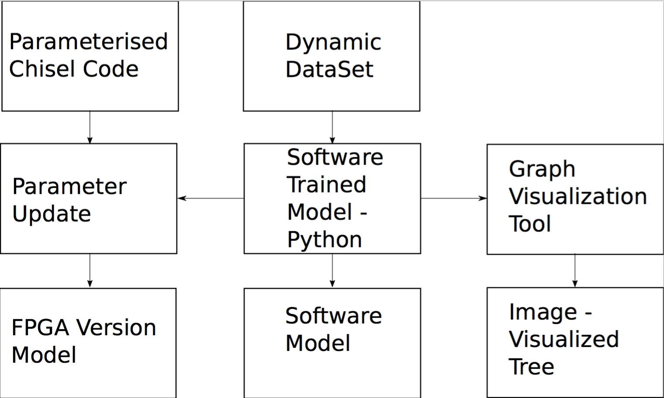
Project Part 1 :
Trustees Presentation
  Automated design flow using scripting.
  Ability to work with multiple datasets.
  Training Decision Tree models using python and Sci-kit learn[1].
  Visualizing Trained models using GraphViz[2].
  Hardware Code Generation using Chisel[3].

Slide 6
Phase 1 Of Design – Training The Model
Trustees Presentation
Script to automate the design flow.
Question and answer type approach.
Extracting dataset and giving it to Python Sci-kit Learn.
Model is trained depending on the user specifications.
Obtaining the software simulation for the trained model – Optional.

Slide 7
Phase 2 of Design – Visualizing The Model
Trustees Presentation
Trained Model is scanned to create a .txt file containing the model’s connection information.
GraphViz is applied to obtain the visualization of the trained models.
Fig[2] – Uses extracted Iris dataset[4] information.
Fig[3] – Uses extracted Breast Cancer[5] information.

Slide 8
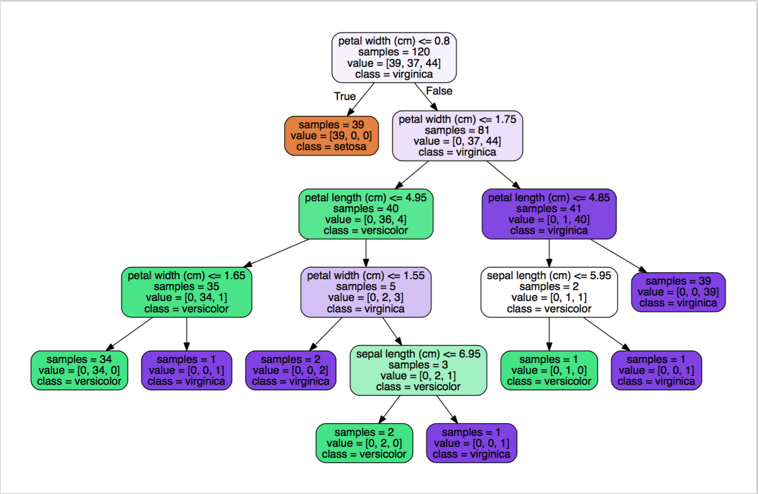
Iris Dataset
Trustees Presentation

Slide 9
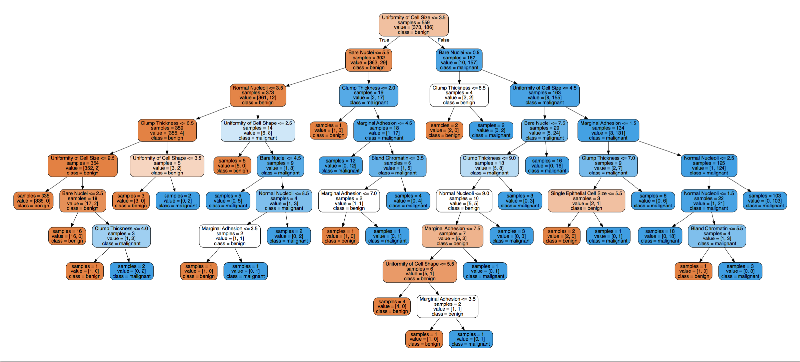
Breast Cancer Dataset
Trustees Presentation

Slide 10
Phase 3 Of Design -
HDL Generation and C++ Simulation
Trustees Presentation
Chisel is based on Scala.
It can generate a verilog code as well as a c++ simulation.
Parameterized chisel code is written for the different classifiers.
Extracted data is passed into the code and compiled.

Slide 11
Project Part 2
Trustees Presentation
Why hardware library ?
Library currently for Decision trees and Random Forests.
Easier for writing and testing hardware designs.
Multiple versions for same module depending on requirements.

Slide 12
Future Work
Trustees Presentation
Open Sourcing once published.
Expanding the library to have multiple classifiers.
Including different implementation / version for each functional modules.

Slide 13
Contact Information
Trustees Presentation
Name – Kiran Vishal Thanjavur Bhaaskar
M.S. Computer Engineering, May 2017.
Mobile – (617)858-7405
Website – http://blogs.bu.edu/vishal94/
LinkedIn - https://www.linkedin.com/in/kiranvishal/
Github - https://github.com/KiranVishal

Slide 14
Other Notable Projects:
Trustees Presentation
Machine Learning
  Localization for Autonomous Navigation.
  Abnormality Predictor for Custom Electronic Cardiac Monitor.
  Decision Tree and Random Forest Implementation on FPGA.
High Performance Computing and Programming
  Code Portability of OpenCL compared to OpenMP, CUDA and pthreads.
  Accelerating Linear Algebra Computation on GPU Cluster.

Slide 15
Acknowledgment
Trustees Presentation
Professor Martin Herbordt, Boston University.
Marcia Sahaya Louis and Professor Ajay Joshi.
Fellow researchers at the Computer Research Lab.
Fellow researchers at CAAD LAB.
Thank you!

Slide 16
Experience with Multi-Cores and GPU
Trustees Presentation
Multi-Cores:
  pthreads
  OpenMP
GPU:
  OpenCL
  Cuda
  GPU cluster – Shared Compute Cluster – Nvidia Tesla Boards

Slide 17
Experience with FPGAs
Trustees Presentation
Xilinx
  Spartan 6
  ZedBoard
Altera
  Stratix V
  Arria 10
  FPGA cluster – 4 Stratix V – JTAG: USB Blaster – Host Connection: PCIe

Slide 18
Experience with Programming Languages
Trustees Presentation
Software
  Python
  c/c++
  Matlab
  Latex
Hardware
  Verilog
  Chisel

Slide 19
D1 : Automated design flow using scripting
Trustees Presentation
Machine Learning involves some level of engineering skills to use.
Deep Learning Frameworks like Caffe and Tensor Flow are difficult to start using right away.
Wanted to come up with a question and answer based flow for implementing machine learning algorithms.
Script asks simple questions and take you from end to end of your implementation.

