Slide 1

Welcome
to the
Training Program
on
APQP & PPAP

Slide 2
INTRODUCTION
This program is designed to provide a working knowledge of the Advance Product Quality Planning Process as per the requirements Of QS 9000/ ISO-TS-16949. This topics should be understood in the broader perspective of a New Product Development rather than as a technique.
The two main requirements of a good Product Development are developing a robust product and developing it in a short time. All the methods discussed in this program are oriented towards these objectives. One of the essential requirements for the success of this approach is the ability to work in teams. Team working is a culture which has to be developed and practiced in the organisation. If we do not adhere to this principle of team working, we may end up without the benefits expected from this process of product development.

Slide 3
INTRODUCTION
“ IT IS BETTER TO SPEND A LITTLE EXTRA TIME DURING THE UPSTREAM PROCESS SO THAT THE DOWNSTREAM PROCESSES ARE FREE FROM ERRORS ”.

Slide 4
THE APQP MODEL
THE ADVANCED PRODUCT QUALITY PLANNING (APQP) MODEL
WHAT IS APQP?
  Advance Product Quality Planning is a structured & systematic method of defining and establishing the steps necessary to assure that a product satisfies the customer’s requirements.
  The commitment from the Top Management is an essential requirement for the success of this process.

Slide 5
THE APQP MODEL
THE OBJECTIVENESS OF APQP
The goals of Quality Planning are :
Effective communication with everyone involved.
On-time completion of all required steps
Minimal or no quality problems
Minimal product launch quality risks
Minimal cycle time to launch the product

Slide 6
THE APQP MODEL
THE BENEFITS OF APQP
Resources are directed toward customer satisfaction
Required changes are identified early
Changes close to or after product launch are avoided
A quality product is provided on time at the lowest cost.
An element of Continuous Improvement is built into the company.

Slide 7
THE APQP PHASES
Plan and Define
Product Design and Development
PHASES
Process Design and Development
Product and Process Validation
Feedback, Assessment and Corrective Action

Slide 8
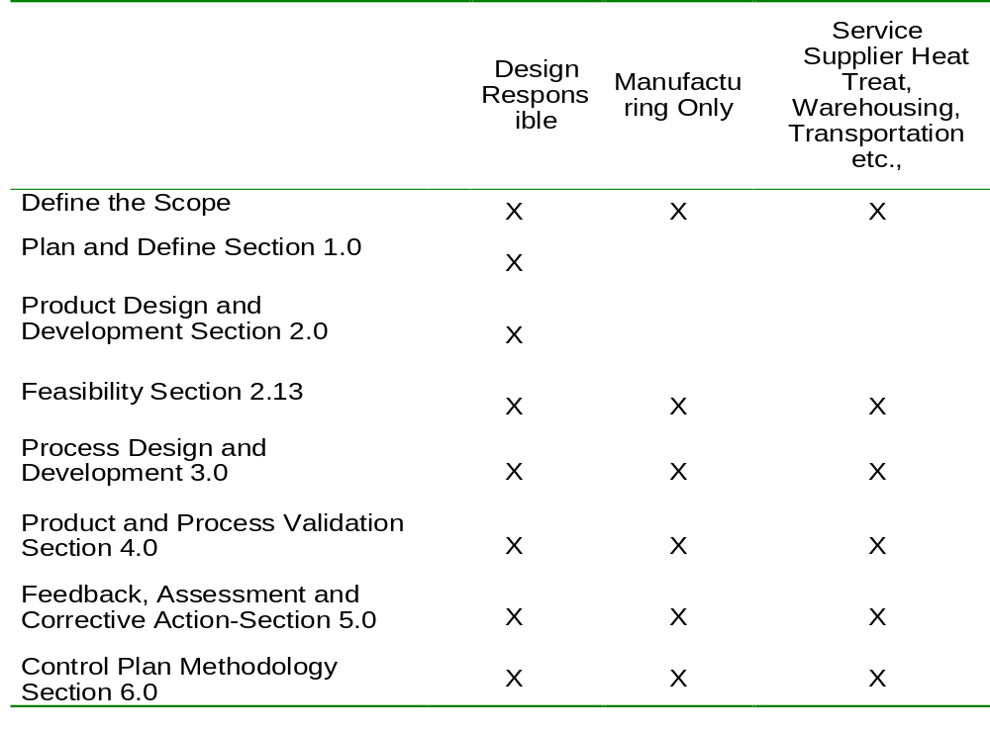
RESPONSIBILITY MATRIX
THE PRODUCT QUALITY PLANNING RESPONSIBILITY MATRIX

Slide 9
PRODUCT QUALITY TIMING PLAN
The product quality planning team’s first effort should be the development of a timing plan. This timing plan should list all tasks with responsibility and target dates. It is a good practice to follow the project management techniques like Gantt Chart, Critical Path Method, PERT etc. This plan can be regularly reviewed and updated as the planning evolves.

Slide 10
PROGRAM MANAGEMENT
TEAM LEADER
Each program has a team leader, but a team leader may manage one or more programs. The team leader:
    is typically a senior Production or Quality Manager
    interfaces with the customer
    ensures that the Program Need Dates (PND) are met
    is responsible for resources and organisation
    is responsible until product launch
    forms and manages one or more APQP Teams

Slide 11
PROGRAM MANAGEMENT
APQP TEAMS
Team Composition
    Team should be cross-functional; it is not composed of only people from the Quality Department. Typical members might come from:
      Engineering
      Manufacturing
      Material Control
      Purchasing
      Sales
      Field Service
      Subcontractors
      Quality
      Industrial Engineering
      Maintenance
      Customers(as appropriate)
      Finance

Slide 12
PROGRAM MANAGEMENT
Team Responsibilities
    Success of the Product Quality Planning Team is dependent upon the interest, commitment, support and direction of upper management. The APQP team:
      is the Product launch Steering Committee responsible for quality planning
      works with the programme manager establish PNDs
      determines the extent of require APQP activities
      determines initial risk assessments and feasibility requirements
      demonstrates that all planning requirements have been met
      ensures that concerns have been documented and scheduled for resolution
    Overall, through this process, the team initiates the building of a Culture of Simultaneous Engineering in the Organisation.

Slide 13
PLAN AND DEFINE PROGRAM
OBJECTIVES
Determine customer needs
Plan a quality program (which includes Scope, Time, Budget, etc.)
INPUTS
    Voice of the customer
      market research
      historical warranty and quality information
      team experience
    Business plan/marketing strategy
    Product/process benchmark data
    Product/process assumptions
    Product reliability
    Customer inputs

Slide 14
PLAN AND DEFINE PROGRAM
OUTPUTS
    Design goals
    Reliability and quality goals
    Target cost, timing & maintainability
    Preliminary bill of material
    Preliminary process flow chart
    Preliminary listing of special product and process characteristics
    Product assurance plan
    Management support

Slide 15
PRODUCT DESIGN & DEVELOPMENT
OBJECTIVES
    Develop design features and characteristic
    Critically review engineering requirements
    Assess potential manufacturing problems
INPUTS
    Design goals
    Reliability and quality goals
    Target cost, timing & maintainability
    Functional and Performance requirements
    Applicable statutory and regulatory requirements
    Preliminary process flow chart
    Preliminary listing of special product and process characteristics
    Product assurance plan
    Management support

Slide 16
PRODUCT DESIGN & DEVELOPMENT
    OUTPUTS BY DESIGN RESPONSIBLE ACTIVITY
    Design failure mode and effects analysis(DFMEA)
    Reliability results
    Product special characteristics
    Product error proofing, as appropriate
    Diagnostic guidelines
    Design for manufacturing and assembly
    Design verification
    Design reviews
    Prototype build – control plan
    Engineering drawings (including math data)
    Engineering specifications
    Material specification
    Drawing and specification changes

Slide 17
PRODUCT DESIGN & DEVELOPMENT
    OUTPUTS BY PRODUCT QUALITY PLANNING TEAM
    New equipment tooling and facilities requirements
    Special product and process characteristics
    Gages/testing equipment requirement
    Team feasibility commitment and management support

Slide 18
DESIGN FOR MANUFACTURABILITY AND ASSEMBLY
SPECIAL PRODUCT AND PROCESS CHARACTERISTICS
    The Product Quality Planning Team should review the preliminary
    special product and process characteristics list and reach a consensus during development and design.
    The consensus should be documented on the Control Plan
      - The supplier can use any form that accomplishments the same documentation requirements
    The customer may have unique approval requirements
    Note : Refer to Chrysler, Ford and General Motors Quality System Requirements Section II

Slide 19
PROCESS DESIGN & DEVELOPMENT
OBJECTIVES
    Develop a comprehensive and effective manufacturing system
    Ensure that the manufacturing systems meets customer requirements.

Slide 20
PROCESS DESIGN & DEVELOPMENT
INPUTS
    Design failure mode and effect analysis (DFMEA)
    Reliability results
    Product special characteristics
    Product error proofing, as appropriate
    Diagnostic guidelines
    Design for manufacturibility and assembly
    Design verification
    Design reviews
    Prototype build-control plan
    Engineering drawings (including math data)
    Engineering specifications
    Material specifications
    Drawing and specification changes
    New equipment tooling and facilities requirements
    Special product and process characteristics
    Gages/testing equipment requirement
    Team feasibility commitment and management support

Slide 21
PROCESS DESIGN & DEVELOPMENT
OUTPUTS
    Packaging standards
    Product process quality system review
    Process flow chart
    Floor plan chart
    Characteristics matrix
    Process failure mode and effects analysis (PFMEA)
    Pre-launch control plan
    Process instruction
    Process approval acceptance criteria
    Measurement systems analysis plan
    Preliminary process capability study plan
    Packaging specification
    Management support

Slide 22
PROCESS FLOW CHART
OBJECTIVES
    To ensure that all operations of a manufacturing flow have been graphically shown to show the direct and alternate paths of production
    Customer requirements, in the form of product characteristics, are mapped to the affected operations.
    Sources of variation and process characteristics are considered at each operation
    A comprehensive Process Flow Chart provides the foundation for the development of an effective Process FMEA and Control Plan.

Slide 23
PROCESS FLOW CHART
SOURCES
    Customer Prints
    In-Process Prints
    Plant Layout
    Problems reports and Logs
    System and / or Design FMEA
    Process FMEA from a similar product or process
Note: The Process flowchart and the appropriate updates to the Floor Plan shall be completed at this level. Other documents that will be partially or fully completed at the same time as the Process Flowchart include the following :
    Floor Plan
    Characteristics Matrix (optional)
    List of Special Product and Process Characteristics
    Process flow
    In-process prints
EXERCISE 6 :

Slide 24
CHARACTERISTIC MATRIX
A Characteristics Matrix :
    Displays the relationship between product/process characteristics and the operations of the process
    Identified the impacts operations have on characteristics
    Identifies the impacts that characteristics have on each other
    Provides criteria for assessing importance levels of characteristics
    Indicates where common tooling is used.

Slide 25
CHARACTERISTIC MATRIX
THE BASIC STEPS IN CONSTRUCTING THE CHARACTEISTICS MATRIX
    List all the characteristics in order on the top row of the matrix
    List all the operations in order by OP# on the left column of the matrix
    Place a relationship symbols in interior cells in the Matrix RELATIONSHIP SYMBOLS
Using the following symbols indicates the relationships between operations and characteristics
    * Indicates a characteristic is cut or changed
    C Indicates a characteristic is used for clamping
    L Indicates a characteristic is used for location in a subsequent Operation
    A Affects a subsequent operation or other characteristic
    T Indicates relationships within an operation, such as common tools or tool head
    M Characteristic is automatically monitored

Slide 26
PFMEA
PROCESS FAILURE MODE AND EFFECTS ANALYSIS (PFMEA)
OBJECTIVES
The primary objective of the Process Failure Mode Effects Analysis (PFMEA) is to reduce manufacturing risk by :
    Aiding in the analysis of new manufacturing and assembly processes
    Assuring that potential manufacturing and / or assembly process failure modes and effects are considered.
    Identifying process deficiencies and provide for the development of controls to resolve the problems by :
- Eliminating or reducing the frequency of unacceptable products
- Increasing the detection of unacceptable products
    Identifying critical characteristics and significant characteristics contributing to the development of a complete manufacturing control plan
    Establishing priorities for process improvement activities
    Providing automatic process design documentation to guide the development of future manufacturing and assembly processes.

Slide 27
PFMEA
Note : Output from the PFMEA is used as a basis for :
    Control Plan development
    Preliminary Process Capability Study Plan development
    Finalisation of special product and process characteristics
    Development of Process and monitoring instructions

Slide 28
PFMEA
SOURCES
The data or reference documents that should be utilised by the cross-functional team to help develop the PFMEA include :
    Process FMEA AIAG Reference Manual
    Characteristics Matrix
    Warranty information
    Customer Complaints and Returns Data
    Corrective or Preventive Actions
    Process Flow Chart
    System and / or Design FMEA
    PFMEA for similar products or processes
    Internal Quality Reports

Slide 29
PFMEA
PROGRAM MANAGEMENT RESPONSIBILITY
The Team Leader and APQP team should manage the construction of the process
FMEA and assess the finished document to ensure that the following expectations
are met :
    The PFMA is developed on or before the Program Need Date
    A cross functional team has been formed to assist in the development of the PFMEA
    Appropriate data have been identified that shall be used by the team to develop the PFMA. Some forms of data for a similar product or process might include:
- Warranty information
- TGW data
- Corrective or preventive actions
- A list of current error proofing techniques used for similar processes
- Higher assembly of component processes
- FMEAs from similar product
- Other data that would help assist the group better understand and assess the process

Slide 30
PFMEA
    The appropriate PFMEA is chosen
    Failure modes are quantifiable
    The effects on all customers are considered
    Causes are identified that point to process deficiencies
    Risk has been assessed and reduced to acceptable levels

Slide 31
PRE-LAUNCH CONTROL PLAN
OBJECTIVES
    To ensure that a written plan for controlling all parts and process after prototype and before full production is documented.
    The plan should include :
- All operations listed on the Process Flow Chart.
- The machine jig or tooling
- Product and process characteristics
- Designation of special characteristics
- Specifications or tolerances
- Gaging or evaluation techniques
- Sample sizes and frequency
- Control methods
- Reaction instruction at each stage of production

Slide 32
PRE-LAUNCH CONTROL PLAN
    The Pre-launch Control Plan will be similar to the Production Control Plan but should include greater sampling for certain characteristics to reflect the initial capability studies (Ppk) and audits to validate that the process is robust.
    A full layout inspection will normally be performed at this stage and then yearly or as specified by the customer.
Note : The Pre-Launch Control Plan is used as input for finalizing:
- Measurement System Analysis Plans
- Operator Process and Monitoring Instructions
- Reaction Plan
- Preliminary Process Capability Study Plan

Slide 33
PRE-LAUNCH CONTROL PLAN
SOURCES
The data or inputs that will be used to develop the Pre-launch Control Plan may include some or all of the following. This data will be reviewed By the cross-functional team during their meetings.
    Advance Product Quality Planning and Control Plan AIAG Reference Manual
    Customer Prints
    Inspection Plans and Sampling Frequency
    Work Instructions for similar parts or processes
    List of special characteristics
    List of Machines, tools, Jigs or Fixtures
    List of Gaging with data showing calibration, discrimination, accuracy, repeatability and reproducibility
    Performance Testing Requirements
    Design Reviews
    Optimisation Data (e.g., QFD, DOE, etc.,)
    Process Flow Chart
    System and / or Design FMEA
    Process FMEA

Slide 34
PRE-LAUNCH CONTROL PLAN
PROGRAM MANAGEMENT RESPONSIBILITY
The Team Leader and APQP Team should manage the construction of the Production Control Plan and assess the finished document to ensure that the following expectations are met :
    A cross-functional team to assist in the development of the Control Plan
    All operations and special characteristics are included on the Control Plan
    Recommended actions from the PFMEA are incorporated in the Control Plan
    Sampling plans are included as defined by customer requirements
    Sampling Plans for Ppk studies for Special Characteristics are included on the Control Plan
    Work Instructions for setup, operation, testing, inspection, SPC and reaction are indicated on the Control Plan
    The Production Control Plan identifies all qualified measurement and test equipment

Slide 35
PRE-LAUNCH CONTROL PLAN
    The customer is given the opportunity to approve the Control Plan
    Tests and measurements for PPAP approval are included on the Control Plan
    Instructions are defined for all material and engineering specifications
    Only rational sampling plans are used.
    Control methods are defined to produce only acceptable product output
    Control methods should focus on :
- meeting all customer requirements
- process control rather than product control
- prevention rather than detection
- targeting nominal rather than specification limits
- error proofing rather than inspection
- managing the control method

Slide 36
PRE-LAUNCH CONTROL PLAN
    Process data have been used to confirm cause and effect relationships between product and process characteristics. The PFMEA should be a primary tool for exposing process deficiencies and potential product/ process relationships.
    The Production Control Plan and PFMEA are consistent in defining current process controls

Slide 37
PRODUCT & PROCESS VALIDATION
OBJECTIVES
    Validate the manufacturing process & the product
    Ensure that customer’s expectations will be met
    Identify additional concerns

Slide 38
PRODUCT & PROCESS VALIDATION
INPUTS
    Packaging standards
    Product process quality system review
    Process flow chart
    Floor plan layout
    Characteristics matrix
    Process Failure Mode and Effects Analysis (PFMEA)
    Pre-launch control plan
    Process instruction
    Process approval acceptance criteria
    Measurement Systems Analysis Plan
    Preliminary process capability study plan
    Packaging specification
    Management support

Slide 39
PRODUCT & PROCESS VALIDATION
OUTPUTS
    Production trial run
    Measurement systems evaluation
    Preliminary process capability study
    Production part approval
    Production validation testing
    Packaging evaluation
    Production control plan
    Quality planning sign-off and management support
      Data for Quality,reliability,maintainability and measurability, results of error proofing,methods of rapid detection and feedback of product /process nonconformance

Slide 40
FEEDBACK, ASSESSMENT & CORRECTIVE ACTION
OBJECTIVES
    Obtain objective feedback for future planning
    To plan the next phase of product development or modification
    To improve the system of planning (from lessons learnt)
    To identify opportunities for Improvement
INPUTS
    Production trial run
    Measurement systems evaluation
    Preliminary process capability study
    Production part approval
    Production validation testing
    Packaging evaluation
    Production control plan
    Quality planning sign-off and management support

Slide 41
FEEDBACK, ASSESSMENT & CORRECTIVE ACTION
OUTPUTS
    Reduced variation
    Customer satisfaction
    Delivery and service

Slide 42
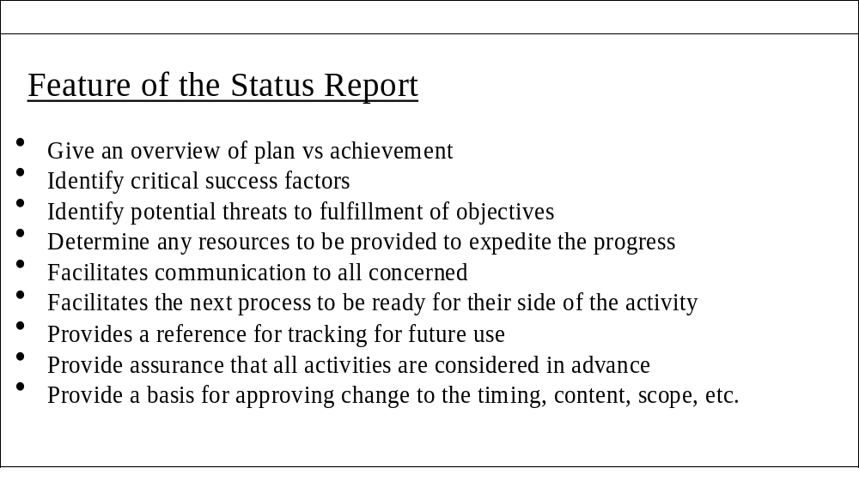
APQP STATUS REPORTING PROCESS

Slide 43
PRODUCTION TRIAL RUN
OBJECTIVES
To ensure the effectiveness of the manufacturing process, using production Tooling, equipment, environment (including production operators), facilities and cycle times.
PROGRAM MANAGEMENT RESPONSIBILITY
Manage and assess the production trial run to ensure meeting the following expectations :
    The pre-launch control plan is followed during the production trial run.
    The trial run must be used to confirm or add linkages between product and process characteristics.
    Note : Linkages should be captured in the PFMEA.
    Corrective design and process actions must be established for concerns identified during the trial run.

Slide 44
PRODUCTION TRIAL RUN
OUTPUT
    Production Part Approval
    Preliminary Process capability Study
    Measurement Systems Evaluation
    Final Feasibility
    Process Review (feedback to process flow and Process FMEA, input to Production Control Plan)
    Production Validation Testing
    Packaging Evaluation
    First Time Capability (FTC)
    Quality Planning sign-off

Slide 45
PPAP
REQUIREMENTS FOR PART APPROVAL
1. Design Records of Saleable Product
  – for proprietary components / details
  – for all other components / details
2. Engineering Change Documents, if any
3. Customer Engineering Approval, if required
4. Design FMEA
5. Process Flow Diagrams
6. Process FMEA
7. Dimensional Results
8. Material / Performance Test Results
9. Initial Process Study
10. Measurement System Analysis Studies

Slide 46
PPAP
REQUIREMENTS FOR PART APPROVAL
11. Qualified Laboratory Documentation
12. Control Plan
13. Part Submission Warrant (PSW)
14. Appearance Approval Report (AAR), if applicable
15. Bulk Material Requirements Checklist (for bulk material PPAP only)
16. Sample Product
17. Master Sample
18. Checking Aids
19. Records of Compliance with Customer Specific requirements

Slide 47
PPAP
1. DESIGN RECORDS
Part drawings, specifications, CAD data or any documents referenced. If it is electronic format, hard copy to identify measurements taken
    for bulk materials
    Raw material identification
    Formulations
    Processing steps & parameters
    Final product specifications & acceptance criteria

Slide 48
PPAP
ANY AUTHORISED ENGG. CHANGE DOCUMENT
Authorized change documents provided by customer incorporated in the part not incorporated in the drawing
ENGINEERING APPROVAL
As required by design record
- For bulk materials, signature of customer on bulk material approval check list or inclusion of supplier’s name in customer list of approved materials
DESIGN FMEA
Applicable to design responsible suppliers
- for bulk materials, Design Matrix & Design FMEA are prepared as required by bulk material requirements checklist
- for bulk materials, Design FMEA ratings for SEV, OCC, DET specified in PPAP manual can be used

Slide 49
PPAP
PROCESS FLOW DIAGRAM
As per APQP manual
· -For bulk materials process flow description satisfies the requirement
PROCESS FMEA
Compliance to QS-9000 III edition requirements Process FMEA for family of parts
· For bulk materials, Process FMEA rating for SEV, OCC, DET specified in PPAP manual can be used

Slide 50
PPAP
DIMENSIONAL RESULTS
Compliance to control plan & Design Record and all characteristics (except ref. Dimensions)
· Dimensional results for each production lines, each cavities, molds, patterns, dies
· Indicate design record, change level, authorized engg. Change document ref. On all reports
· Identify master sample which is measured
· Tracing is required when optical comparator is required
· Appendix C can be used

Slide 51
PPAP
MATERIAL / PERFORMANCE TEST RESULTS
Compliance to design record / control plan
Record of qty. tested on each tests
Engg. Change level or authorized engg. Change
Date of testing
Material sub contractor’s name and their code (from customer approved List)

Slide 52
PPAP
INITIAL PROCESS STUDIES
Prior to submission, acceptable level of initial process capability or performance shall be determined with customer
MSA prior to initial process studies
For special Characteristics of variable data
Cpk or Ppk can be as per customer agreement
Control charts are preferred, if X bar – R charts used, Min. 25 sub groups, min 100 nos. from significant production run.

Slide 53
PPAP
QUALITY INDICES
Use Cpk or Ppk
Where historical Cpk data is available for similar parts of same process, Cpk can be captured
- For chronically unstable processes (within specification) use Ppk
- For bulk material, customer agreement on usage of techniques
- Index value > 1.67, Else CA plan is reqd.
- For Unstable processes, notify customer & submit CA plan
- One sided specification or non normal data (E.g. F/O, R/O, concentricity, twist, effort, surface finish, uniformity, etc.,)
- Alternate method of calculation & acceptance criteria with customer agreement
- For bulk materials, if Ppk/Cpk is not achieved 100% inspection of a sample (s) from a continuous process or homogeneous batch, which represents online production run.

Slide 54
PPAP
MEASUREMENT SYSTEMS ANALYSIS STUDIES
Compliance to QS-9000 III edition
QUALIFIED LABORATORY DOCUMENTATION
if in house laboratory is only used for testing / calibration
Add laboratory scope
If outside laboratory is used for testing / calibration
Add NABL certificate or equivalent of that laboratory
Add scope of accreditation of that lab

Slide 55
PPAP
CONTROL PLAN
As per APQP manual & QS-9000 III edition
PART SUBMISSION WARRANT
- Separate PSW for each part no.
- Identify Mould / cavity / line no. in PSW
- Part weight shall be rounded off to four decimals derived out of 10 randomly selected part
- 10 parts represent all moulds, cavities, lines as appropriate

Slide 56
PPAP
APPEARANCE APPROVAL REPORT
As required in Design Record
BULK MATERIAL REQUIREMENT CHECKLIST (Appendix F)
- Jointly agreed by customer during early stage of APQP
- Completion of all agreed activities
SAMPLE PRODUCTION PARTS
- As per customer request

Slide 57
PPAP
MASTER SAMPLE
Retain till new master sample is produced or as per design record requirement for inspection criteria
For each position of a multiple cavity, die, tool, mould or pattern, line.
Retention period can be waived or modified by customer
CHECKING AIDS
Inspection Fixtures, gages, models, templates, etc. specific to the part
If more than one , prepare & refer the list in PSW including its change level
Submit if required by customer
Certification of checking aid w.r.t part dimensions
Demonstration of engg. Change in gauge change
Appropriate MSA studies
CUSTOMER SPECIFIC REQUIREMENTS
compliance records to all specific requirements of customer (Sec. II)

Slide 58
PPAP SUBMISSION LEVELS
There are 5 Levels
Level 3 is the Default level
Levels are agreed and documented in the form of QSR

Slide 59
WHEN PPAP IS REQUIRED?
SITUATIONS REQUIRES PPAP
  Notification & Submission
  Notification and Submission as required by customer
  Notification and Submission not required

Slide 60
CONTINUOUS IMPROVEMENT
OUTPUTS
REDUCED VARIATION
Control charts and other statistical techniques should be used as tools to identify process variation. Analysis and corrective actions should be used to reduce variation. Continual improvement required attention not only to the special causes of variation but understanding common causes and seeking ways to reduce these sources of variation. Proposals should be developed including costs, timing, and anticipated improvement for customer review. Often the reduction or elimination of a common cause results in lower costs. Suppliers should not be reluctant to prepare proposals based on value analysis, reduction of variation, etc., The decision to implement, negotiate, or progress to the next product design level is the customer’s prerogative.

Slide 61
CONTINUOUS IMPROVEMENT
CUSTOMER SATISFACTION
Detailed planning activities and demonstrated process capability of a product or service do not always guarantee customer satisfaction. The product or service must perform in the customer environment. The product usage stage required supplier participation. It is in this stage where the most can be learned by both the supplier and customer. The effectiveness of the Product Quality Planning efforts can be evaluated in this stage. The supplier and customer must be partners in making the changes necessary to correct deficiencies to achieve customer satisfaction.

Slide 62
CONTINUOUS IMPROVEMENT
DELIVERY AND SERVICE
The delivery and service stage of quality planning continues the supplier/customer partnership in solving problems and continual improvement. The customer’s replacement and service operations always merit the same consideration in quality, cost and delivery. Failure to correct a problem the first time always damages the supplier’s reputation and customer partnership. It is important that both and supplier and customer listen to the Voice of the Customer. The experience gained in this provides the customer and supplier with the necessary knowledge to recommend price reductions achieved by reducing process, inventory, and quality costs to provide the right component or system for the next product.

Slide 63

THANK YOU

