Slide 1
CALIFORNIA STATE UNIVERSITY, NORTHRIDGE
BANA 698 Final Presentation
From Social Proof to Action
Algorithmic amplification as a conditional mechanism with reach saturation and authority effects
Kiran Kanth Madigani | Adhunika Kandala
Advisor / Committee: Pouyan Seyed Eslami ,Akash Gupta, Sheng Qiuhua| May 2026

Slide 2
MAIN PRESENTATION
CALIFORNIA STATE UNIVERSITY, NORTHRIDGE
Agenda
1
Research problem and gap
2
Research model and hypotheses
2
3
Data and methodology
3
4
Key findings
4
5
Contributions, limitations, and Takeaways
5
2/7

Slide 3
MAIN PRESENTATION
CALIFORNIA STATE UNIVERSITY, NORTHRIDGE
Research Problem and Gap
Why separate visibility from meaningful engagement?
Gap in prior work
This project tests whether early persuasive signals become action through amplification, and whether authority and high visibility change that pathway.
Separates signal, amplification, and outcome stages.
Tests authority as a boundary condition.
Shows diminishing returns under high visibility.
Business / research problem
Prior studies often treat reach and engagement as linked outcomes, but do not clearly separate early social proof, amplification, and high-effort action.
Low-effort and high-effort engagement are often blurred.
User response and algorithm response are rarely separated clearly.
Authority and saturation are under-modeled together.
Our contribution
Posts are not seen solely because users choose them. Platform ranking and recommendation systems allocate attention at scale.
Platforms allocate attention algorithmically, not neutrally.
Reach does not always convert into meaningful action.
Performance metrics can overstate true effectiveness.
This study addresses the gap by examining 10,000 social media posts from 800 influencers, with a focus on how social proof becomes meaningful action under algorithmic visibility.
Core distinction: visibility is not the same as effectiveness.
3/7

Slide 4
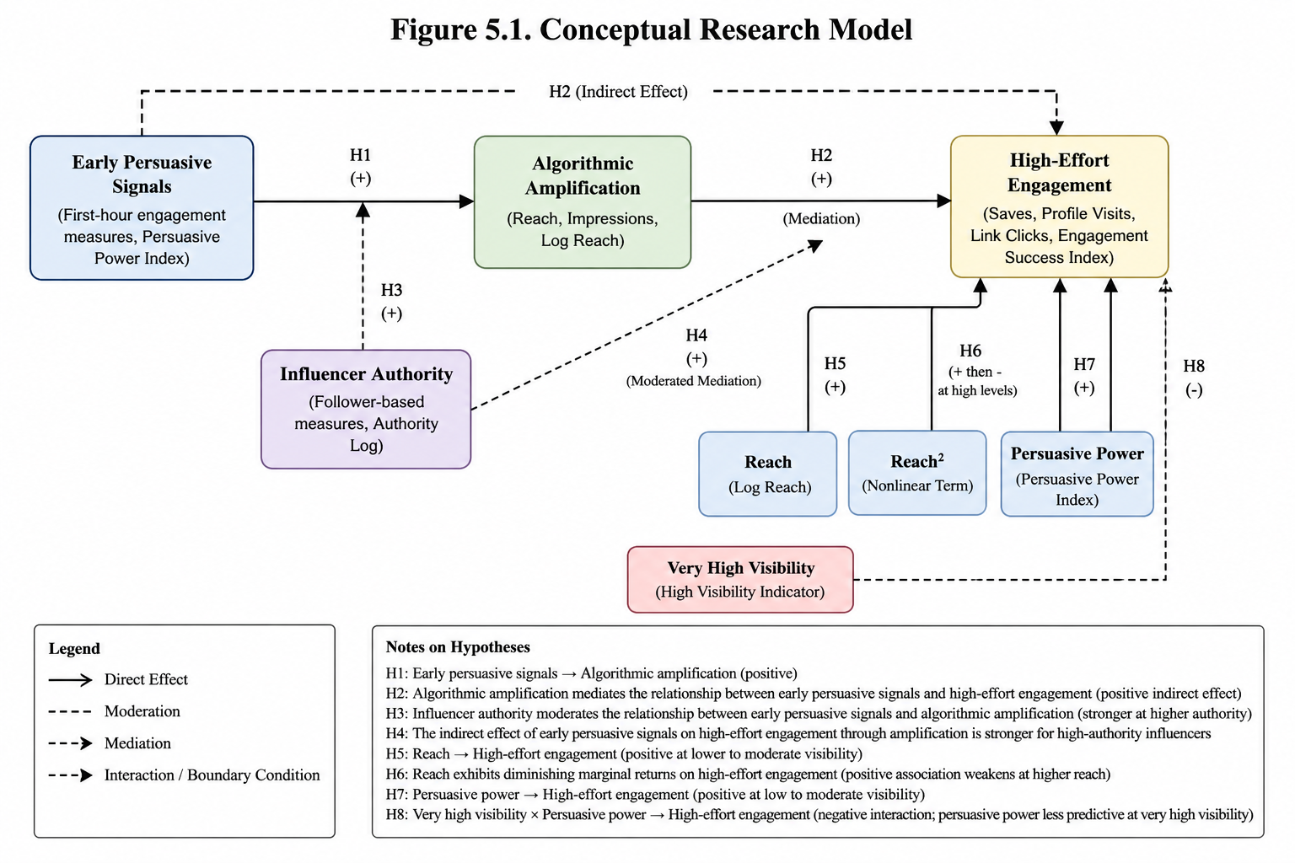
MAIN PRESENTATION
CALIFORNIA STATE UNIVERSITY, NORTHRIDGE
Research Model and Hypotheses
Show the logic, not every detail
RQ1: Mechanism + authority
Do early signals translate to high-effort engagement through amplification, and does authority shape the path?
RQ2: Diminishing returns
At what point does additional reach add less meaningful engagement?
RQ3: High-visibility condition
Does very high visibility reduce the predictive role of persuasive power?
Theory lens: HSM explains early cues; Source Credibility Theory explains why authority changes cue interpretation.
4/7

Slide 5
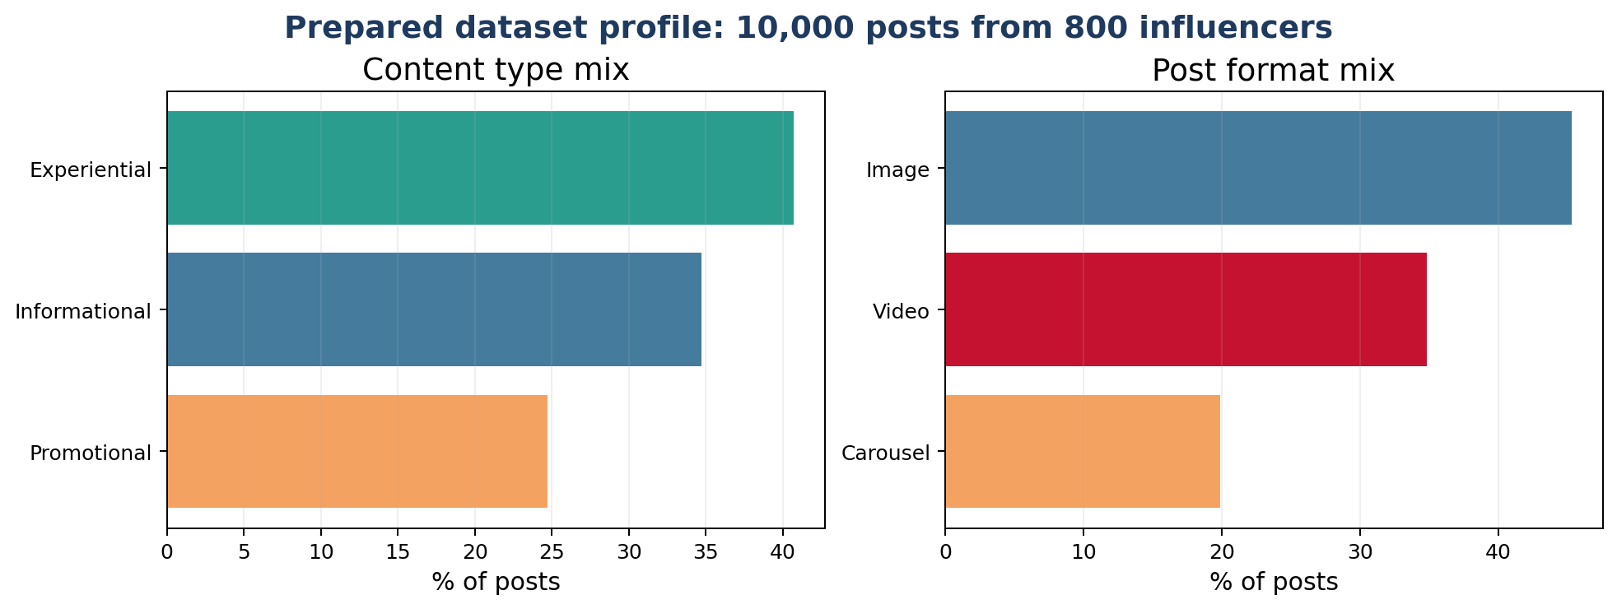
MAIN PRESENTATION
CALIFORNIA STATE UNIVERSITY, NORTHRIDGE
Data and Methodology
What data did we use and how did we analyze it?
Measures
Methods
IV: persuasive_power_index
Mediator: reach / impressions / log reach
DV: high-effort engagement
Moderator: authority_log
Regression-based mediation + moderation
OLS with clustered SE by influencer
Quadratic reach + high-visibility interaction
10,000
800
2024–2025
social media posts
influencers
timestamped posts
Important limitation: prepared instructional dataset; algorithmic amplification is inferred through visibility proxies, not directly observed platform internals.
5/7

Slide 6
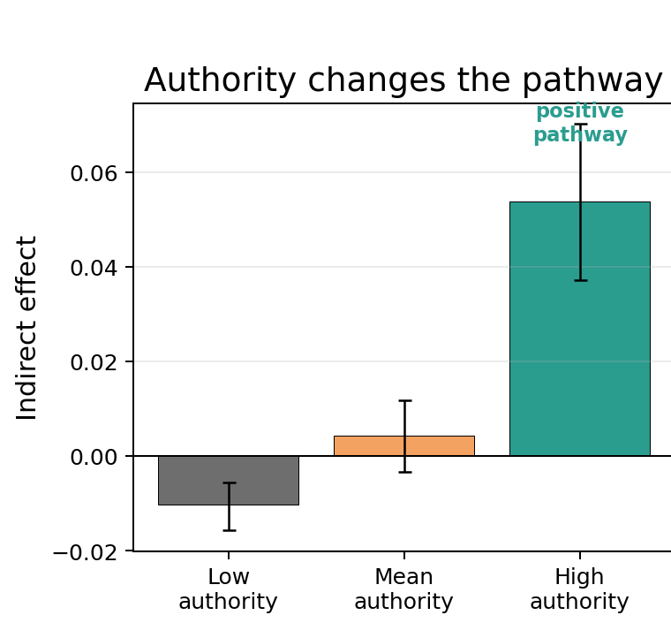
MAIN PRESENTATION
CALIFORNIA STATE UNIVERSITY, NORTHRIDGE
Key Findings I: Authority Changes the Pathway
RQ1 — mechanism and authority
Finding 1
H1 Supported Early persuasive signals are positively associated with algorithmic amplification.
Finding 2
H2 Supported Early persuasive signals influence high-effort engagement indirectly through amplification.
Finding 3
H3 and H4 Supported Authority strengthens the pathway; the indirect effect is weakest at low authority and strongest at high authority.
Bottom line: authority is the clearest boundary condition in the pathway from early signals to meaningful action.
6/8

Slide 7
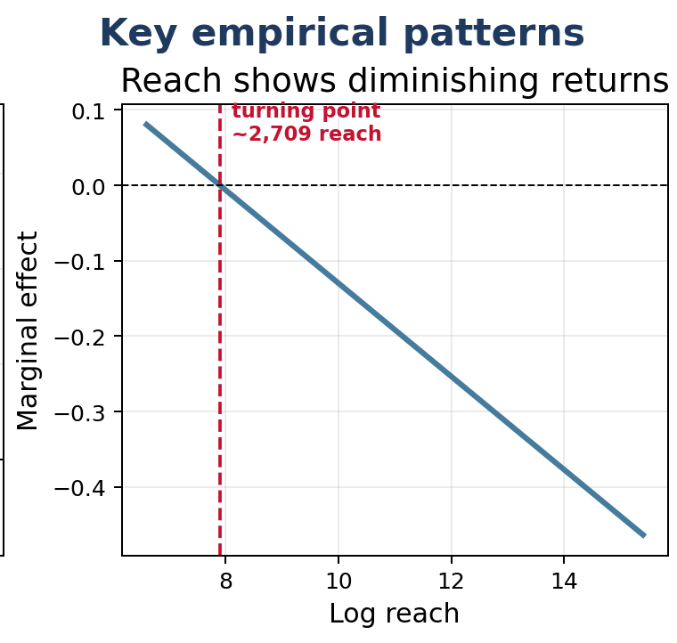
MAIN PRESENTATION
CALIFORNIA STATE UNIVERSITY, NORTHRIDGE
Key Findings II: Visibility Has Limits
RQ2 and RQ3 — diminishing returns and very high visibility
Finding 1
H5 Supported Reach is positively associated with high-effort engagement at lower to moderate visibility levels.
Finding 2
H6 Supported Reach shows diminishing marginal returns. Turning point: log reach = 7.90; actual reach ≈ 2,709.
Finding 3
H7 and H8 Supported Persuasive power matters under lower/moderate visibility but becomes less predictive under very high visibility.
Bottom line: visibility helps, but beyond a point it adds less value and weakens persuasive differentiation.
7/8

Slide 8
MAIN PRESENTATION
CALIFORNIA STATE UNIVERSITY, NORTHRIDGE
Contributions, Limitations, and Takeaways
Academic contribution
Managerial contribution
Limitations / next step
Shows algorithmic amplification as a conditional mechanism, not just a descriptive outcome.
Separates signal, amplification, and outcome stages.
Shows authority and saturation as key boundary conditions.
Measure success with saves, clicks, and profile visits—not reach alone. Prioritize early quality and authority fit.
Helps identify when early momentum converts into action.
Shows that more reach is not always more value.
Observational data, proxy amplification measures, and prepared instructional data. Future work should use platform-partnered or experimental data.
Observational design limits causal claims.
Future work should test live multi-platform data.
Final takeaway
On algorithmic platforms, being widely seen is not the same as driving meaningful action.
7/7

Slide 9
MAIN PRESENTATION
CALIFORNIA STATE UNIVERSITY, NORTHRIDGE
@social_proof
# THANK YOU
♥
@
#
Early signals
Amplification
Action
From Social Proof to Action — thank you for your time.
Kiran Kanth Madigani | Adhunika Kandala

Slide 10
BACKUP SLIDES
Use only during Q&A. Do not present these during the 5-minute talk unless asked.
CSUN | BANA 698

Slide 11
BACKUP
CALIFORNIA STATE UNIVERSITY, NORTHRIDGE
Backup A: Detailed Hypotheses / Research Questions
Keep details here so the main talk stays under 5 minutes
Hypothesis | Predictor / Focal Variable | Outcome Variable | Model Role | Expected Relationship
H1 | Early persuasive signals | Algorithmic amplification | Direct effect | Positive association
H2 | Early persuasive signals | High-effort engagement | Mediation through algorithmic amplification | Positive indirect association
H3 | Early persuasive signals × Influencer authority | Algorithmic amplification | Moderation | Positive moderation; stronger association at higher authority
H4 | Early persuasive signals | High-effort engagement | Moderated mediation through amplification, conditioned by authority | Stronger indirect association for high-authority influencers
H5 | Reach | High-effort engagement | Direct effect under lower to moderate visibility | Positive association
H6 | Reach | High-effort engagement | Nonlinear effect / saturation | Positive association weakens at higher reach
H7 | Persuasive power | High-effort engagement | Direct effect under low to moderate visibility | Positive association
H8 | Very high visibility × persuasive power | High-effort engagement | Boundary condition / interaction effect | Negative interaction; persuasive power is less predictive under very high visibility
Hypothesis | Statement | Result | Evidence
H1 | Early persuasive signals are positively associated with algorithmic amplification. | Supported | coef=0.3551, p=0.0000
H2 | Algorithmic amplification mediates the relationship between early persuasive signals and high-effort engagement outcomes. | Supported | indirect_effect=0.0041
H3 | Influencer authority positively moderates the relationship between early persuasive signals and algorithmic amplification. | Supported | coef=0.2103, p=0.0000
H4 | The indirect effect of early persuasive signals on high-effort engagement through algorithmic amplification is stronger for high-authority influencers. | Supported | low=-0.0105, high=0.0541
H5 | Reach is positively associated with high-effort engagement at low-to-moderate levels of visibility. | Supported | coef=0.7436, p=0.0000
H6 | The positive effect of reach on high-effort engagement exhibits diminishing marginal returns at higher levels of reach. e | Supported | coef=-0.0262, p=0.0048
H7 | Persuasive power is positively associated with high-effort engagement under low-to-moderate visibility conditions. | Supported | coef=0.0304, p=0.0210
H8 | Under very high visibility conditions, persuasive power is less predictive of high-effort engagement than under lower visibility conditions. | Supported | coef=-0.3397, p=0.0000
Q&A use: H2 is not supported as a uniform direct effect, but conditional indirect effects show the pathway is meaningful mainly at high authority.
B1

Slide 12
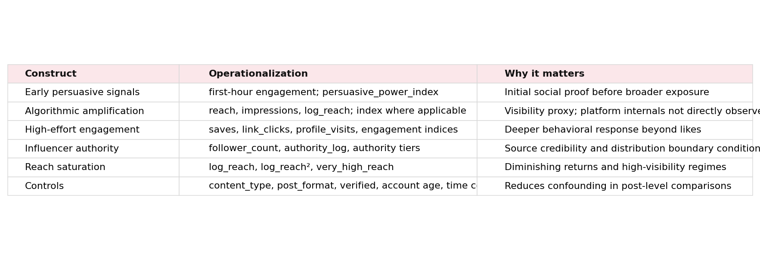
BACKUP
CALIFORNIA STATE UNIVERSITY, NORTHRIDGE
Backup B: Variable Definitions and Feature Engineering
Define constructed indices, transformations, tiers, and formulas
Measurement caution: amplification is inferred from visibility-related proxies, not directly observed recommendation logic.
B2

Slide 13
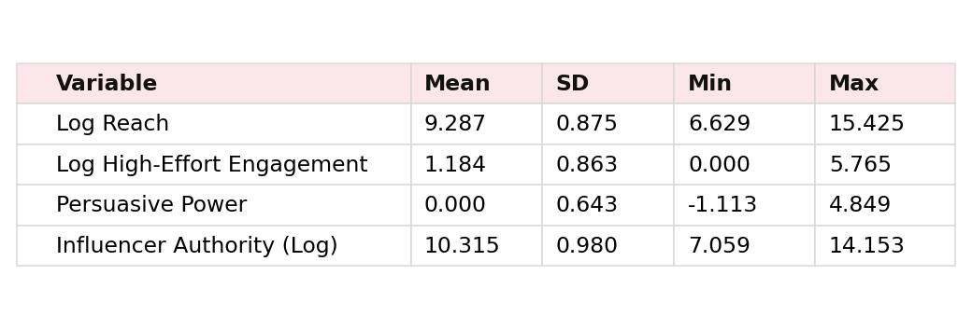
BACKUP
CALIFORNIA STATE UNIVERSITY, NORTHRIDGE
Backup C: Descriptive Statistics and Data Quality
Sample profile, data quality, and filtering decisions
Data quality decisions
Generalizability
• log transforms for skewed count variables
• casewise exclusion only when focal variables are missing
• clustered standard errors by influencer
The dataset is prepared for analysis and should be interpreted as analytically informative, not a probability sample of all social media contexts.
B3

Slide 14
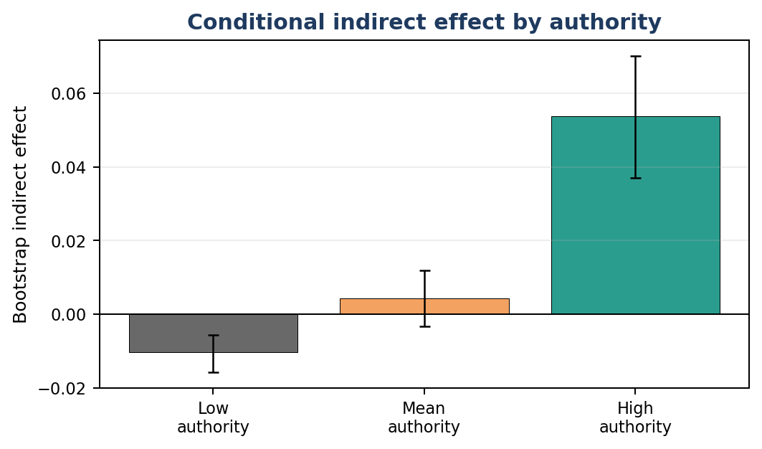
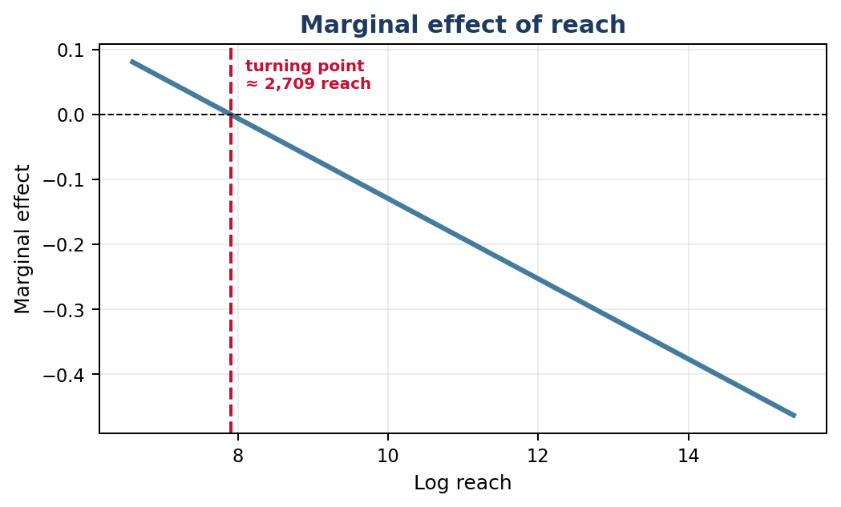
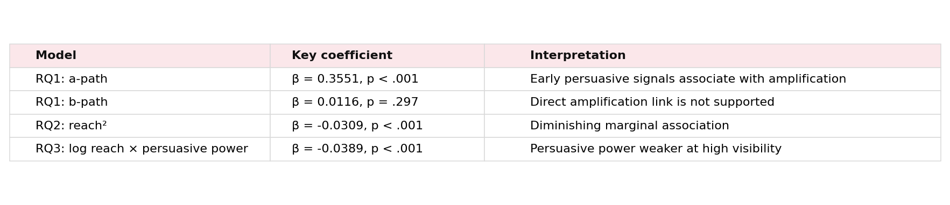
BACKUP
CALIFORNIA STATE UNIVERSITY, NORTHRIDGE
Backup D: Full Model Results / Robustness Checks
Keep detailed results here for committee questions
B4

Slide 15
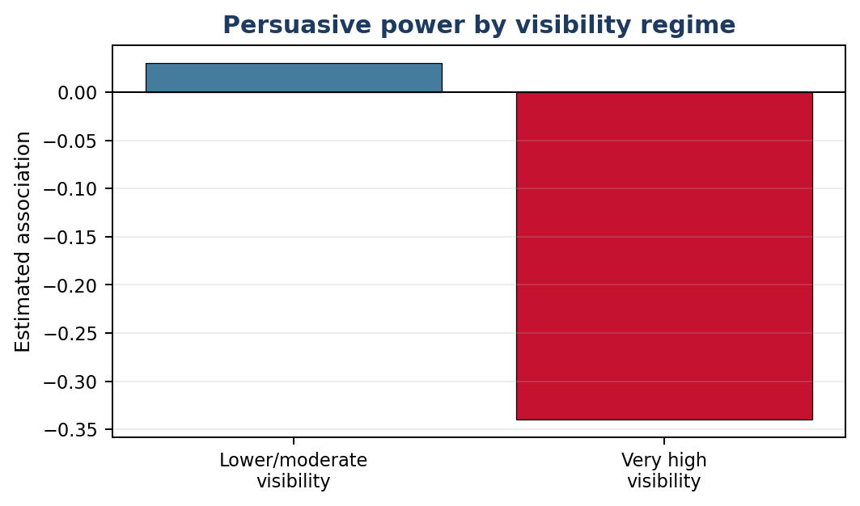
BACKUP
CALIFORNIA STATE UNIVERSITY, NORTHRIDGE
Backup E: Managerial Recommendations
Additional high-visibility visualization and action guidance
Recommendation 1
Separate reach from effectiveness. Report high-effort outcomes alongside reach and impressions.
Recommendation 2
Invest in early content quality and launch timing because early signals are linked to visibility.
Recommendation 3
Use influencer authority strategically: high-authority creators convert early signals into meaningful outcomes more effectively.
Do not over-optimize for maximum reach. The model suggests diminishing returns and high-visibility boundary effects.
B5

Slide 16
BACKUP
CALIFORNIA STATE UNIVERSITY, NORTHRIDGE
Backup F: References and AI-Use Statement
Abbreviated references and disclosure
• Chaiken (1980) — Heuristic versus systematic information processing.
• Bucher (2012) — Algorithmic power and visibility on Facebook.
• Cotter (2019) — Influencers and algorithmic visibility on Instagram.
• Petre, Duffy, & Hund (2019) — Politics of algorithmic visibility.
• De Veirman, Cauberghe, & Hudders (2017) — Followers and influencer effects.
• Lou & Yuan (2019) — Message value, credibility, and branded content trust.
• Xiao, Wang, & Chan-Olmsted (2018) — HSM and influencer credibility.
AI-use statement
AI tools were used to support drafting, organization, and slide formatting. The analysis and interpretation are based on the provided dataset, code outputs, and project materials.
Final reminder: claims should be framed as associations because the design is observational and amplification is measured through proxies.
B6

