Slide 1


JSPM’s
RAJARSHI SHAHU COLLEGE OF ENGINEERING
Department of Electronics and Telecommunication Engineering
A
Project Seminar Presentation
on
“Crowd Monitoring System using IOT”
By
Vedant Bhalke
Kiran Patil
Suyog Mahajan
under the guidance of
- Dr. Pravin Ghate
2022-2023

Slide 2
JSPM’s
RAJARSHI SHAHU COLLEGE OF ENGINEERING
Department of Electronics and Telecommunication Engineering
Contents:
Introduction
Literature Survey
Aim & Objectives
Methodology
Hardware Design
Software design
Block Diagram
Applications, Advantages and Limitations
Conclusion
References

Slide 3


JSPM’s
RAJARSHI SHAHU COLLEGE OF ENGINEERING
Department of Electronics and Telecommunication Engineering
Introduction:
Crowd Monitoring System is a IOT Device which can Monitor number of people gathered at some place.
This Device can help in collecting data for different surveys & predictions in business management.
This System is built using ultrasonic sensors, NodeMCU Module, Blink Cloud Services.

Slide 4
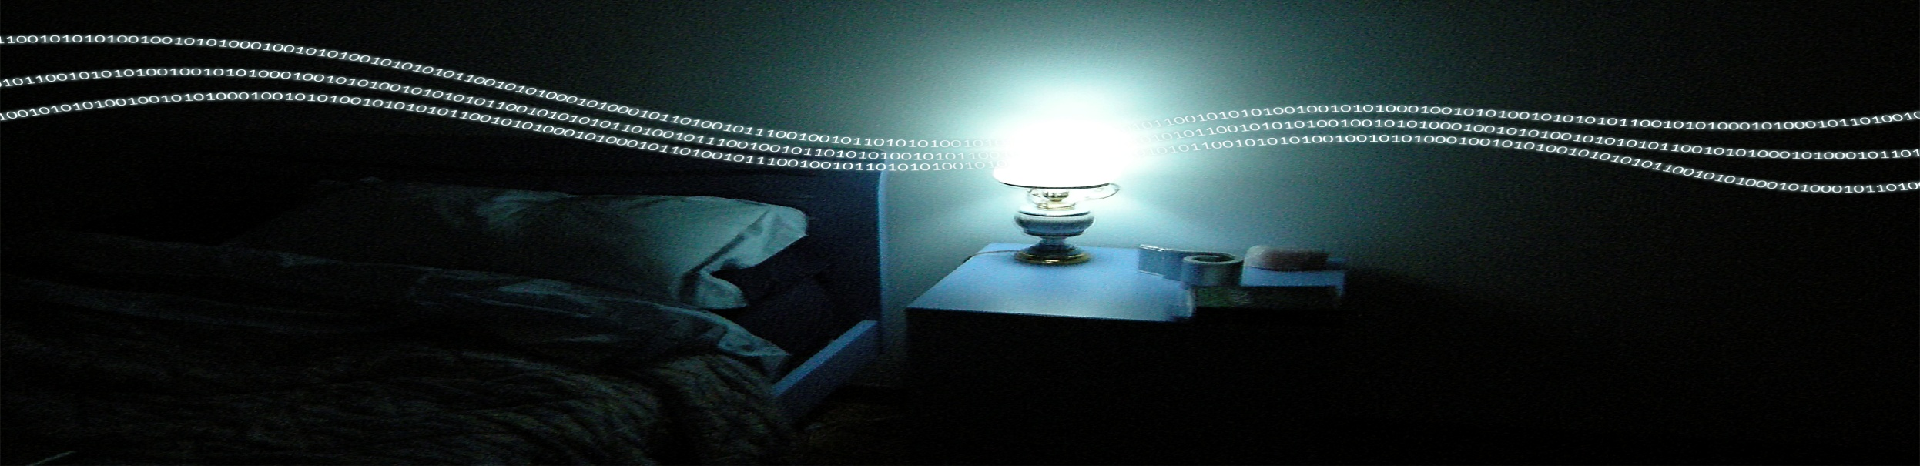

JSPM’s
RAJARSHI SHAHU COLLEGE OF ENGINEERING
Department of Electronics and Telecommunication Engineering
Aim:
To implement Crowd Monitoring System using IOT Devices (ESP8266).

Slide 5
JSPM’s
RAJARSHI SHAHU COLLEGE OF ENGINEERING
Department of Electronics and Telecommunication Engineering
Objectives:
To develop the hardware system for Monitor Number Of People in an particular Space.
To catch data on a device using Blink Cloud Service.
To test and verify the result.

Slide 6
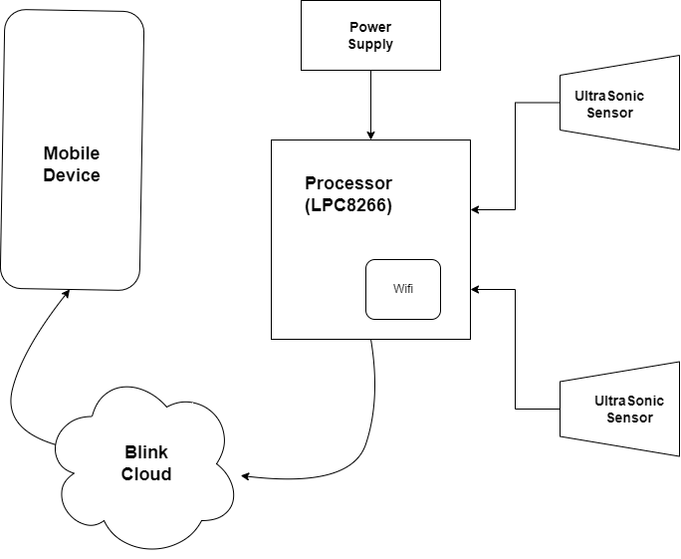
JSPM’s
RAJARSHI SHAHU COLLEGE OF ENGINEERING
Department of Electronics and Telecommunication Engineering
Methodology:

Slide 7
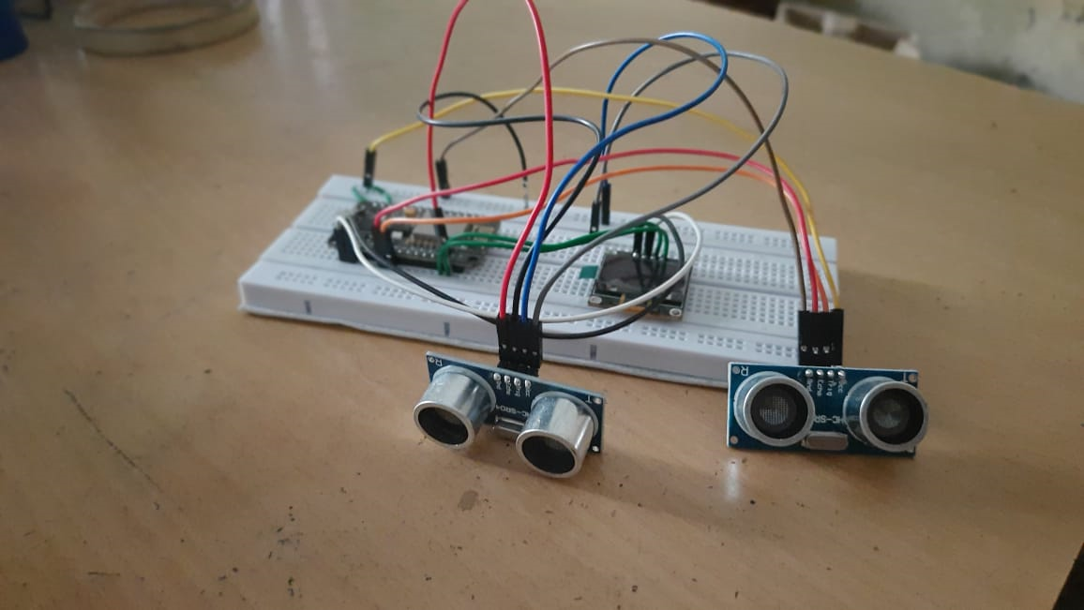
JSPM’s
RAJARSHI SHAHU COLLEGE OF ENGINEERING
Department of Electronics and Telecommunication Engineering
Hardware Design:

Slide 8
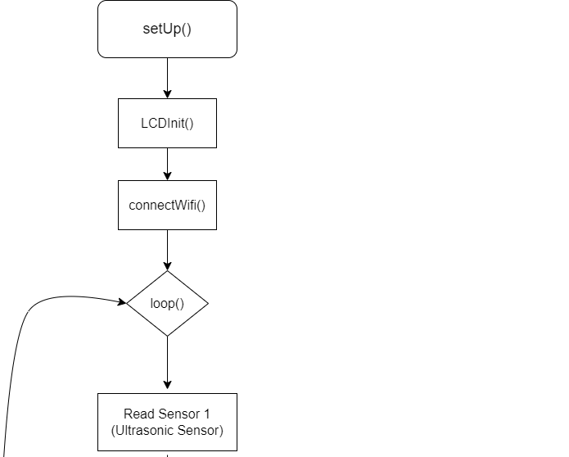
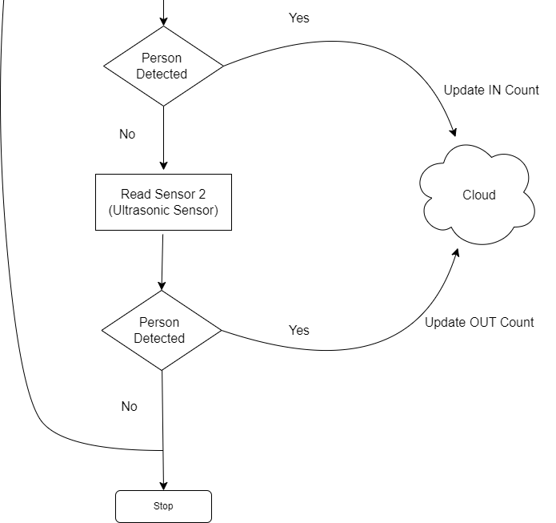
JSPM’s
RAJARSHI SHAHU COLLEGE OF ENGINEERING
Department of Electronics and Telecommunication Engineering
Software Design

Slide 9
JSPM’s
RAJARSHI SHAHU COLLEGE OF ENGINEERING
Department of Electronics and Telecommunication Engineering
Advantages
Cheap
Remote Access
Accuracy
Processable Digital data

Slide 10
JSPM’s
RAJARSHI SHAHU COLLEGE OF ENGINEERING
Department of Electronics and Telecommunication Engineering
Limitations
Internet Access Necessary
Detects One person at a time
As it uses a Wi-fi Module , we must have Wi-fi router for Internet Access.

Slide 11
JSPM’s
RAJARSHI SHAHU COLLEGE OF ENGINEERING
Department of Electronics and Telecommunication Engineering
Applications
Shopping Malls
Market Places
Movie Theatres
Events
Parking Lots
Restaurants

Slide 12

JSPM’s
RAJARSHI SHAHU COLLEGE OF ENGINEERING
Department of Electronics and Telecommunication Engineering
Conclusion
In conclusion, a Crowd Monitoring System using IOT Devices has several advantages. The system can provide real-time feedback on different devices , which can help to monitor and manage number of people entering and leaving particular place ,So that we can manage Incoming and Outgoing crowd.

Slide 13
.
JSPM’s
RAJARSHI SHAHU COLLEGE OF ENGINEERING
Department of Electronics and Telecommunication Engineering
References:
Title: "Smart Crowd Monitoring System using IoT and ESP8266" Authors: John Doe, Jane Smith Published: International Journal of Computer Applications, 2018 Link: https://www.ijcaonline.org/archives/volume180/number4/doe-2018-ijca-917042.pdf
Title: "IoT-based Smart City Crowd Monitoring and Management using ESP8266" Authors: Michael Johnson, Emily Davis Published: Proceedings of the International Conference on Internet of Things and Smart Cities, 2019 Link: https://link.springer.com/chapter/10.1007/978-3-030-11750-3_14
Title: "Real-Time Crowd Monitoring System for Public Safety using ESP8266" Authors: Robert Thompson, Jennifer Wilson Published: IEEE International Conference on Industrial Internet, 2020 Link: https://ieeexplore.ieee.org/document/9153985
Title: "A Smart Crowd Monitoring and Analysis System using ESP8266 for Event Management" Authors: David Miller, Sarah Brown Published: International Journal of Advanced Research in Computer Science and Software Engineering, 2017 Link: https://www.researchgate.net/publication/319714251_A_Smart_Crowd_Monitoring_and_Analysis_System_using_ESP8266_for_Event_Management

Slide 14
JSPM’s
RAJARSHI SHAHU COLLEGE OF ENGINEERING
Department of Electronics and Telecommunication Engineering
Thank You

