Slide 1
VECTOR AUTOREGRESSION(VAR)
TIME SERIES FORECASTING METHODS

Slide 2
SPECIALITY OF THE SUBMISSION:
Topic Explanation in simple/relevant terms
Python demonstration from scratch without the creation of any user defined functions
Verified links for further learning

Slide 3
What is VAR ?
VAR model is a stochastic(random) process that represents a group of time-dependent variables as a linear function of their own past values and the past values of all the other variables in the group.
VAR model is used to capture the linear interdependencies among multiple time series. It generalizes the univariate autoregressive model (AR) by allowing more than one time-dependent variable.
Stochastic process means it includes some irreducible uncertainty and the values cannot be forecasted precisely using such processes.

Slide 4
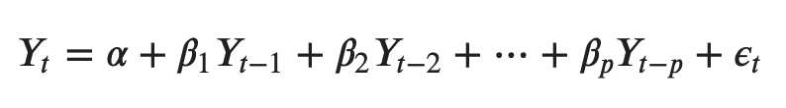
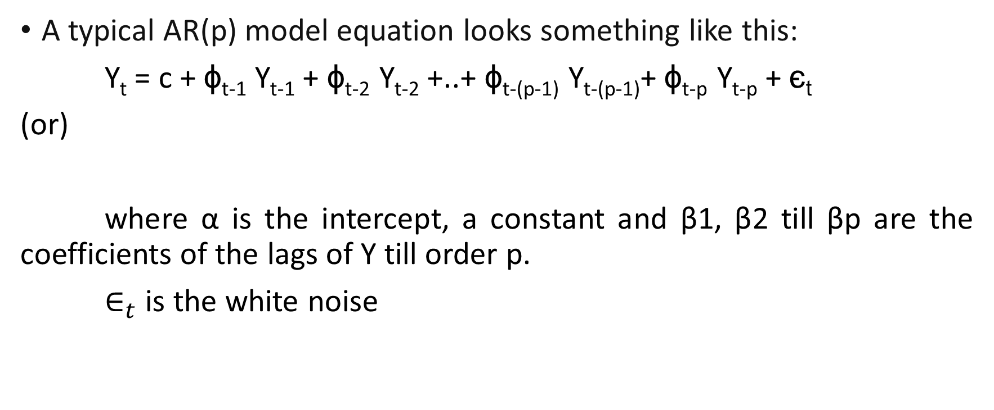
Recap on AR Model
A typical AR(p) model equation looks something like this:
Y_{t} = c + ϕ_{t-1} Y_{t-1} + ϕ_{t-2} Y_{t-2} +..+ ϕ_{t-(p-1)} Y_{t-(p-1)}+ ϕ_{t-p} Y_{t-p} + є_{t}
(or)
where α is the intercept, a constant and β1, β2 till βp are the coefficients of the lags of Y till order p.
$∈_{t}$ is the white noise

Slide 5
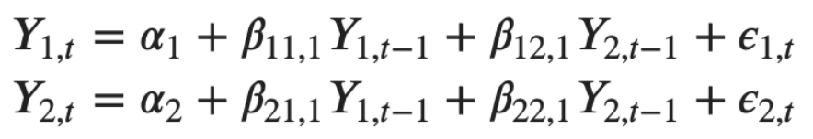

Intuition behind VAR model formula
In the VAR model, each variable is modelled as a linear combination of past values of itself and the past values of other variables in the system. For example, the system of equations for a VAR(1) model with two time series (variables $Y_{1}$ and $Y_{2}$ ) is:

Slide 6
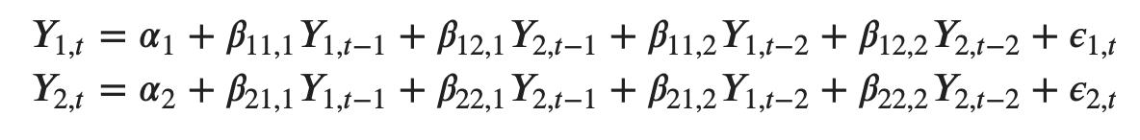

Contd…
Likewise, the second order VAR(2) model for two variables would include up to two lags for each variable ($Y_{1}$ and $Y_{2}$)

Slide 7
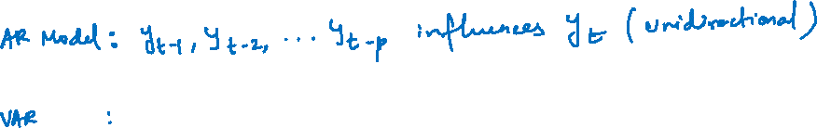
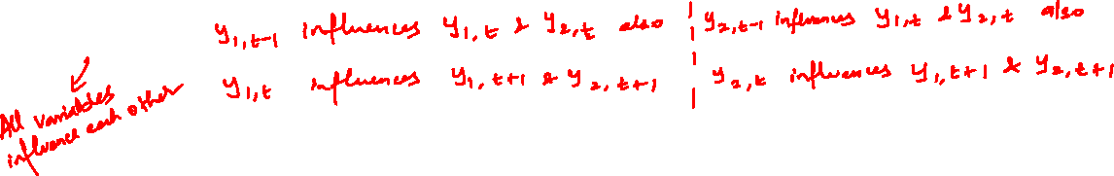
Why VAR ?
One limitation of the models that we have considered so far is that they impose a unidirectional relationship — the forecast variable is influenced by the predictor variables, but not vice versa. However, there are many cases where the reverse should also be allowed for — where all variables affect each other.

Slide 8
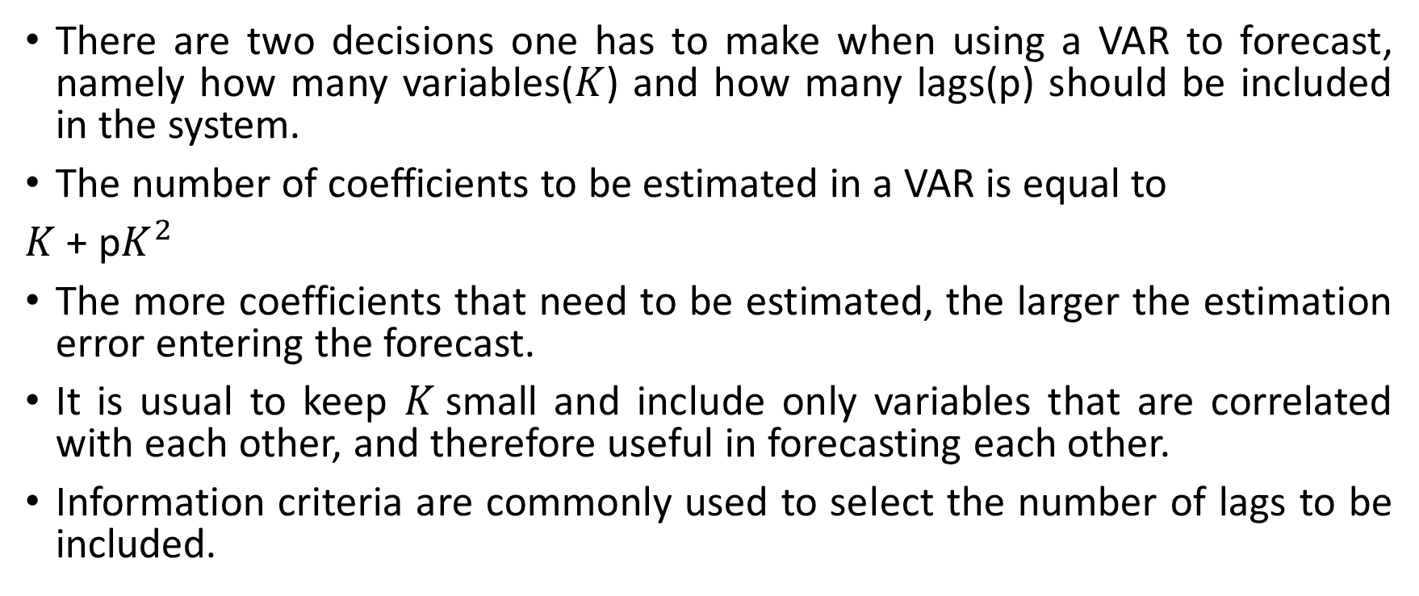
Key decisions
There are two decisions one has to make when using a VAR to forecast, namely how many variables($K$) and how many lags(p) should be included in the system.
The number of coefficients to be estimated in a VAR is equal to
$K$ + p$K^{2}$
The more coefficients that need to be estimated, the larger the estimation error entering the forecast.
It is usual to keep $K$small and include only variables that are correlated with each other, and therefore useful in forecasting each other.
Information criteria are commonly used to select the number of lags to be included.

Slide 9
Python steps
Visual inspection of series
Granger Causality Check & Co-integration test
Stationarity Check
Train & Test split
Find the best order of lag(p)
Fit VAR Model using the chosen lag(p)
Check correlation in errors
Forecast future values
Performance Metric

Slide 10
Applications of VAR
Forecasting a collection of related variables where no explicit interpretation is required
Testing whether one variable is useful in forecasting another(the basis of Granger causality tests)
Impulse response analysis, where the response of one variable to a sudden but temporary change in another variable is analysed.
Disadvantage of VAR
Every variable is assumed to influence every other variable in the system, which makes it difficult to directly interpret the estimated coefficients.

Slide 11
Useful links for further learning
Vector autoregression - Wikipedia
A Real-World Application of Vector Autoregressive (VAR) model | by Thought Partner for Data | Towards Data Science
https://www.machinelearningplus.com/time-series/vector-autoregression-examples-python/
Vector Auto Regression : Time Series Talk – YouTube
Forecasting: Principles and Practice by Rob J Hyndman & George Athanasopoulos
Cointegration Test
Github link of sample code

