Slide 1
CS 7375 Artificial Intelligence Spring 2022 Instructor: Xinyue Zhang
Lecture 2

Slide 2
Outline
AI history
Two Views of AI
Modeling + Inference + Learning Paradigm
Optimization Problem

Slide 3
AI Prehistory
There are many disciplines that contributed ideas, viewpoints, and techniques to AI.
Philosophy | logic, methods of reasoning mind as physical system foundations of learning, language, rationality
Mathematics | formal representation and proof algorithms, computation, (un)decidability, (in)tractability probability
Psychology | adaptation phenomena of perception and motor control experimental techniques (psychophysics, etc.)
Economics | formal theory of rational decisions knowledge
Linguistics | representation grammar
Neuroscience | physical substrate for mental activity
Control theory | homeostatic systems, stability simple optimal agent designs
… | …

Slide 4
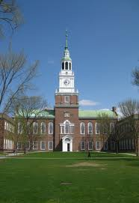
1956 Birth of AI
1956: Workshop at Dartmouth College; attendees: John McCarthy, Marvin Minsky, Claude Shannon, etc.
Aim for general principles:
Every aspect of learning or any other feature of intelligence can be so precisely described that a machine can be made to simulate it.
*Slides adopted from CS221 Stanford University

Slide 5


Birth of AI, early successes
Checkers (1952): Samuel’s program learned weights and played at strong amateur level
Problem solving (1955): Newell & Simon’s Logic Theorist: prove theorems in Principia Mathematica using search +heuristics; later, General Problem Solver (GPS)

Slide 6
Overwhelming optimism...
Machines will be capable, within twenty years, of doing any work a man can do. —Herbert Simon
Within 10 years the problems of artificial intelligence will be substantially solved. —Marvin Minsky
I visualize a time when we will be to robots what dogs are to humans, and I’m rooting for the machines. —Claude Shannon

Slide 7
...underwhelming results
Example: machine translation
The spirit is willing but the flesh is weak.
(Russian)
The vodka is good but the meat is rotten.
1966: ALPAC report cut off government funding for MT, first AI winter

Slide 8
Implications of early era
Problems:
Limited computation: search space grew exponentially, outpac ing hardware (100! ≈ 10¹⁵⁷ > 10⁸⁰)
Limited information: complexity of AI problems (number of words, objects, concepts in the world)
Contributions:
Lisp, garbage collection, time-sharing (John McCarthy)
Key paradigm: separate modeling and inference

Slide 9

Knowledge-based systems (70-80s)
Expert systems: elicit specific domain knowledge from experts in form of rules:
if [premises] then [conclusion]

Slide 10
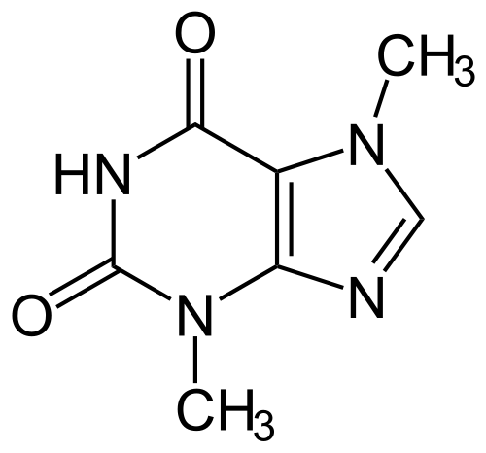

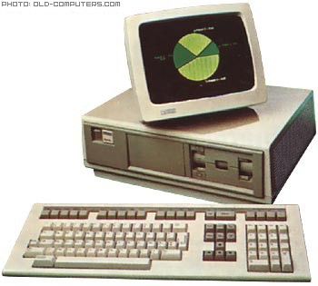
Knowledge-based systems (70-80s)
DENDRAL: infer molecular structure from mass spectrometry
MYCIN: diagnose blood infections, recommend antibiotics
XCON: convert customer orders into parts specification; save DEC $40 million a year by 1986

Slide 11
Knowledge-based systems
We know that this is not the end of the AI story, but actually it is not the beginning. There is another thread for which we need to go back to 1943.
Contributions:
First real application that impacted industry
Knowledge helped curb the exponential growth
Problems:
Knowledge is not deterministic rules, need to model uncertainty
Requires considerable manual effort to create rules, hard to maintain
1987: Collapse of Lisp machines and second AI winter

Slide 12
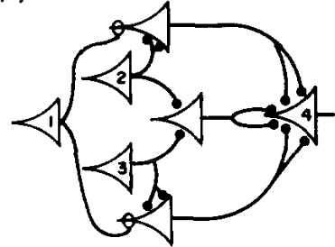
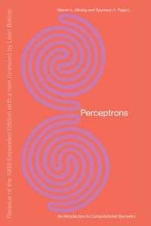
1943 -- Artificial neural networks
1943: introduced artificial neural networks, connect neu- ral circuitry and logic (McCulloch/Pitts)
1969: Perceptrons book showed that linear models could not solve XOR, killed neural nets research (Min- sky/Papert)

Slide 13
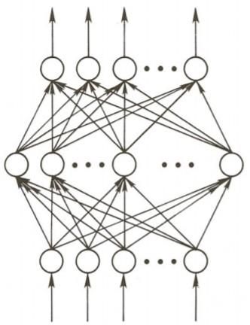
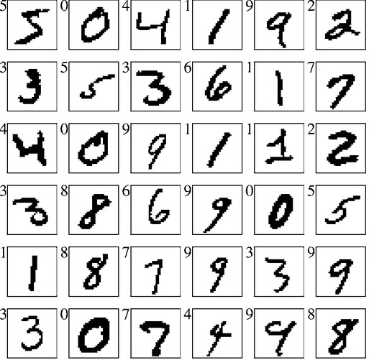
Training networks
1986: popularization of backpropagation for training multi-layer networks (Rumelhardt, Hinton, Williams)
1989: applied convolutional neural networks to recogniz- ing handwritten digits for USPS (LeCun)

Slide 14
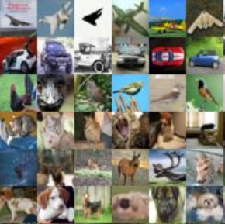
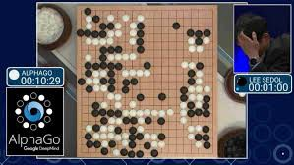
Deep learning
AlexNet (2012): huge gains in object recognition; trans- formed computer vision community overnight
AlphaGo (2016): deep reinforcement learning, world champion Lee Sedol

Slide 15
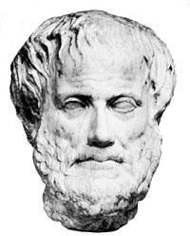
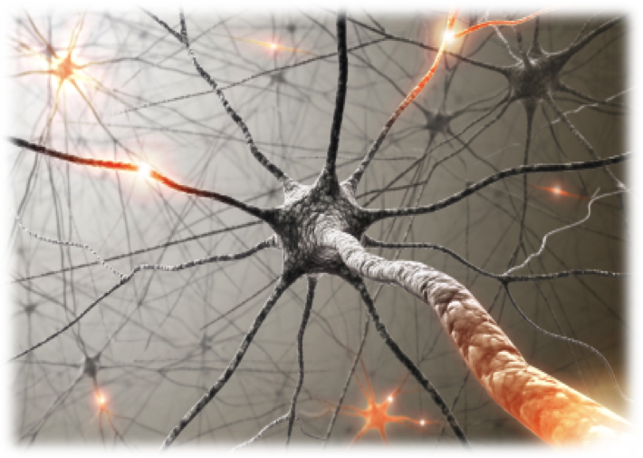
Two intellectual traditions
AI has always swung back and forth between the two
Deep philosophical differences, but deeper connection (McCulloch/Pitts, AlphaGo)?

Slide 16
A melting pot
Bayes rule (Bayes, 1763) from probability
Least squares regression (Gauss, 1795) from astronomy
First-order logic (Frege, 1893) from logic
Maximum likelihood (Fisher, 1922) from statistics
Artificial neural networks (McCulloch/Pitts, 1943) from neuroscience
Minimax games (von Neumann, 1944) from economics
Stochastic gradient descent (Robbins/Monro, 1951) from optimization
Uniform cost search (Dijkstra, 1956) from algorithms
Value iteration (Bellman, 1957) from control theory

Slide 17
Outline
AI history
Two Views of AI
Modeling + Inference + Learning Paradigm
Optimization Problem

Slide 18
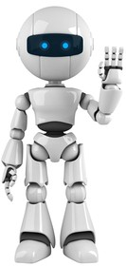

Two views of AI
AI agents: how can we create intelligence?
AI tools: how can we benefit society?

Slide 19
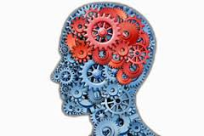
AI agents...
Perception
Robotics
Language
Knowledge
Reasoning
Learning

Slide 20
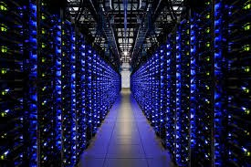

Are we there yet?
Machines: narrow tasks, millions of examples
Humans: diverse tasks, very few examples

Slide 21
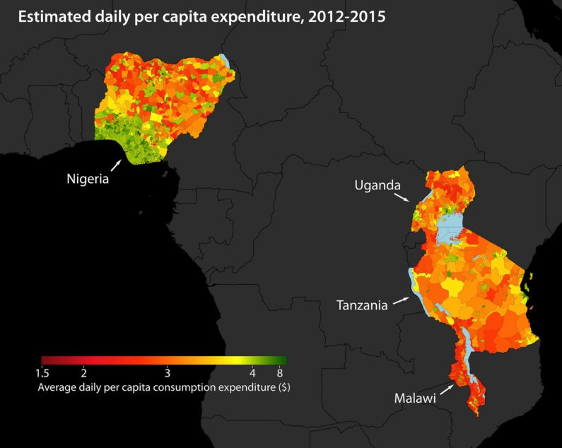
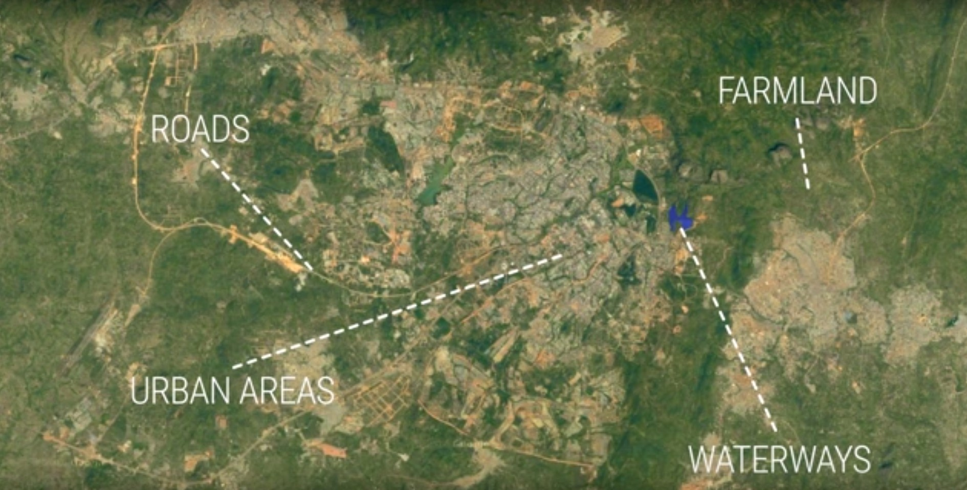
AI tools...
Predicting poverty

Slide 22
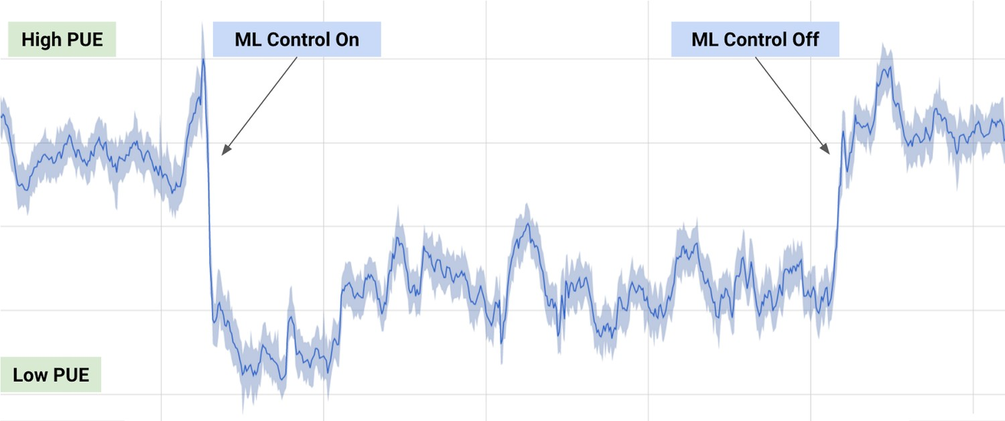
AI tools...
Saving energy by cooling datacenters

Slide 23
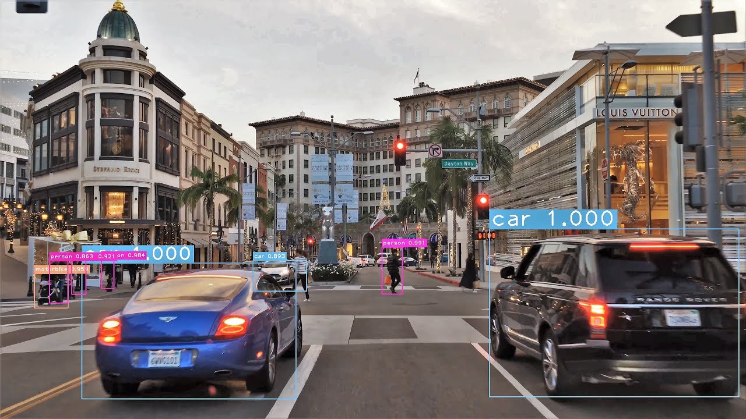

AI tools...
Self-driving car
Authentication

Slide 24
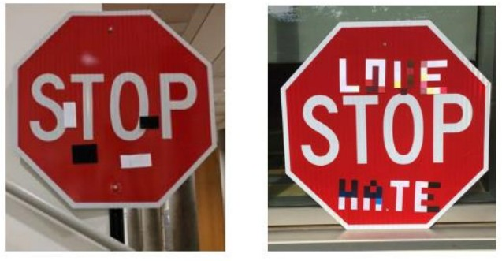
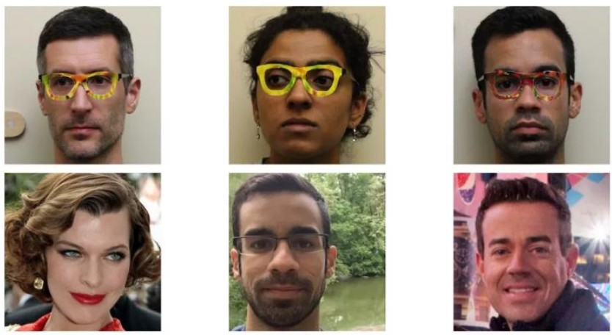
AI tools...
Security issues
[Evtimov+ 2017]
[Sharif+ 2016]

Slide 25
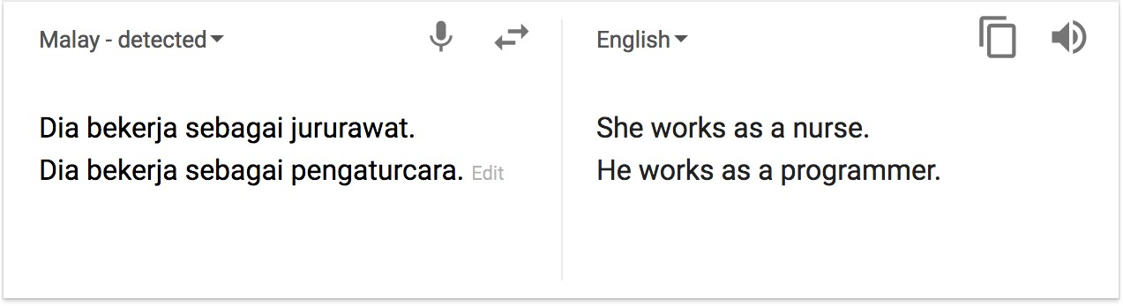
AI tools...
Bias in machine translation
society ⇒ data ⇒ predictions

Slide 26
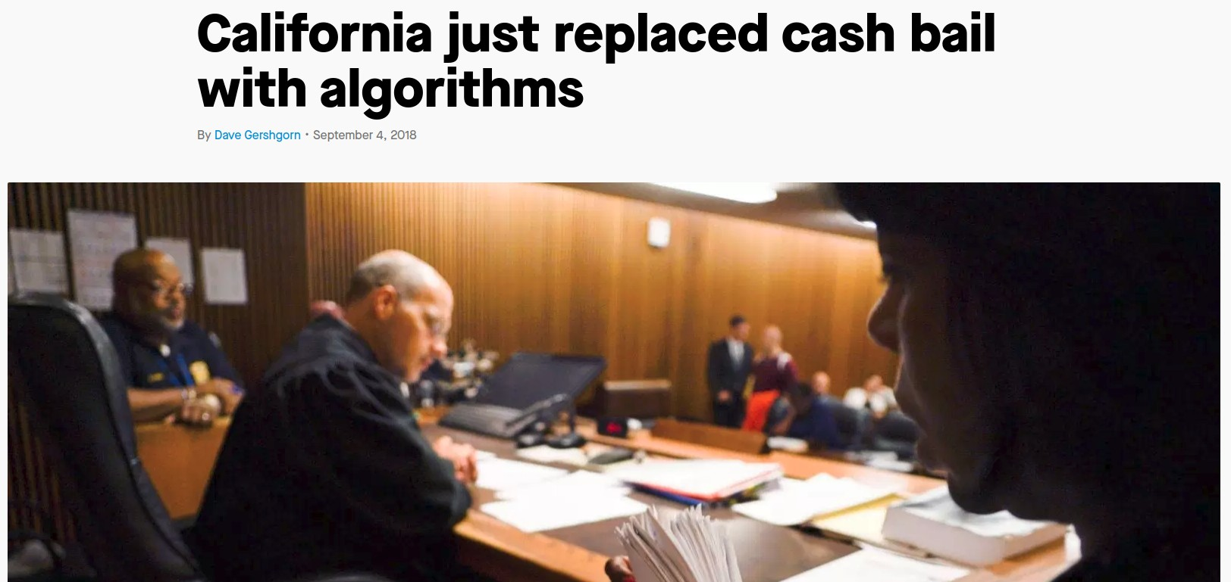
Fairness in criminal risk assessment
Northpointe: COMPAS predicts criminal risk score (1-10)
ProPublica: given that an individual did not reoffend, blacks 2x likely to be (wrongly) classified 5 or above
Northpointe: given a risk score of 7, 60% of whites reoffended, 60% of blacks reoffended

Slide 27
Summary so far
AI agents: achieving human-level intelligence, still very far (e.g., generalize from few examples)
AI tools: need to think carefully about real-world consequences (e.g., security, biases)

Slide 28
Outline
AI history
Two Views of AI
Modeling + Inference + Learning Paradigm
Optimization Problem

Slide 29
How do we solve AI tasks?
Modeling
Paradigm
Inference
Learning

Slide 30
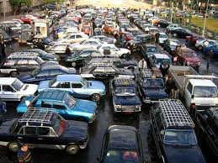
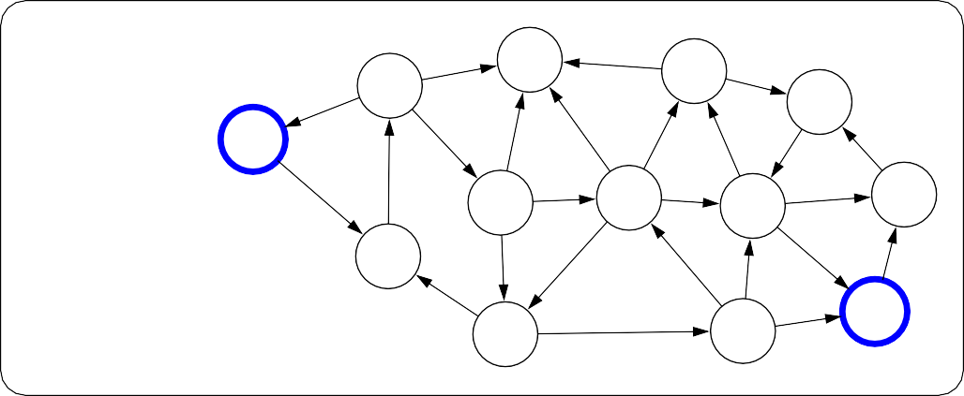
Paradigm: modeling
Real world
Modeling
6
7
4
5
5
5
3
1
Model
0
8
6
3
8
8
1
1
7
2
3
6
7
2
4
8
6

Slide 31

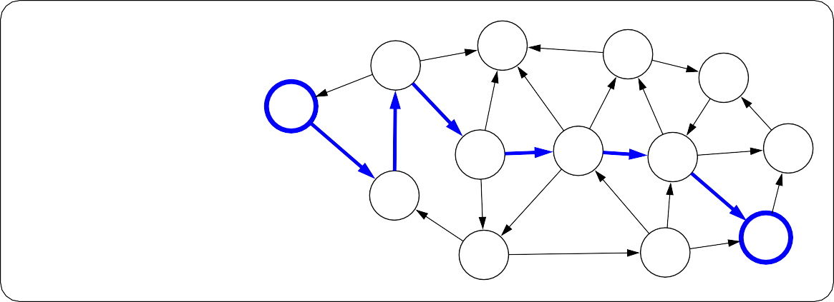
Paradigm: inference
6
7
4
5
5
5
3
1
Model
0
8
6
3
8
8
1
1
7
2
3
6
7
2
4
8
6
Inference
6
7
4
5
8
5
5
3
1
Predictions
0
6
3
8
8
1
1
7
2
3
6
7
2
4
8
6

Slide 32
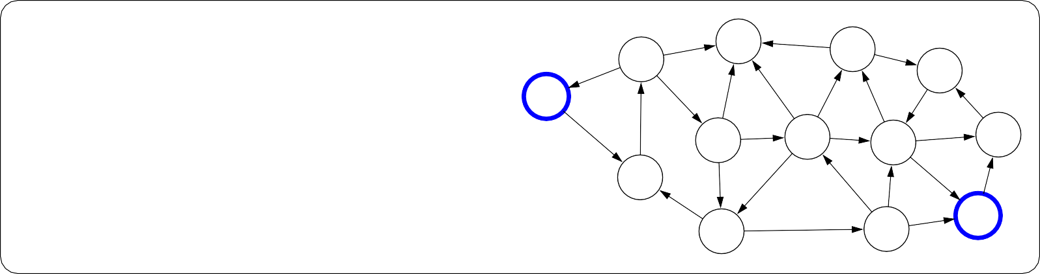
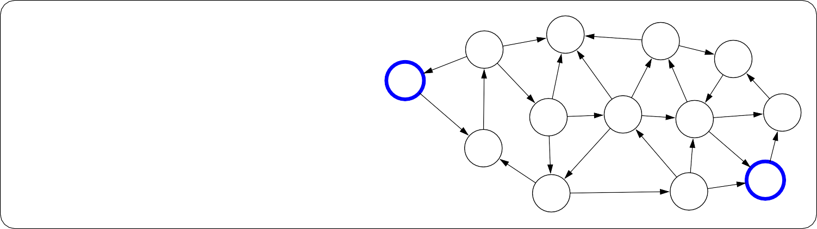
Paradigm: learning
?
?
?
?
?
?
?
?
Model without parameters
?
?
?
?
?
?
?
?
?
?
?
?
?
?
?
?
?
+data
Learning
6
7
4
5
5
5
3
1
Model with parameters
0
8
6
3
8
8
1
1
7
2
3
6
7
2
4
8
6

Slide 33
Improve Intelligence
“Low-level intelligence”
“High-level intelligence”
Machine learning

Slide 34

Machine learning
The main driver of recent successes in AI
Move from “code” to “data” to manage the information complexity
Requires a leap of faith: generalization
Data
Model

Slide 35
Improve Intelligence
Reflex
“Low-level intelligence”
“High-level intelligence”
Machine learning

Slide 36
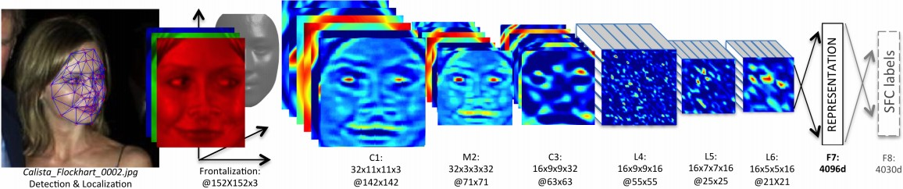
Reflex-based models
Examples: linear classifiers, deep neural networks
Most common models in machine learning
Fully feed-forward (no backtracking)

Slide 37
Improve Intelligence
Search problems
Markov decision processes Adversarial games
Reflex
States
“Low-level intelligence”
“High-level intelligence”
Machine learning

Slide 38
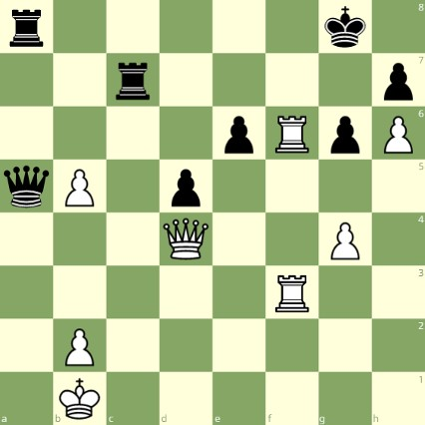
State-based models
White to move

Slide 39
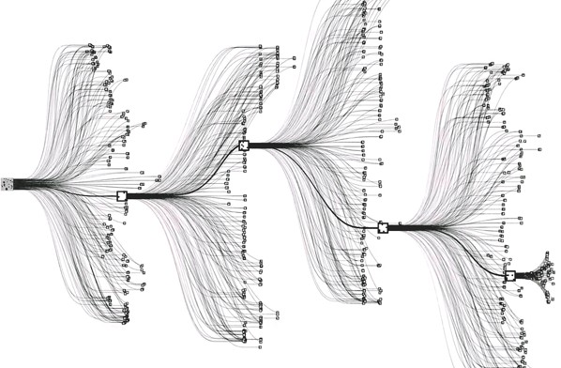
State-based models
Applications:
Games: Chess, Go, Pac-Man, Starcraft, etc.
Robotics: motion planning
Natural language generation: machine translation, image caption ing

Slide 40
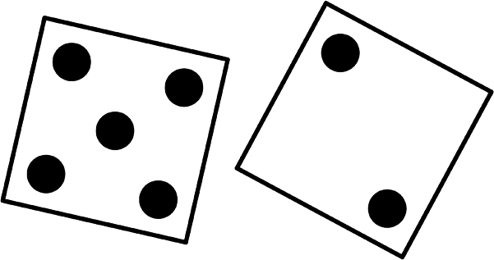

State-based models
Search problems: you control everything
Markov decision processes: against nature (e.g., Blackjack)
Adversarial games: against opponent (e.g., chess)

Slide 41
Improve Intelligence
Search problems
Markov decision processes Adversarial games
Constraint satisfaction problems
Bayesian networks
Reflex
States
Variables
“Low-level intelligence”
“High-level intelligence”
Machine learning

Slide 42
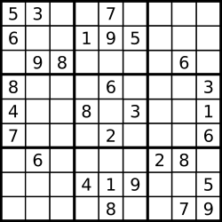
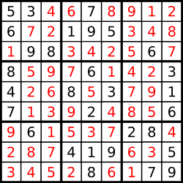
Sudoku
Goal: put digits in blank squares so each row, column, and 3x3 sub-block has digits 1–9
Note: order of filling squares doesn’t matter in the evaluation criteria!

Slide 43
Variable-based models
Constraint satisfaction problems: hard constraints (e.g., Sudoku, scheduling)
Bayesian networks: soft dependencies (e.g., tracking cars from sensors)
X₁
X₂
X₃
X₄
H₁ H₂ H₃ H₄ H₅
E₁
E₂
E₃
E₄
E₅

Slide 44
Improve Intelligence
Search problems
Markov decision processes Adversarial games
Constraint satisfaction problems
Bayesian networks
Reflex
States
Variables
Logic
“Low-level intelligence”
“High-level intelligence”
Machine learning

Slide 45


Motivation: virtual assistant
Need to:
Digest heterogenous information
Reason deeply with that information
Tell information
Ask questions

Slide 46
Course Roadmap
Search problems
Markov decision processes Adversarial games
Constraint satisfaction problems
Bayesian networks
Reflex
States
Variables
Logic
“Low-level intelligence”
“High-level intelligence”
Machine learning

Slide 47
Outline
AI history
Two Views of AI
Modeling + Inference + Learning Paradigm
Optimization Problem

Slide 48
Optimization
Discrete optimization: find the best discrete object
min Cost(p), p∈Paths
Algorithmic tool: dynamic programming
Continuous optimization: find the best vector of real numbers
min TrainingError(w), w∈R^{d}
Algorithmic tool: gradient descent

Slide 49
Summary
History: roots from logic, neuroscience, statistics—melting pot!
Modeling [reflex, states, variables, logic] +inference +learning paradigm
AI has high societal impact, how to steer it positively?

Slide 50

Email: xzhang48@kennesaw.edu
Teams: Xinyue Zhang (xzhang48)

