Slide 1
CS 7375 Artificial Intelligence Spring 2022 Instructor: Xinyue Zhang
Lecture 3

Slide 2
Outline
Review of Lecture 2
Agents and Environments
Rational Agents
Intelligent Agents
PEAS: Performance measure, Environment, Actuators, Sensors
Types of Environments
Types of Agents
Conclusions

Slide 3
A melting pot
Bayes rule (Bayes, 1763) from probability
Least squares regression (Gauss, 1795) from astronomy
First-order logic (Frege, 1893) from logic
Maximum likelihood (Fisher, 1922) from statistics
Artificial neural networks (McCulloch/Pitts, 1943) from neuroscience
Minimax games (von Neumann, 1944) from economics
Stochastic gradient descent (Robbins/Monro, 1951) from optimization
Uniform cost search (Dijkstra, 1956) from algorithms
Value iteration (Bellman, 1957) from control theory

Slide 4
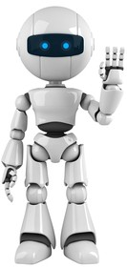

Two views of AI
AI agents: achieving human-level intelligence, still very far (e.g., generalize from few examples)
AI tools: need to think carefully about real-world consequences (e.g., security, biases)

Slide 5
Two views of AI
AI agents: how can we create intelligence?
AI tools: how can we benefit society?

Slide 6
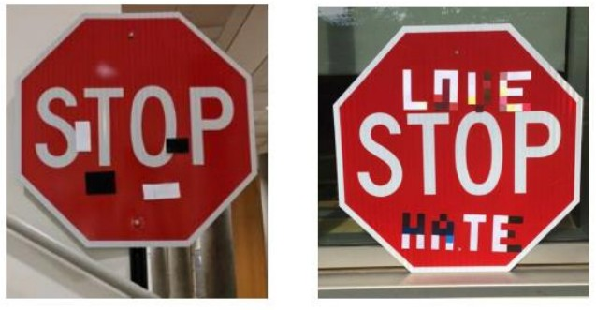
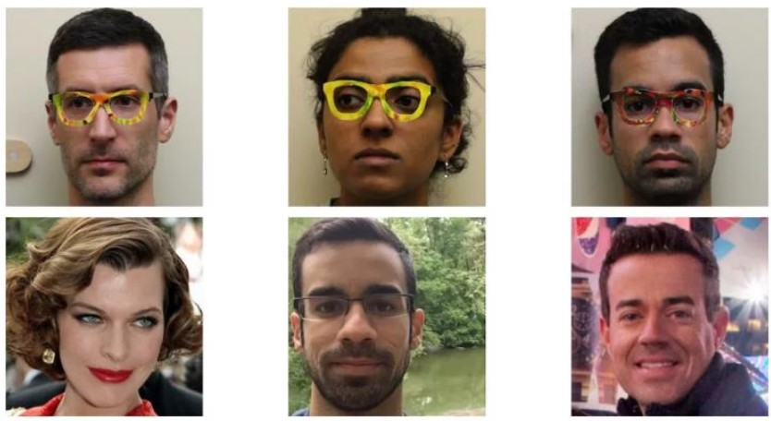
Security Issues
Adversarial examples
[Evtimov+ 2017]
[Sharif+ 2016]

Slide 7
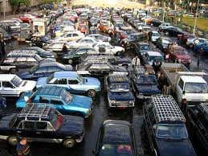
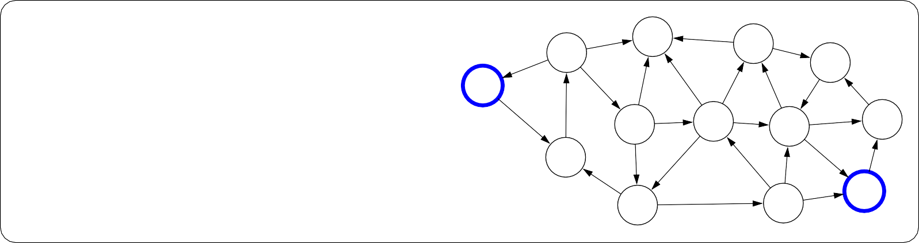
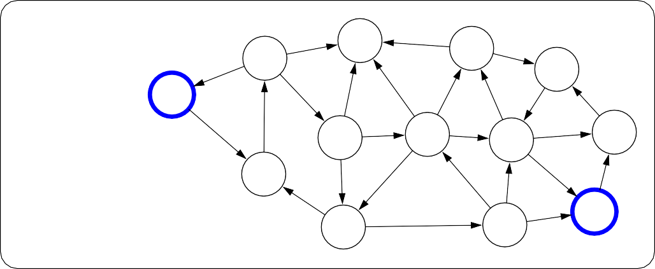
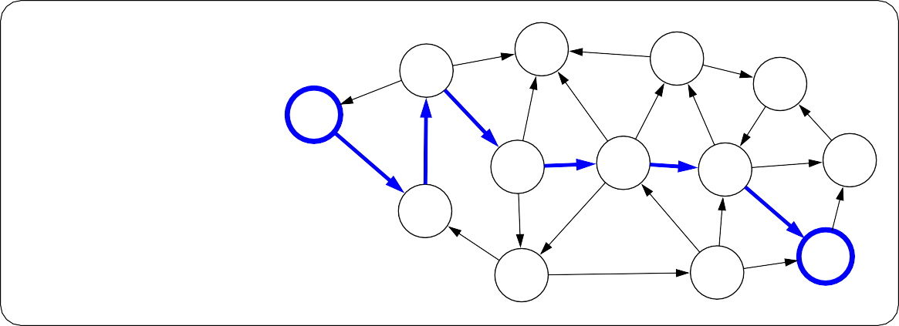
How do we solve AI tasks?
?
?
?
?
?
?
?
?
Real world
Model without parameters
?
?
?
?
?
?
?
?
?
?
?
?
?
?
?
?
?
+data
Modeling
Learning
6
7
4
Inference
6
7
4
5
5
5
3
1
5
8
5
5
3
1
Model
0
8
6
3
Predictions
6
3
8
8
1
1
8
0
8
1
1
7
2
3
6
7
2
7
2
3
6
7
2
4
8
4
8
6
6

Slide 8
Improve Intelligence
Search problems
Markov decision processes Adversarial games
Constraint satisfaction problems
Bayesian networks
Reflex
States
Variables
Logic
“Low-level intelligence”
“High-level intelligence”
Machine learning

Slide 9
Optimization
Discrete optimization: find the best discrete object
min Cost(p), p∈Paths
Algorithmic tool: dynamic programming
Continuous optimization: find the best vector of real numbers
min TrainingError(w), w∈R^{d}
Algorithmic tool: gradient descent

Slide 10
Definitions of AI
if our system can be more rational than humans in some cases, why not?
Systems that think like humans | Systems that think rationally
Systems that act like humans | Systems that act rationally
focus on action avoids philosophical issues such as “is the system conscious” etc.
We will follow “act rationally” approach
Distinction may not be that important
acting rationally/like a human presumably requires (some sort of) thinking rationally/like a human,
humans much more rational anyway in complex domains

Slide 11
Outline
Review of Lecture 2
Agents and Environments
Rational Agents
Intelligent Agents
PEAS: Performance measure, Environment, Actuators, Sensors
Types of Environments
Types of Agents
Conclusions

Slide 12
What are Intelligent Agents ?

Slide 13
What are Intelligent Agents ?
Ability to Exist to be Autonomous, Reactive, Goal-Oriented, etc. - are the basic abilities of an Intelligent Agent

Slide 14
But, what is autonomous?
A system is autonomous to the extent that its behaviour is determined by its own experience.
What agents are ?

Slide 15
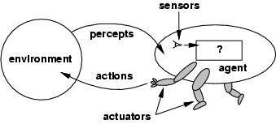
Agents
Definition: An agent perceives its environment via sensors and acts upon that environment through its actuators.
This definition includes:
Robots, humans, and programs.
Machine Vision
Logic Reasoning
Act; Motion

Slide 16
Agents
The agent view is really quite generic.
In a sense, all areas of engineering can be seen as designing artifacts that interact with the world. AI operates that end of the spectrum, where the artifacts use significant computational resources, and the task and environment requires non-trivial decision making.
But, the definition of “agents” does technically also include, e.g., calculators or cars, artifacts with very limited to no intelligence. (Self-driving cars come closer to what we view as intelligent agents.)

Slide 17
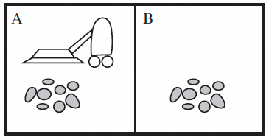
Vacuum Cleaner World
Percepts: location and contents, e.g., [A, Dirty]
Actions: Left, Right, Suck, NoOp

Slide 18
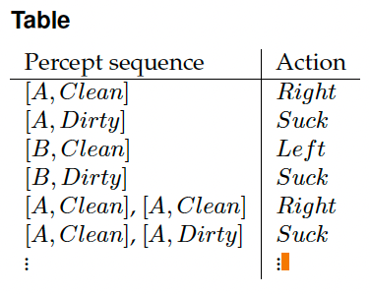
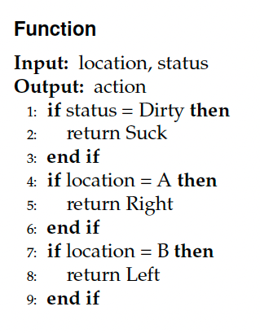
Vacuum Cleaner Agent
How to implement the vacuum cleaner agent?
What is the right way to fill out the table?

Slide 19
Rational agents
An agent should strive to "do the right thing", based on:
it can perceive and
the actions it can perform.
The right action is the one that will cause the agent to be most successful.
Fixed performance measure evaluates the environment sequence
Earn one point per square cleaned up in time T?
Earn one point per clean square per time step, minus one per move?
Penalize for > k dirty squares?

Slide 20
Performance measure
An objective criterion for success of an agent's behavior.
Performance measures self-driving car: time to reach destination (minimize), safety, predictability of behavior for other agents, reliability, etc.
Performance measure of game-playing agent: win/loss percentage (maximize), robustness, unpredictability (to “confuse” opponent), etc.

Slide 21
Rational agents
A rational agent chooses whichever action maximizes the expected value of the performance measure given the percept sequence to date.
Why “expected value”?
Captures actions with stochastic/uncertain effects or actions performed in stochastic environments. We can then look at the expected value of an action.
In high-risk settings, we may also want to limit the worst-case behavior.

Slide 22
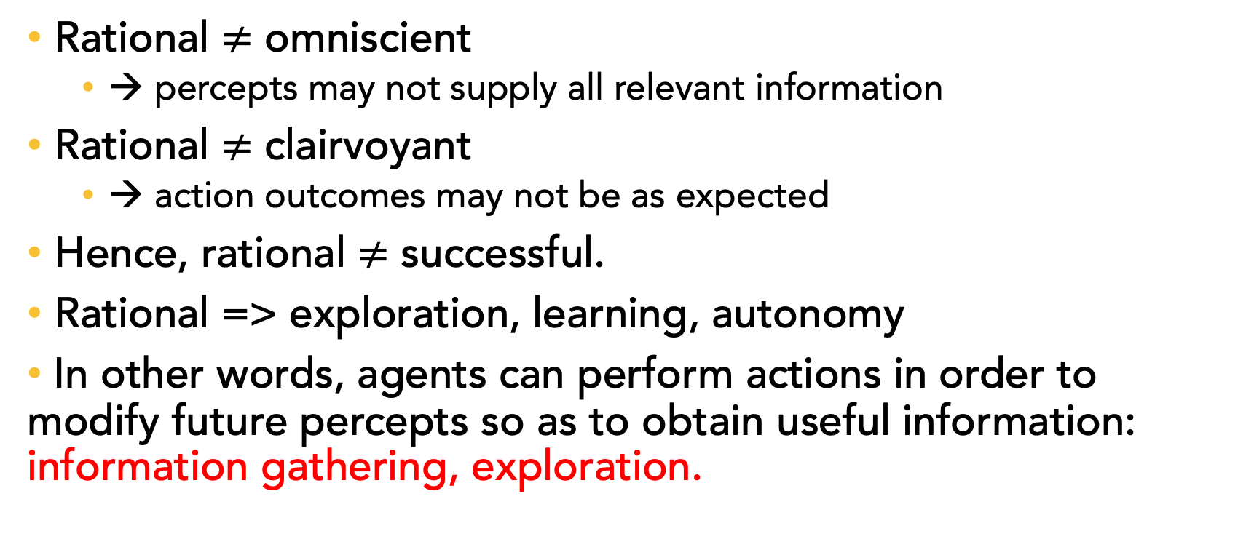
Rational agents
Rational $≠$ omniscient
→ percepts may not supply all relevant information
Rational $≠$ clairvoyant
→ action outcomes may not be as expected
Hence, rational $≠$ successful.
Rational => exploration, learning, autonomy
In other words, agents can perform actions in order to modify future percepts so as to obtain useful information: information gathering, exploration.

Slide 23
Intelligent Agent
Definition:
An intelligent agent perceives its environment via sensors and acts rationally upon that environment with its effectors.
Properties
– autonomous
– reactive to the environment
– pro-active (goal-directed)
– interacts with other agents via the environment

Slide 24
Outline
Review of Lecture 2
Agents and Environments
Rational Agents
Intelligent Agents
PEAS: Performance measure, Environment, Actuators, Sensors
Types of Environments
Types of Agents
Conclusions

Slide 25
Example: Self-Driving Car
Sensors/Percepts: Video, sonar, speedometer, odometer, engine sensors, keyboard input, microphone, GPS, ...
Actuators/Actions: Steer, accelerate, brake, horn, speak/display, ...
Performance measure/Goals: Maintain safety, reach destination, maximize profits (fuel, tire wear), obey laws, provide passenger comfort, ...
Environment: U.S. urban streets, freeways, traffic, pedestrians, weather, ...
Task Environment:
PEAS: Performance measure, Environment, Actuators, Sensors
In designing an agent, the first step must always be to specify the task environment as fully as possible

Slide 26
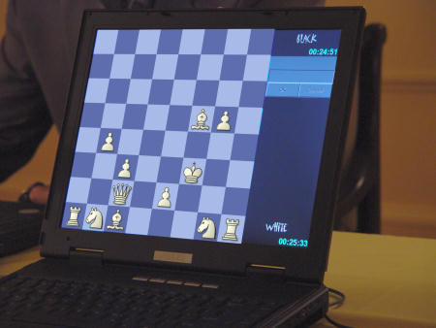
Task Environments
1) Fully observable / Partially observable
If an agent’s sensors give it access to the complete state of the environment needed to choose an action, the environment is fully observable.
(e.g. chess)

Slide 27
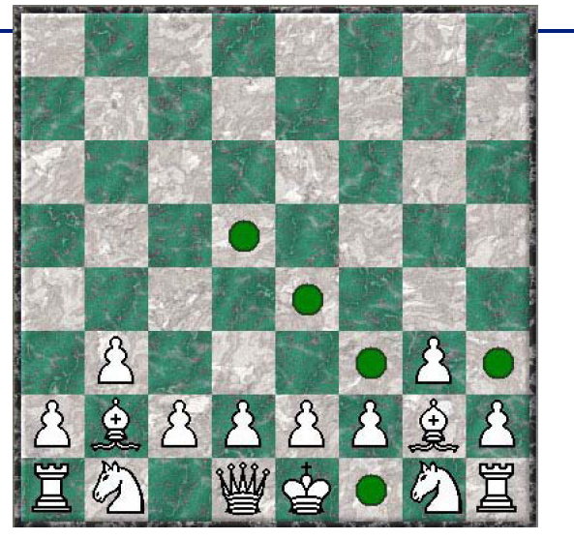
Making things a bit more challenging…
you can’t see your opponent!
Incomplete/uncertain information inherent in the game.
Balance
exploitation (best move given current knowledge)
and exploration (moves to explore where opponent’s pieces might be).
Use probabilistic
reasoning techniques.

Slide 28
Task Environments
2) Deterministic / Stochastic
An environment is deterministic if the next state of the environment is completely determined by the current state of the environment and the action of the agent;
In a stochastic environment, there are multiple, unpredictable outcomes. (If the environment is deterministic except for the actions of other agents, then the environment is strategic).
In a fully observable, deterministic environment, the agent need not deal with uncertainty.
Note: Uncertainty can also arise because of computational limitations. E.g., we may be playing an omniscient (“all knowing”) opponent but we may not be able to compute his/her moves.

Slide 29
Task Environments
3) Episodic / Sequential
In an episodic environment, the agent’s experience is divided into atomic
episodes. Each episode consists of the agent perceiving and then performing
a single action.
Subsequent episodes do not depend on what actions occurred in previous
episodes. Choice of action in each episode depends only on the episode itself.
(E.g., classifying images.)
In a sequential environment, the agent engages in a series of connected
episodes. Current decision can affect future decisions. (E.g., chess and driving)

Slide 30
Task Environments
4) Static / Dynamic
A static environment does not change while the agent is thinking.
The passage of time as an agent deliberates is irrelevant.
The environment is semidynamic if the environment itself does not change
with the passage of time but the agent's performance score does.

Slide 31
Task Environments
5) Discrete / Continuous
If the number of distinct percepts and actions is limited, the environment is discrete, otherwise it is continuous.
6) Single agent / Multi-agent
If the environment contains other intelligent agents, the agent needs to be concerned about strategic, game-theoretic aspects of the environment (for either cooperative or competitive agents).
Most engineering environments don’t have multi-agent properties, whereas most social and economic systems get their complexity from the interactions of (more or less) rational agents.

Slide 32
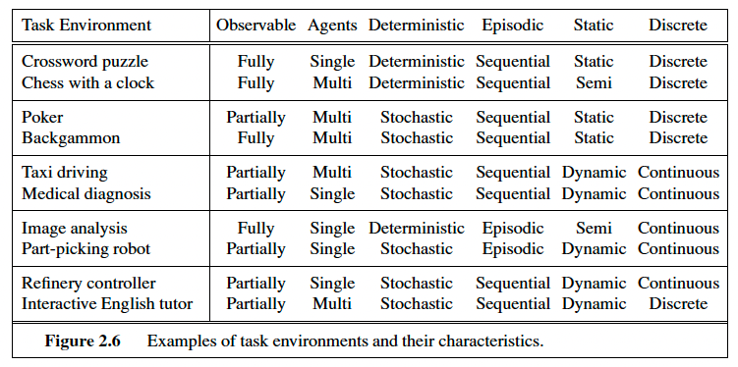
Examples of Task Environments

Slide 33
Agents and environments
The agent function maps from percept histories to actions
f: P* → A
The agent program runs (internally) on the physical. architecture to produce f
agent = architecture + program
our focus
Design an agent program assuming an archictecture that will make the percepts from
the sensors available to the program.

Slide 34
Outline
Review of Lecture 2
Agents and Environments
Rational Agents
Intelligent Agents
PEAS: Performance measure, Environment, Actuators, Sensors
Types of Environments
Types of Agents
Conclusions

Slide 35
Types of Agents
I) --- Table-lookup driven agents
Uses a percept sequence / action table in memory to
find the next action. Implemented as a (large) lookup table.
Drawbacks:
Huge table (often simply too large)
Takes a long time to build/learn the table

Slide 36
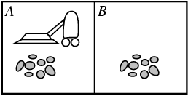
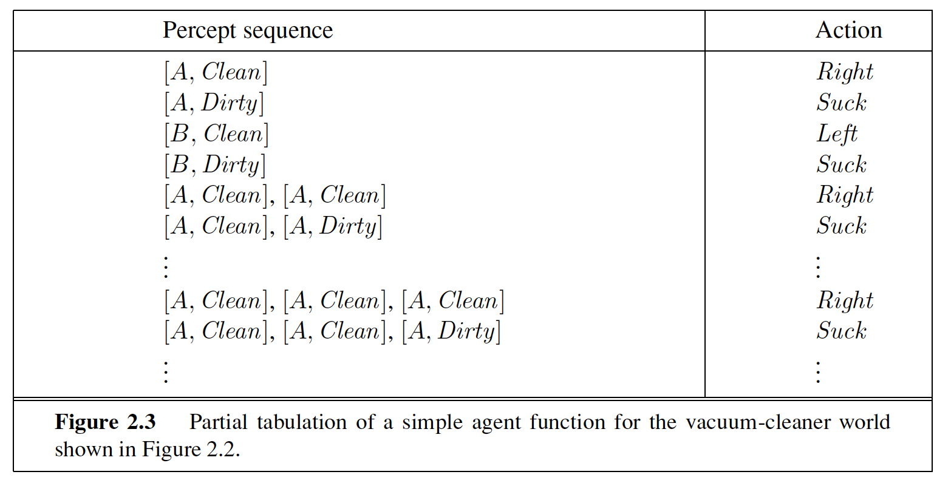
Recall: Vacuum Cleaner World
Notes:
Action sequence of length K, gives 4^K different possible sequences.
At least many entries are needed in the table. So, even in this very toy
world, with K = 20, you need a table with over 4^20 > 10^12 entries.
In more real-world scenarios, one would have many more different
percepts (eg many more locations), e.g., >=100. There will therefore be
100^K different possible sequences of length K. For K = 20, this would
require a table with over 100^20 = 10^40 entries. Infeasible to even store.
So, table lookup formulation is mainly of theoretical interest. For practical
agent systems, we need to find much more compact representations. For
example, logic-based representations, Bayesian net representations,
or neural net style representations, or use a different agent architecture,
e.g., “ignore the past” --- Reflex agents.

Slide 37
Types of Agents
II) --- Simple reflex agents
Agents do not have memory of past world states or percepts.
So, actions depend solely on current percept.
Action becomes a “reflex.”
Uses condition-action rules.

Slide 38
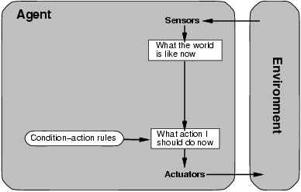
Agent selects actions on the basis of current percept only.
If tail-light of car in front is red, then brake.
Notes:
Closely related to “behaviorism” (psychology; quite
effective in explaining lower-level animal behaviors, such
as the behavior of ants and mice).
The Roomba robot largely behaves like this. Behaviors are robust and
can be quite effective and surprisingly complex.
But, how does complex behavior arise from simple reflex behavior?
E.g. ants colonies and bee hives are quite complex.
Simple rules in a diverse environment can
give rise to surprising complexity.

Slide 39
Types of Agents
III) --- Model-based reflex agents
Key difference (wrt simple reflex agents):
Agents have internal state, which is used to keep track of past states of the world.
Agents have the ability to represent change in the World.

Slide 40
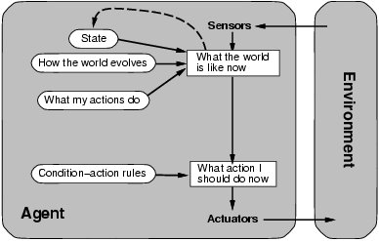
“Infers potentially
dangerous driver
in front.”
If “dangerous driver in front,”
then “keep distance.”

Slide 41
Brooks’ Subsumption Architecture
Main idea: build complex, intelligent robots by decomposing behaviors into a hierarchy of skills, each defining a percept-action cycle for one very specific task.
Examples: collision avoidance, wandering, exploring, recognizing doorways, etc.
Each behavior is modeled by a finite-state machine with a few states (though each state may correspond to a complex function or module;
provides internal state to the agent).
Behaviors are loosely coupled via asynchronous interactions.
Note: minimal internal state representation.
Notes:
In subsumption architecture, increasingly complex behaviors arise from the combination of simple behaviors.
The most basic simple behaviors are on the level of reflexes: • avoid an object; • go toward food if hungry, • move randomly.
A more complex behavior that sits on top of simple behaviors may be “go across the room.”
The more complex behaviors subsume the less
complex ones to accomplish their goal.

Slide 42
Types of Agents
IV) --- Goal-based agents
Key difference wrt Model-Based Agents:
In addition to state information, have goal information that describes desirable situations to be achieved.
Agents of this kind take future events into consideration.
What sequence of actions can I take to achieve certain goals?
Choose actions so as to (eventually) achieve a (given or computed) goal.
→ problem solving and search!

Slide 43
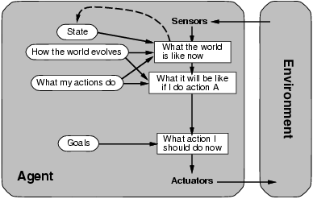
Considers “future”
“Clean kitchen”
Agent keeps track of the world state as well as set of goals it’s trying to achieve: chooses
actions that will (eventually) lead to the goal(s).
More flexible than reflex agents → may involve search and planning

Slide 44
Types of Agents
V) --- Utility-based agents
When there are multiple possible alternatives, how to decide which one is best?
Goals are qualitative: A goal specifies a crude distinction between a happy and unhappy state, but often need a more general performance measure that describes “degree of happiness.”
Utility function U: State → R indicating a measure of success or happiness when at a given state.
Important for making tradeoffs: Allows decisions comparing choice between conflicting goals, and choice between likelihood of success and importance of goal (if achievement is uncertain).
Use decision theoretic models: e.g., faster vs. safer.

Slide 45
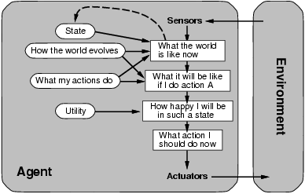
Decision theoretic actions:
e.g. faster vs. safer

Slide 46
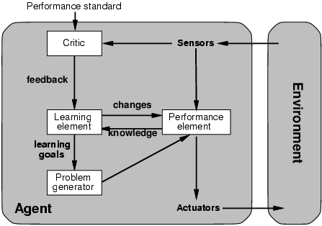
Types of Agents
VI) --- Learning agents: Adapt and improve over time
More complicated when agent needs to learn utility information: Reinforcement learning (based on action payoff)
“Quick turn is not safe”
No quick turn
Road conditions, etc
Takes percepts
and selects actions
Try out the brakes on
different road surfaces

Slide 47
Types of Agents Summary
(1) Table-driven agents
use a percept sequence/action table in memory to find the next action. They are implemented by a (large) lookup table.
(2) Simple reflex agents
are based on condition-action rules, implemented with an appropriate production system. They are stateless devices which do not have memory of past world states.
(3) Agents with memory - Model-based reflex agents
have internal state, which is used to keep track of past states of the world.
(4) Agents with goals – Goal-based agents
are agents that, in addition to state information, have goal information that describes desirable situations. Agents of this kind take future events into consideration.
(5) Utility-based agents
base their decisions on classic axiomatic utility theory in order to act rationally.
(6) Learning agents
they have the ability to improve performance through learning.

Slide 48
Outline
Review of Lecture 2
Agents and Environments
Rational Agents
Intelligent Agents
PEAS: Performance measure, Environment, Actuators, Sensors
Types of Environments
Types of Agents
Conclusions

Slide 49
Conclusions
An agent perceives and acts in an environment, has an architecture, and is implemented by an agent program.
A rational agent always chooses the action which maximizes its expected performance, given its percept sequence so far.
An intelligent agent perceives its environment via sensors and acts rationally upon that environment with its effectors.
An agent program maps from percept to action and updates its internal state.
Reflex agents (simple / model-based) respond immediately to percepts.
Goal-based agents act in order to achieve their goal(s), possible sequence of steps.
Utility-based agents maximize their own utility function.
Learning agents improve their performance through learning.
The most challenging environments are partially observable, stochastic, sequential, dynamic, and continuous, and contain multiple intelligent agents.

Slide 50

Email: xzhang48@kennesaw.edu
Teams: Xinyue Zhang (xzhang48)

