Slide 1
CS 7375 Artificial Intelligence Spring 2022 Instructor: Xinyue Zhang
Lecture 4

Slide 2
Outline
Review of Lecture 3
Tree Structure
Search Problem
Backtracking Algorithm
Conclusions

Slide 3
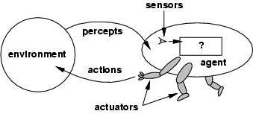
Agents
Definition: An agent perceives its environment via sensors and acts upon that environment through its actuators.
This definition includes:
Robots, humans, and programs.
Machine Vision
Logic Reasoning
Act; Motion

Slide 4
Rational agents
An agent should strive to "do the right thing", based on:
it can perceive and
the actions it can perform.
The right action is the one that will cause the agent to be most successful.
Fixed performance measure evaluates the environment sequence
Earn one point per square cleaned up in time T?
Earn one point per clean square per time step, minus one per move?
Penalize for > k dirty squares?

Slide 5
Rational agents
A rational agent chooses whichever action maximizes the expected value of the performance measure given the percept sequence to date.
Why “expected value”?
Captures actions with stochastic/uncertain effects or actions performed in stochastic environments. We can then look at the expected value of an action.
In high-risk settings, we may also want to limit the worst-case behavior.

Slide 6
Intelligent Agent
Definition:
An intelligent agent perceives its environment via sensors and acts rationally upon that environment with its effectors.
Properties
– autonomous
– reactive to the environment
– pro-active (goal-directed)
– interacts with other agents via the environment

Slide 7
Example: Self-Driving Car
Sensors/Percepts: Video, sonar, speedometer, odometer, engine sensors, keyboard input, microphone, GPS, ...
Actuators/Actions: Steer, accelerate, brake, horn, speak/display, ...
Performance measure/Goals: Maintain safety, reach destination, maximize profits (fuel, tire wear), obey laws, provide passenger comfort, ...
Environment: U.S. urban streets, freeways, traffic, pedestrians, weather, ...
Task Environment:
PEAS: Performance measure, Environment, Actuators, Sensors
In designing an agent, the first step must always be to specify the task environment as fully as possible

Slide 8
Types of Agents Summary
(1) Table-driven agents
use a percept sequence/action table in memory to find the next action. They are implemented by a (large) lookup table.
(2) Simple reflex agents
are based on condition-action rules, implemented with an appropriate production system. They are stateless devices which do not have memory of past world states.
(3) Agents with memory - Model-based reflex agents
have internal state, which is used to keep track of past states of the world.
(4) Agents with goals – Goal-based agents
are agents that, in addition to state information, have goal information that describes desirable situations. Agents of this kind take future events into consideration.
(5) Utility-based agents
base their decisions on classic axiomatic utility theory in order to act rationally.
(6) Learning agents
they have the ability to improve performance through learning.

Slide 9
Warmup Question
A farmer wants to get his cabbage, goat, and wolf across a river. He has a boat that only holds two. He cannot leave the cabbage and goat alone or the goat and wolf alone. How many river crossings does he need?
4
5
6
7
no solution
Notes:
When you solve this problem, try to think about how you did it. You probably simulated the scenario in your head, trying to send the farmer over with the goat and observing the consequences. If nothing got eaten, you might continue with the next action. Otherwise, you undo that move and try something else.
But the point is not for you to be able to solve this one problem manually. The real question is: How can we get a machine to do solve all problems like this automatically? One of the things we need is a systematic approach that considers all the possibilities. We will see that search problems define the possibilities, and search algorithms explore these possibilities.

Slide 10
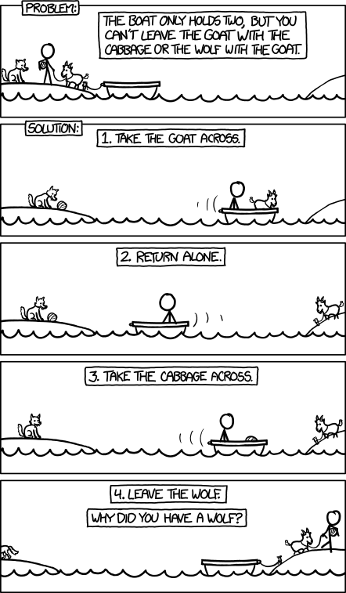

Slide 11
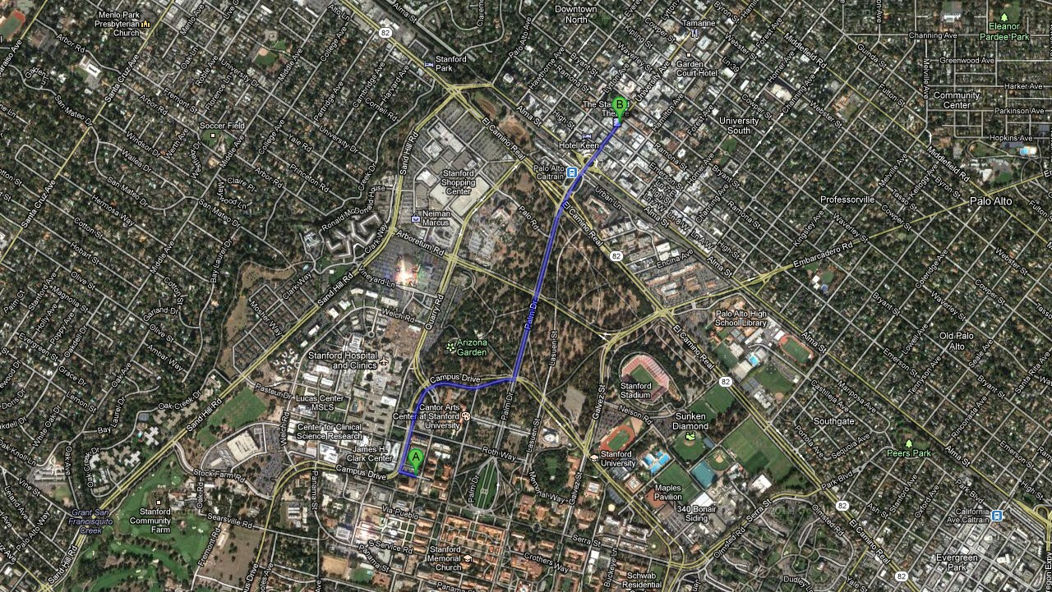
Motivating Examples
Application: route finding
Objective: shortest? fastest? most scenic?
Actions: go straight, turn left, turn right

Slide 12
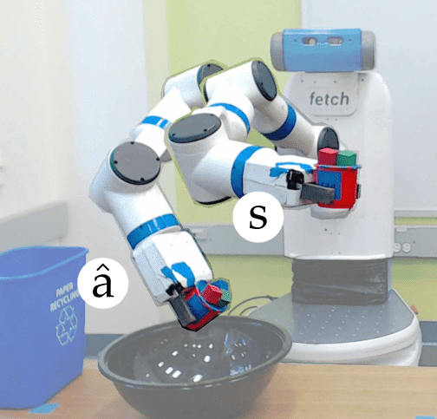
Motivating Examples
Application: robot motion planning
Objective: fastest? most energy efficient? safest? most expressive?
Actions: translate and rotate joints

Slide 13
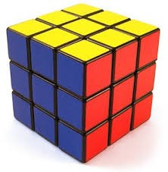
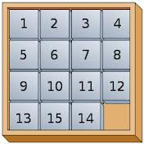
Motivating Examples
Application: solving puzzles
Objective: reach a certain configuration
Actions: move pieces (e.g., Move12Down)

Slide 14
Motivating Examples
Application: machine translation
la maison bleue
the blue house Objective: fluent English and preserves meaning Actions: append single words (e.g., the)

Slide 15
Search Problem
Classifier (reflex-based models):
x
f
single action y ∈ {−1, +1}
Search problem (state-based models):
x
f
action sequence (a₁, a₂, a₃, a₄, . . . )
Key: need to consider future consequences of an action!

Slide 16
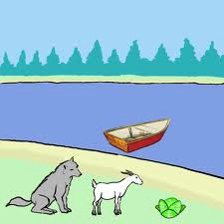
Boat Crossing a River
Farmer, Cabbage, Goat, Wolf
Actions:
F→, F←
FC→, FC←
FG→, FG←
FW→, FW←
Cost: Assume every crossing cost 1.
Approach: build a search tree!

Slide 17
Create a Tree
FCGW ||
Node
FC→: 1
FW→: 1
FG →: 1
GW || FC
CW || FG
CG || FW
F←: 1
FC→: 1
FCW ||G
FW→: 1
W || FCG
C || FGW
F←: 1
FG ←: 1
F←: 1
FG ←: 1
FW || CG
FGW || C
FC || GW
FCG ||W
FW→: 1
FC→: 1
G || FCW
G || FCW
F←: 1
F←: 1
FG || CW
FG || CW
FG →: 1
FG →: 1
|| FCGW
|| FCGW

Slide 18
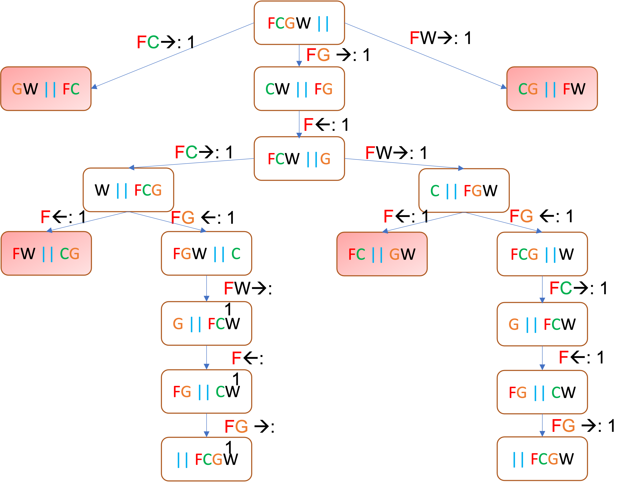

Search Problem
Definition: search problem
s_{start}: starting state
Actions(s): possible actions
Cost(s, a): action cost
Succ(s, a): successor
IsEnd(s): reached end state?
1
1
1

Slide 19
Tree Search Algorithm
Basic idea:
offline, simulated exploration of state space
by generating successors of already-explored states (a.k.a. expanding states)
function Tree-Search( problem, strategy) returns a solution, or failure
initialize the search tree using the initial state of problem
loop do
if there are no candidates for expansion then return failure
choose a leaf node for expansion according to strategy
if the node contains a goal state then return the corresponding solution
else expand the node and add the resulting nodes to the search tree
end

Slide 20

Transportation Example
Street with blocks numbered 1 to n.
Walking from s to s +1 takes 1 minute.
Taking a magic tram from s to 2s takes 2 minutes.
How to travel from 1 to n in the least time?
1
2
3
4
5
6
7
8
…
1 minute
2 minutes
*Code available on D2L

Slide 21
Transportation Example
How to travel from 1 to 3 in the least time?
Walk from 1 to 2, 1 minute.
Walk from 2 to 3, 1 minute.
Total cost: 2 minutes.
1
2
3
4
5
6
7
8
…
1 minute
2 minutes
*Code available on D2L

Slide 22
Transportation Example
How to travel from 1 to 8 in the least time?
Walk from 1 to 2, 1 minute.
Tram from 2 to 4, 2 minutes.
Tram from 4 to 8, 2 minutes.
Total cost: 5 minutes.
1
2
3
4
5
6
7
8
…
1 minute
2 minutes
*Code available on D2L

Slide 23
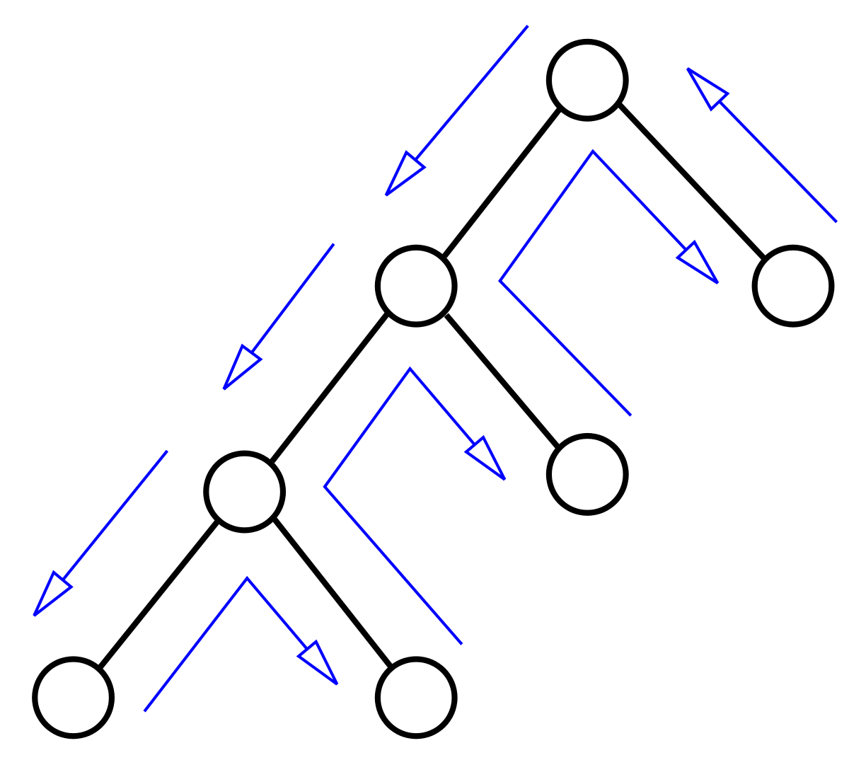
Backtracking Search
The backtracking algorithm uses a brute force approach for finding the desired output.
If b actions per state, maximum depth is D actions:
Memory: O(D) (small)
Time: O(b^{D} ) (huge)
E.g. [2⁵⁰ = 1125899906842624]

Slide 24
Backtracking Search
def backtrackingSearch(s, path):
If IsEnd(s): update minimum cost path For each action a ∈ Actions(s):
Extend path with Succ(s, a) and Cost(s, a) Call backtrackingSearch(Succ(s, a), path)
Return minimum cost path

Slide 25
Conclusions
Tree Structure
Boat crossing a rive problem
Search Problem
Transportation problem
Backtracking Search Algorithm
Code is available on D2L.

Slide 26

Email: xzhang48@kennesaw.edu
Teams: Xinyue Zhang (xzhang48)

