Slide 1
CS 7375 Artificial Intelligence Spring 2022 Instructor: Xinyue Zhang
Lecture 6

Slide 2
Outline
Project Guidelines (D2L)
Review of Lecture 5
Backtracking Algorithm
Depth-first search (DFS)
Breadth-first search (BFS)
Depth-limited search
Iterative deepening depth-first search
Dynamic Programming (DP)
Conclusions

Slide 3

Transportation Example
Street with blocks numbered 1 to n.
Walking from s to s +1 takes 1 minute.
Taking a magic tram from s to 2s takes 2 minutes.
How to travel from 1 to n in the least time?
1
2
3
4
5
6
7
8
…
1 minute
2 minutes
*Code available on D2L

Slide 4
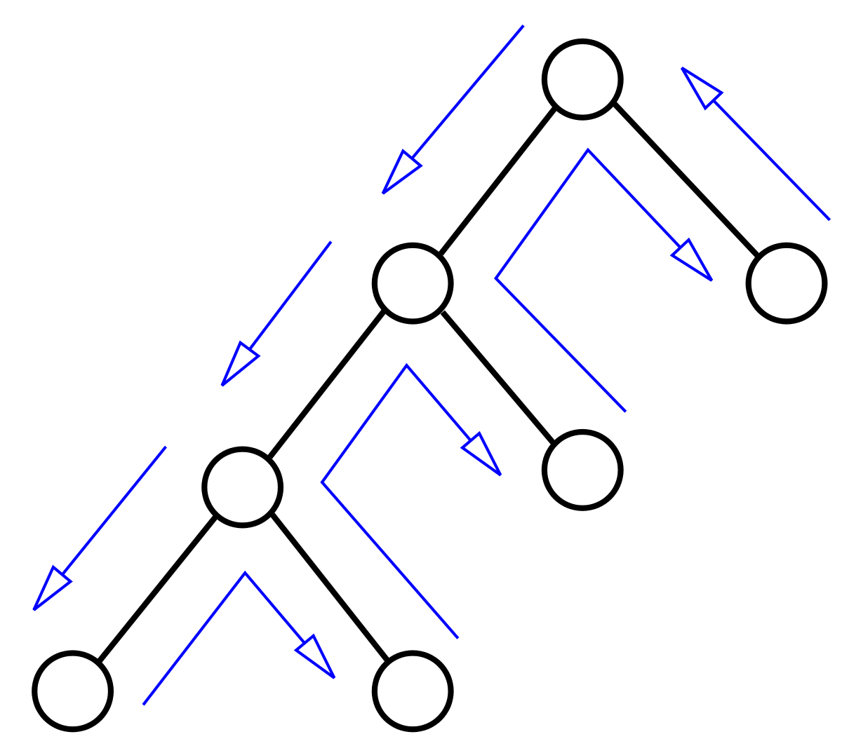
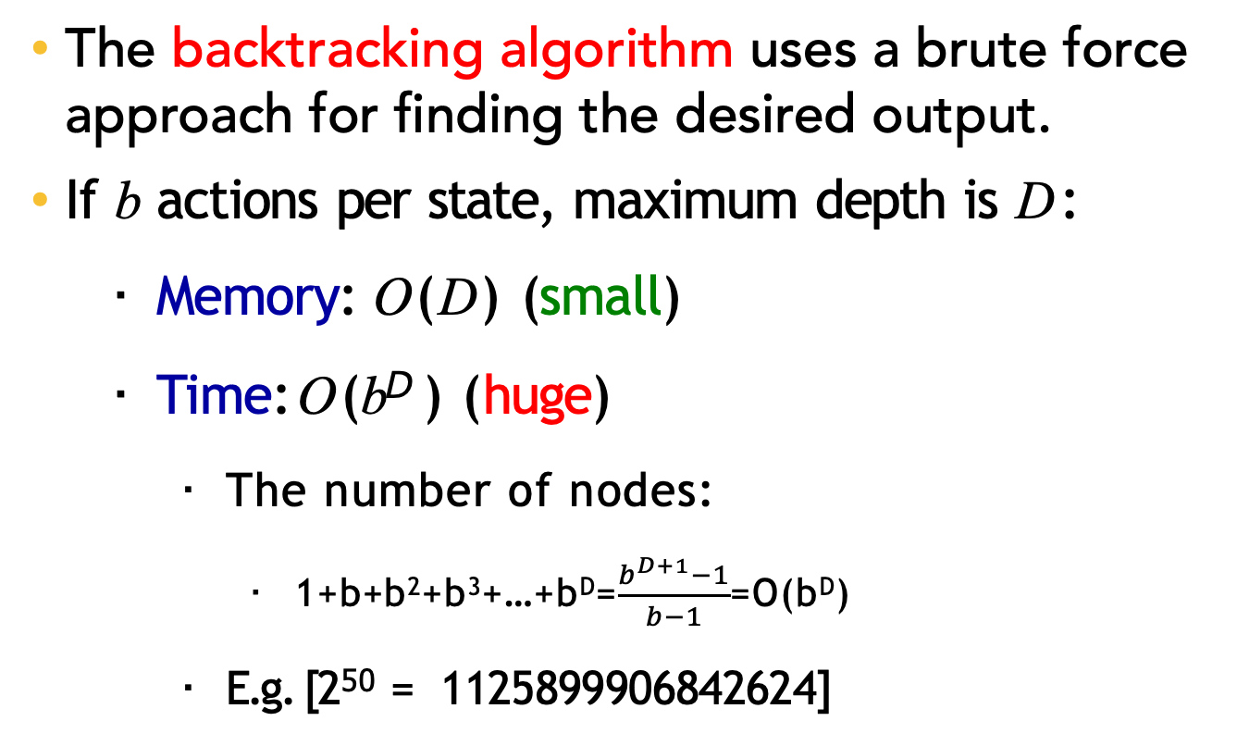
Backtracking Search
The backtracking algorithm uses a brute force approach for finding the desired output.
If b actions per state, maximum depth is D:
Memory: O(D) (small)
Time: O(b^{D} ) (huge)
The number of nodes:
1+b+b²+b³+…+b^{D}=$\frac{b^{D+1}−1}{b−1}$=O(b^{D})
E.g. [2⁵⁰ = 1125899906842624]

Slide 5
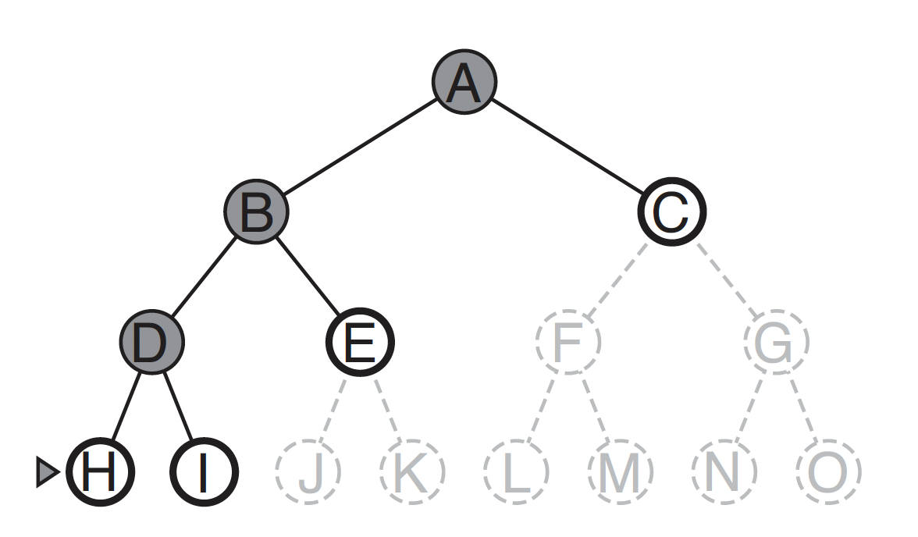
Depth-first search (DFS)
Depth-first search always expands the deepest node in the current frontier of the search tree.

Slide 6

Depth-first search (DFS)
Assumption: zero action costs
Assume action costs Cost(s, a) = 0.
Idea: Backtracking search + stop when find the first end state. If b actions per state, maximum depth is D:
Space: still O(D)
Time: still O(b^{D} ) worst case, but could be much better if solutions are easy to find

Slide 7
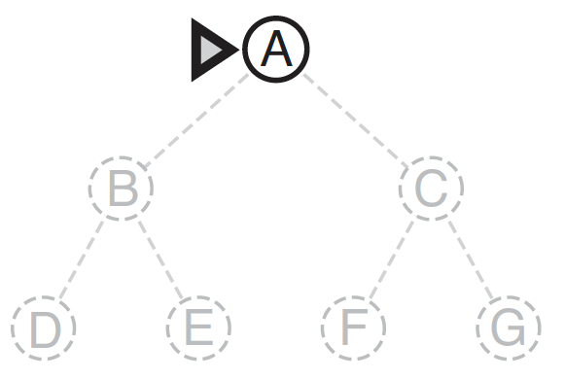
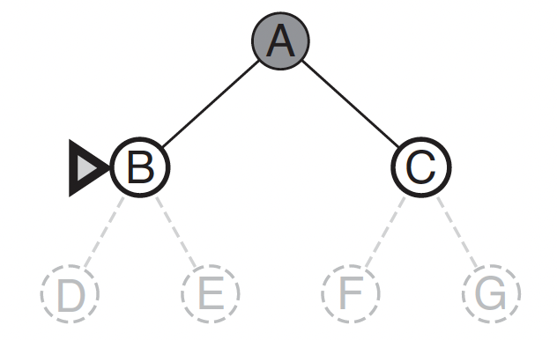
Breadth-first search (BFS)
Breadth-first search is a simple strategy in which the root node is expanded first, then all the successors of the root node are expanded next, then their successors, and so on.

Slide 8
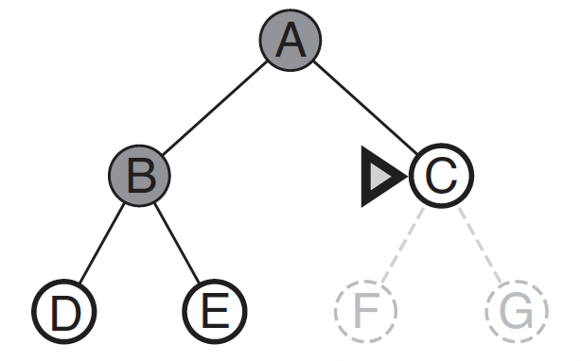
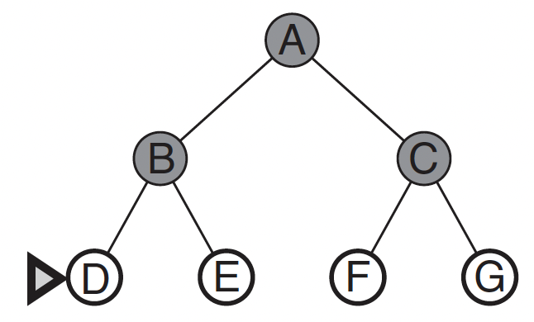
Breadth-first search (BFS)
Breadth-first search is a simple strategy in which the root node is expanded first, then all the successors of the root node are expanded next, then their successors, and so on.

Slide 9
Breadth-first search (BFS)
Assumption: constant/nondecreasing
action costs
E.g. Assume action costs Cost(s, a) = c for some c ≥ 0.
Idea: explore all nodes in order of increasing depth.
Legend: b actions per state, solution is at the depth d
Space: now O(b^{d}) (a lot worse!)
Time: O(b^{d}) (better, depends on d, not D)

Slide 10
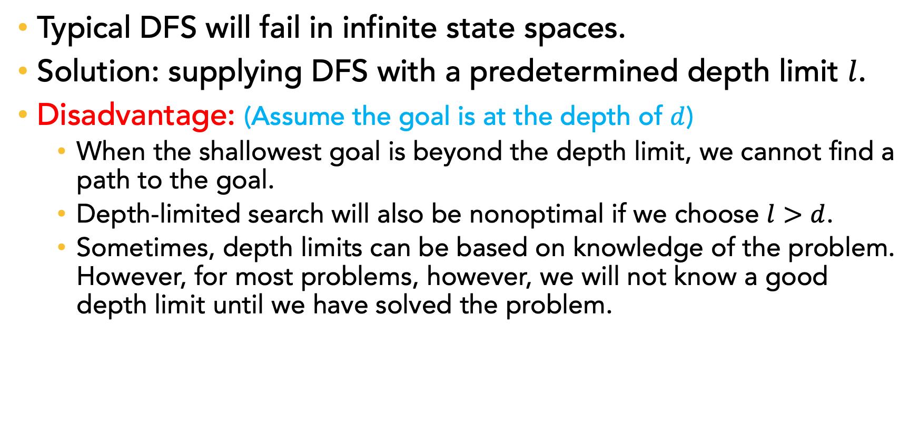
Depth-limited search
Typical DFS will fail in infinite state spaces.
Solution: supplying DFS with a predetermined depth limit $l$.
Disadvantage: (Assume the goal is at the depth of $d$)
When the shallowest goal is beyond the depth limit, we cannot find a path to the goal.
Depth-limited search will also be nonoptimal if we choose $l>d$.
Sometimes, depth limits can be based on knowledge of the problem. However, for most problems, however, we will not know a good depth limit until we have solved the problem.

Slide 11
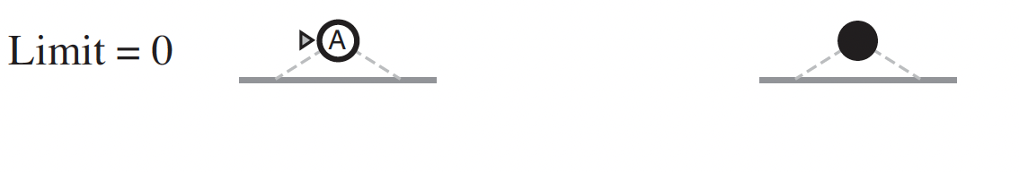
Iterative deepening depth-first search
Iterative deepening search (or iterative deepening DFS) is a general strategy, that finds the best depth limit.
It does this by gradually increasing the limit—first 0, then 1, then 2, and so on—until a goal is found.

Slide 12
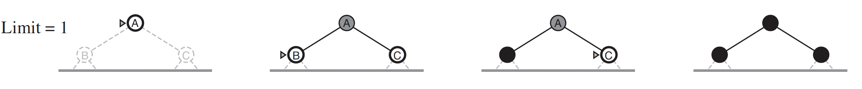
Iterative deepening depth-first search
Iterative deepening search (or iterative deepening DFS) is a general strategy, that finds the best depth limit.
It does this by gradually increasing the limit—first 0, then 1, then 2, and so on—until a goal is found.

Slide 13
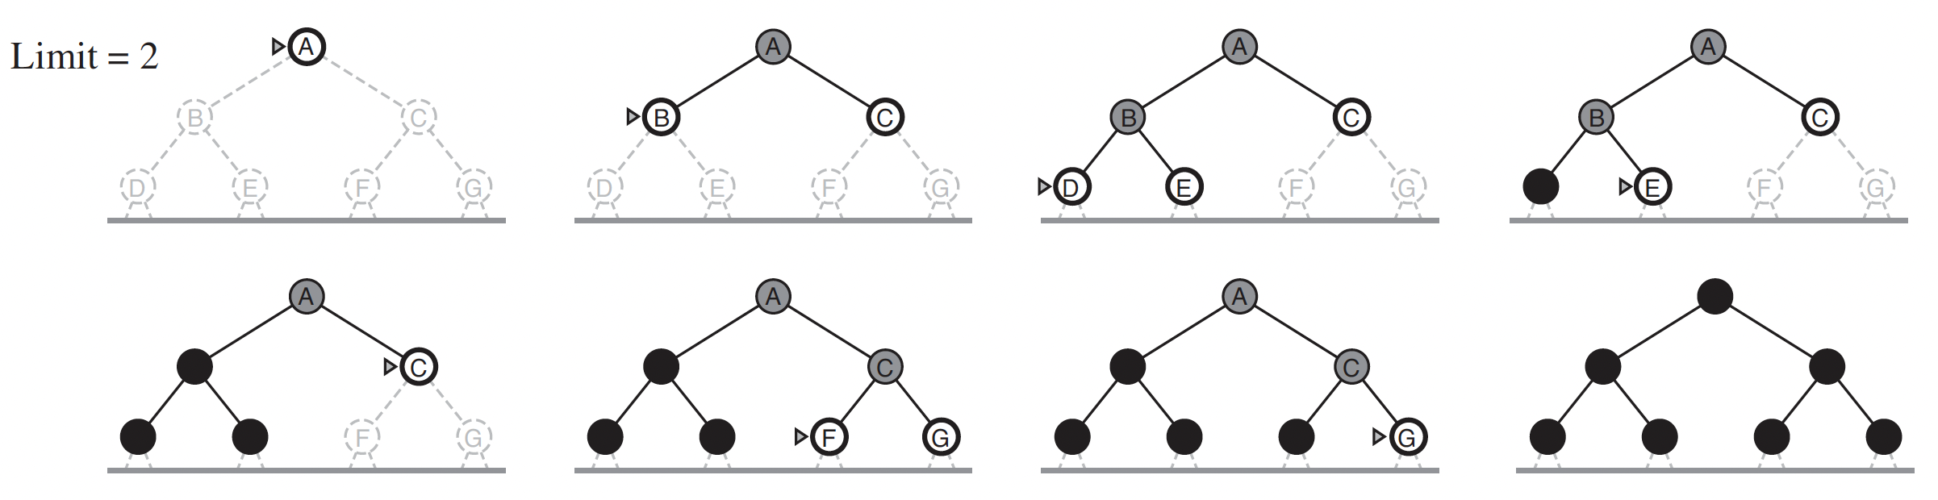
Iterative deepening depth-first search
Iterative deepening search (or iterative deepening DFS) is a general strategy, that finds the best depth limit.
It does this by gradually increasing the limit—first 0, then 1, then 2, and so on—until a goal is found.

Slide 14
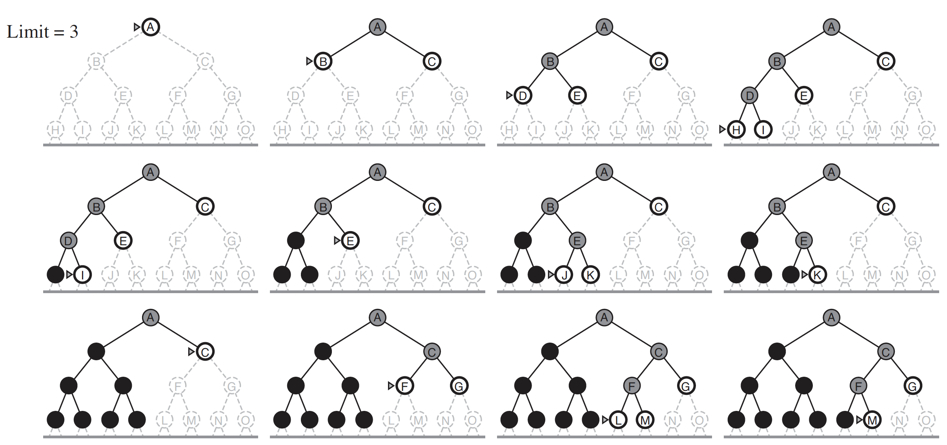
Iterative deepening depth-first search

Slide 15
Iterative deepening depth-first search
Assumption: constant/nondecreasing action costs
Assume action costs Cost(s, a) = c for some c ≥ 0.
Idea:
Modify DFS to stop at a maximum depth.
Call DFS for maximum depths 1, 2, . . . .
DFS on d asks: is there a solution with d actions?
Legend: b actions per state, solution size d
Space: O(d) (saved!)
Time: O(b^{d}) (same as BFS)

Slide 16
Tree search algorithms summary
Legend: b actions/state, solution depth d, maximum depth D
Algorithm | Action costs | Space complexity | Time complexity
Backtracking | any | O(D) | O(b^{D})
DFS | zero | O(D) | O(b^{D}) worst case
BFS | Constant ≥0 | O(b^{d}) | O(b^{d})
Iterative deepening DFS | Constant ≥0 | O(d) | O(b^{d})
Always exponential time!!! How to avoid it?

Slide 17
Dynamic Programming
Current State s
Objective: Minimum cost path from state s to the end state:
Cost(s, a)
Successor State s’
FutureCost(s’)
End State
0, if the current state is the end state, IsEnd(s).
FutureCost(s) =
min_{a∈Actions(s)}[Cost(s, a) + FutureCost(Succ(s, a))], Otherwise

Slide 18
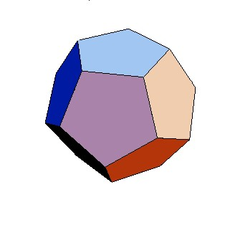
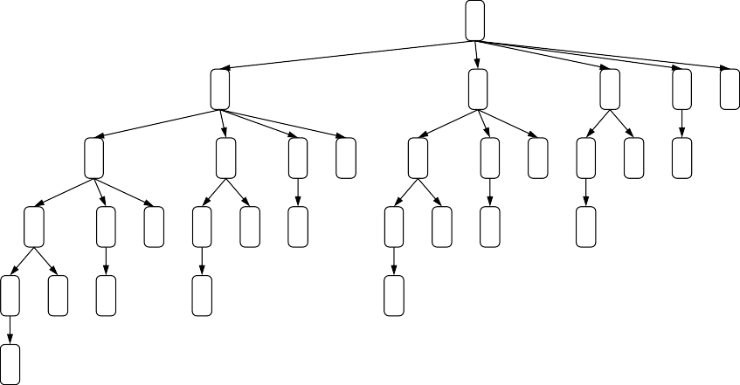
Motivating task
Example: route finding
Find the minimum cost path from city 1 to city n, only moving forward. It costs c_{ij} to go from i to j.
1
2
3
4
5
6 7
3
4
5
6 7
4
5
6 7
5
6 7 6 7 7
4
5
6 7
5
6 7 6 7 7
5
6 7 6 7 7
6 7 7
7
5 |  | 6 | 7 | 6 | 7 | 7 | 6 | 7 | 7 | 7 | 6 | 7 | 7 | 7 | 7
6 | 7 | 7 |  | 7 |  |  | 7 |  |  |  | 7
7
Observation: future costs only depend on current city

Slide 19
Dynamic Programming
State: current city
4
3
5
2
6
1
7
Exponential saving in time and space!

Slide 20

Dynamic Programming
Algorithm: dynamic programming
def DynamicProgramming(s):
If already computed for s, return cached answer.
If IsEnd(s): return solution
For each action a ∈ Actions(s): ...
Assumption: acyclicity
The state graph defined by Actions(s) and Succ(s, a) is acyclic.
Code is available on D2L.

Slide 21

Dynamic Programming
Key idea: state
A state is a summary of all the past actions sufficient to choose future actions optimally.
past actions (all cities) state (current city)
1 3 4 6
1 3 4 6

Slide 22
Handling additional constraints
Example: route finding
Find the minimum cost path from city 1 to city n, only moving forward. It costs c_{ij} to go from i to j.
Constraint: Can’t visit three odd cities in a row.
How to define a state in this example?
First Choice:
State: (previous city, current city)
The size of the state:
|S| = n²

Slide 23
Handling additional constraints
Example: route finding
Find the minimum cost path from city 1 to city n, only moving forward. It costs c_{ij} to go from i to j.
Constraint: Can’t visit three odd cities in a row.
How to define a state in this example?
Second Choice:
State: (whether previous city is odd, current city)
The size of the state:
|S| = 2n
The second choice is much better!!
n/a, 1
3:c₁₃
4:c₁₄
odd, 3
7:c₃₇ 4:c₃₄
odd, 7 odd, 4
odd, 4
5:c₄₅
even, 5

Slide 24
Handling additional constraints
Example Question 1:
Objective: travel from city 1 to city n, visiting at least 3 odd cities.
How to define the state?
What is the minimal size of the state?
Options:
(# of odd cities, current city)
Size: n²/2
(min(number of odd cities visited, 3), current city)
Size: 3n
This can reduce from O(n²) to O(n).

Slide 25
State graph
State: (min(number of odd cities visited, 3), current city)
1,3 1,4
2,3 2,4
1,2
1,5
3,4
3,3
2,2
2,5
3,2
3,5
1,1
1,6
2,1
2,6
3,1
3,6

Slide 26
Handling additional constraints
Example Question 2:
Objective: travel from city 1 to city n, visiting more odd cities than even cities.
How to define the state?
What is the minimal size of the state?
Options:
(# of odd cities, # of even cities, current city)
Size: n/2 * n/2 * n = n³/4
(n₁−n₂, current city), where n₁ is the number of odd cities visited so far and n₂ is the number of even cities visited so far.
Size: n²/2

Slide 27
Dynamic Programming Summary
State: summary of past actions sufficient to choose future actions optimally
Dynamic programming: backtracking search with memorization
— potentially exponential savings

Slide 28
Conclusions
Understand and be able to implement the following search algorithms
Backtracking Search Algorithm
Depth-first search (DFS)
Breadth-first search (BFS)
Depth-limited search
Iterative deepening depth-first search
Dynamic Programming (DP)
Code is available on D2L

Slide 29

Email: xzhang48@kennesaw.edu
Teams: Xinyue Zhang (xzhang48)

