Slide 1
CS 7375 Artificial Intelligence Spring 2022 Instructor: Xinyue Zhang
Lecture 7

Slide 2
Outline
Review of Lecture 6
Dynamic Programming (DP)
Uniform-cost Search
8 Puzzle Problem
Conclusions

Slide 3

Transportation Example
Street with blocks numbered 1 to n.
Walking from s to s +1 takes 1 minute.
Taking a magic tram from s to 2s takes 2 minutes.
How to travel from 1 to n in the least time?
1
2
3
4
5
6
7
8
…
1 minute
2 minutes
*Code available on D2L

Slide 4
Tree search algorithms summary
Legend: b actions/state, solution depth d, maximum depth D
Algorithm | Action costs | Space complexity | Time complexity
Backtracking | any | O(D) | O(b^{D})
DFS | zero | O(D) | O(b^{D}) worst case
BFS | Constant ≥0 | O(b^{d}) | O(b^{d})
Iterative deepening DFS | Constant ≥0 | O(d) | O(b^{d})

Slide 5
Dynamic Programming
Current State s
Objective: Minimum cost path from state s to the end state:
Cost(s, a)
Successor State s’
FutureCost(s’)
End State
0, if the current state is the end state, IsEnd(s).
FutureCost(s) =
min_{a∈Actions(s)}[Cost(s, a) + FutureCost(Succ(s, a))], Otherwise

Slide 6


Dynamic Programming
Algorithm: dynamic programming
def DynamicProgramming(s):
If already computed for s, return cached answer.
If IsEnd(s): return solution
For each action a ∈ Actions(s): ...
Assumption: acyclicity
The state graph defined by Actions(s) and Succ(s, a) is acyclic.
Code is available on D2L.

Slide 7
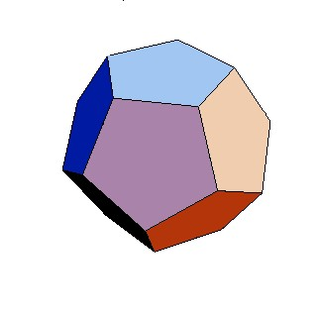
Handling additional constraints
Example: route finding
Find the minimum cost path from city 1 to city n, only moving forward. It costs c_{ij} to go from i to j.
Constraint: Can’t visit three odd cities in a row.
How to define a state in this example?
First Choice:
State: (previous city, current city)
The size of the state:
|S| = n²

Slide 8
Outline
Review of Lecture 6
Dynamic Programming (DP)
Uniform-cost Search
8 Puzzle Problem
Conclusions

Slide 9
Ordering the states
Observation: prefixes of optimal path are optimal
Key: if graph is acyclic, dynamic programming makes sure we compute PastCost(s) before PastCost(s’)
If graph is cyclic, then we need another mechanism to order states...
PastCost(s)
Cost(s, a)
s
_{s’}
sstart

Slide 10

Uniform cost search (UCS)
Expand least-cost unexpanded node
This is done by storing the frontier as a priority queue ordered by path cost.
Key idea: state ordering
UCS enumerates states in order of increasing past cost.
Assumption: non-negativity
All action costs are non-negative: Cost(s, a) ≥ 0.

Slide 11
High-level strategy
Frontier
Explored
Unexplored
Explored: states we’ve found the optimal path to
Frontier: states we’ve seen, still figuring out how to get there
cheaply
Unexplored: states we haven’t seen

Slide 12
Uniform cost search example
Example: UCS example
B
A D
C
Start state: A, end state: D
Unexplored | Frontier | Explored
A | A, 0 | A, 0
B | B, 1 | B, 1
C | C, 100 2 | C, 2
D | D, 101 3 | D, 3
1
100
1
100
1
What is the minimum cost path from A to D?
Minimum cost path:
A → B → C → D with cost 3

Slide 13
Uniform cost search (UCS)
Example: UCS example
B
A D
C
Start state: A, end state: D
Algorithm: uniform cost search [Dijkstra, 1956]
Add s_{start} to frontier (priority queue) Repeat until frontier is empty:
Remove s with smallest priority p from frontier If IsEnd(s): return solution
Add s to explored
For each action a ∈ Actions(s): Get successor s' ← Succ(s, a)
If s' already in explored: continue
Update frontier with s' and priority p + Cost(s, a)
1
100
1
100
1
Unexplored | Frontier | Explored
A | A, 0 | A, 0
B | B, 1 | B, 1
C | C, 100 2 | C, 2
D | D, 101 3 | D, 3
Priority of p is defined as the minimum cost to the state of p.

Slide 14

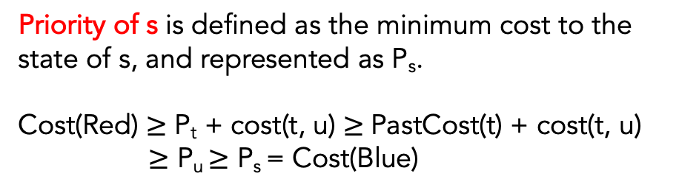
Analysis of uniform cost search
Theorem: correctness
When a state s is popped from the frontier and moved to explored, its priority is PastCost(s), the minimum cost to s.
Proof: The cost of the red line is always greater than the blue line.
Explored
Priority of s is defined as the minimum cost to the state of s, and represented as P_{s}.
Cost(Red) $≥$ P_{t} + cost(t, u) $≥$PastCost(t) + cost(t, u)
$≥$ P_{u} $≥$ P_{s} = Cost(Blue)
sstart
s
t u

Slide 15
DP versus UCS
N total states, n of which are closer than end state
Note: UCS potentially explores fewer states, but requires more overhead to maintain the priority queue
Note: assume number of actions per state is constant (independent of n and N )
Algorithm | Cycles? | Action costs | Time/space
DP | no | any | O(N )
UCS | yes | ≥ 0 | O(n log n)

Slide 16
Uninformed Search Strategies
Uninformed strategies use only the information available in the problem definition
Breadth-first search
Uniform-cost search
Depth-first search
Depth-limited search
Iterative deepening search

Slide 17
Outline
Review of Lecture 6
Dynamic Programming (DP)
Uniform-cost Search
8 Puzzle Problem
Conclusions

Slide 18
8 Puzzle Problem
In Assignment 1
DUE DATE: Sunday 2/13 11:59pm
Use DFS, BFS, UCS to solve the problem
Submit TWO files:
Written report: pdf file
Source code
Your code should be well-commented to show your understanding.

Slide 19
8 Puzzle Problem: BFS
Initial State
1 | 4 | 3
7 | BK | 6
5 | 8 | 2
1 | 2 | 3
8 | BK | 4
7 | 6 | 5
Goal
Try to generate a state space of the 8-puzzle by using “move blank” operations.
State: The current puzzle board.
4 actions: Move the blank tile DOWN, UP, RIGHT, or LEFT.
Cost: Each move will cost 1.

Slide 20
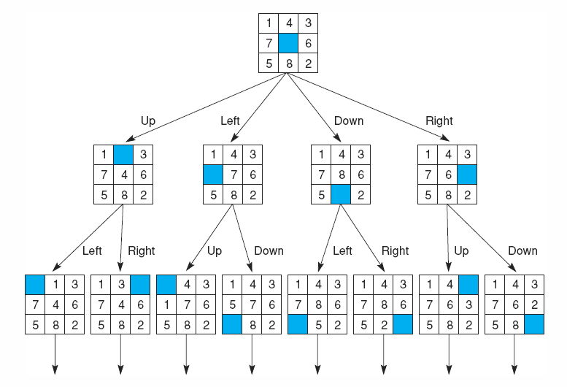

Slide 21
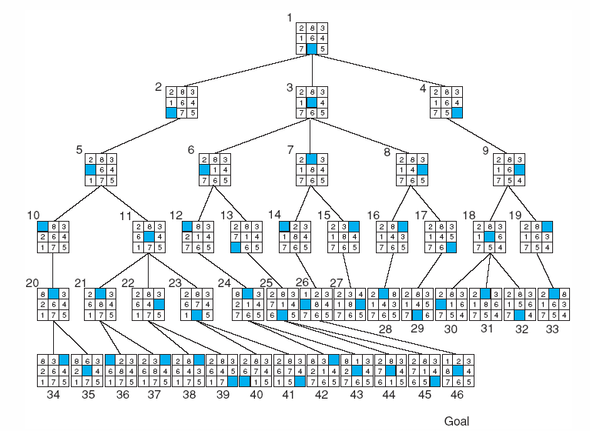
BFS of the 8-puzzle

Slide 22
8 Puzzle Problem: DFS Example
Initial State
2 | 8 | 3
1 | 6 | 4
7 | BK | 5
1 | 2 | 3
8 | BK | 4
7 | 6 | 5
Goal
Try to generate a state space of the 8-puzzle by using “move blank” operations.
State: The current puzzle board.
4 actions: Move the blank tile DOWN, UP, RIGHT, or LEFT.
Cost: Each move will cost 1.

Slide 23
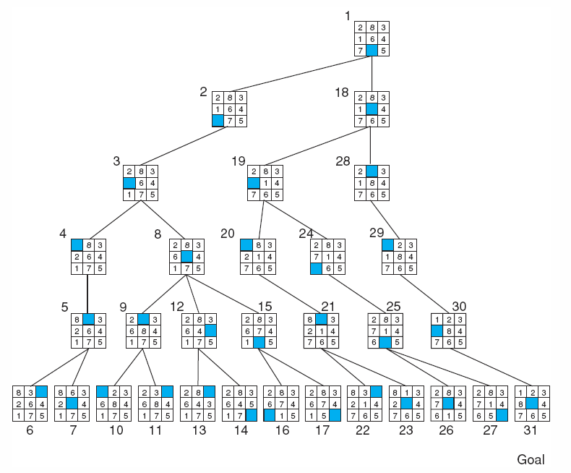
DFS of the 8-puzzle
It is better to set a depth limit.

Slide 24
Conclusions
Understand and be able to implement the following search algorithms
Uniformed-Cost Search
Uninformed Search Strategies
8-Puzzle Problem Hints
Code is available on D2L

Slide 25

Email: xzhang48@kennesaw.edu
Teams: Xinyue Zhang (xzhang48)

