Slide 1
CS 7375 Artificial Intelligence Spring 2022 Instructor: Xinyue Zhang
Lecture 8

Slide 2
Outline
Review of Lecture 7
Uninformed Search
Informed (Heuristic) Search
Greedy best-first Search
A* Search
Relaxation
Conclusions

Slide 3

Transportation Example
Street with blocks numbered 1 to n.
Walking from s to s +1 takes 1 minute.
Taking a magic tram from s to 2s takes 2 minutes.
How to travel from 1 to n in the least time?
1
2
3
4
5
6
7
8
…
1 minute
2 minutes
*Code available on D2L

Slide 4
Tree search algorithms summary
Legend: b actions/state, solution depth d, maximum depth D
Algorithm | Action costs | Space complexity | Time complexity
Backtracking | any | O(D) | O(b^{D})
DFS | zero | O(D) | O(b^{D}) worst case
BFS | Constant ≥0 | O(b^{d}) | O(b^{d})
Iterative deepening DFS | Constant ≥0 | O(d) | O(b^{d})

Slide 5


Uniform cost search (UCS)
Expand least-cost unexpanded node
This is done by storing the frontier as a priority queue ordered by path cost.
Key idea: state ordering
UCS enumerates states in order of increasing past cost.
Assumption: non-negativity
All action costs are non-negative: Cost(s, a) ≥ 0.

Slide 6
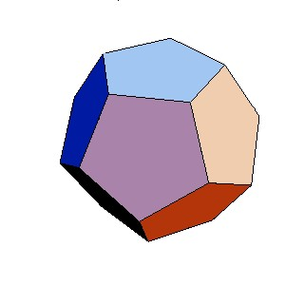

Uniform cost search (UCS)
Example: UCS example
B
A D
C
Start state: A, end state: D
Algorithm: uniform cost search [Dijkstra, 1956]
Add s_{start} to frontier (priority queue) Repeat until frontier is empty:
Remove s with smallest priority p from frontier If IsEnd(s): return solution
Add s to explored
For each action a ∈ Actions(s): Get successor s' ← Succ(s, a)
If s' already in explored: continue
Update frontier with s' and priority p + Cost(s, a)
1
100
1
100
1
Unexplored | Frontier | Explored
A | A, 0 | A, 0
B | B, 1 | B, 1
C | C, 100 2 | C, 2
D | D, 101 3 | D, 3
Priority of p is defined as the minimum cost to the state of p.

Slide 7
DP versus UCS
N total states, n of which are closer than end state
Note: UCS potentially explores fewer states, but requires more overhead to maintain the priority queue
Note: assume number of actions per state is constant (independent of n and N )
Algorithm | Cycles? | Action costs | Time/space
DP | no | any | O(N )
UCS | yes | ≥ 0 | O(n log n)

Slide 8
Outline
Review of Lecture 7
Uninformed Search
Informed (Heuristic) Search
Greedy best-first Search
A* Search
Relaxation
Conclusions

Slide 9
Informed (Heuristic) Search Strategies
Informed Search – a strategy that uses problem-specific knowledge beyond the definition of the problem itself.
Efficient
Evaluation function f(n)
f(n) = evaluation function to select a node for expansion (usually the lowest cost node).
Heuristic function h(n)
h(n) = estimated cost of the cheapest path from the state at node n to a goal state.
If n is a goal node, then h(n)=0.

Slide 10
Best-first search
Idea: use an evaluation function f(n) for each node
f(n) provides an estimate for the total cost.
Expand the node n with smallest f(n).
Implementation:
Order the nodes in the frontier increasing order of cost.
Special cases:
– Greedy best-first search
– A* search

Slide 11
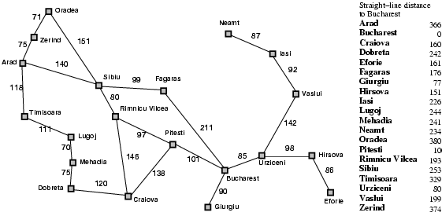
Greedy best-first search (GBFS)
Expand the node that is closest to the goal,
The node is likely to lead to a solution quickly.
Evaluation function f(n) = h(n) (heuristic), the estimate of cost from n to goal.
Route in Romania

Slide 12
Greedy best-first search (GBFS)
In the previous example, We use the straight-line distance heuristic:
h(n) = straight-line distance from n to Bucharest.
Note that the heuristic values cannot be computed from the problem description itself!
In addition, we require extrinsic knowledge to understand that h(n) in this example is correlated with the actual road distances, making it a useful heuristic.

Slide 13

Greedy best-first search example
Find a path from Arad to Bucharest.

Slide 14
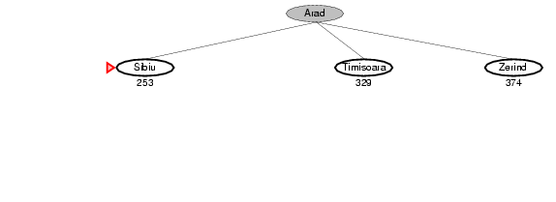
Greedy best-first search example
Find a path from Arad to Bucharest.

Slide 15
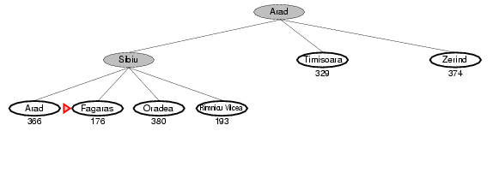
Greedy best-first search example
Find a path from Arad to Bucharest.

Slide 16
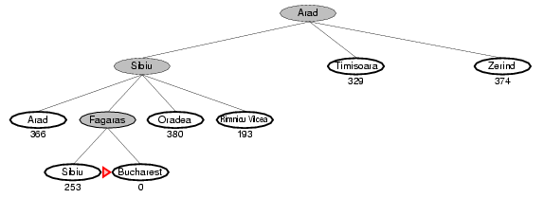
Greedy best-first search example
Find a path from Arad to Bucharest.

Slide 17
Greedy best-first search
In GBFS, with the heuristic h(n) defined before, the search will get stuck in the loops of a-b-c.
d
c
b
g
a
goal state
start state
h(n) = straight-line distance

Slide 18
Properties of greedy best-first search
Complete? No – can get stuck in loops.
Time? O(b^{m}), but a good heuristic can give dramatic improvement.
Space? O(b^{m}) - keeps all nodes in memory.
Optimal? No
e.g. Arad→Sibiu→Rimnicu Virea→Pitesti→Bucharest is shorter!

Slide 19
Outline
Review of Lecture 7
Uninformed Search
Informed (Heuristic) Search
Greedy best-first Search
A* Search
Relaxation
Conclusions

Slide 20
A* Search
Idea: avoid expanding paths that are already expensive (In Best-First Search, we do not have path cost information)
Evaluation function f(n) = g(n) + h(n)
g(n) = cost so far to reach n
h(n) = estimated cost from n to goal
f(n) = estimated total cost of path through n to goal
Uniform Cost search has f(n)=g(n)
Greedy Best-First search has f(n)=h(n)

Slide 21
A* Search
A* search algorithm is a best-first search algorithm that aims at minimizing the total cost along a path from start to goal.
f(n) = g(n) + h(n)
estimate of cost to reach goal from n
estimate of total cost along path through n
actual cost to reach n

Slide 22

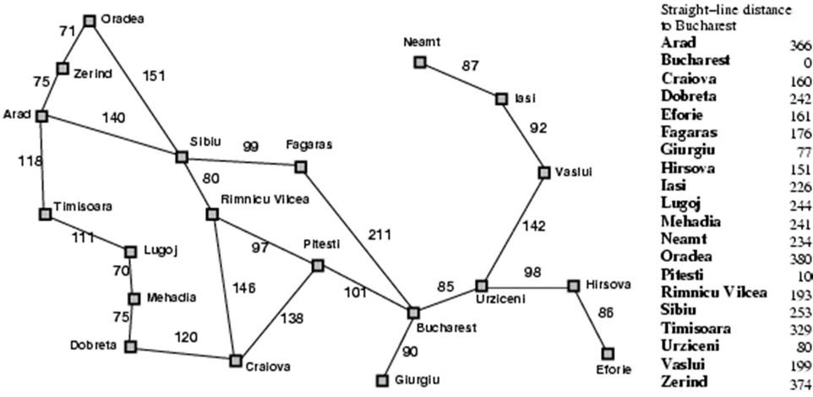
A* Search Example
f(n)=g(n)+h(n)

Slide 23
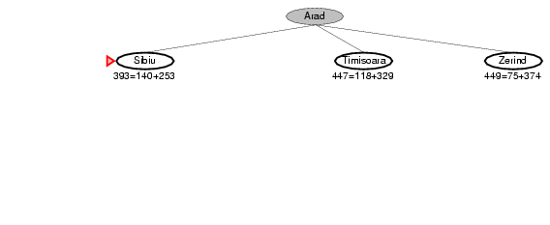
A* Search Example

Slide 24
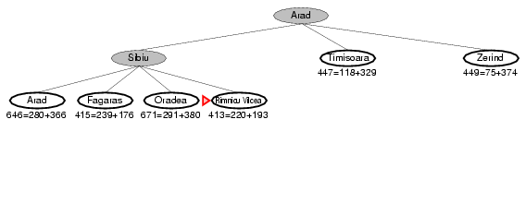
A* Search Example

Slide 25
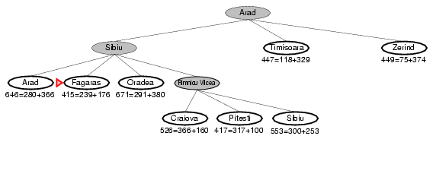
A* Search Example

Slide 26
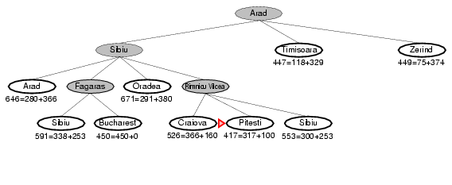
A* Search Example

Slide 27
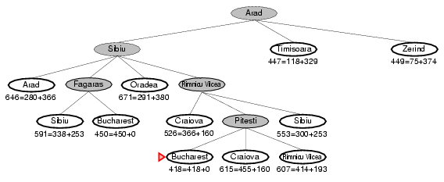
A* Search Example

Slide 28
Admissible heuristics
A heuristic h(n) is admissible if for every node n, h(n) ≤h*(n), where h*(n) is the true cost to reach the goal state from n.
An admissible heuristic never overestimates the cost to reach the goal, i.e., it is optimistic.
Example: h_{SLD}(n) (never overestimates the actual road distance)
Theorem: If h(n) is admissible, A* in TREE-SEARCH is optimal.

Slide 29
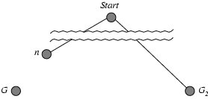
Optimality of A* (proof)
Suppose some suboptimal goal G₂ has been generated and is in the frontier. Let n be an unexpanded node in the frontier such that n is on a shortest path to an optimal goal G.
f(G₂) = g(G₂)
g(G₂) > g(G)
f(G) = g(G)
f(G₂) > f(G)
since h(G₂) = 0
since G₂ is suboptimal
since h(G) = 0 from above

Slide 30
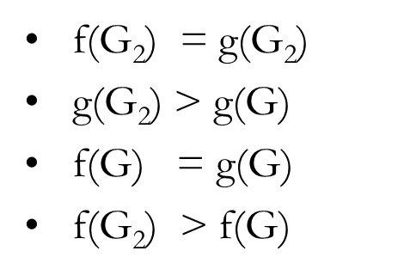
Optimality of A* (proof)
Suppose some suboptimal goal G₂ has been generated and is in the frontier. Let n be an unexpanded node in the frontier such that n is on a shortest path to an optimal goal G.
f(G₂) > f(G)
h(n) ≤ h*(n)
(from above)
(since h is admissible)
-> g(n) + h(n) ≤ g(n) + h*(n)
f(n) ≤ g(n) + h*(n) < f(G) < f(G₂)
Hence f(G₂) > f(n), and A* will never select G₂ for expansion.

Slide 31
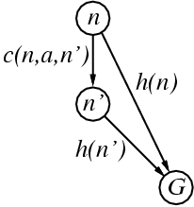
Consistent Heuristics
A heuristic is consistent (or monotonic) if for every node n, every successor n' of n generated by any action a:
h(n) ≤ c(n,a,n') + h(n’)
If h is consistent, we have:
i.e., f(n) is non-decreasing along any path.
Theorem: If h(n) is consistent, A* using GRAPH-SEARCH is optimal.
f(n')
= g(n') + h(n')
= g(n) + c(n,a,n') + h(n')
≥ g(n) + h(n)
= f(n)

Slide 32
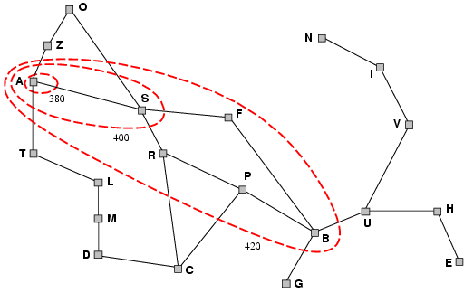
Optimality of A*
A* expands nodes in order of increasing f value.
Gradually adds "f-contours" of nodes.
Contour i has all nodes with f=f_{i}, where f_{i} < f_{i+1.}
That is to say, nodes inside a given contour have f-costs less than or equal to contour value.

Slide 33
Properties of A*
Complete: Yes.
Time: Exponential.
Space: Keeps all nodes in memory, so also exponential.
Optimal: Yes (provided h admissible or consistent).
Optimally Efficient: Yes (no algorithm with the same heuristic is guaranteed to expand fewer nodes).

Slide 34
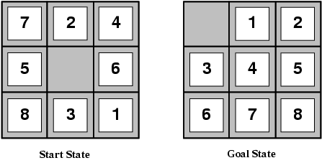
Admissible Heuristics Examples
E.g., for the 8-puzzle:
h₁(n) = number of misplaced tiles
h₂(n) = total Manhattan distance (i.e. 1-norm)
Q: Why are these admissible heuristics?
h₁(S) = ?
h₂(S) = ?

Slide 35
Admissible Heuristics Examples
E.g., for the 8-puzzle:
h₁(n) = number of misplaced tiles
h₂(n) = total Manhattan distance (i.e. 1-norm)
Q: Why are these admissible heuristics?
h₁(S) = ? 9
h₂(S) = ? 3+1+2+2+2+3+3+2 = 18

Slide 36
Dominance
If h₂(n) ≥h₁(n) for all n (both admissible), then h₂ dominates h₁ .
Domination = Efficiency
h₂ is better for search.
A* using h₂ will never expand more nodes than A* using h₁.
Typical search costs (average number of nodes expanded):
d=12
IDS = 3,644,035 nodes
A*(h₁) = 227 nodes
A*(h₂) = 73 nodes
IDS = too many nodes
A*(h₁) = 39,135 nodes
d=24
A*(h₂) = 1,641 nodes
(IDS=iterative deepening search)

Slide 37
Outline
Review of Lecture 7
Uninformed Search
Informed (Heuristic) Search
Greedy best-first Search
A* Search
Relaxation
Conclusions

Slide 38
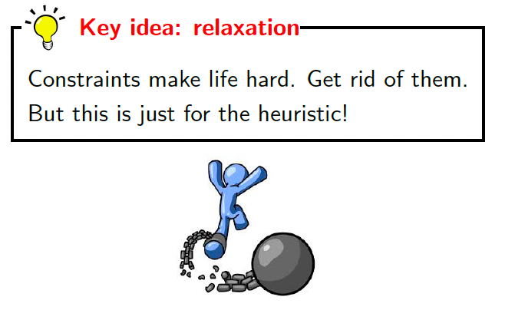
Relaxation
A problem with fewer restrictions on the actions is called a relaxed problem.
The cost of an optimal solution to a relaxed problem is an admissible heuristic for the original problem.

Slide 39

Independent subproblems:
8-puzzle problem:
Constraint: tiles cannot overlap.
If the rules of the 8-puzzle are relaxed so that a tile can move anywhere, then h₁(n) gives the shortest solution.
If the rules are relaxed so that a tile can move to any adjacent square, then h₂(n) gives the shortest solution.
h₁(n) = number of misplaced tiles
h₂(n) = total Manhattan distance

Slide 40
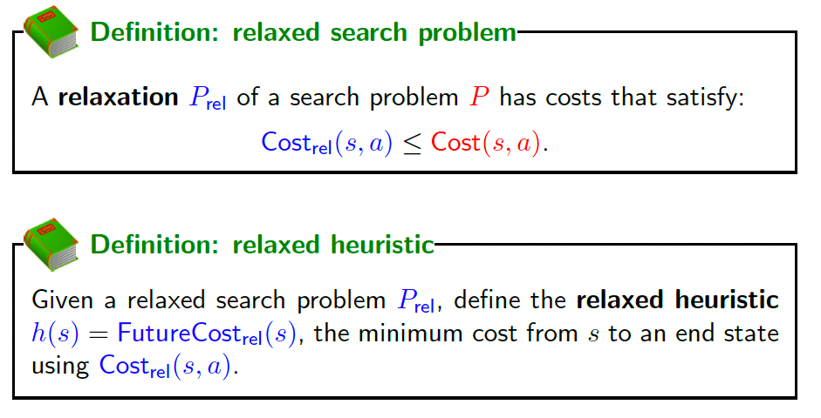
General Framework

Slide 41
Conclusions
Informed search methods may have access to a heuristic function h(n) that estimates the cost of a solution from n.
Greedy best-first search: expand the node that is closest to the goal
A*: add in heuristic estimate of future costs
Relaxation (breaking the rules): framework for producing consistent heuristics

Slide 42

Email: xzhang48@kennesaw.edu
Teams: Xinyue Zhang (xzhang48)

