Slide 1

Shri Vishnu Engineering College For Women (Autonomous)
Department of CSE
Academic Year :: 2024-25 :: II Semester
III B.Tech :: Mini Project Reviews
Final Review::31-05-2025
Batch Number: B - 13
Project Title:
AirHealth: A Machine Learning-Based Web Application for Health Impact Classification and Prediction
SNO | Regd no. | Student Name
1 | 22B01A0582 | Kathulla Yamini
2 | 22B01A05B0 | Manchem Shunmadhuri Suryaja
3 | 22B01A05C9 | Naramsetti Asritha
4 | 23B05A0507 | Katha Venkata Chaturya
Project Guide: Mr.Y.Ramu

Slide 2
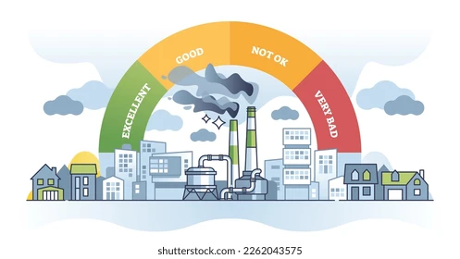
CONTENTS
Introduction
Problem Statement
Literature Review
Proposed system
Flow Diagram
Data Preprocessing
Model Training
Model Evaluation
Explainable Ai
References

Slide 3
INTRODUCTION
Air pollution contributes to millions of deaths globally due to respiratory and cardiovascular issues caused by pollutants like PM2.5, PM10, NO₂, SO₂, and O₃.
There is a lack of real-time tools to assess health risks based on current air quality and weather conditions.
AirHealth is a machine learning-based web application that predicts the Health Impact Class using AQI and meteorological data (temperature, humidity, wind speed, etc.).
This project aims to raise awareness, support early warnings, and encourage data-driven environmental health policies.

Slide 4
PROBLEM STATEMENT
Problem: Existing systems don't provide real-time, user-accessible tools for health risk classification using air quality and meteorological data.
Objective: Develop a ML-based web app to classify health risk levels (Very Low to Very High) using environmental features like AQI, temperature, humidity, etc

Slide 5
LITERATURE REVIEW

Slide 6
PROPOSED SYSTEM
Designed a web application to classify Health Impact Levels based on AQI and environmental features.
Implemented Random Forest, Gradient Boosting, and Logistic Regression for model training.
The system integrates LIME and SHAP to provide model explainability by highlighting the contribution of each feature to the prediction outcome.
Uses AQI, pollutant levels, and weather data as input to predict health impact class.
Provides a simple and interactive interface for users to view predictions and insights.

Slide 7
PROPOSED SYSTEM
Develop a user-friendly web platform for health impact prediction and classification.
Use classification and regression algorithms to analyze air quality and pollutant data.
Provide accurate, real-time health risk assessments based on environmental factors.
Empower policymakers, healthcare professionals, and the public with actionable health insights.

Slide 8
FLOW DIAGRAM

Slide 9
Data Preprocessing
Clean Dataset: No missing values or duplicate records were found, so no imputation or deduplication was required.
Irrelevant Feature Dropped: The RecordID column was removed as it does not contribute to the analysis.
Outlier Analysis: Boxplots and IQR method were used for all numerical features, and no extreme outliers were detected.
Ready for Modeling: The dataset is clean, well-structured, and directly usable for training machine learning models.

Slide 10
Model Training
We trained classification models using three train-test splits: 80:20, 75:25, and 70:30, applying stratified sampling to preserve class distribution across all splits.
Models Trained:
Random Forest:An ensemble of decision trees that combines multiple trees to reduce overfitting. It captures complex, non-linear relationships within the data for improved accuracy.
Gradient Boosting:Builds models sequentially, with each new model correcting errors from previous ones. This approach enhances predictive performance, especially on structured datasets.
Logistic Regression:A simple linear model used as a baseline, estimating probabilities for classification. Effective for understanding feature importance and interpreting results.

Slide 11
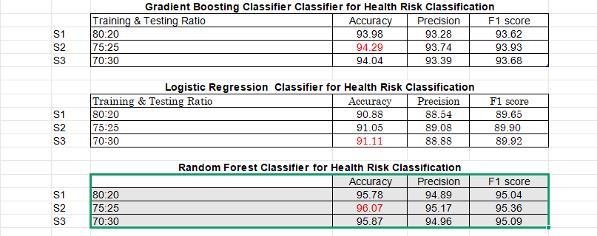
MODEL EVALUATION:

Slide 12
GRAPHS

Slide 13
EXPLAINABLE AI

Slide 15
References :
Moderate Air Quality Prediction Model Using Regression. (n.d.). [online] International Journal of Scientific Research & Engineering Trends. Available at: https://ijsret.com/wp-content/uploads/2024/03/IJSRET_V10_issue2_140.pdf.
‌Mohammed, A., S. Roshan Zameer, Chowdhry, U. and Dr. Ashok Kumar (2024). Machine Learning-Based System for Weather Prediction and Air Quality Index Estimation. International Journal of Engineering and Management Research, [online] 14(2), pp.134–142. doi:https://doi.org/10.5281/zenodo.11084950.
Bohumír Garlík and Přívětivý, J. (2024). Artificial Intelligence Algorithms for Prediction and Diagnosis of Air Pollution Affecting Human Health. Journal of Physics Conference Series, 2701(1), pp.012072–012072. doi:https://doi.org/10.1088/1742-6596/2701/1/012072
Rahman, Md.M., Nayeem, Md.E.H., Ahmed, Md.S., Tanha, K.A., Sakib, Md.S.A., Uddin, K.M.M. and Babu, H.Md.H. (2024). AirNet: predictive machine learning model for air quality forecasting using web interface. Environmental Systems Research, 13(1). doi:https://doi.org/10.1186/s40068-024-00378-z.

Slide 16


