Slide 1

PLAnt disease prediction
J - COMPONENT
SWE2009 - Data Mining Techniques

Slide 2
Review-2 By - C Thanmayee Reddy - 22MIS1056 MVNSS Kiranmai - 22MIS1096
Gaddam Nikitha - 22MIS1178
Faculty - Pattabiraman V

Slide 3
ABSTRACT
This project proposes a Convolutional Neural Network (CNN)-based approach for the early detection and diagnosis of plant diseases using images of plant leaves. The CNN model is trained on a large dataset of labeled images to accurately classify new images as healthy or diseased, and identify the type of disease if present. The system aims to provide a reliable and efficient tool for farmers and agricultural experts to manage plant diseases, ensuring food security and sustainable agriculture.

Slide 4
OBJECTIVE
Collecting a large dataset of labeled images of plant leaves, including various plant diseases and healthy leaves.
Preprocessing the image dataset to enhance the quality and remove noise.
Designing and training a CNN model to classify images into healthy and diseased categories and identify the type of disease if present.
Evaluating the performance of the CNN model using metrics such as accuracy, precision, recall, and F1-score.
Deploying the trained model as a user-friendly tool for farmers and agricultural experts to use for disease diagnosis in real-time.
Conducting experiments and case studies to demonstrate the effectiveness and efficiency of the proposed approach in real-world scenarios.

Slide 5
LITERATURE SURVEY
"Deep learning for plant disease detection and diagnosis" by Singh et al. (2018) - This paper provides an overview of deep learning techniques, including CNNs, applied to plant disease detection. It discusses various datasets, model architectures, and performance metrics used in existing studies.
"A survey of deep learning techniques for image classification in agriculture" by Mohanty et al. (2016) - This survey paper provides a comprehensive review of deep learning techniques applied to various agricultural tasks, including plant disease detection. It discusses the advantages and limitations of different approaches.
"Plant disease detection using deep learning: A review" by Sladojevic et al. (2016) - This review paper summarizes the recent advancements in plant disease detection using deep learning techniques. It discusses the challenges, datasets, and future research directions in this field.

Slide 6
"Applications of convolutional neural networks in plant pathology: A review" by Thakare et al. (2020) - This review paper provides an in-depth analysis of the applications of CNNs in plant pathology, including disease detection and classification. It discusses the challenges and future prospects of using CNNs in this domain.
"Deep learning-based plant disease detection and classification: A review" by Ferentinos (2018) - This review paper discusses the recent developments in deep learning-based plant disease detection and classification. It covers various aspects such as dataset creation, model architectures, and performance evaluation metrics.
"Advances in deep learning for plant diseases: Detection and classification" by Chandra et al. (2019) - This paper discusses the recent advances in deep learning techniques for plant disease detection and classification. It highlights the challenges and future research directions in this field.

Slide 7
Identifying the Gap:
Accuracy and Sensitivity: The existing system may struggle with accurately identifying plant diseases, especially in cases of early-stage symptoms or when diseases exhibit similar visual characteristics. The proposed system aims to bridge this gap by leveraging a more extensive dataset, advanced CNN architecture, and transfer learning to improve accuracy and sensitivity.
Robustness and Generalization: The existing system may lack robustness and generalization, leading to performance degradation when faced with new or unseen plant disease images. The proposed system addresses this gap by using advanced data augmentation techniques, transfer learning, and fine-tuning to enhance model robustness and adaptability.
Efficiency and Deployment: The existing system may not be optimized for efficient deployment on edge devices or in cloud environments, limiting its practicality for real-world applications. The proposed system aims to bridge this gap by considering deployment factors from the outset, making it more suitable for practical use in plant disease prediction applications.

Slide 8
Bridging The Gap:
Improved Accuracy: By using a more extensive dataset, advanced CNN architecture, and transfer learning, the proposed system aims to significantly improve the accuracy of plant disease prediction compared to the existing system.
Enhanced Generalization: The use of advanced data augmentation techniques and transfer learning helps the proposed system generalize better to unseen plant disease images, bridging the gap in robustness and adaptability.
Efficient Deployment: By considering deployment on edge devices or in the cloud, the proposed system aims to bridge the gap in scalability and accessibility, making plant disease prediction more widely available and practical for end-users.

Slide 9
Proposed Idea and Technique:
For the project on plant disease prediction using Convolutional Neural Networks (CNNs), the proposed idea involves developing a robust CNN model that can accurately classify plant images as healthy or diseased, as well as identify the specific disease if present. The CNN model will be trained on a large and diverse dataset containing images of various plant species and diseases. To enhance the model's performance, transfer learning will be utilized, leveraging pre-trained models , which have been trained on large-scale image datasets . Fine-tuning of the pre-trained model will be performed to adapt it to the specific task of plant disease prediction, ensuring that the model can effectively extract relevant features from plant images.
The CNN model will function by first receiving an input image of a plant leaf or stem. The model will then apply a series of convolutional and pooling layers to extract features from the input image, capturing important patterns and characteristics related to plant diseases. These features will be passed through several fully connected layers, where the model will learn to classify the image into one of several disease classes or determine if the plant is healthy. The model will be trained using a combination of loss functions, such as categorical cross-entropy, to optimize its parameters and improve its ability to accurately predict plant diseases. Finally, the trained CNN model will be capable of accurately classifying plant images, providing valuable insights to farmers and agricultural experts for early detection and management of plant diseases.

Slide 10
Expected output
The expected output for the project would be a trained Convolutional Neural Network (CNN) model that can accurately classify images of plant leaves as either healthy or diseased, and if diseased, identify the specific type of disease present. The model should be able to take an input image of a plant leaf, process it using the trained CNN, and output a prediction indicating whether the leaf is healthy or diseased, along with the type of disease if applicable.

Slide 11
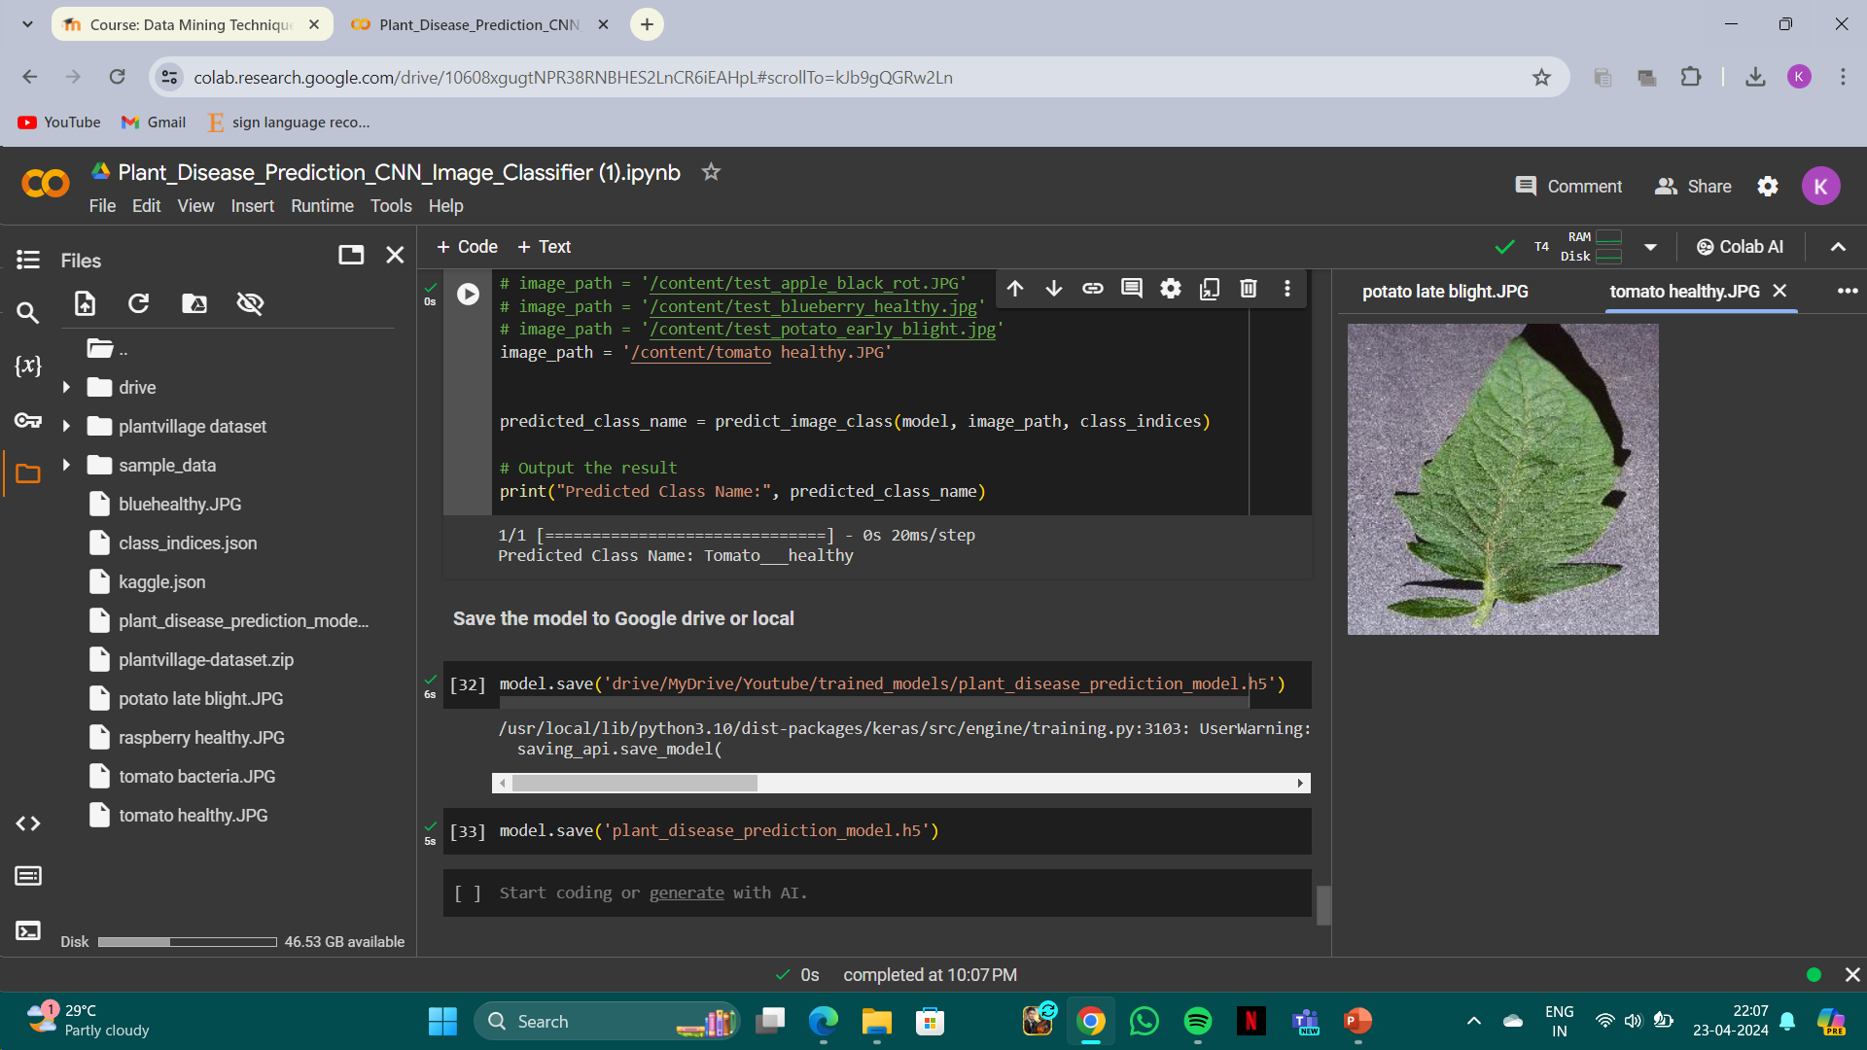
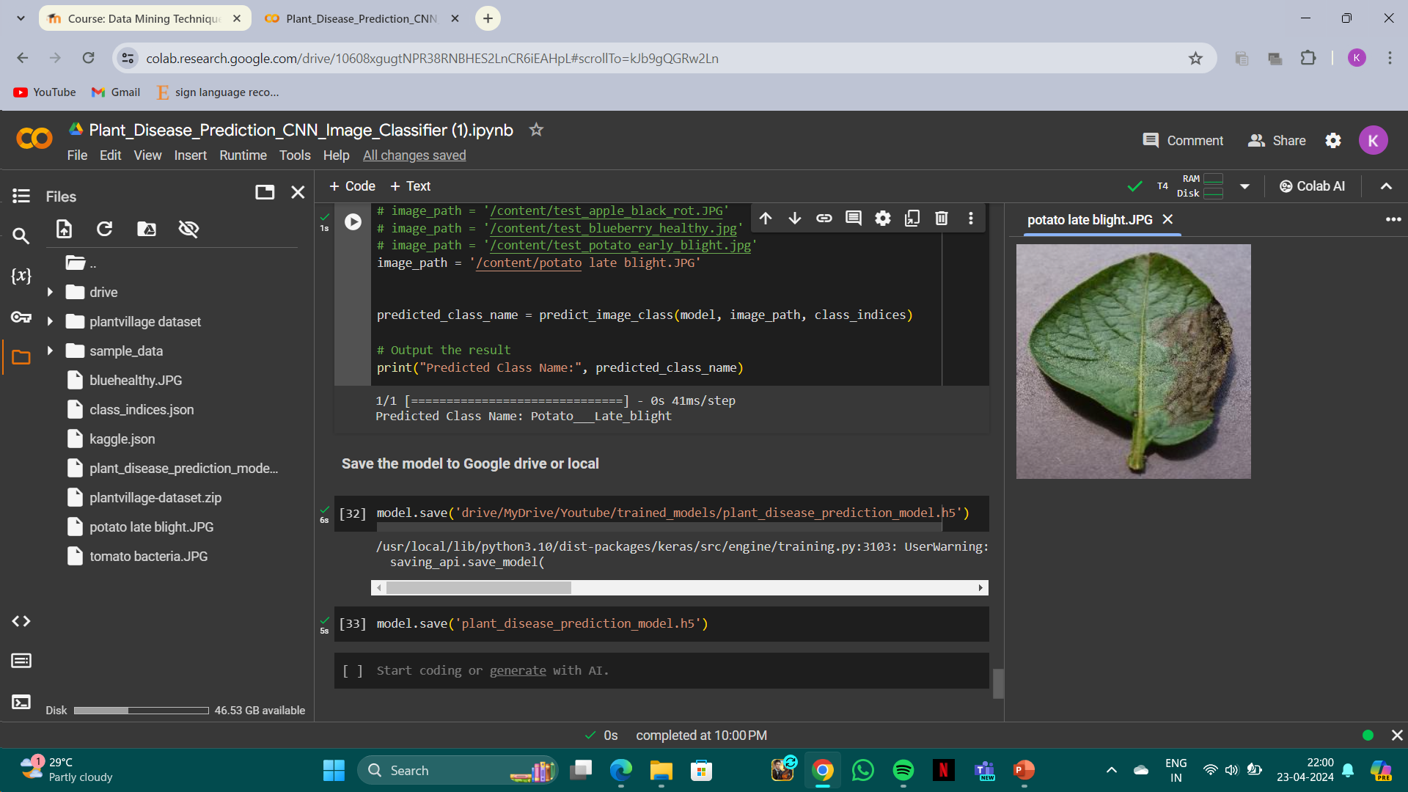
OUTPUT

Slide 12
CONCLUSION
In conclusion, this project demonstrates the effectiveness of Convolutional Neural Networks (CNNs) in the early detection and diagnosis of plant diseases using images of plant leaves. The trained CNN model shows promising results in accurately classifying new images as healthy or diseased, and identifying the specific type of disease if present. By providing a reliable and efficient tool for disease management, this system can help farmers and agricultural experts to take timely actions, thereby ensuring food security and sustainable agriculture. Future work could focus on improving the model's accuracy and robustness, as well as integrating additional features to enhance its usability in real-world agricultural settings.

Slide 13
REFERENCES:
G. Delnevo, R. Girau, C. Ceccarini and C. Prandi, "A Deep Learning and Social IoT Approach for Plants Disease Prediction Toward a Sustainable Agriculture," in IEEE Internet of Things Journal, vol. 9, no. 10, pp. 7243-7250, 15 May15, 2022, doi: 10.1109/JIOT.2021.3097379.
Z. Liu, R. N. Bashir, S. Iqbal, M. M. A. Shahid, M. Tausif and Q. Umer, "Internet of Things (IoT) and Machine Learning Model of Plant Disease Prediction–Blister Blight for Tea Plant," in IEEE Access, vol. 10, pp. 44934-44944, 2022, doi: 10.1109/ACCESS.2022.3169147.
R. K. Lakshmi and N. Savarimuthu, "PLDD—A Deep Learning-Based Plant Leaf Disease Detection," in IEEE Consumer Electronics Magazine, vol. 11, no. 3, pp. 44-49, 1 May 2022, doi: 10.1109/MCE.2021.3083976.
K. S. Patle, R. Saini, A. Kumar and V. S. Palaparthy, "Field Evaluation of Smart Sensor System for Plant Disease Prediction Using LSTM Network," in IEEE Sensors Journal, vol. 22, no. 4, pp. 3715-3725, 15 Feb.15, 2022, doi: 10.1109/JSEN.2021.3139988.
R. Maurya, S. Mahapatra and L. Rajput, "A Lightweight Meta-Ensemble Approach for Plant Disease Detection Suitable for IoT-Based Environments," in IEEE Access, vol. 12, pp. 28096-28108, 2024, doi: 10.1109/ACCESS.2024.3367443.

