Slide 1
Quantum Circuit
Designer and Simulator
Product 1 final presentation
Qiskit | Qiskit Aer | Streamlit
Quantum Circuit Designer and Simulator | Product 1 | 1

Slide 2
Project objectives
What the application demonstrates
Construct fundamental single-qubit and multi-qubit circuits.
Explain qubits, gates, superposition, entanglement, and measurement.
Simulate ideal statevectors and finite-shot measurement outcomes.
Visualize circuit diagrams, histograms, and Bloch representations.
Compare theory with Qiskit Aer and inspect transpilation cost.
Quantum Circuit Designer and Simulator | Product 1 | 2

Slide 3
Quantum foundations
The mathematical model behind the simulator
A qubit is |psi> = alpha|0> + beta|1>, with |alpha|^2 + |beta|^2 = 1.
Measurement returns 0 or 1 according to the squared amplitudes.
Quantum gates are unitary transformations of the statevector.
Controlled gates create correlations; entanglement cannot be described as independent qubits.
An n-qubit statevector contains 2^n complex amplitudes.
Quantum Circuit Designer and Simulator | Product 1 | 3

Slide 4
Circuit catalog
Reusable Qiskit builders cover the required gate families
Single qubit
I, X, Y, Z
H, S, T
Rx, Ry, Rz
Measurement
Multi-qubit
CNOT / CX
Controlled-Z
SWAP
Toffoli / CCX
Entanglement
Bell state
GHZ state
Correlated measurements
Statevector inspection
Quantum Circuit Designer and Simulator | Product 1 | 4

Slide 5
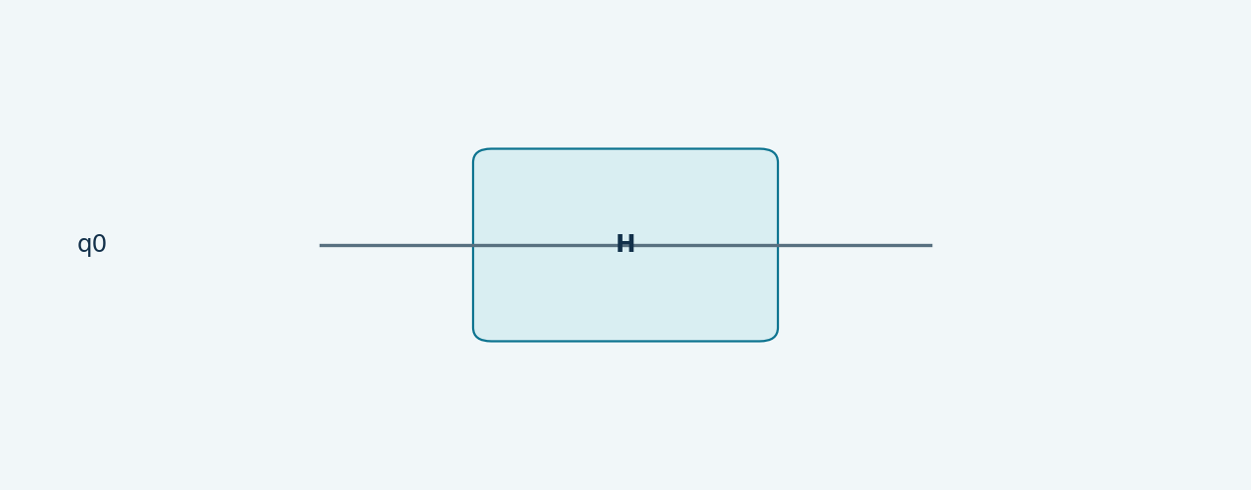
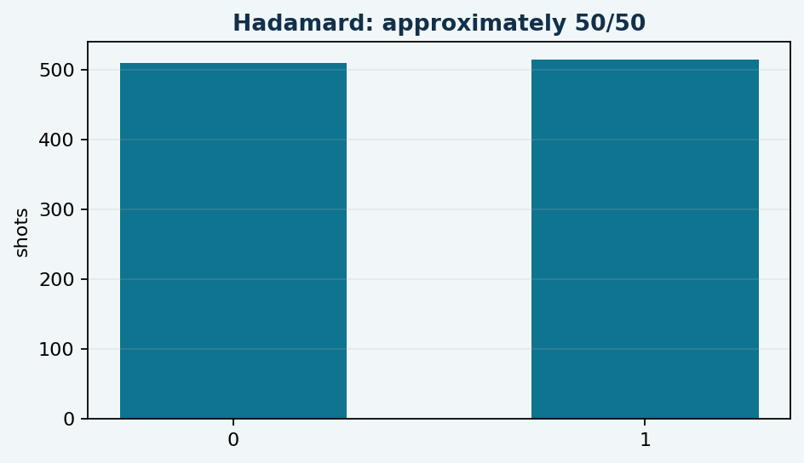
Hadamard superposition
H transforms |0> into an equal superposition.
Quantum Circuit Designer and Simulator | Product 1 | 5

Slide 6
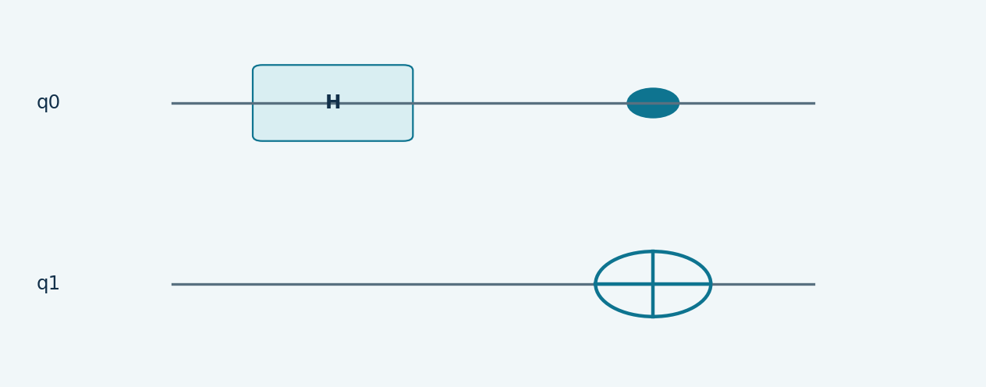
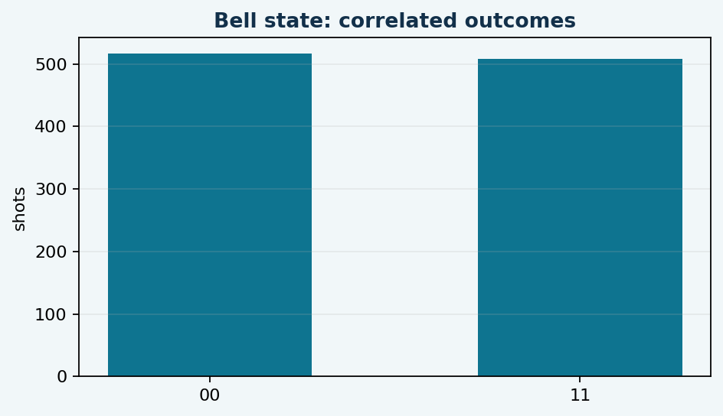
Bell-state entanglement
H followed by CNOT produces correlated 00 and 11 outcomes.
Quantum Circuit Designer and Simulator | Product 1 | 6

Slide 7
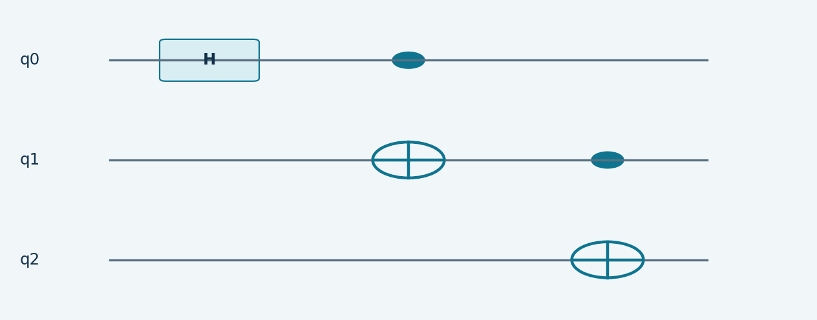
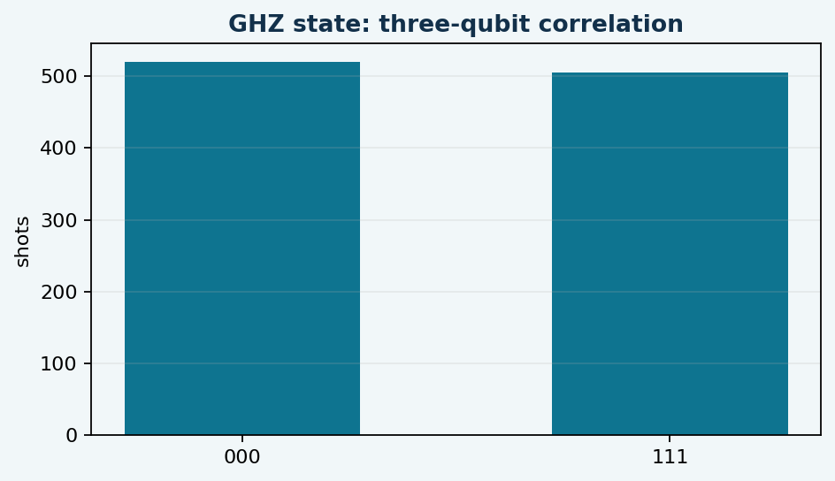
GHZ-state entanglement
A three-qubit extension produces correlated 000 and 111 outcomes.
Quantum Circuit Designer and Simulator | Product 1 | 7

Slide 8
Implementation architecture
One shared API powers the app, notebook, and tests
circuits.py
14 reusable circuit constructors
simulator.py
statevectors, seeded counts, transpilation
visualization.py
histograms and Bloch plots
app.py
interactive Streamlit interface
test_simulator.py
six automated behavior checks
Quantum Circuit Designer and Simulator | Product 1 | 8

Slide 9
Theoretical versus simulated results
Seeded Aer measurements reproduce the expected behavior
Pauli-X: |0> becomes |1> with probability 1.
Hadamard: approximately 50% |0> and 50% |1> over 1024 shots.
Bell: only 00 and 11 appear, demonstrating two-qubit correlation.
GHZ: only 000 and 111 appear, demonstrating three-qubit correlation.
The test suite verifies state probabilities and measurement support.
Quantum Circuit Designer and Simulator | Product 1 | 9

Slide 10
Transpilation and validation
Preparing high-level circuits for a backend
Qiskit transpilation lowers circuits to operations supported by the selected backend.
The app reports original depth, transpiled depth, circuit size, and operation counts.
Six automated tests cover the catalog, Pauli-X, Hadamard, Bell, GHZ, rotations, and transpilation.
Latest validation result: 6 tests passed.
Quantum Circuit Designer and Simulator | Product 1 | 10

Slide 11
Challenges, limitations, and future work
The base simulator is ideal and does not model decoherence or readout error.
Measurement results are statistical and depend on the number of shots.
Real IBM Quantum comparison requires credentials, backend access, and noise-aware analysis.
Future enhancements: drag-and-drop editing, noise models, hardware comparison, and export tools.
Quantum Circuit Designer and Simulator | Product 1 | 11

Slide 12
Final submission package
Ready for demonstration and Google Classroom submission
Editable Jupyter Notebook with saved execution outputs and result plots.
Detailed editable report with complete source-code appendix.
Modular Python source code and functional Streamlit interface.
Automated test suite, README, dependency file, and presentation/video materials.
Demo video: quantum_circuit_product_1_demo.mp4.
Quantum Circuit Designer and Simulator | Product 1 | 12

