Slide 1
Online Booking Movie Ticket System
“Team 4”
Nasim Adabi
Hina Thahseen
Mahshad Saghaleini
R V Pavan Kamur Reddy
Kiranmayie Bethi
Swetha Chenna
Sahana Shankar
Nandini Bandlamudi
Department of Computer Science & Software Engineering
17 June 2019
Instructor: Nora Houari

Slide 2
Outline
Architecture Style
4+1 View
Product overview
Challenges
Lessons

Slide 3

Architecture Style:
“Client-Server”
Why?!

Slide 4
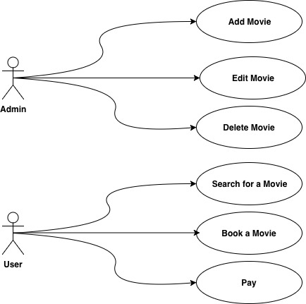
User scenario
4

Slide 5
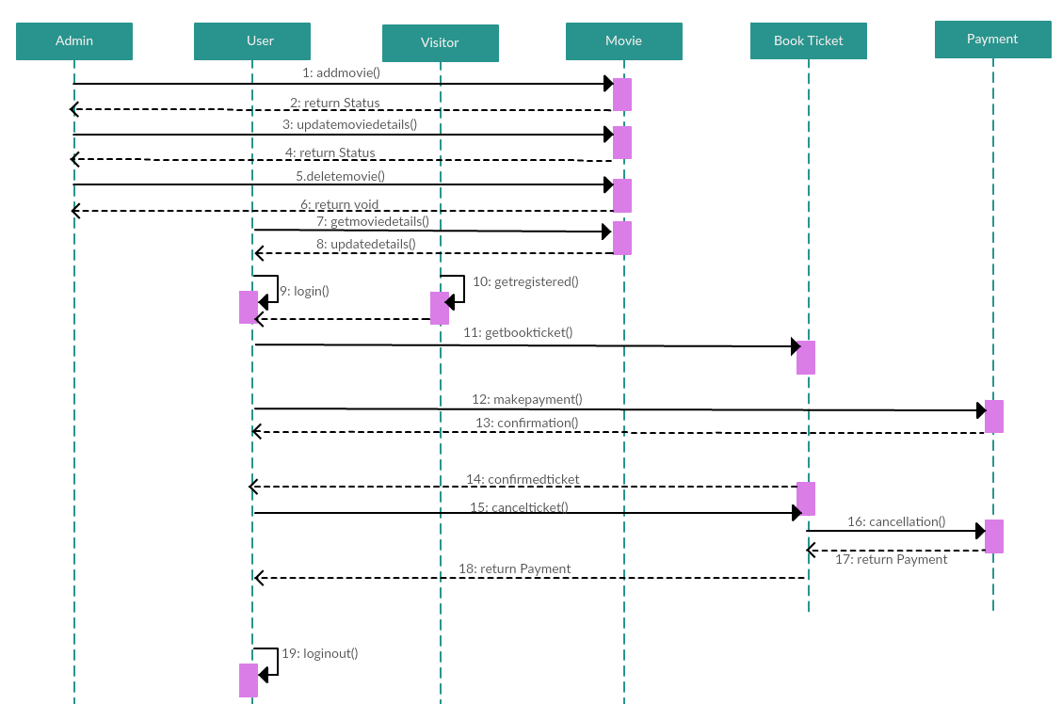
Logical View

Slide 6
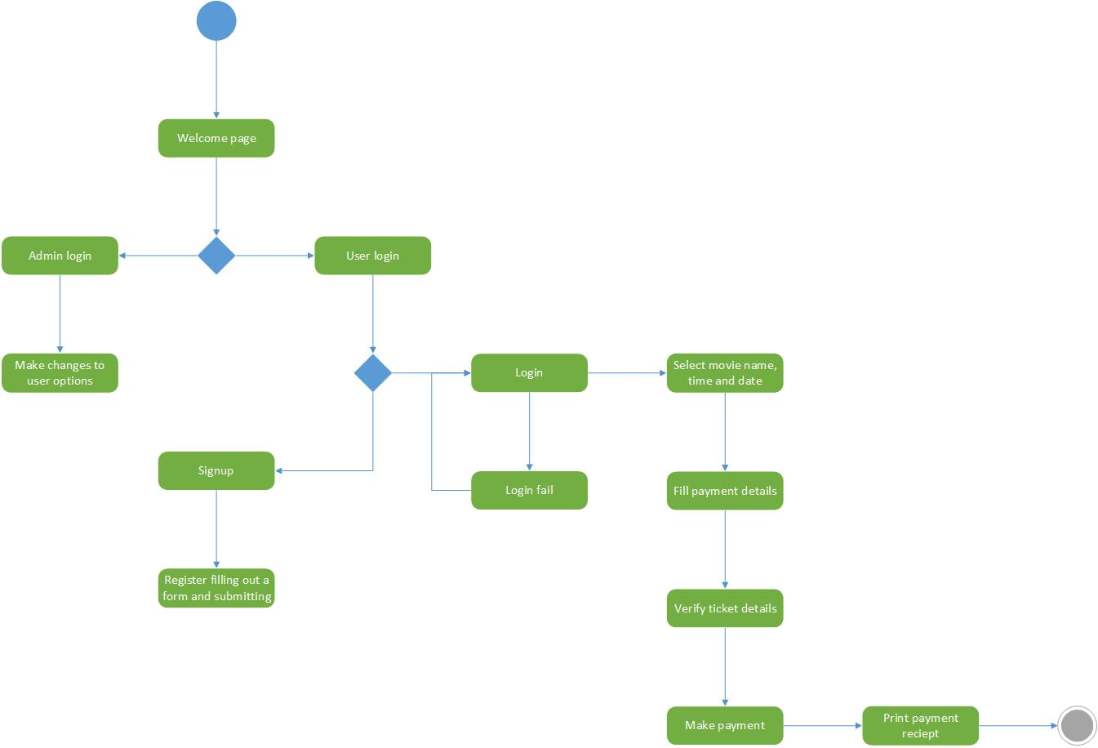
Process View

Slide 7
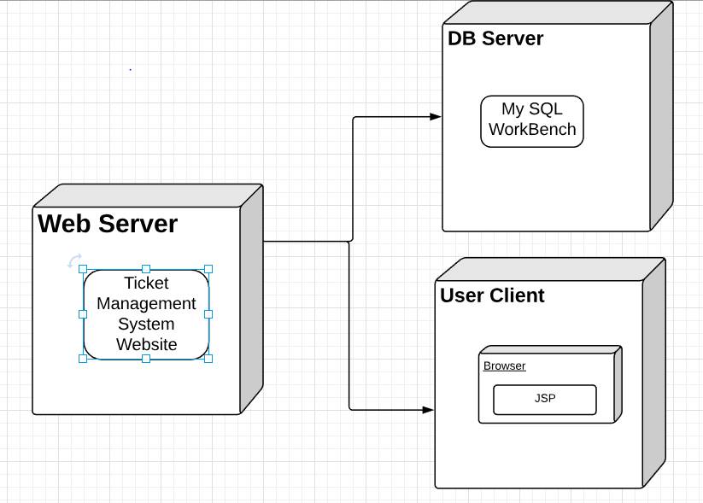
Deployment/Physical View

Slide 8
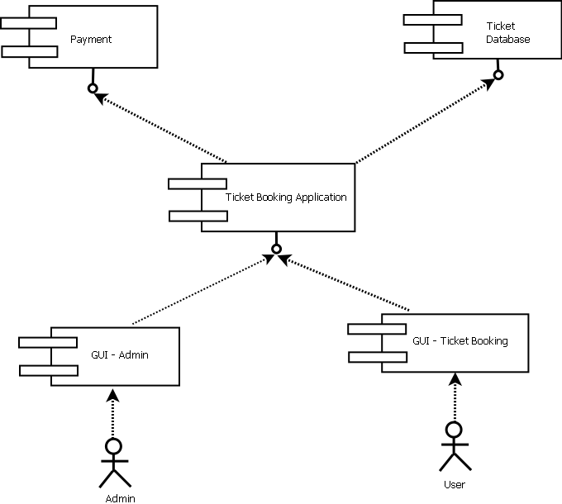
Development View

Slide 9
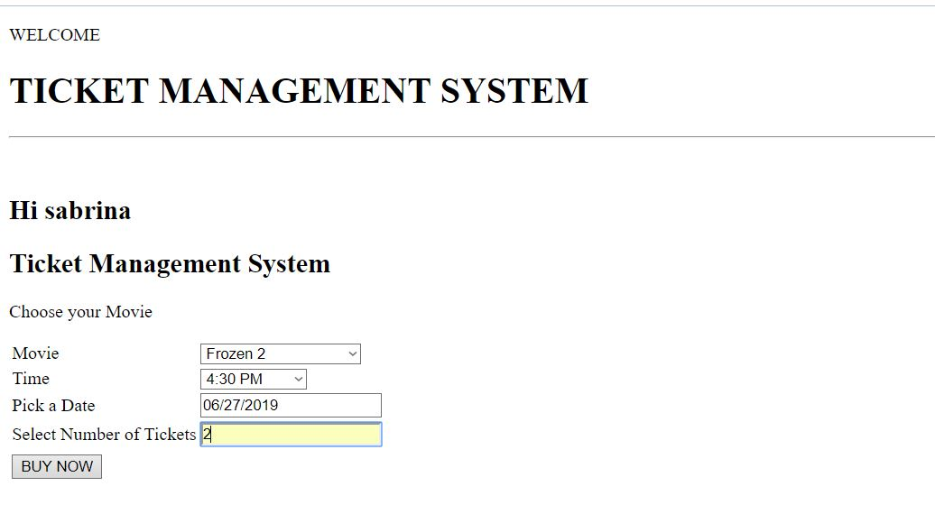
Product Overview

Slide 10
What went wrong?
Challenges :
Lessons :
Group Meetings
Devide & Conquer
1
Common Vocabulary
Clear & Concise Words
2
Technical Issues
Search/Ask
3
Notes:
Technical Issues: Database Connection

Slide 11
THANKS!
Questions?

