Slide 1
GOAL OF UNIT TEST
Ensure code has been tested well at the very early stage of software development lifecycle.
How?
By identifying the hidden component bugs – that can be identified with mock data.
Excluding integration bugs.
By identifying bugs/breaking changes that get introduced due to development of new feature/refactoring of existing code.
If unit test doesn’t able to catch the above issues, then we can say that unit test are not efficient enough.

Slide 2
Quality metric – Test Coverage
Test coverage is one of the quality metric that help us to understand
how much lines of code has been tested/covered by the unit tests,
but not how well the lines of code has been tested.
We can execute one scenario to cover the specific lines of code.
But there may be other scenarios that we didn’t cover.
Also, we assume those scenarios will work as expected and don’t have the unit tests for them.

Slide 3
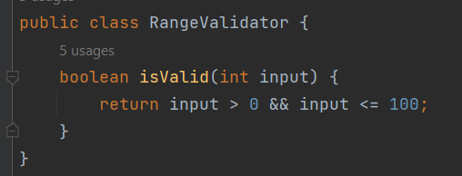
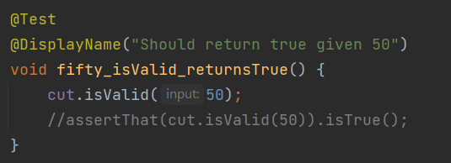

Tricking Test Coverage
Tricking test coverage metric is possible and easy.
By executing the lines of code without any assertion and still we can achieve 100% code coverage.
OUR DEV’S - DON’T DO THAT.
JUST FOR EXPANTION PURPOSE ONLY ☺

Slide 4
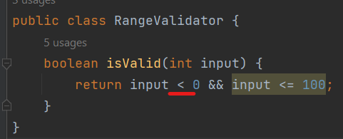
Test Coverage – Inefficiency as a quality metric
Now our code coverage is 100% ( as we have seen in previous slide).
We have added the assertion also in the unit test.
Assume that during new feature development/refactoring of existing code, the range validator logic got changed- accidentally.
By mistake.
“input > 0” changed to “input < 0”
This is called a MUTANT.

Slide 5
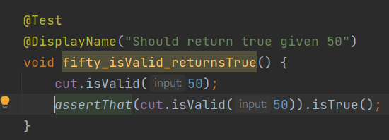
(Continued.) Test Coverage – Inefficiency as a quality metric
Now, expected is that our unit should be able to catch this breaking change the get introduced in the code, since we have 100% code coverage.
But our unit tests fails to identify that because we don’t have any unit test for it.
Although we have 100% code coverage.
This shows that Code Coverage or 100% Code Coverage is not a reliable quality metric.
Code coverage helps to quantify the quality of code to some extent.
But not something that we can rely upon completely.
This is where Mutation Testing helps to solve the by problem.

Slide 6
RECAP – Lessons learnt
Code coverage metrics is not very effective to measure the code quality, because a 100% code coverage score only means that all lines were executed at least once, but it says nothing about tests accuracy or use-cases completeness, or "even whether the lines of code has been tested at all or not" and that's why mutation testing actually matters.
Quality Test is not about having test being executed which covers 100% code or all lines of code, it's about how well the test has tested the lines of code.
It means:
If there is change which introduced a bug/defect, does the tests will be able to catch that?
Does the tests will fail, if any bug or defect has been introduced in the code as result of any new change in the code?

Slide 7
Mutation Testing
Mutation Testing is also called Fault-based testing strategy as it involves creating a fault in the program and it is a type of White Box Testing which is mainly used for Unit Testing.
Mutation testing is also called Testing Unit Tests.
Mutation Testing forces to include quality unit tests. (will see how in later slides)
Goal of Mutation Testing:
• Identify the weakly tested code - those for which mutants are not killed.
• Identify worthless tests - that never kill mutants. [HAVE DOUBT – NEED TO CONFIRM]
• Compute Mutation score.
• Improve Mutation Score.

Slide 8
How Mutation Testing Works?
First ensure that all the unit tests are passing in the Test Suite, there should not be any failing tests initially.
Mutation testing requires 100% passing test suite.
Next, mutate the code, that is, introduce errors in the code.
This error which is intentional inserted in the code is called Mutant.
Run the Test suite again.
If tests fails, that means the mutant has been killed. That is , there exists a test which is able to catch the error/mutant.
If no tests fails, that means the mutant has been survived. That is, there is no single test exist which is able to catch the error/mutant.
This indicates, that the lines of code has not really been tested well with quality tests.
As a result, we now know that we need to add a test to catch the error/mutant that has survived.
Repeat this process until all mutants are killed, and this will ensure that all the lines of code has really been tested well with quality tests.

Slide 9
Measuring quality through mutation testing
The quality of unit test can be measured from the percentage of mutants killed;
we call this metric as Mutation Coverage Score.
Better the Mutation Coverage Score, better the quality of tests.
Focus should be to increase the Mutation Coverage Score.
The mutation score is defined as the percentage of killed mutants with the total number of mutants.
Test cases are mutation adequate if the score is 100%.
Experimental results have shown that mutation testing is an effective approach for measuring the adequacy of the test cases.
But the main drawback is that the high cost of generating the mutants and executing each test case against that mutant program.
It depends on the ability of the mutation testing framework such as PITEST – how good it is able to generate the mutants for different scenarios automatically.

Slide 10
PITEST – Mutation Testing Framework for JAVA
Official Site - https://pitest.org/
Read the home page – it has good intro to Mutation Testing)
Quick Start Guide - https://pitest.org/quickstart/
Different Types of Mutators available in Pitest: https://pitest.org/quickstart/mutators/
Incremental analysis: https://pitest.org/quickstart/incremental_analysis/
If this option is activated, PIT will track changes to the code and tests and store the results from previous runs. It will then use this information to avoid re-running analysis when the results can be logically inferred.

Slide 11
MUTATION TESTING DEMO

Slide 12
THANK YOU
☺

