Slide 1
Hushhush Recruiter
Team 6
- Kiran Mulawad
Notes:
good evening everyone,
Myself kiran mulawad
I am from team 6,

Slide 2
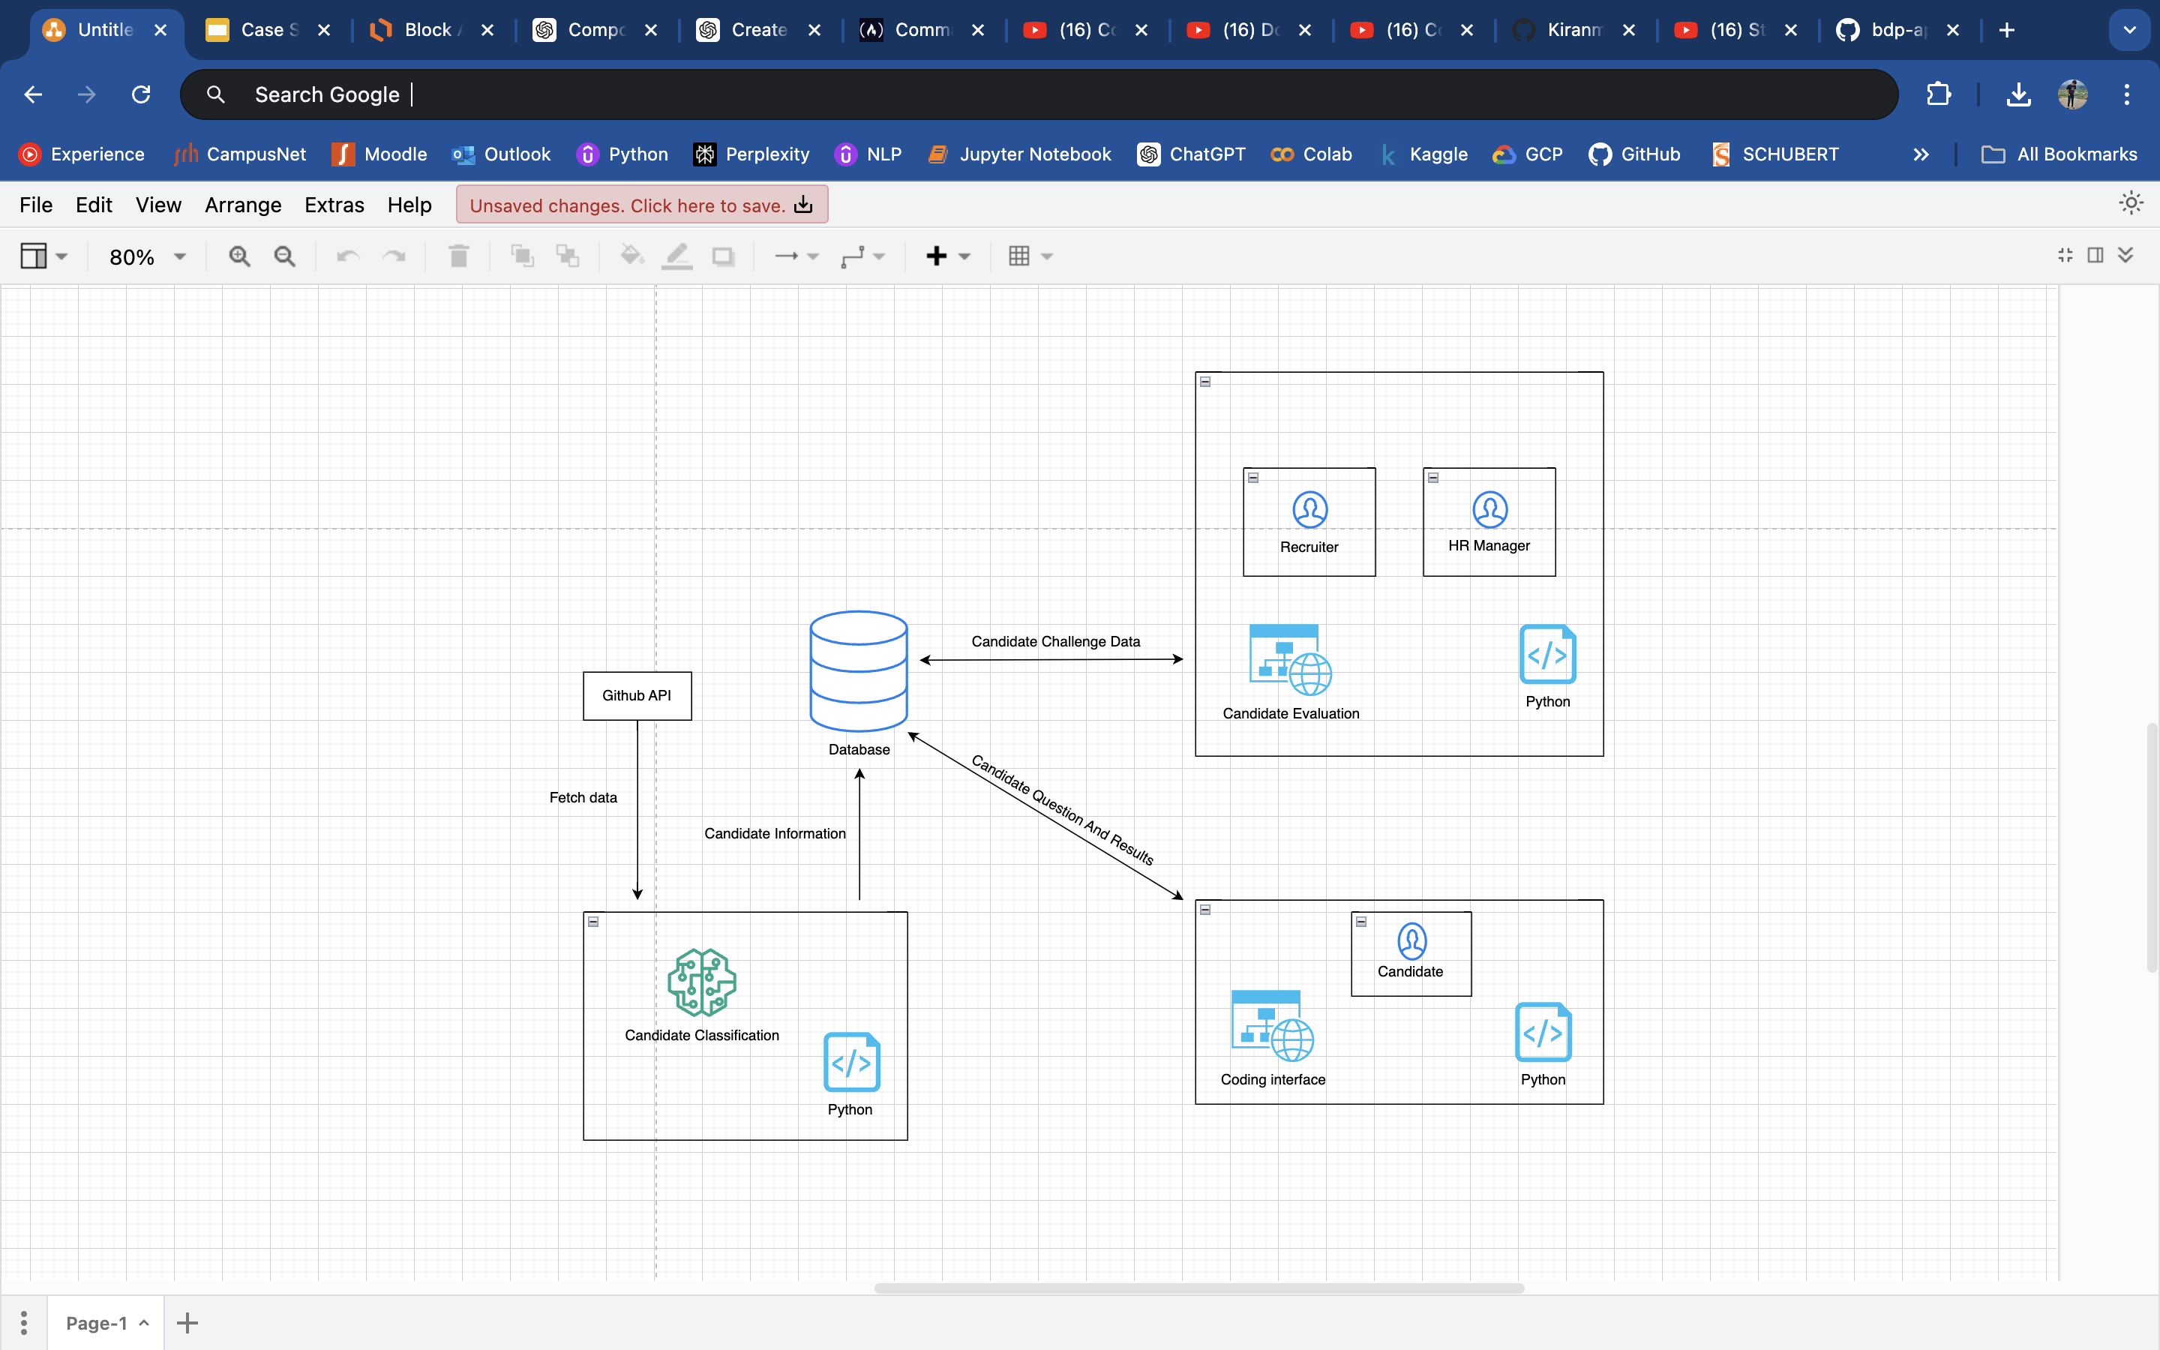
ARCHITECTURE DIAGRAM
Notes:
User story3-
HR receives list of candidates through interface
The information about the appointment for an interview would be sent through emails to the candidates who are selected by the technical recruiter.
After the interview based on the candidates response he/she would receive a mail about the company’s decision

Slide 3
Thank You!!!

