Slide 1


Group 8
HUSHHUSH
RECRUITER
Big Data Programming : Python
Kiran Mulawad
1

Slide 2

TABLE OF CONTENTS
01
Introduction
02
User Stories
03
Data Fetch
04
Data Pre-Processing
05
Model
06
Architechture
07
Database
08
Frontend
08
Backend
09
Demo
10
Future Scopes
11
References
2

Slide 3
INTRODUCTION
Recruitment
Difficult Process
Hard to find Right skill
Application Goal
Spot the Skills that Thrill
Robust selection
3

Slide 4
USER STORIES
CANDIDATE
TECH MANAGER
HR MANAGER
User-friendly platform
Coding test
Secure interface
Evaluate candidate
Robust selection
Secure interface
Process for selection
4

Slide 5

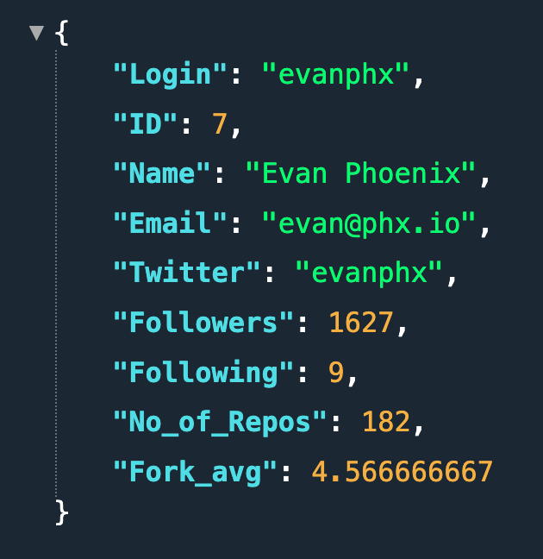

DATA FETCH
Data was obtained from GitHub by utilizing application programming interfaces (APIs), in a reliable and programmatic way while maintaining data integrity and accuracy.
5

Slide 6
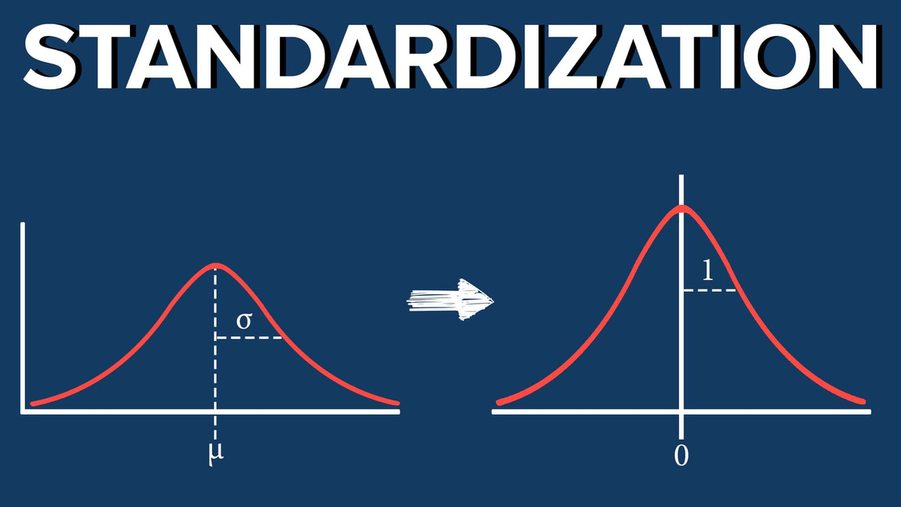
DATA PRE-PROCESSING
STANDARDIZATION
FEATURES
Followers
Following
No of Repos
Average Fork
6

Slide 7
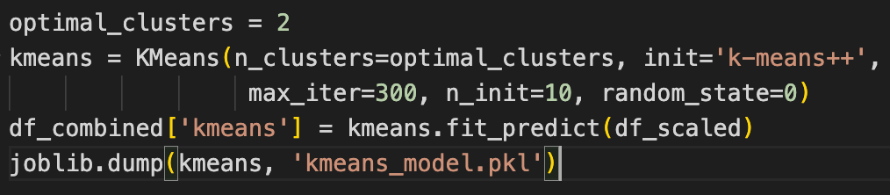
MODEL
K-Means Clustering
Tends to group data points into a predefined number of clusters (K) by minimizing the distance between points and their assigned cluster center (centroid)
Categories based on experience
Beginner
Advanced
7

Slide 8
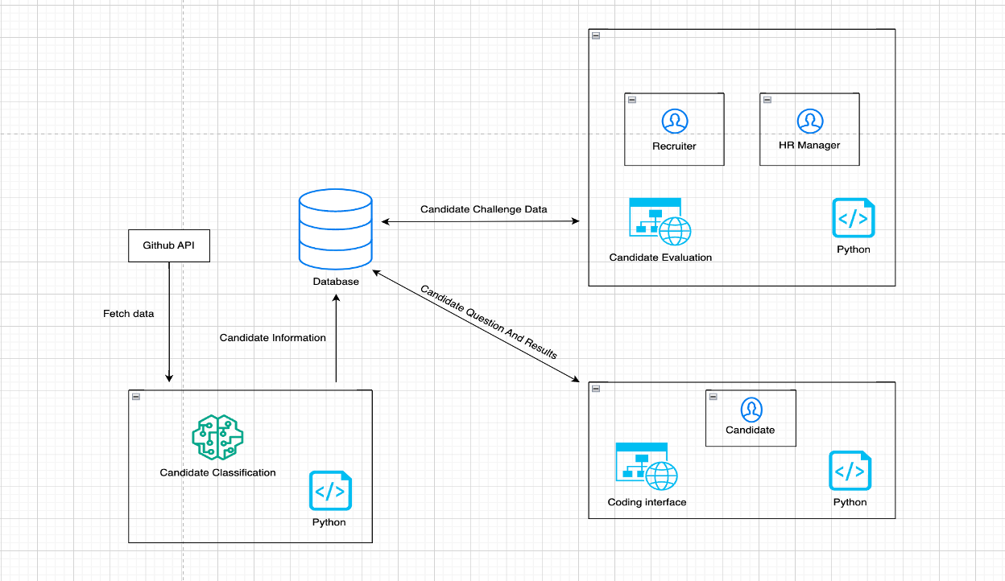
ARCHITECTURE
8

Slide 9

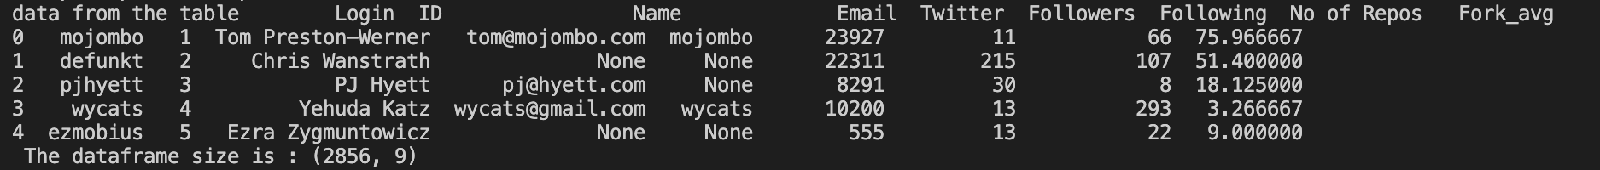
DATABASE
Example of 5 Records from CANDIDATE table
9

Slide 10



FRONTEND
10

Slide 11

BACKEND
Endpoints
candidate
login
questions
tech_manager
hr_manager
view_responses
select_candidate/user_id
more...
11

Slide 12
LIVE DEMO
Interface
12

Slide 13
FUTURE SCOPES
Increase data source
Interface connections with database
CRON JOB
Docker environment for candidates
13

Slide 14
REFERENCES
SKLearn: https://scikit-learn.org/0.21/documentation.html
Flask: https://flask.palletsprojects.com/en/3.0.x/
CSS: https://developer.mozilla.org/en-US/docs/Web/CSS
Youtube: https://youtu.be/Z1RJmh_OqeA?si=rEAU92SiH6TruGtd
Canva: https://youtu.be/hrgrFmV7aCM?si=iehGCyuK0ceKPgaK
Docker with postgres: https://hub.docker.com/_/postgres
Istock : https://www.istockphoto.com/de
LinkedIn: https://www.linkedin.com/pulse/unveiling-power-chatgpt-revolutionizing-recruitment-beyond-kumar/
14

Slide 15

THANK YOU
FOR YOUR ATTENTION

