Slide 1
DEVOPS FINAL CAPSTONE · SESSION 21
StockPilot
Inventory management, shipped through a full DevOps pipeline
Kiran · Roll No. 10446
github.com/Kirann1973/stockpilot-devops-capstone

Slide 2
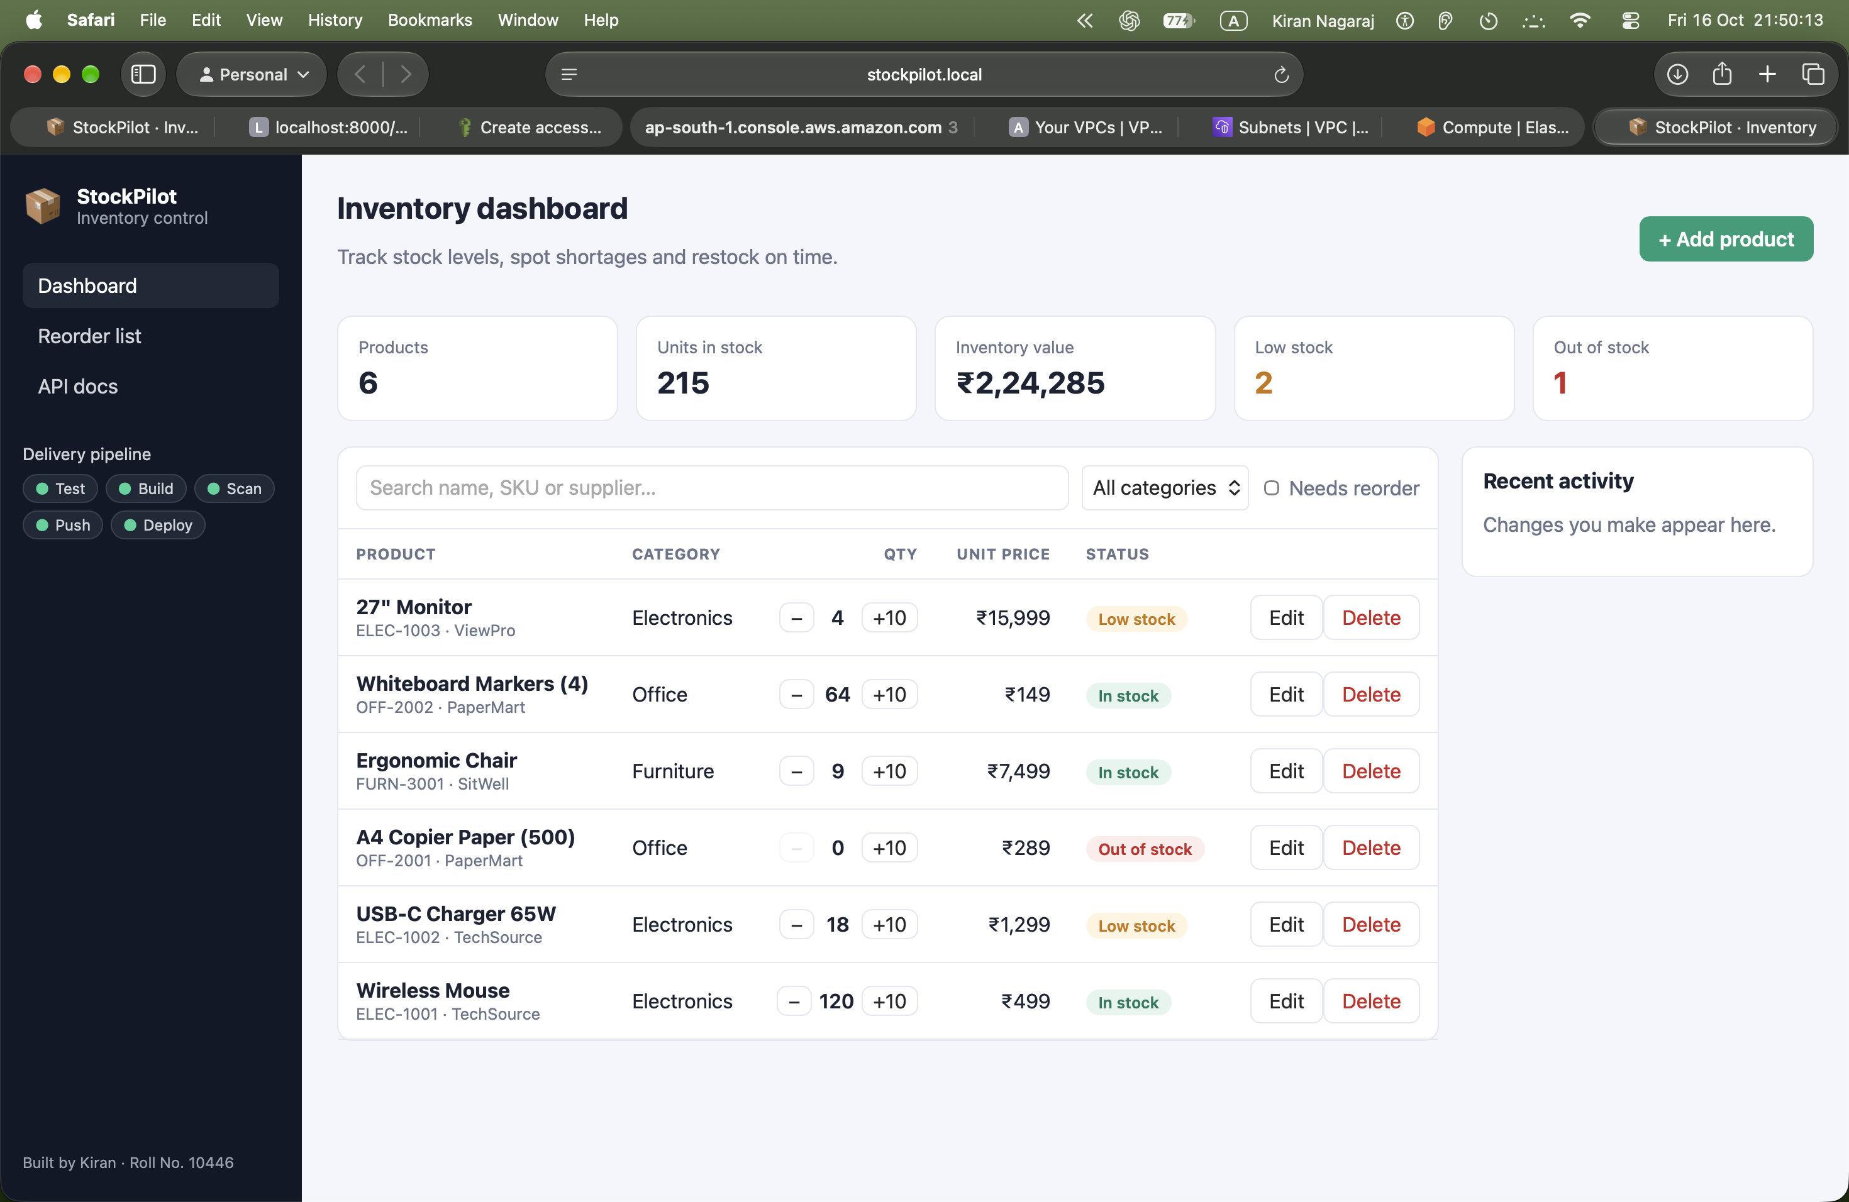
02
Project overview
What StockPilot does and who it is for
Problem Small stores and offices track stock in spreadsheets and run out of items without warning.
Solution A web dashboard: product catalogue with SKU, category, supplier and price.
Stock status In stock, Low stock (at or below the reorder level), Out of stock.
One-click updates Receive or ship stock with +10 / − buttons.
KPIs Product count, units on hand, inventory value, low and out-of-stock counts.
API FastAPI REST: CRUD on /api/products, stats, stock adjust, /health, /ready, /metrics.
StockPilot · Kiran · Roll No. 10446

Slide 3
03
Tech stack
Every layer from the browser to the cloud
Frontend
React 18 + Vite, responsive CSS, Nginx (unprivileged)
Backend
FastAPI, SQLAlchemy 2, Alembic migrations, Pydantic
Database
PostgreSQL 16
Testing
Pytest, 14 tests on an isolated SQLite database
Containers
Docker (non-root images), Docker Compose
CI/CD
GitHub Actions → GitHub Container Registry (tag = commit SHA)
Security
Trivy image scan, fails on HIGH / CRITICAL
Infrastructure
Terraform: AWS VPC + EKS 1.34 in ap-south-1
Kubernetes
Helm chart, NGINX Ingress, HPA, Argo CD (GitOps)
Observability
Prometheus (kube-prometheus-stack) + Grafana
StockPilot · Kiran · Roll No. 10446

Slide 4
04
Architecture
From a git push to a monitored Kubernetes cluster
Developer
git push
GitHub Actions
test · build · scan
GHCR
images :<sha>
Argo CD
GitOps sync
Terraform
AWS VPC + EKS
Kubernetes cluster (Minikube live · EKS proven) · Helm chart helm/stockpilot
Frontend ×2
React on Nginx /
Prometheus
ServiceMonitor
Grafana
dashboard
scrapes /metrics
Ingress
stockpilot.local
Backend ×2–6
FastAPI /api (HPA)
PostgreSQL
StatefulSet + PVC
StockPilot · Kiran · Roll No. 10446

Slide 5
05
CI/CD pipeline
.github/workflows/ci-cd.yml runs on every push to main
Test
pytest ×14
React build
Terraform
fmt + validate
Build
backend +
frontend images
Trivy
fail on
HIGH/CRITICAL
Push GHCR
tag = commit SHA
amd64 + arm64
GitOps
bump tag →
Argo CD syncs
Quality gate first A failing test stops the pipeline, so no broken image is ever built or pushed.
Traceability Every image is tagged with the Git commit SHA, never "latest". Commit → image → pod.
Multi-arch Images are published for amd64 (EKS) and arm64 (Apple Silicon Minikube).
Pull-based deploy CI only commits the new tag to Git. Argo CD pulls it into the cluster, so CI holds no cluster credentials.
StockPilot · Kiran · Roll No. 10446

Slide 6
06
DevSecOps: Trivy security gate
The scan really blocked a vulnerable image
Run #1: BLOCKED
7 HIGH CVEs in the backend image
Fix
Upgrade FastAPI / Starlette, remove pip + setuptools from the runtime image
Runs #2–#4: CLEAN
0 HIGH / CRITICAL, images pushed
What is scanned Both images: OS packages (Debian, Alpine) and Python libraries, against public CVE databases.
Gate --severity HIGH,CRITICAL --ignore-unfixed --exit-code 1. On a finding the job fails and the push step is skipped.
Example CVE urllib3 2.7.0 (CVE-2026-97687): traffic interception via HTTPS proxy TLS configuration override. Fixed in 2.8.0.
What "clean" means No known fixable high-risk CVEs at scan time. It is one layer; SAST, secret scanning and runtime security are separate.
StockPilot · Kiran · Roll No. 10446

Slide 7
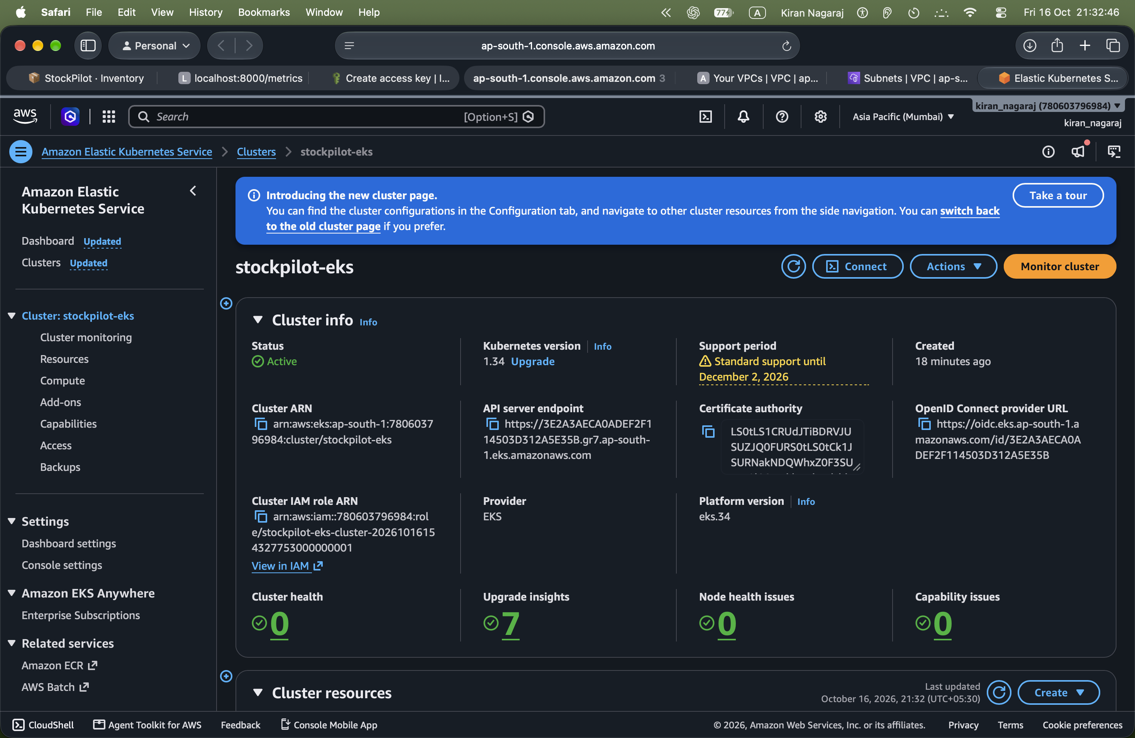
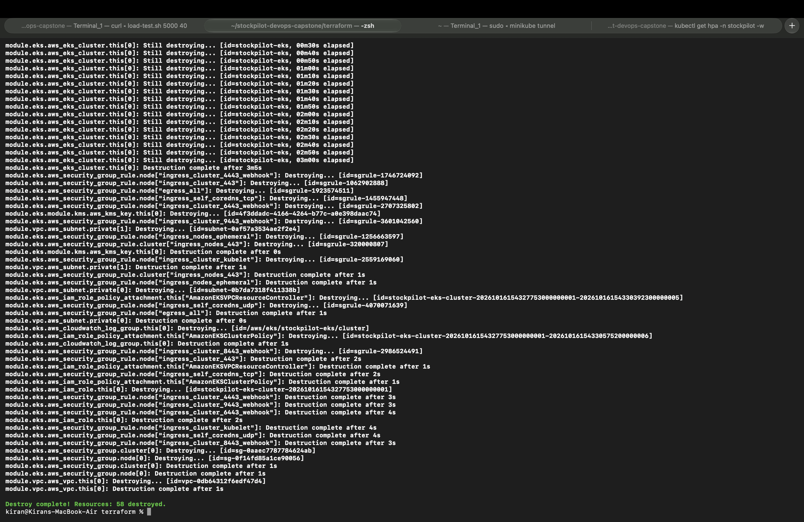
07
Infrastructure as Code: Terraform on AWS
terraform/ · region ap-south-1 (Mumbai)
VPC 10.0.0.0/16 with 2 public + 2 private subnets across 2 AZs, one NAT gateway.
EKS 1.34 Managed control plane, node group "main" with 2 × t3.medium in private subnets.
Modules terraform-aws-modules/vpc 5.21 and /eks 20.37, pinned versions.
Lifecycle init → plan (58 to add) → apply → verified 2 nodes Ready → destroy (58 destroyed).
Safety No credentials in Git: terraform.tfvars.example only, *.tfvars and state are git-ignored.
Cost About $0.25–0.30 per hour, destroyed the same day.
StockPilot · Kiran · Roll No. 10446

Slide 8
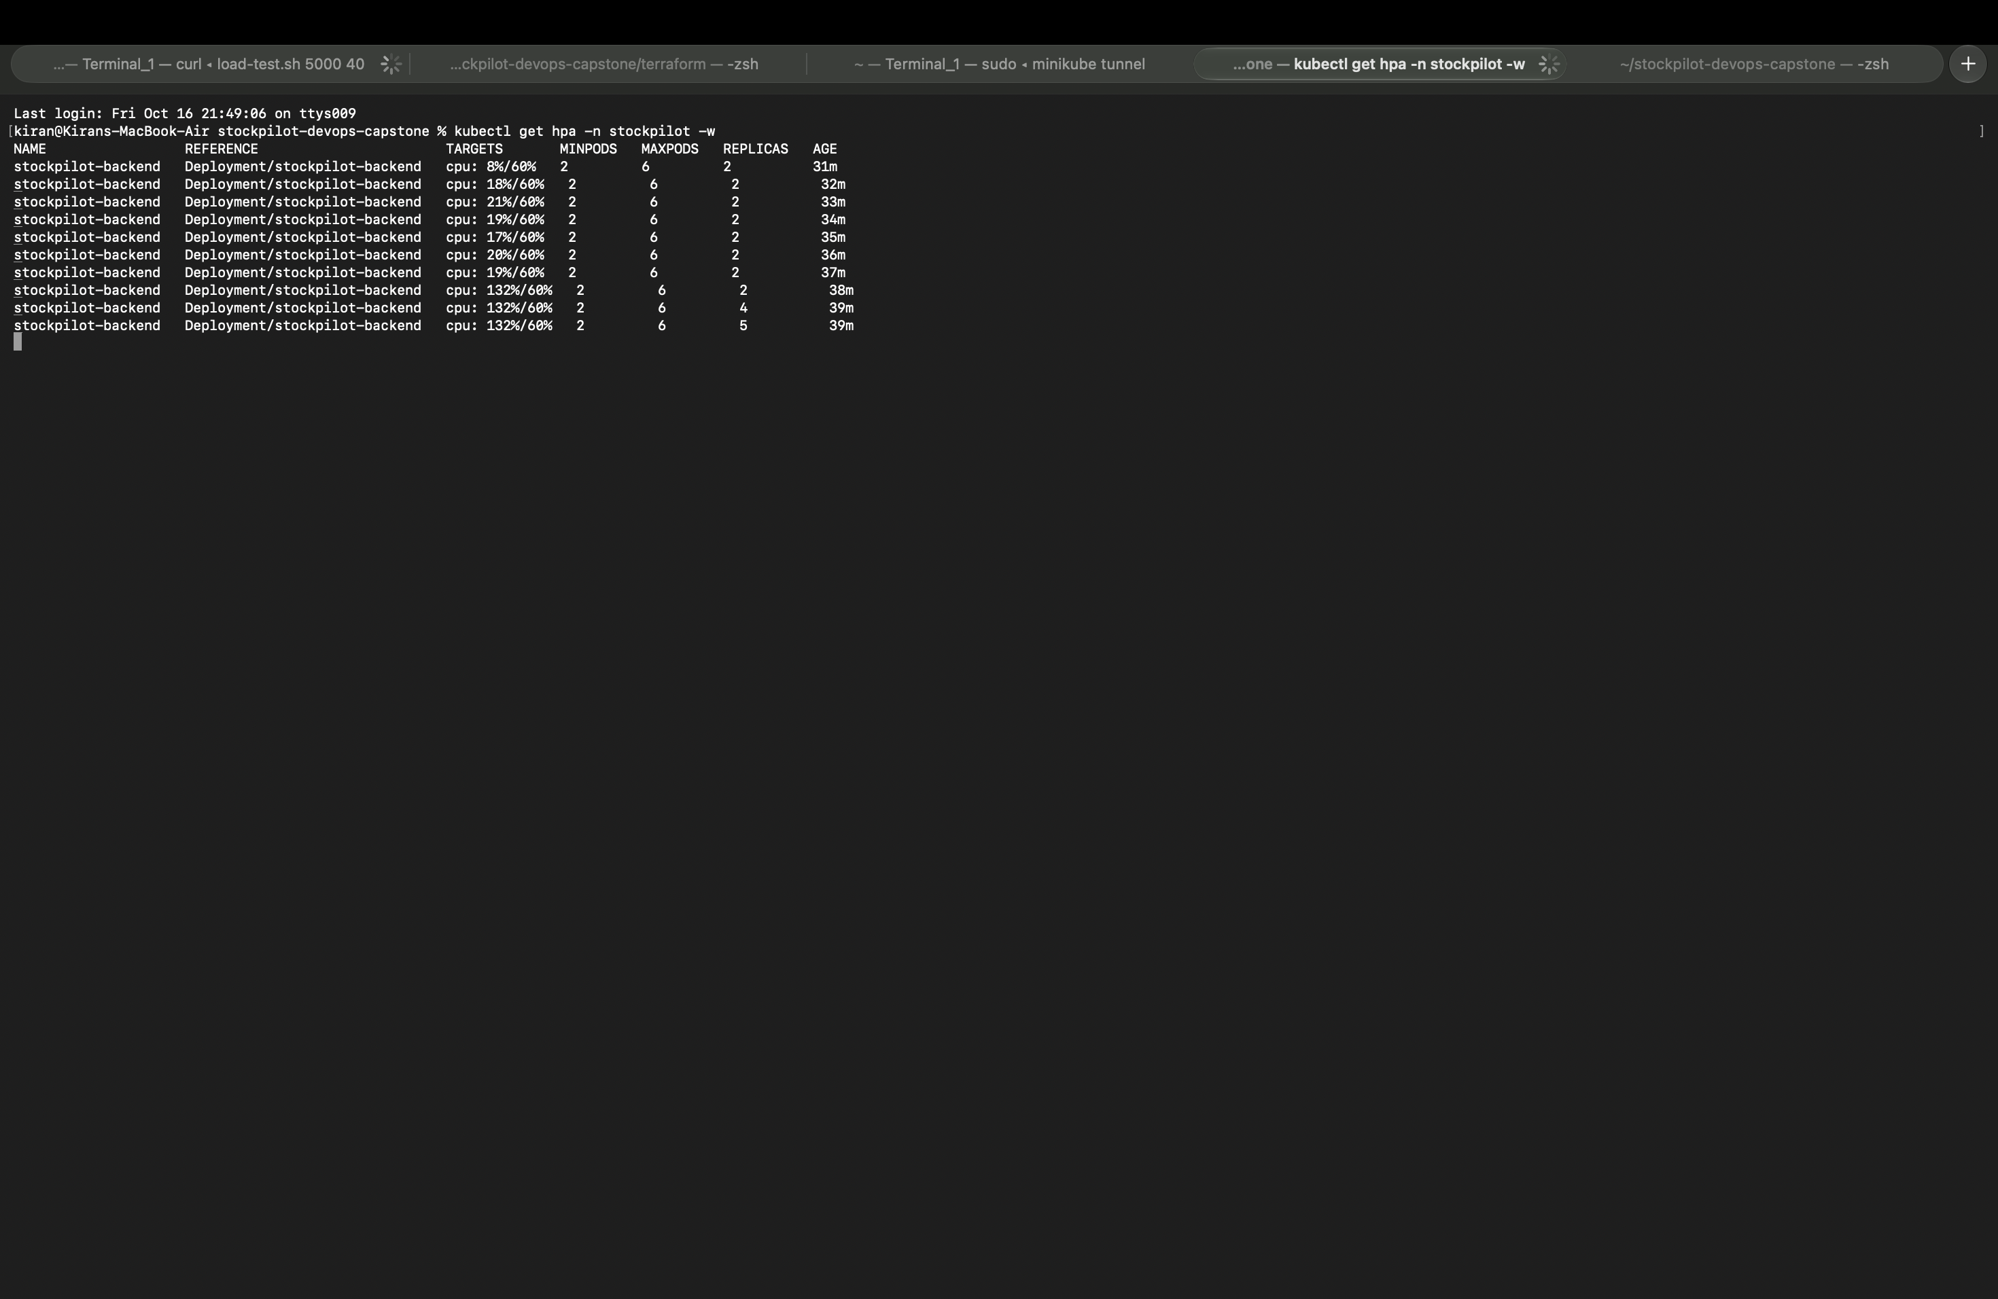
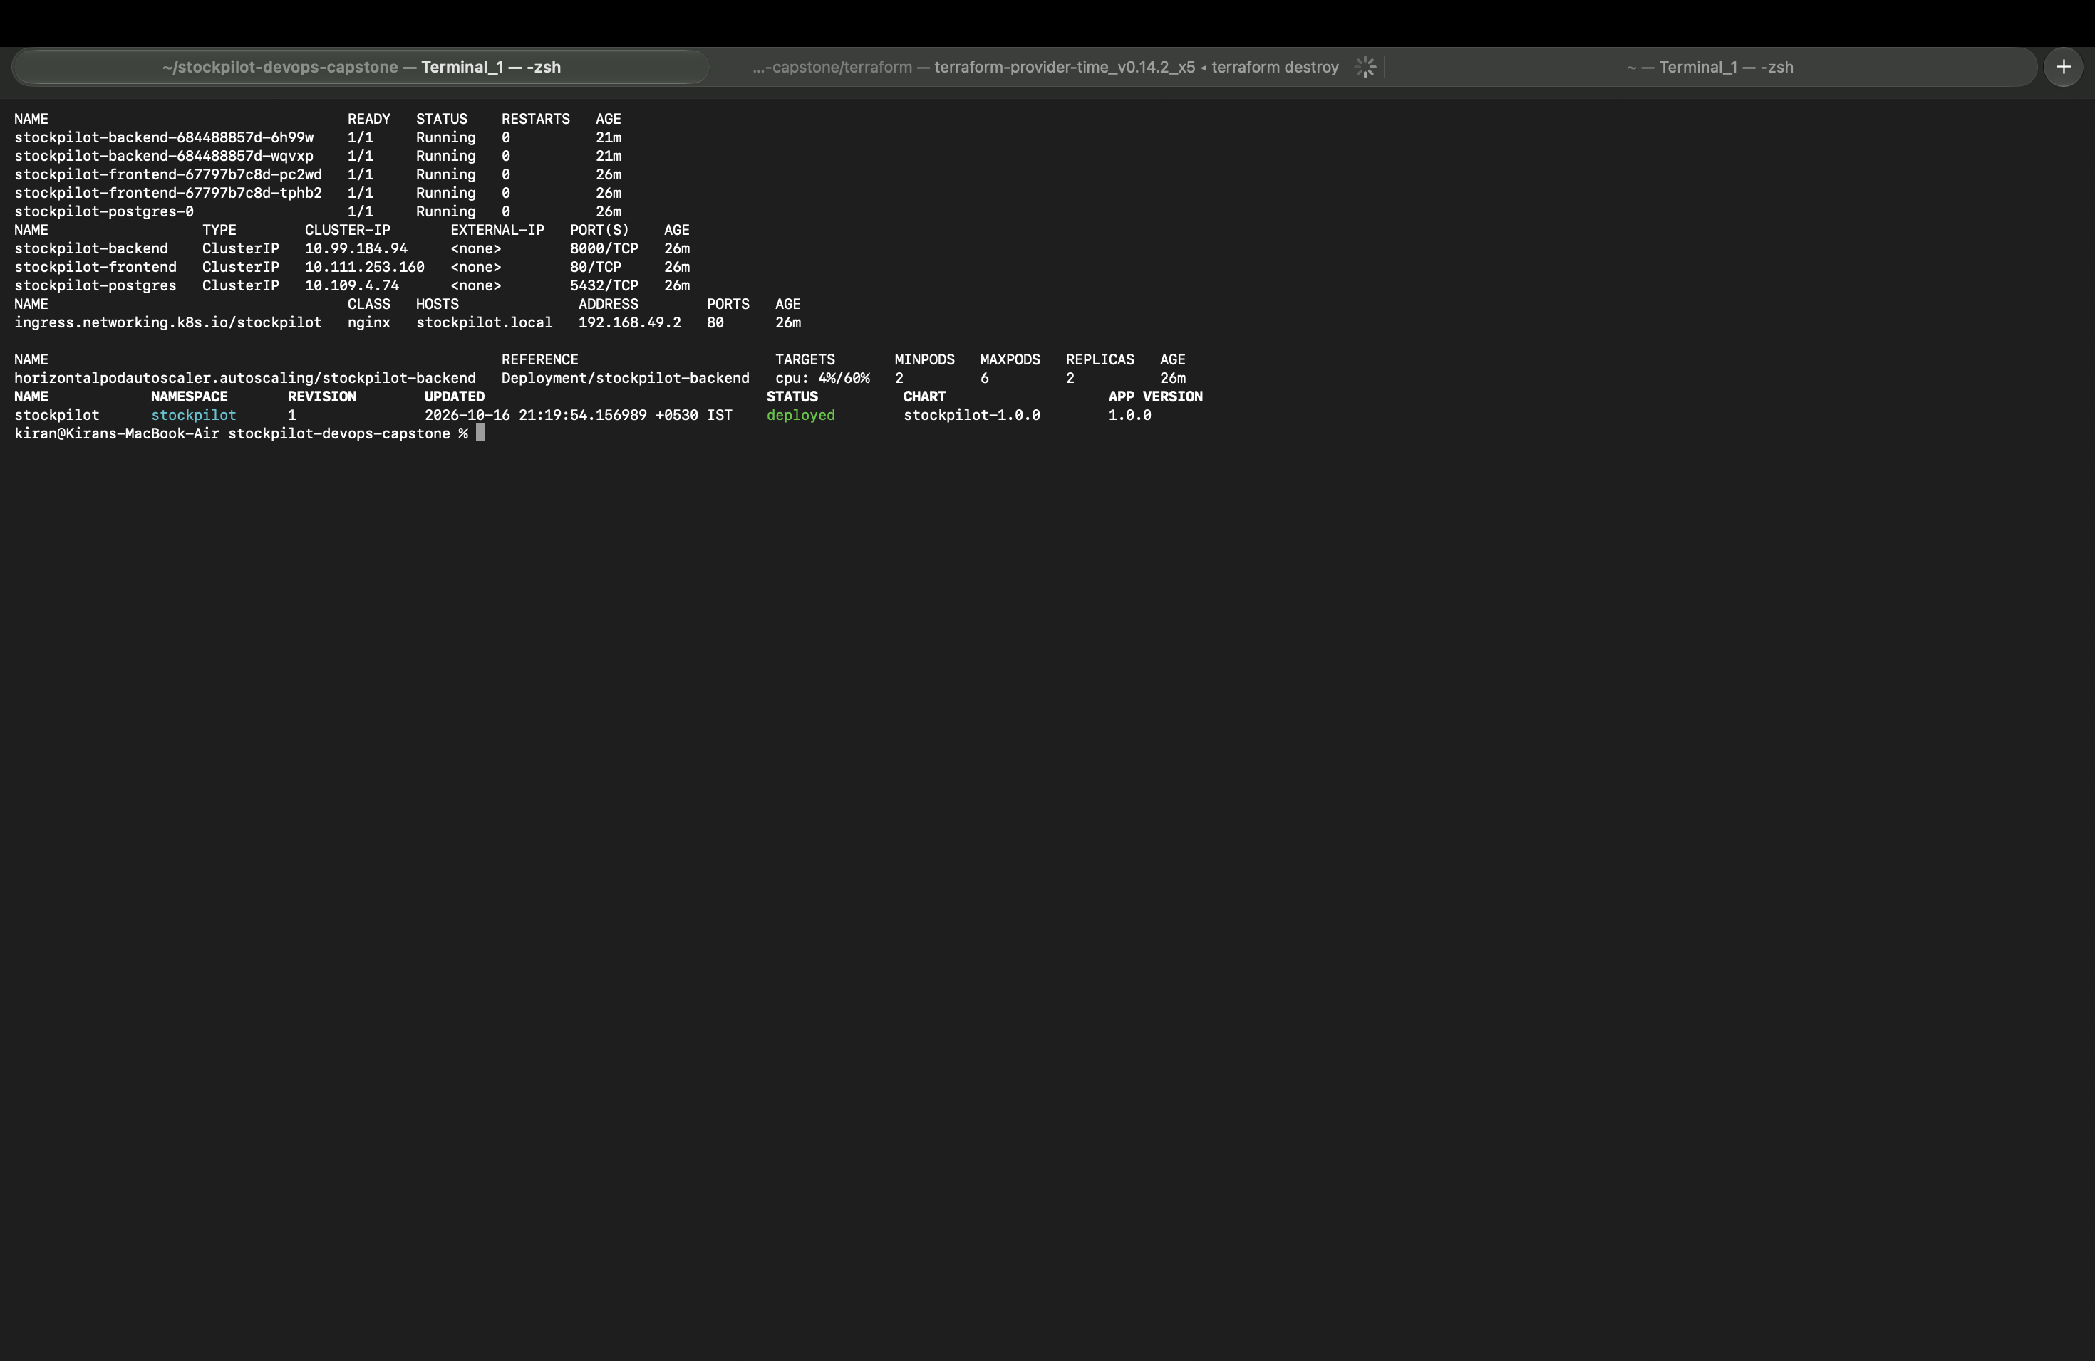
08
Kubernetes, Helm and GitOps
One Helm chart, deployed by Argo CD
Helm chart helm/stockpilot: Deployments, ClusterIP Services, Ingress, HPA, Postgres StatefulSet + PVC, Secret.
Replicas Frontend ×2, backend ×2 (HPA scales up to 6 at 60% CPU).
Ingress / → frontend, /api → backend on stockpilot.local (NGINX Ingress).
Probes /health for liveness, /ready checks the database before taking traffic.
HPA proven Under load, CPU hit 132% of target and the backend scaled 2 → 4 → 6 pods.
Argo CD Watches main; CI commits the new image SHA, Argo CD syncs the cluster automatically.
StockPilot · Kiran · Roll No. 10446

Slide 9
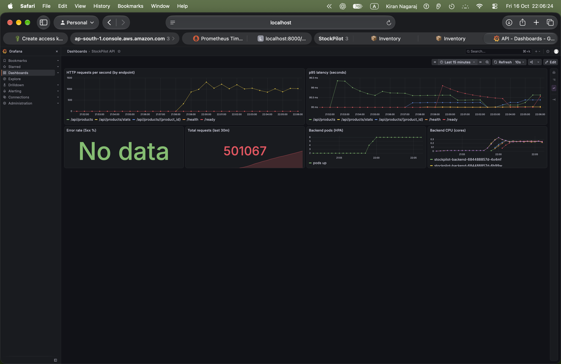
09
Observability: Prometheus + Grafana
kube-prometheus-stack, ServiceMonitor, provisioned dashboard
/metrics prometheus-fastapi-instrumentator exposes request counts and latency histograms.
Prometheus ServiceMonitor scrapes every backend pod: 6/6 targets UP during the load test.
Grafana "StockPilot API" dashboard: requests/s per endpoint, p95 latency, error rate, total requests, HPA pods, CPU per pod.
Result ~1,300 req/s peak, ~500k requests, 0 server errors.
StockPilot · Kiran · Roll No. 10446

Slide 10
10
Key learnings
What building this taught me
Gates beat good intentions
Tag by commit SHA
Infrastructure is code
Tests and Trivy run before any push, so a bad commit cannot reach the registry. Run #1 proved it.
Every running pod traces back to one exact commit, and rollback is just an older tag.
58 AWS resources created and destroyed from the same files, repeatable and reviewable.
Platforms matter
Pull beats push for deploys
Measure, then scale
Apple Silicon needed multi-arch images; EKS versions have support windows that change cost.
Argo CD keeps the cluster equal to Git; CI never needs cluster credentials.
The HPA only scaled once real load pushed CPU over target; Grafana showed it happening.
StockPilot · Kiran · Roll No. 10446

Slide 11
Thank you
Live walkthrough next: code → pipeline → Argo CD → Kubernetes → Prometheus → Grafana
Kiran · Roll No. 10446
github.com/Kirann1973/stockpilot-devops-capstone

